Slide 1
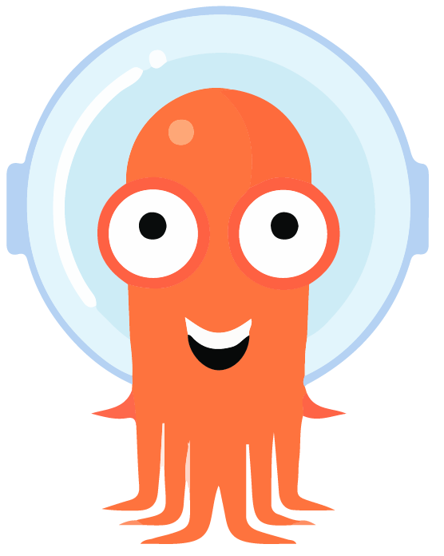
ArgoCD
“A declarative, GitOps continuous delivery tool for Kubernetes.”
by: Nicolas Thériaut-Langelier
@nicolas.theriaultlan
#nc-caas

Slide 2
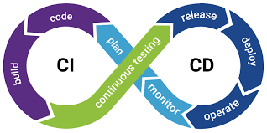
What is CI / CD
Continuous Integration (CI)
  Integrating your code frequently (daily) with each integration being validated in an automated way to quickly detect integration errors.
Team maturity
Continuous Delivery (CD) ⭐️
  Being able to deploy your software in Production at a moment’s notice.
Continuous Deployment (CD)
  Deploying your software automatically in production.
synopsys.com/glossary/what-is-cicd.html
martinfowler.com
Notes:
CI : Commit often, merge often, get feedback fast (fail fast, learn fast)
Automation is key
Linting
Automated testing
Code compliance and security scans
Etc.
CD (Delivery): All merged code is available for deployment
- Manual intervention after successful CI
CD (Deploy): All code is “shippable” when merged therefore it’s shipped/deployed
Deploy small iteration and deploy them often
Only failed automated tests will prevent a deployment
No human intervention

Slide 3
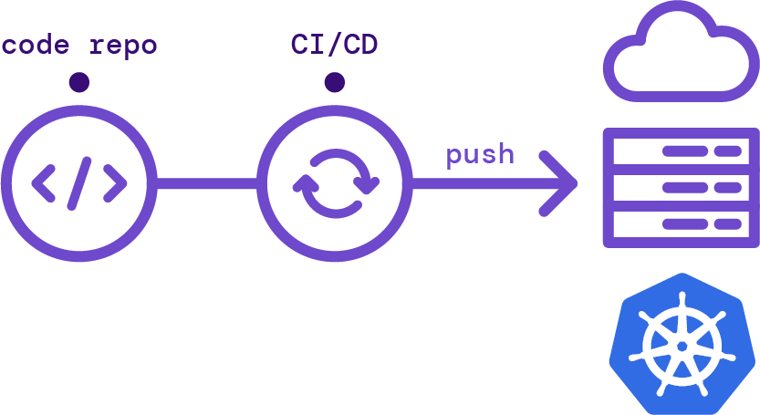
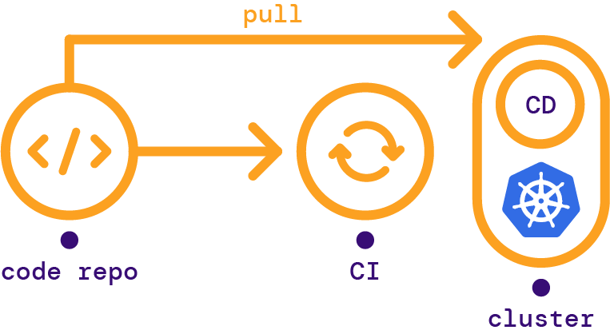
GitOps
Push-based
Pull-based
about.gitlab.com/blog/2021/04/27/gitops-done-3-ways
Notes:
GitOps Brings Application Development best practices to operations through git repositories:
CI/CD
Version control
Collaboration
GitOps Bridges the gap between Developers and Operations
Here are 2 ways of doing GitOps
Push-based:
Closer to what everyone is familiar with
CI and CD often in the same flow/pipeline
Pull-based:
A bit different than what we see in a lot of tools
Need something somewhere that is not within a CI/CD pipeline

Slide 4
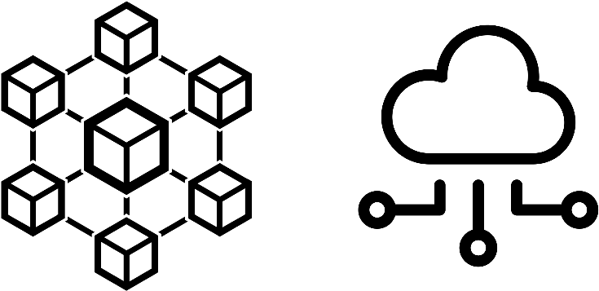
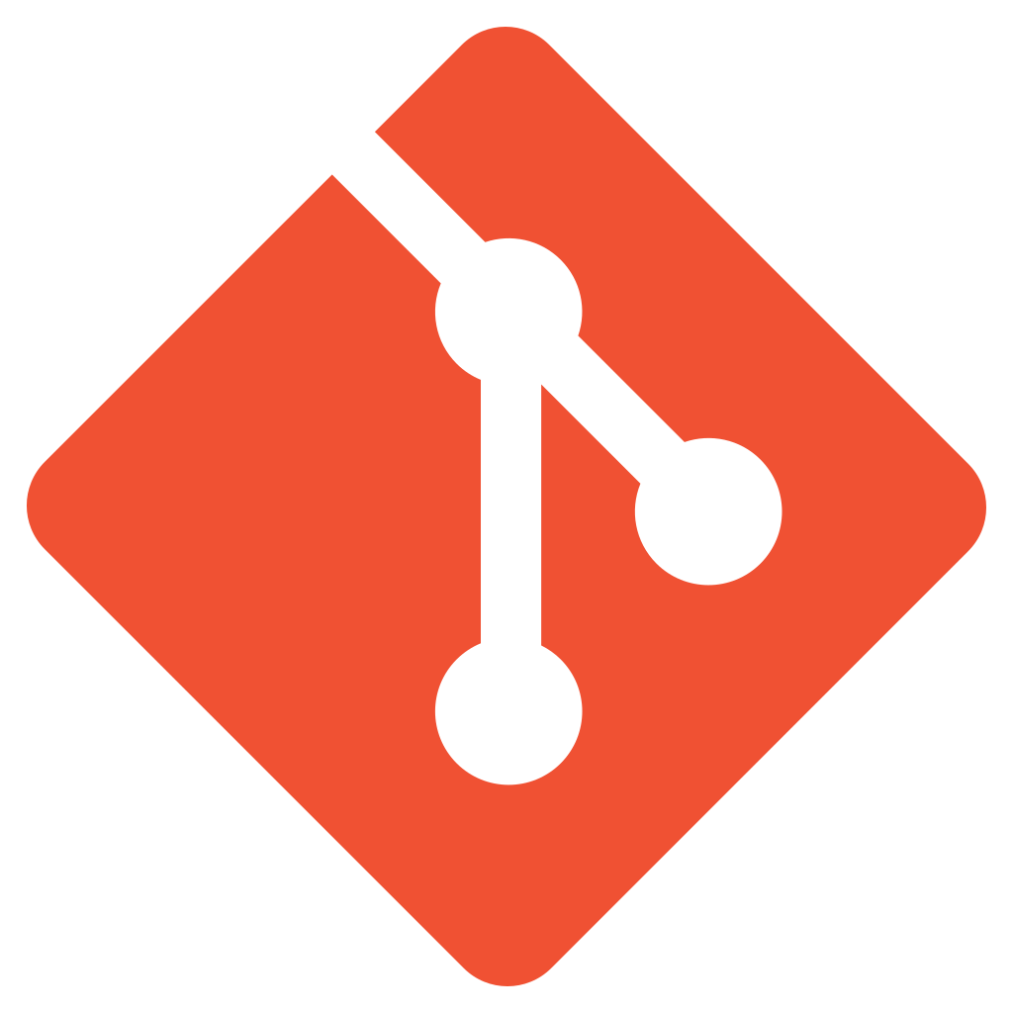
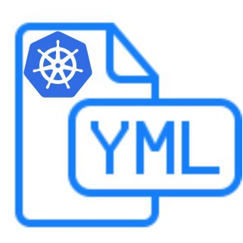
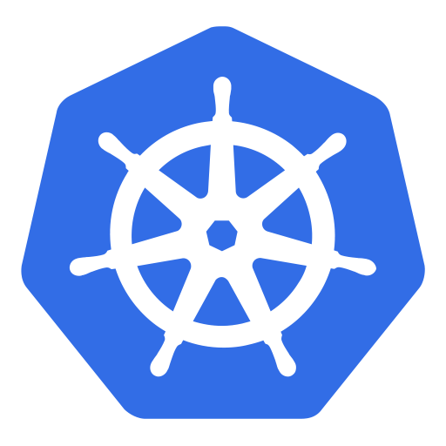

The Desired State Approach
Observe
Diff
Act
Observe
Diff
Act
ArgoCD
Control Plane
</>
Manifests
Notes:
Kubernetes
The control plane uses manifests of various types to actively track and enforce a desired state on the applications/workloads on the cluster
ArgoCD
Actively track and enforce a desired state on the manifests used by the Kubernetes control plane

Slide 5
How ArgoCD works
A short overview

Slide 6

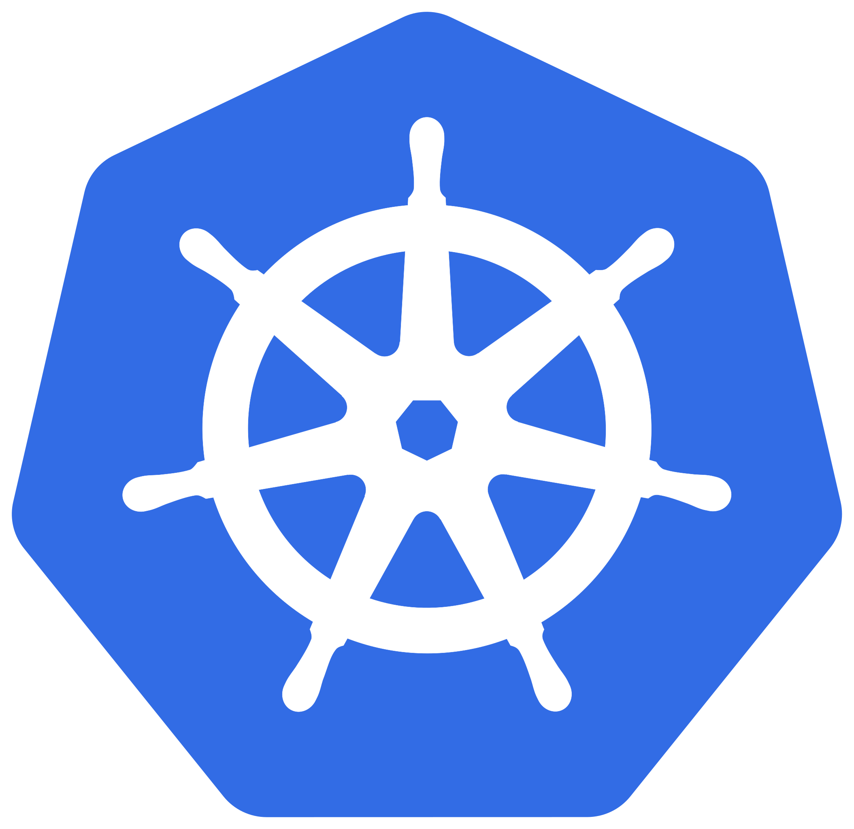

Some key features
Single Sign-On Integration (OAuth, LDAP, etc.)
Compatible with any Git provider
Multi-cluster management
Automated creation, update and pruning of Kubernetes resources

Slide 7

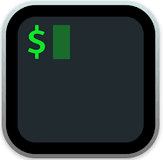
Interacting with ArgoCD
Full fledged UI
Access to all operations features
  Real-time view of application status
Limited features for advanced setup/deployment
CI integration and automation:
argocd CLI
kubectl
Notes:
UI:
Can do all the same thinks in the UI as the CLI for Applications (create, modify, remove) (access to Application yaml)
Useful to quickly see a deployment progress
Overview of apps and their sync status
Not so great for ArgoCD admin features (there are still very much cli/manifest driven)
CI integration:
Can interact with the argocd command for argocd specific stuff (convenience features like can-i)
ArgoCD is manifest-driven so kubectl can be used to modify all settings

Slide 8

Information flow
Pull
Push
Notes:
ArgoCD pulls from the desired source in your application configuration
Acts a bit like a GitLab runner
Need to be able to reach git/repo
The repo don’t need to be able to reach your ArgoCD instance
ArgoCD will then apply the desired manifests on the target cluster according the the sync policy
Aligns with one of the two GitOps approaches seen earlier

Slide 9
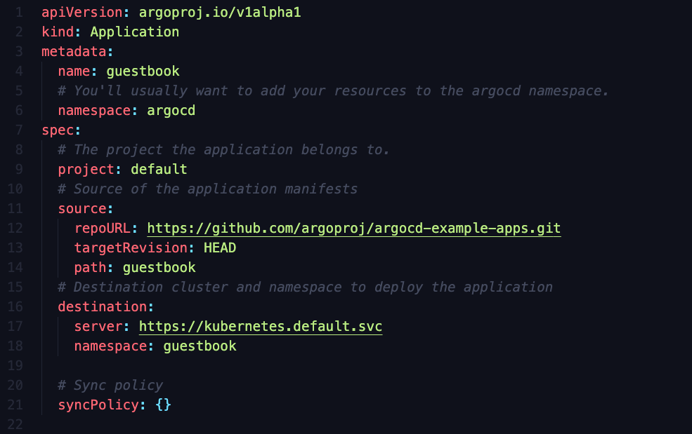
The ArgoCD Application CRD (Custom Resource Definition)
Notes:
API & kind: This is an ArgoCD application (CRD)
Metadata: name, location, labels, etc. like standard manifest
spec: where the fun starts
project: ArgoCD Project (another CRD), mostly drive security and access rights (repo, namespaces, etc.)
Source: where are we getting our manifests from
Destination: on what cluster/namespace we want to apply the application
SyncPolicy: how hard we want ArgoCD to try to apply/fix our application

Slide 10
Demo time!
Simple deployment with manifests
Simple deployment with a Helm Chart
More complex scenarios (if we have time)
https://github.com/theriaultnicolas/geekfest

Slide 11

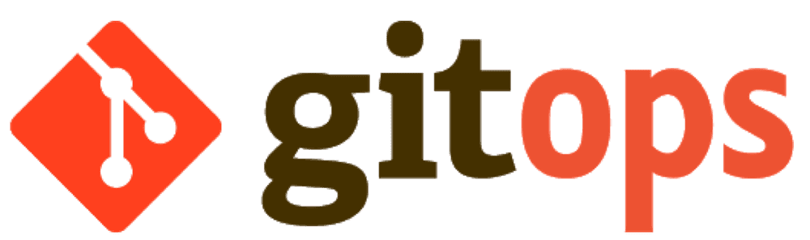
How we use it. (a.k.a. GitOps all the things!)
Deploy ArgoCD?
Configure ArgoCD?
Add/Modify/Remove Applications in ArgoCD?
Create/Update Helm Charts?
Notes:
Deployment
GitLab CI/CD pipeline to deploy ArgoCD with a helm chart
Configure
Same pipeline that deploys ArgoCD also configure it
Repositories (GitLab, Helm Charts, etc.)
SSO/LDAP configuration
Cluster access
Base/root app of apps (our “trigger”)
Applications
Git repo with ArgoCD Applications that is monitored by the root app
App of Apps pattern to organize the various apps
On merge, ArgoCD captures the change and apply it to the target cluster
Helm Charts
Managed like software applications
Gitlab CI/CD pipeline
linting and tests
Push to Helm repo when merged to master

Slide 12
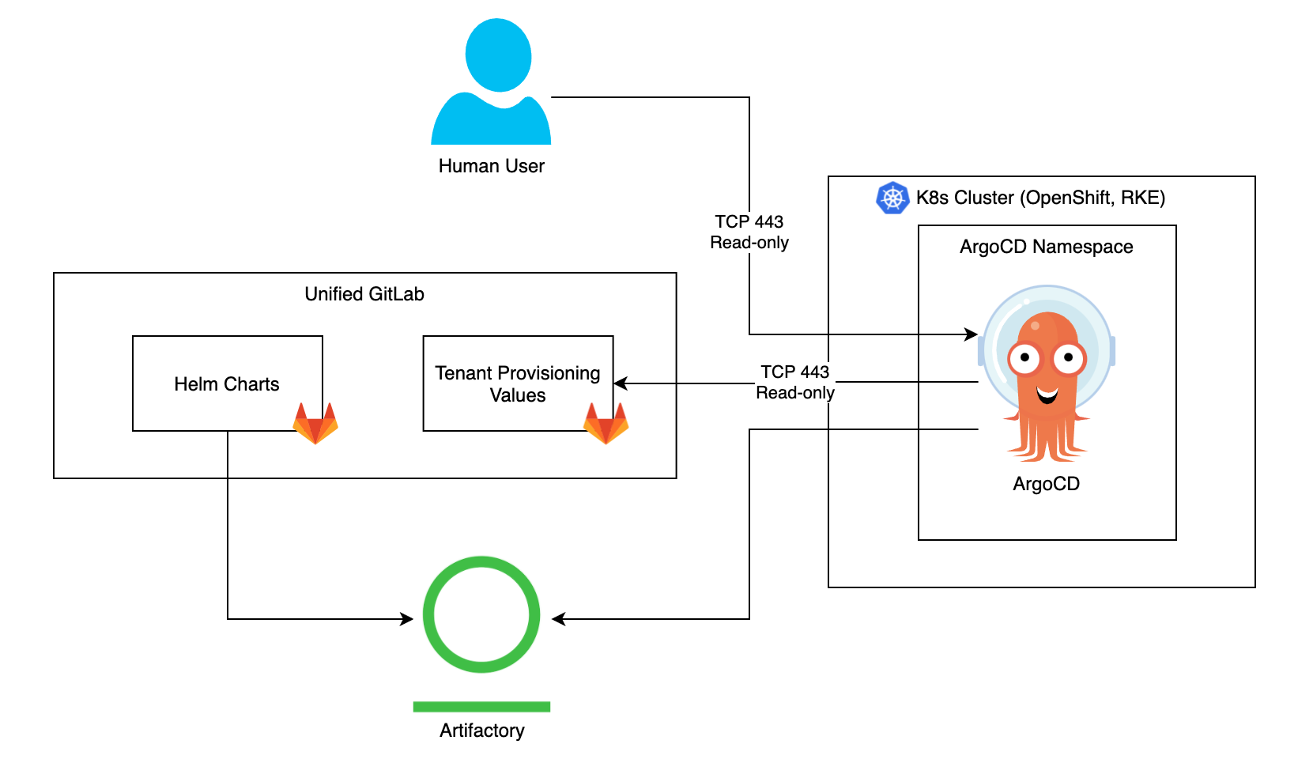
Our setup visualized

Slide 13
Thank-you!
Q & A period

Slide 14
Extras / Backup

Slide 15
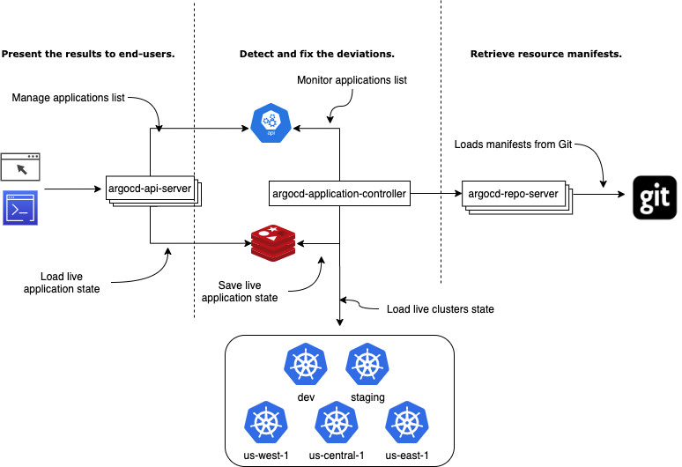
The ArgoCD Architecture
livebook.manning.com/book/gitops-and-kubernetes/chapter-9

Slide 16
Basic requirements to setup ArgoCD?
  Needs cluster level access on the cluster you want to manage (ClusterRoleBindings)
Multiple ArgoCD instances on the same cluster?
  They will all share the same CRDs so the versions deployed must depend on CRDs with the same version.
Performance limitations?
  Starts slowing down at 1000+ Applications (require repository Server)
  100+ clusters support
Deploying the same application on multiple clusters?
  The ApplicationSet allow to easily setup an application once and rollout the deployment across multiple clusters.

Slide 17
What if I already deployed through another way (ansible, helm, etc.)?
  ArgoCD will add its labels to the existing manifests and start monitoring the existing app (look for diff, sync or not based on the sync settings, etc.)
ArgoCD polling rates
  Git : Every 3 minutes by default. You can increase this duration using timeout.reconciliation setting in the argocd-cm ConfigMap.
  Manifests: ArgoCD uses the K8s watch API to keep the process lightweight
    https://kubernetes.io/docs/reference/using-api/api-concepts/#efficient-detection-of-changes

