Slide 1

Predicting Cannabis Use Using Canadian Health Survey Data
Jonathan Steen
MSDS, Bellevue University
DSC 630: Predictive Analytics
Instructor: Frank Neugebauer
May 31, 2025

Slide 2

Introduction
Cannabis use presents public health challenges, impacting well-being and healthcare resources.
This project applies predictive analytics to identify demographic, lifestyle, and psychosocial factors linked to cannabis use in Canada.

Slide 3
Data Overview
The Canadian Community Health Survey (2019-2020) was used as a data source.
The dataset includes 108,252 records with health, lifestyle, and socioeconomic variables.
Final analytic sample: 7,274 complete records, 30 predictive features.
Kaggle Healthcare Survey Dataset

Slide 4
Project Objectives
Identify predictors of cannabis use in the Canadian population.
1
Build and evaluate models to distinguish users from non-users.
2
Demonstrate the effect of class imbalance and correction strategies.
3

Slide 5
Data Preparation & Cleaning
Standardized column names and corrected typos.
Decoded categorical variables using a mapping dictionary.
Removed sparse, high-leakage, or redundant features.
Binarized the target: cannabis user (yes/no).

Slide 6
Exploratory Analysis
Class distribution: ~85% non-users, 15% users.
A strong imbalance was observed in the outcome variable.
Visualization showed higher cannabis use among males, younger adults, and those reporting tobacco use.
Correlations were identified with age, tobacco, and mental health.

Slide 7
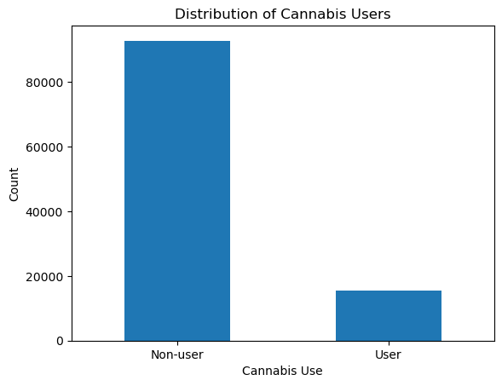
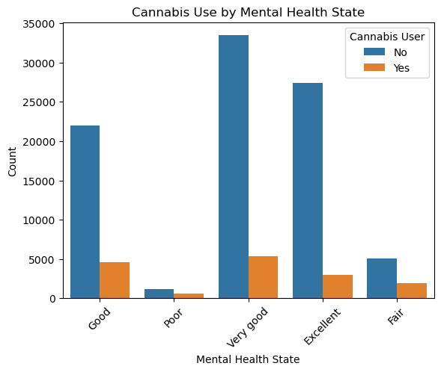
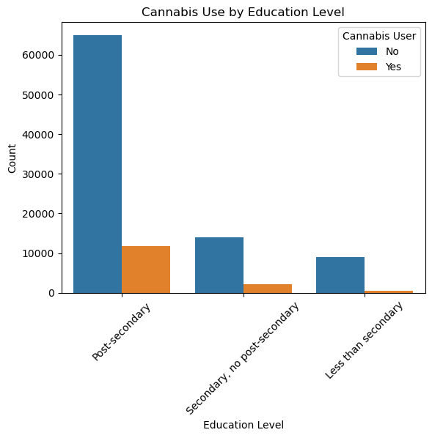
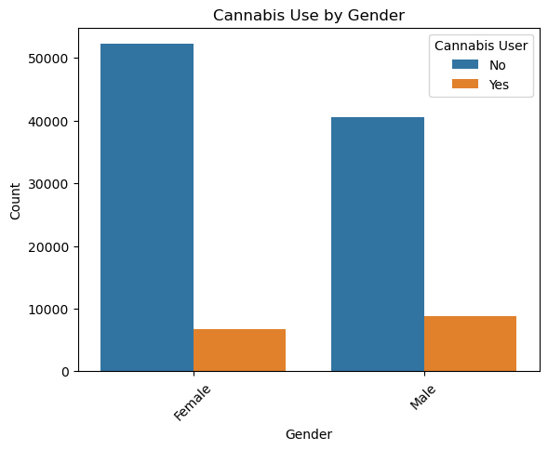
Exploratory Analysis Cont.

Slide 8

Modeling Approach
Logistic Regression and Decision Tree classifiers are used for interpretability.
Baseline models were trained on imbalanced data.
Random oversampling was applied to correct class imbalance in the training set (Abbott, 2014).

Slide 9
Results
Baseline (Imbalanced Data):
Logistic Regression: 81% accuracy, 17% recall (user), ROC AUC 0.56
Decision Tree: 72% accuracy, 34% recall (user), ROC AUC 0.57
Post-Oversampling:
Logistic Regression: 69% accuracy, 64% recall (user), ROC AUC 0.67
Decision Tree: 59% accuracy, 62% recall (user), ROC AUC 0.60
Logistic regression outperformed the decision tree on all metrics.

Slide 10
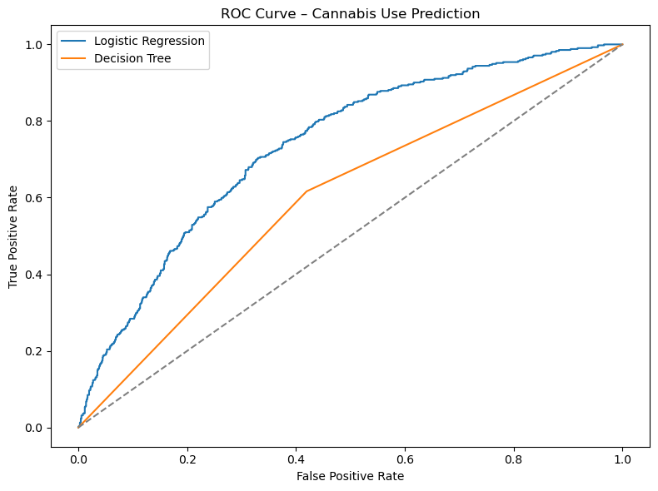
Results Continued

Slide 11
Feature Importance & Interpretation
Top predictors: age, tobacco use, gender, life satisfaction, food security, and mental health.
Cannabis use is influenced by a combination of demographic, behavioral, and psychosocial factors.

Slide 12
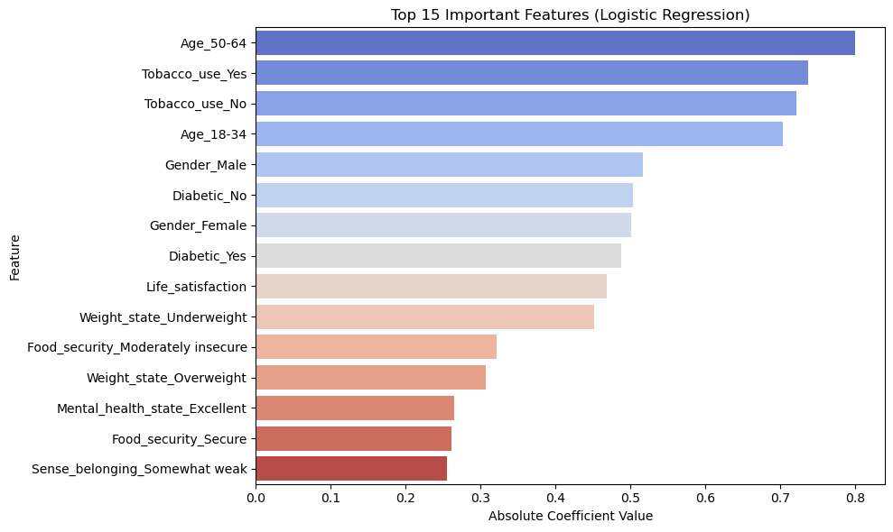
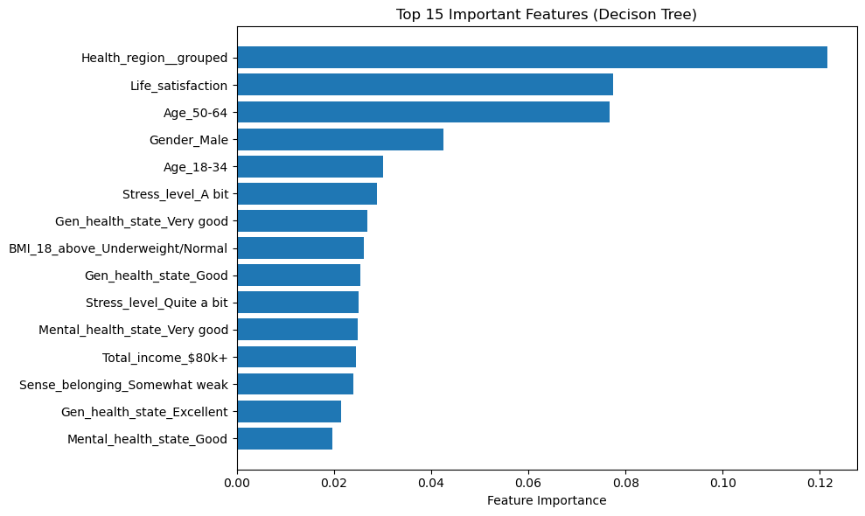
Top Features

Slide 13
Conclusion
Random oversampling improved user recall and balanced prediction.
Logistic regression provides reliable performance for cannabis use prediction.
Future steps: hyperparameter tuning, ensemble models, and advanced imputation.

Slide 14
References:
Abbott, D. (2014). Applied Predictive Analytics: Principles and Techniques for the Professional Data Analyst. Wiley.
Siegel, E. (2016). Predictive Analytics: The Power to Predict Who Will Click, Buy, Lie, or Die. Wiley.
Canadian Community Health Survey Dataset (2019-2020), Kaggle: https://www.kaggle.com/datasets/aradhanahirapara/healthcare-survey/data
Scikit-learn Documentation: https://scikit-learn.org/

