Slide 1

CodeType Trainer
A Real-Time Syntax Typing Tutor Powered by a fine-tuned OpenAI model
Jonathan Steen
Bellevue University
DSC670 – Advanced Uses of Generative AI
Instructor: Frank Neugebauer
November 22, 2025

Slide 2

The Problem: Syntax Fluency
Muscle Memory Gap: Standard typing tutors use English prose, not code syntax like `{}`, `[]`, or `=>`.
Language Specificity: Developers need to practice the idiomatic patterns of specific languages (Python vs. JS).
Speed vs. Accuracy: In live coding interviews or rapid development, syntax errors break flow.
Goal: Build a tool that generates infinite, valid coding scenarios for practice.

Slide 3
The Solution: CodeType Trainer
AI-Generated Content
Leverages my fine-tuned GPT-3.5 model to generate randomized, syntactically correct code snippets on demand. No static databases.
Real-Time Metrics
Tracks WPM, accuracy, and error count character-by-character using a custom JavaScript implementation embedded in Streamlit.

Slide 4
System Architecture
Frontend: Streamlit (Python) handles state management and UI layout.
Backend Logic: OpenAI API (`ft:gpt-3.5-turbo`) generates content dynamically.
Bridge: `streamlit.components.v1` renders a custom HTML/JS isolated iframe.
Data Flow: Python fetches snippet -> Sends to JS -> JS captures events -> Returns metrics to Python.

Slide 5

Technology Stack
Python & Streamlit
Core application logic, session state management, and UI framework.
OpenAI API
Fine-tuned model `ft:gpt-3.5-turbo-0125` for strict output formatting.
Custom prompting as well for extra hardening
HTML5 / JS
Custom component for low-latency event handling (keydown listeners) and visual feedback.

Slide 6
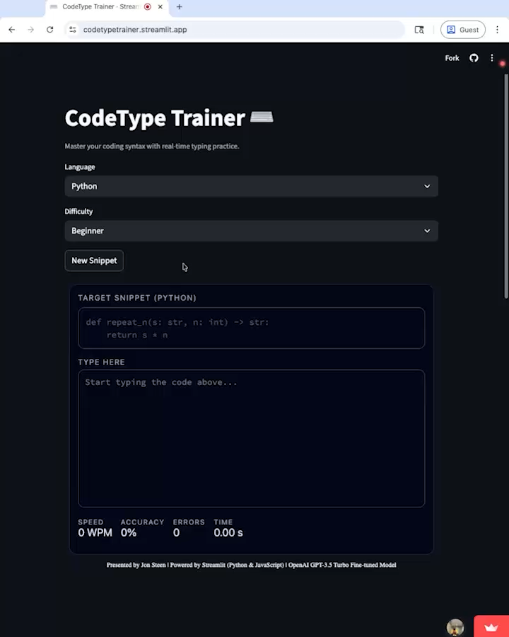
Live Demo & UX
Video Demo
Live App
https://codetypetrainer.streamlit.app/?embed_options=dark_theme

Slide 7

Project Summary
CodeType Trainer
A full-stack application demonstrating the power of integrating Generative AI with traditional web frontend logic.
Functional: Real-time syntax practice.
Technical: Advanced usage of Streamlit Components.
AI-Driven: Custom Fine-Tuned Model.

