Slide 1
Kia & Hyundai Vehicle Theft Trends: A Public Safety Briefing Evidence of a targeted and unevenly distributed theft surge (2019–2022)
• Jon Steen
• MSDS, Bellevue University
• DSC 640: Data Presentation and Visualization
• Instructor: Benjamin Schneider
• Feb 1, 2026

Slide 2

Why Focus on Kia and Hyundai Theft?
Vehicle thefts have increased nationally
Kia and Hyundai thefts show a distinct growth pattern
Impact is concentrated in specific cities

Slide 3
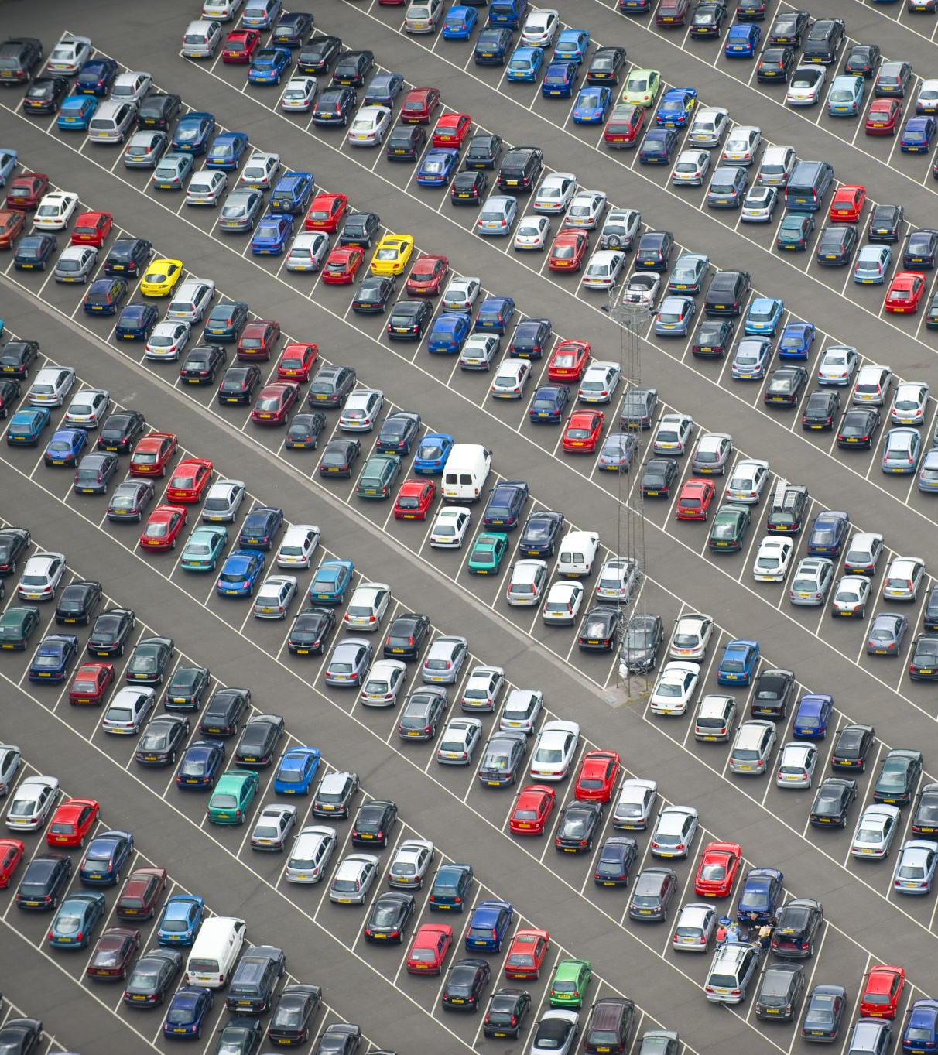
Briefing Context
Audience: City officials and public safety leadership
Purpose: Identify whether Kia/Hyundai thefts warrant targeted intervention
Call to Action: Approve focused prevention measures in high-impact areas

Slide 4
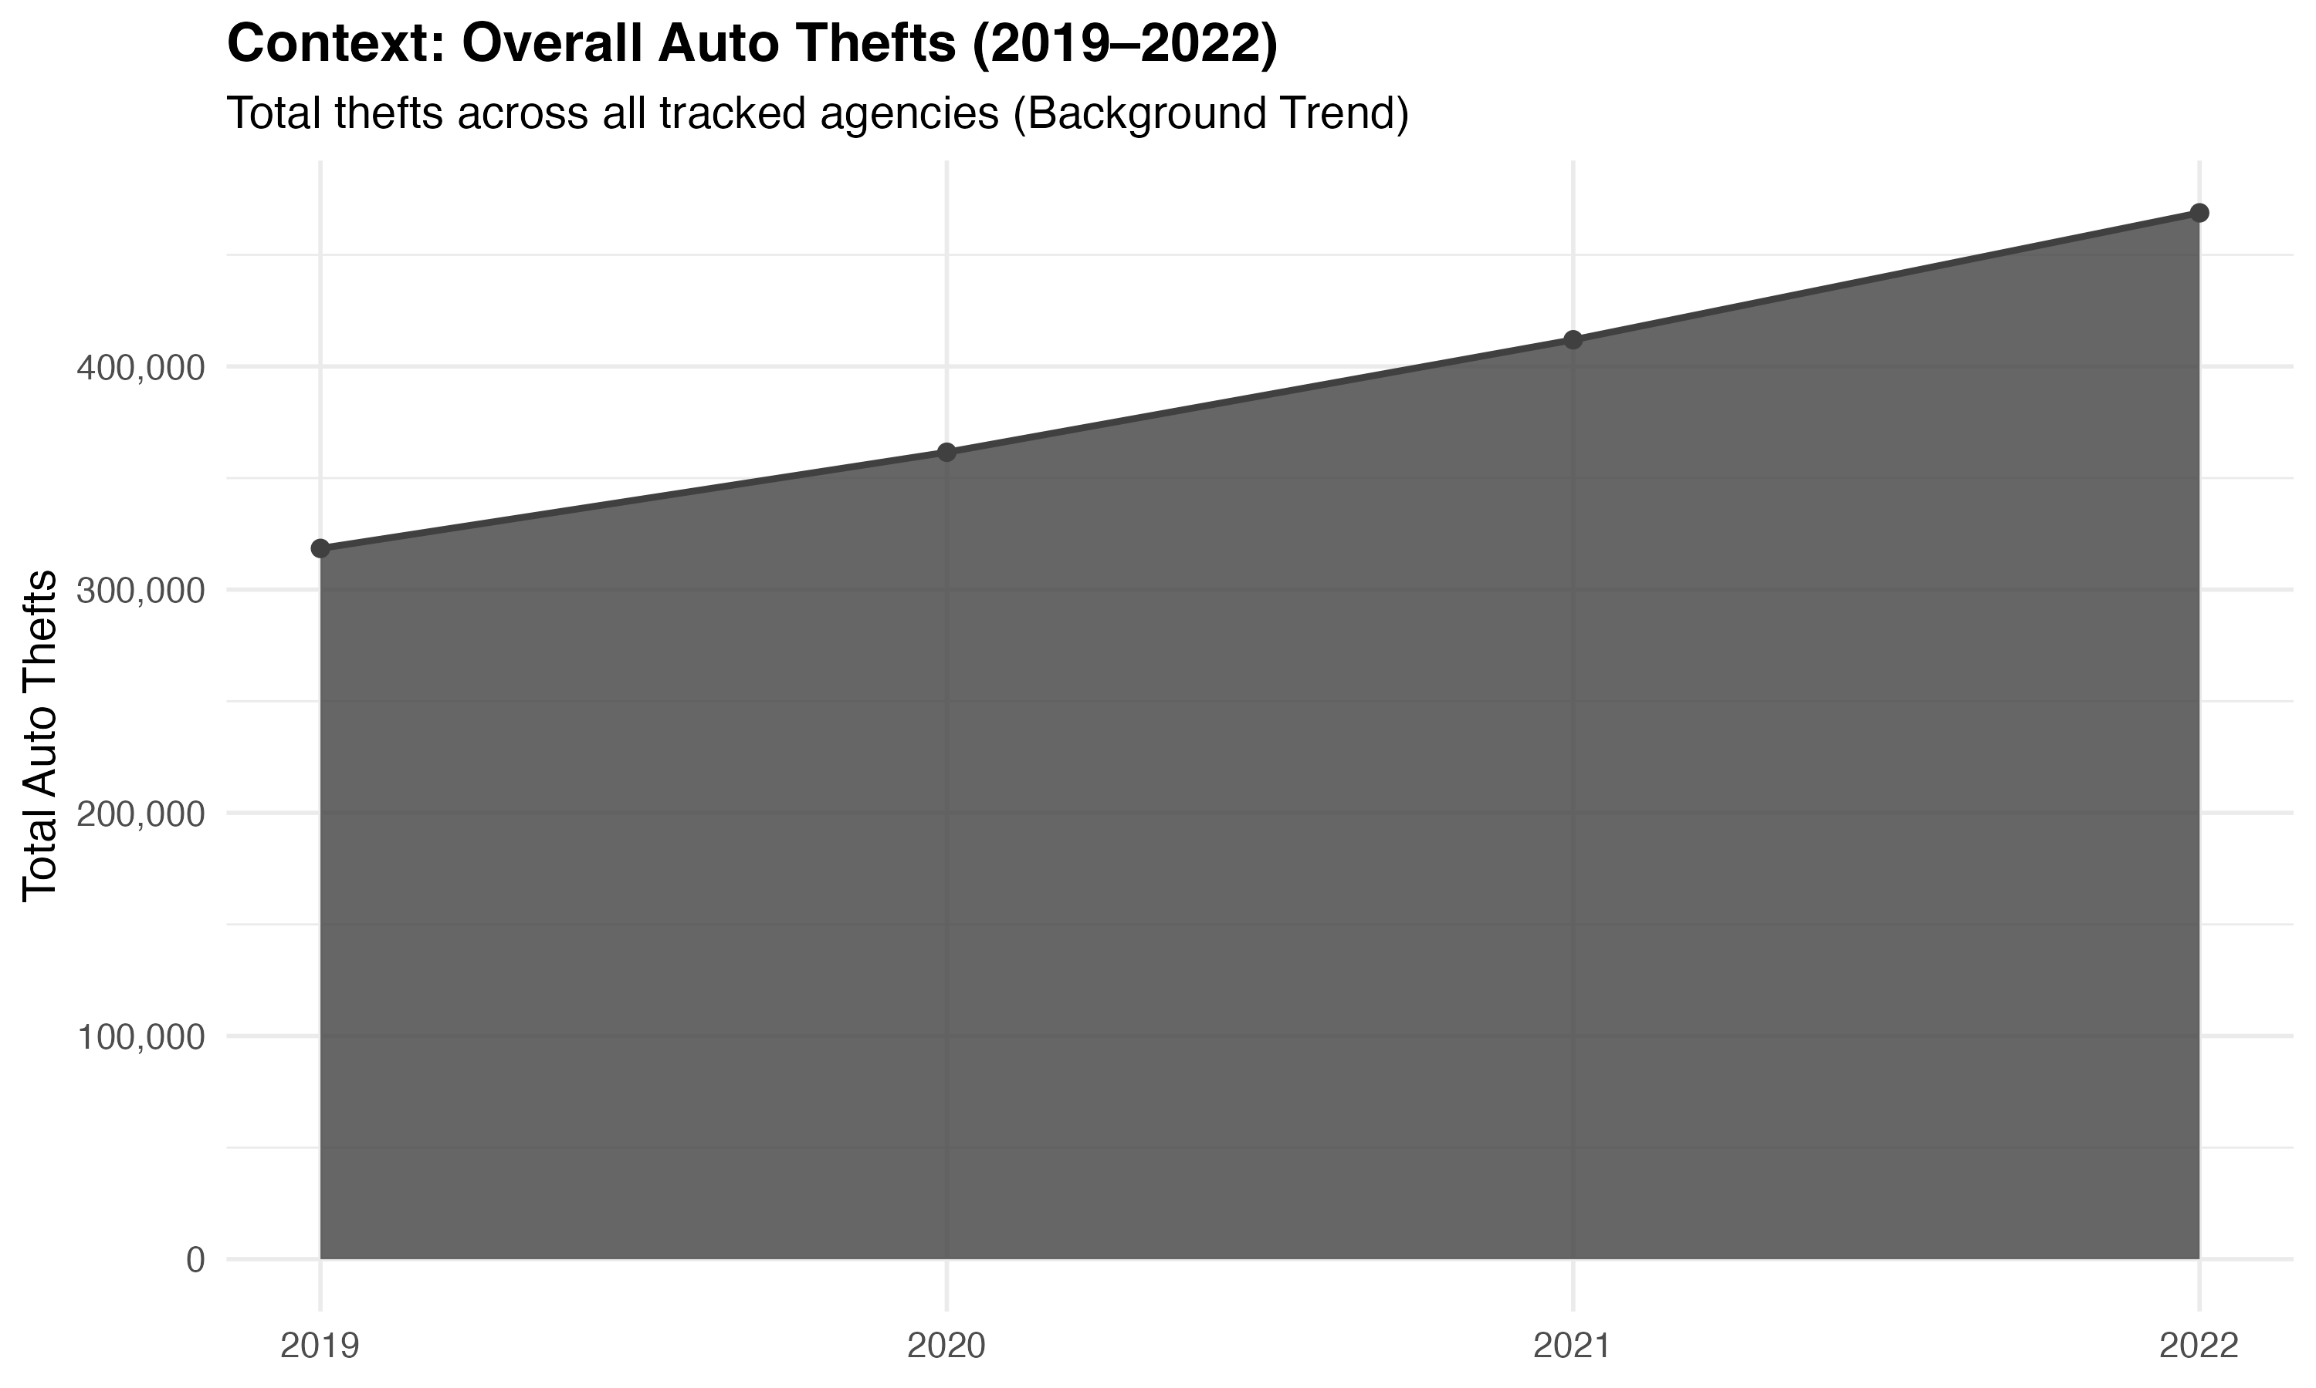
Overall Auto Thefts Are Rising
Auto thefts increased across agencies between 2019 and 2022.

Slide 5
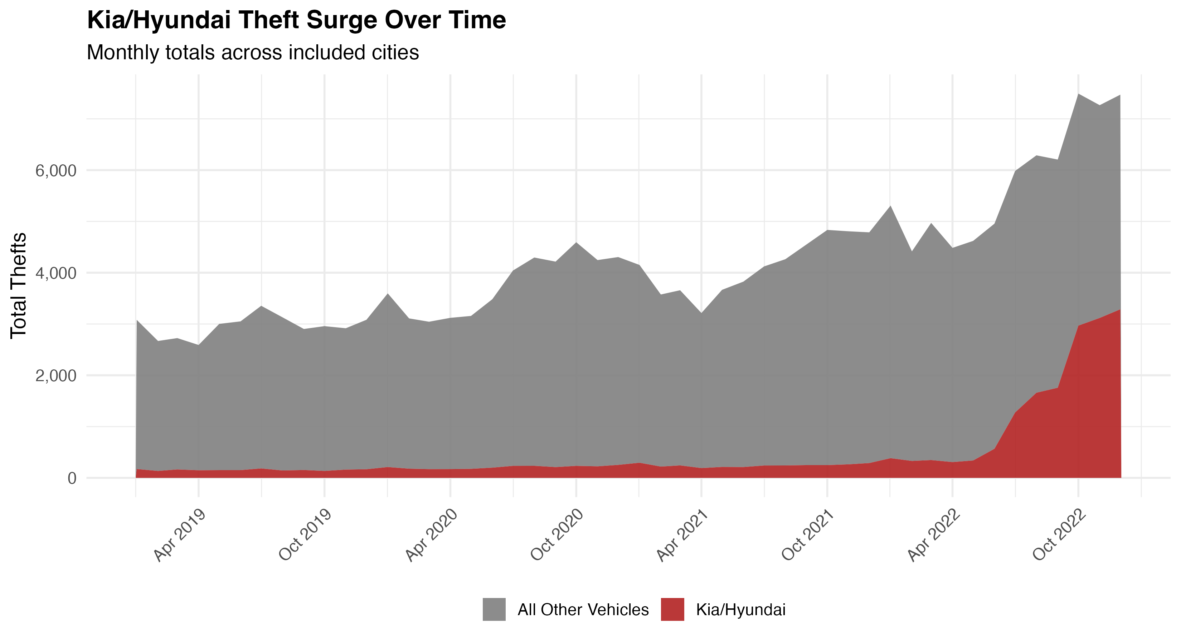
Kia and Hyundai Theft Growth Exceeds Baseline Trends
Kia and Hyundai thefts accelerate sharply beginning in mid-2022.

Slide 6
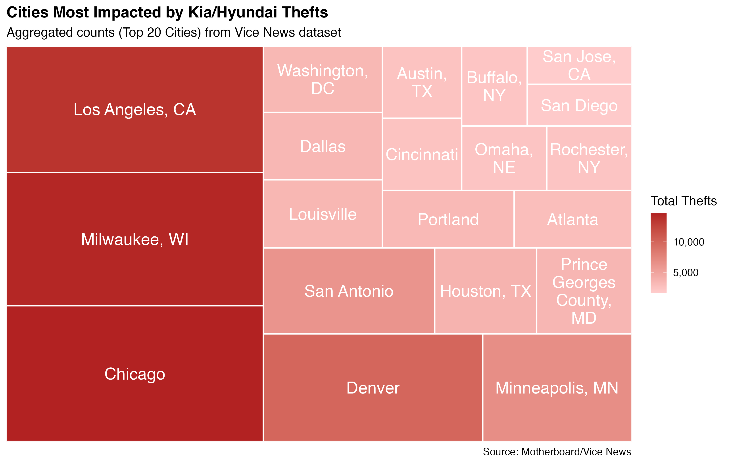
Impact Is Concentrated, Not Uniform
A limited number of cities account for a disproportionate share of incidents.

Slide 7
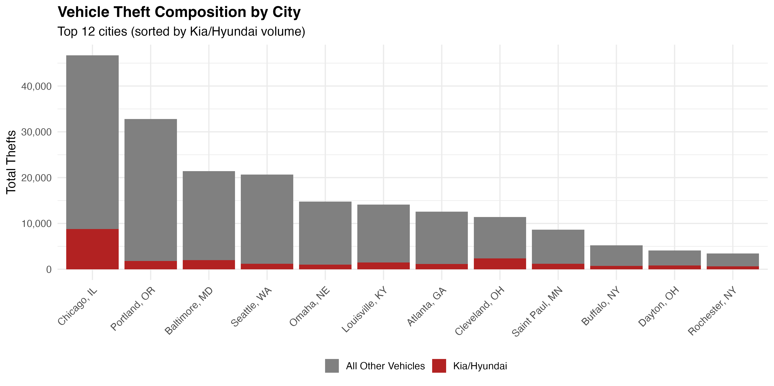
Kia/Hyundai Theft Share Varies by City
In several cities, Kia and Hyundai thefts make up a notably higher share of total thefts.

Slide 8
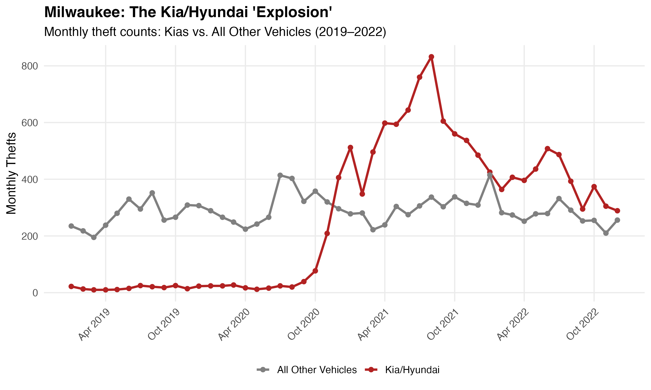
Case Study: Milwaukee
Kia/Hyundai thefts increased rapidly while other vehicle thefts remained stable.

Slide 9
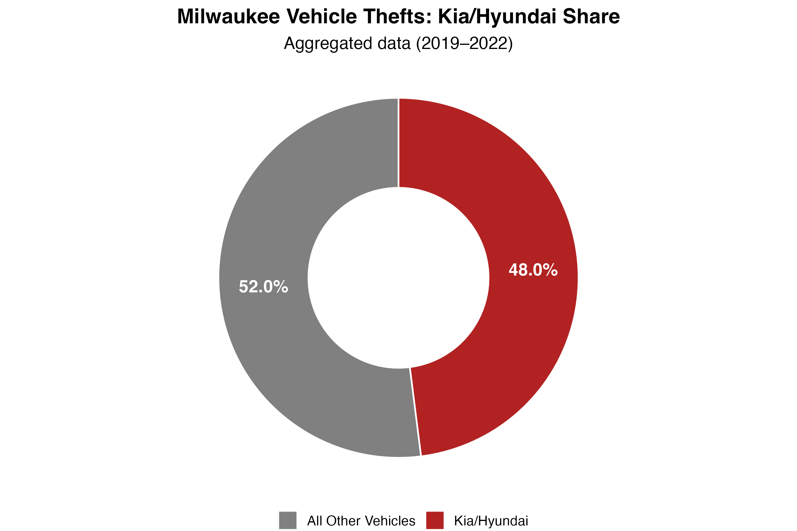
Milwaukee Theft Distribution
By the end of the period, Kia/Hyundai vehicles accounted for nearly half of reported thefts.

Slide 10

Policy Implications
The issue is targeted and location-specific
Broad, citywide responses may be inefficient
Focused prevention aligns better with observed patterns

Slide 11

Recommended Actions
Expand steering-wheel lock distribution in high-risk areas
1
Adjust patrol allocation during peak theft periods
2
Deploy localized public awareness campaigns
3

Slide 12
Closing
Data supports targeted intervention over generalized response.
Sources: Municipal records; Motherboard / VICE News

