Slide 1

Overview of Julia
Erik Stryshak

Slide 2
Creation & Influences
Released 2012
Numerical Analysis
Scientific Computing
C
Lisp
Python (NumPy)
MATLAB

Slide 3
Attributes
Dynamic & Non-Strict Typing
Parametric Types
Just-In-Time Compilation
Multi-Paradigm

Slide 4
Features
Multiple Dispatch
Built-in Package Manager
Call C-Functions Directly
Call Python Functions
Parallelism and Distributed Computation
User-Defined Types
Notes:
Multiple dispatch first seen in Lisp

Slide 5
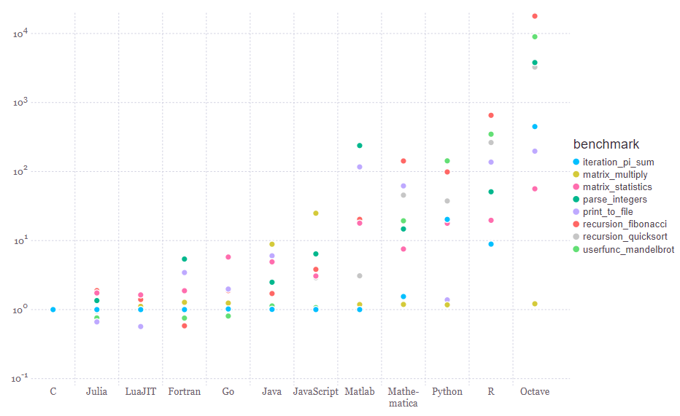
High-Performance

Slide 6
Objects & Types
struct foo
var_1 -> defaults to type “Any”
var_2::Int64 -> must be an Int64
end
foo.var_1
structs are mutable by default
:: operator
primitive type {name} {bits} end

Slide 7
Lists & Dictionaries
DICTIONARY
Dict(“Key” => Value, …)
Dict([(“Key”, Value), …])
ARRAY
Array{Type}(dimensions)
Type[vals]

Slide 8
Hello World
function HelloWorld(s)
println(s)
end
________________________________________________
function HelloWorld(s::Int64)
println(s)
end
__________________________________________________
HelloWorld = println(s)
HelloWorld(“Hello World”)
Out>> Hello World
HelloWorld(“Hello World”)
Out>> Method Error
HelloWorld(“Hello World”)
Out>> Hello World

Slide 9
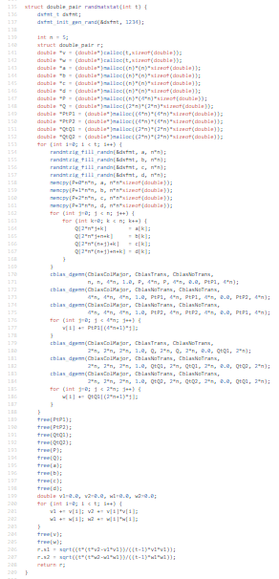
Julia vs. C Example
function randmatstat(t)
n = 5
v = zeros(t)
w = zeros(t)
for i=1:t
a = randn(n,n)
b = randn(n,n)
c = randn(n,n)
d = randn(n,n)
P = [a b c d]
Q = [a b; c d]
v[i] = trace((P.'*P)^4)
w[i] = trace((Q.'*Q)^4)
end
return (std(v)/mean(v), std(w)/mean(w))
end

Slide 10


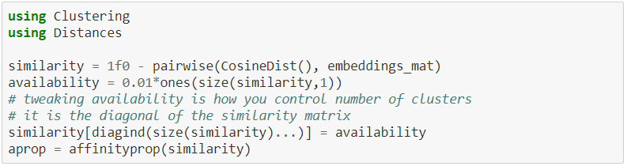
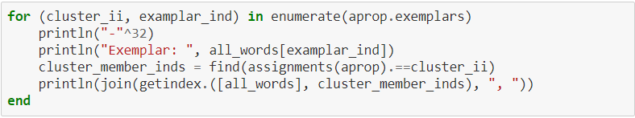
Example Program
Source: https://ucidatascienceinitiative.github.io/IntroToJulia/Html/ClusteringSolutions

