Slide 1
Erik Stryshak Summer 2017 Projects

Slide 2
PDF Printing
Used the Auto hotkey scripting language
The program uses keyboard sends and excel to loop through all orders from a city brewery in a defined date range and saves each order as “order#.pdf”
On average it takes the script 9 seconds to save one order, whereas a person takes about 15 seconds
In July there were 179 orders needing to be saved as a pdf and 270 for August
Assuming a person takes no pauses or breaks, the script saved 18 minutes in July and 27 minutes in August
The script also eliminates the chance of saving an order with the wrong order number Solution is a workaround due to the difficulty of extracting from vbs. With more time I would pursue using python so the program could run in the background instead of causing a computer to be unusable for the duration the script runs for

Slide 3
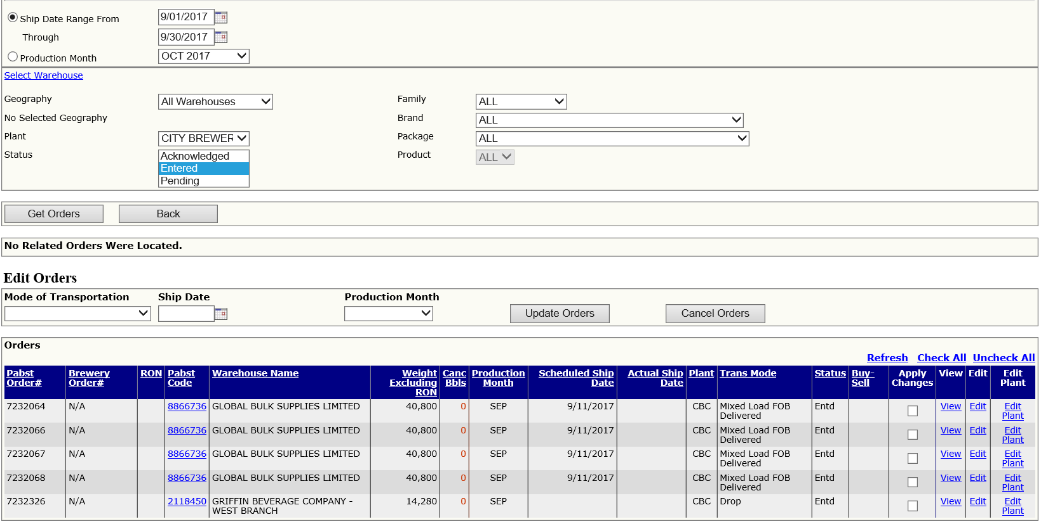
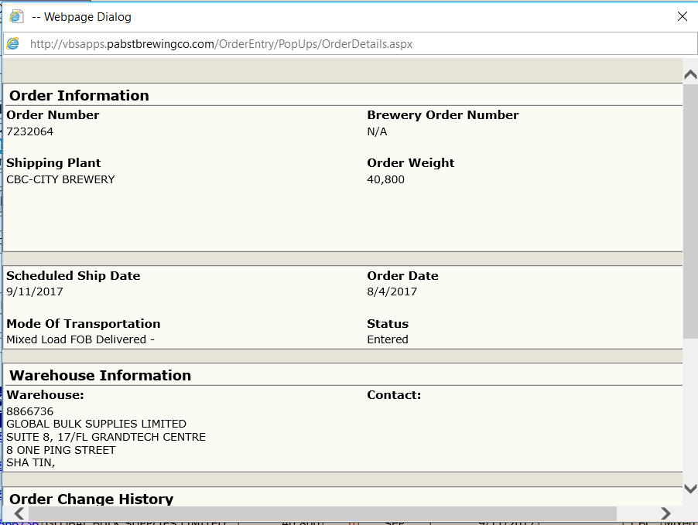
List of orders to be printed
Sample order to be printed

Slide 4
Inventory Report
Developed two VBA macros and a python script to automatically combine daily inventory reports sent daily to the DSR’s into a filterable table including production and ship by dates
The outlook macro saves the inventory reports to a SharePoint folder
The python script is used to extract the Lindner inventory
The excel macro is run from within the outlook macro and extracts the inventory quantities and production dates from each report and combines them into one
The macros, in total, take about 10 seconds to run and are performed in the background

Slide 5
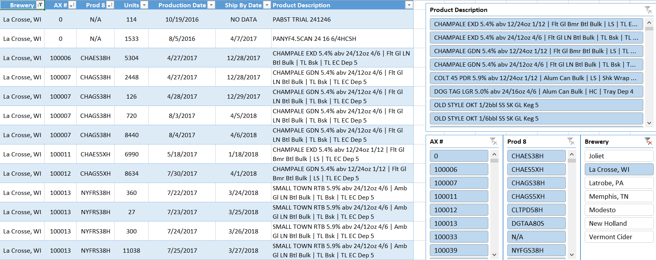
Inventory report with dates

Slide 6
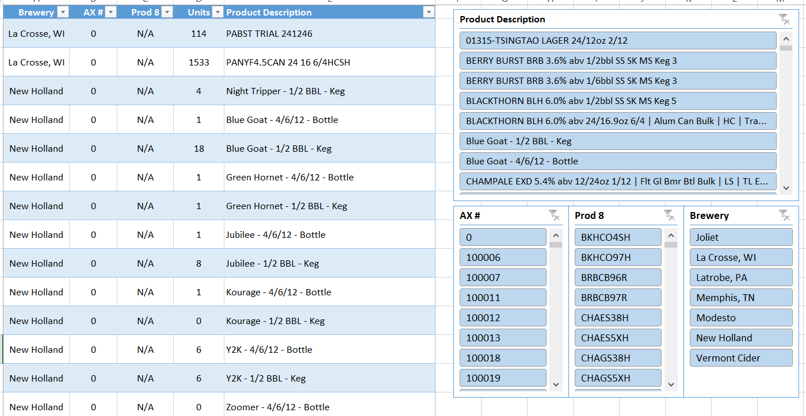
Inventory report with no dates

Slide 7
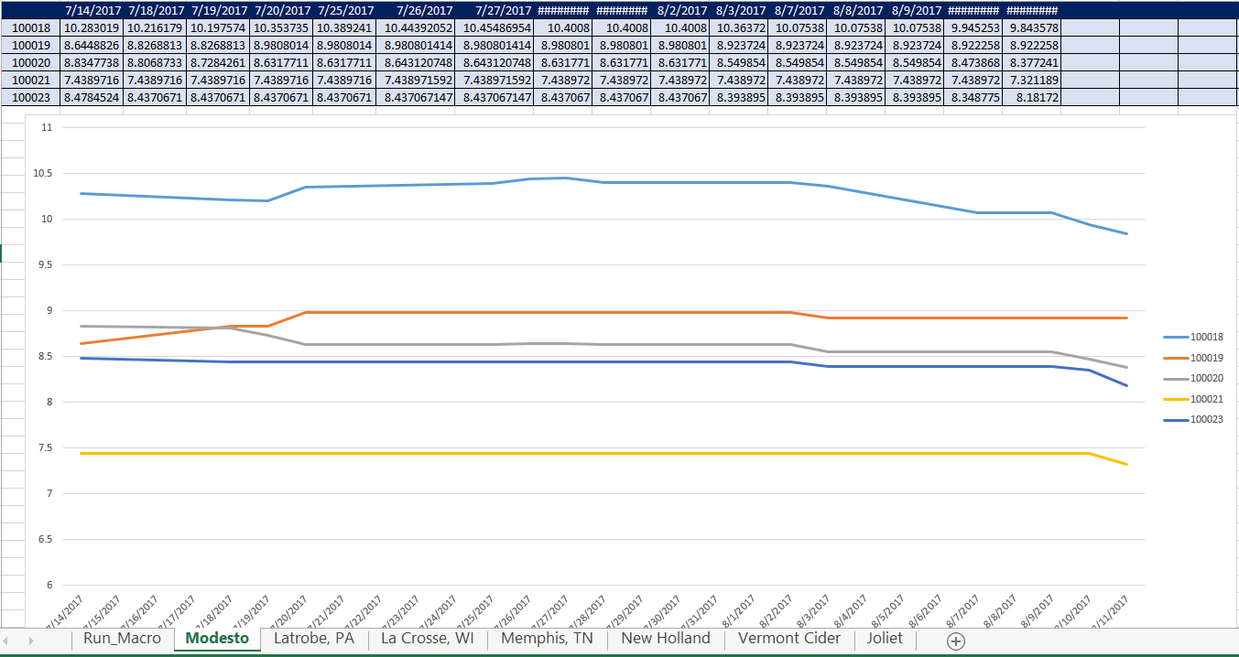
Inventory Tracking
Excel workbook to track the inventories from each brewery
Data is transformed with the natural log function to make it easier to compare
No defined use at this time, but interesting visual to see popular SKUs and their variability

Slide 8
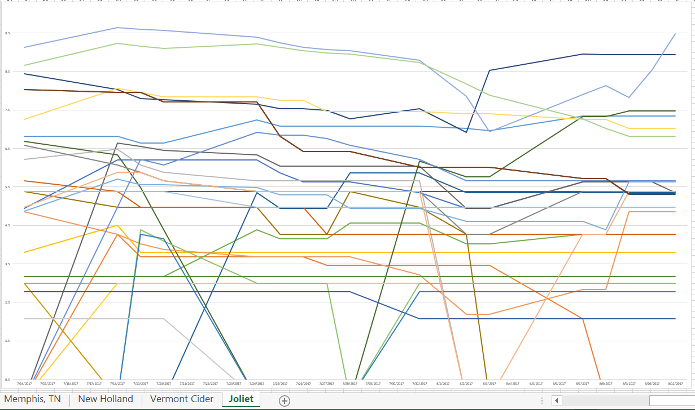

Slide 9
Miller Inventory/Order Report
Was given a script written by Jeremy Vance that turned the daily miller report into a csv file.
I examined the data that the script output and found missing and inaccurate sections of the data
To correct this, I analyzed all of the anomalies in the final csv file, compared them to the original dataset, and found edge cases that the code did not account for

Slide 10
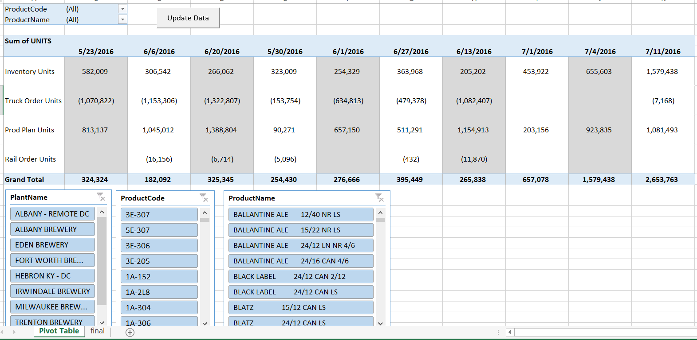
Miller Report

Slide 11
Keg data parse
Task: Find shipments of kegs by wholesaler of Global Keg separated by size
Parsed dataset of over 50 columns and 35,000 rows
First found each distributor name and ID and placed in a table
Used the Excel SUMIFS function to first check the Distributor ID in the dataset, and then separated ½ and 1/6 kegs into their own columns
Final product is a filterable table by distributor name and id to see the number of kegs by size shipped

Slide 12
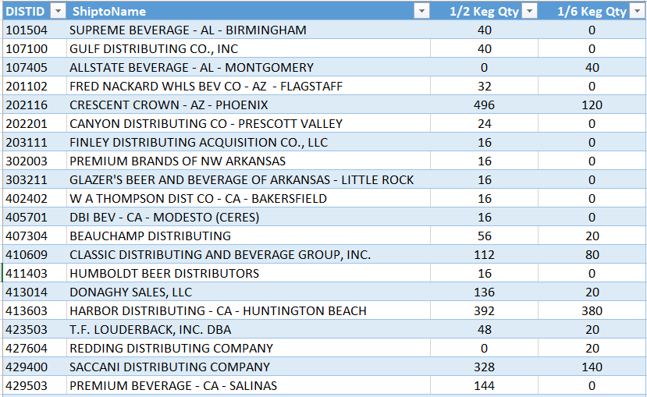
Final table of the keg data

