Slide 1

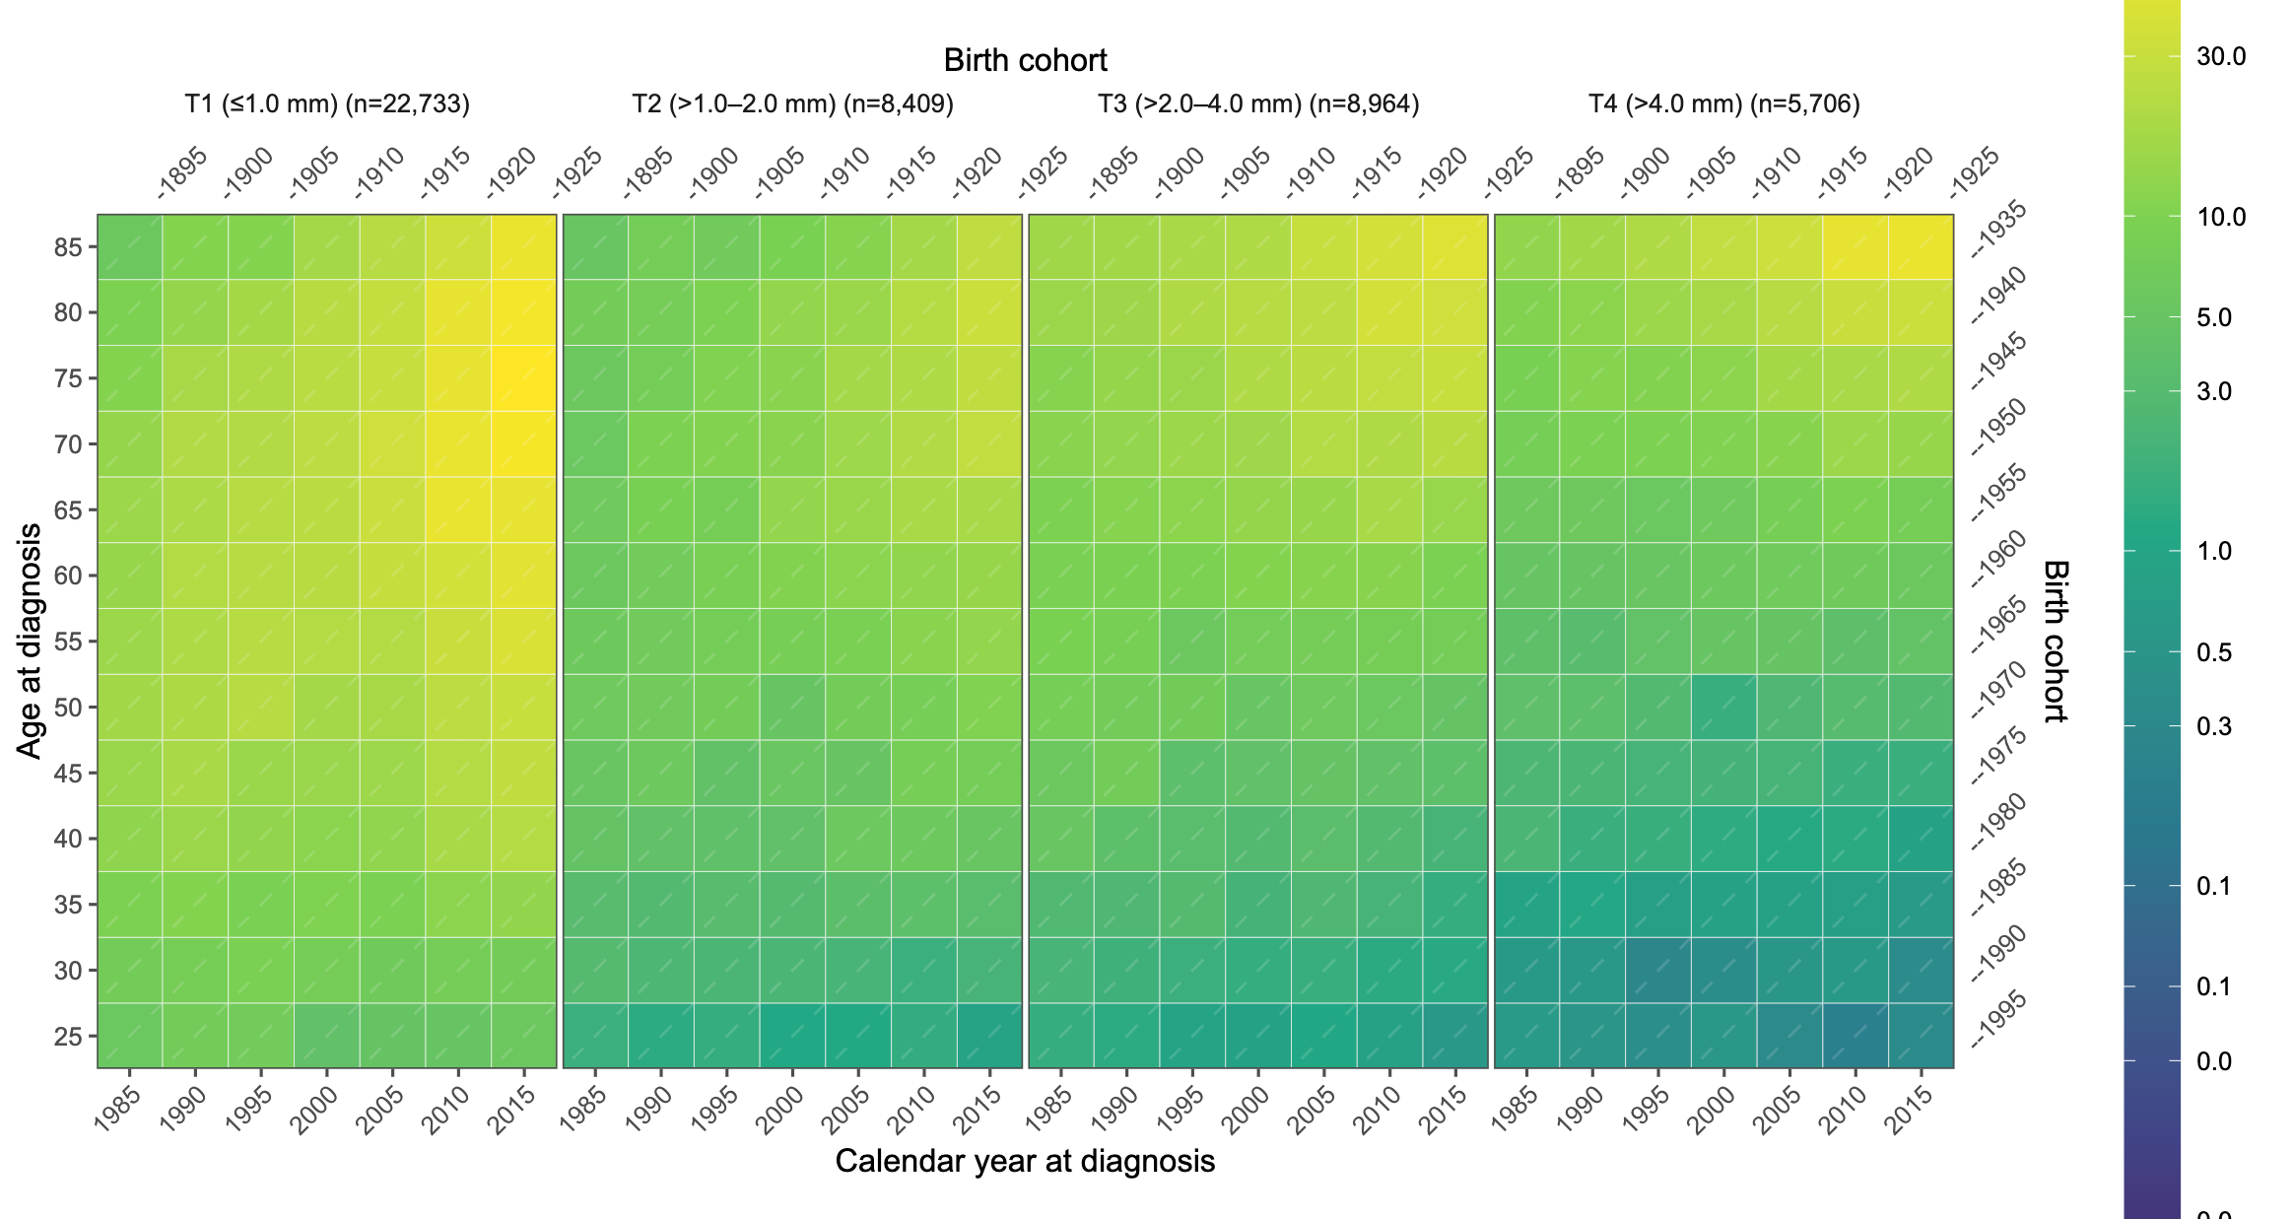
Trends in melanoma tumour thickness in Norway, 1983–2019
Raju Rimal ^{1,} @mathatistics raju.rimal@medisin.uio.no
Raju Rimal¹ Trude E Robsahm² Adele Green^{3,4} Reza Ghiasvand^{2,5} Corina S Rueegg⁵ Assia Bassarova⁶ Petter Gjersvik⁷ Elisabete Weiderpass⁸ Odd O Aalen¹ Bjørn Møller⁹ Marit B Veierød¹
¹Oslo Centre for Biostatistics and Epidemiology, Department of Biostatistics, University of Oslo, Norway
²Department of Research, Cancer Registry of Norway, Oslo, Norway
³Department of Population Health, QIMR Berghofer Medical Research Institute, Brisbane, Australia
⁴Cancer Research UK Manchester Institute, University of Manchester, Manchester, United Kingdom
⁵Oslo Centre for Biostatistics and Epidemiology, Oslo University Hospital, Oslo, Norway
⁶Department of Pathology, Oslo University Hospital – Ullevål, Oslo, Norway
⁷Institute of Clinical Medicine, University of Oslo, Oslo, Norway
⁸International Agency for Research on Cancer, Lyon, France
⁹Department of Registration, Cancer Registry of Norway, Oslo, Norway
Background
Incidence of cutaneous melanoma has increased in fair-skinned populations during the past decades [1]. Tumour (Breslow) thickness at diagnosis is important for assessing early detection. Tumour thickness is the primary determinant of the T category in the Tumor-Node-Metastasis (TNM) staging system, and the most important prognostic factor for survival after localized melanoma [2].
Background
Incidence of cutaneous melanoma has increased in fair-skinned populations during the past decades [1]. Tumour (Breslow) thickness at diagnosis is important for assessing early detection. Tumour thickness is the primary determinant of the T category in the Tumor-Node-Metastasis (TNM) staging system, and the most important prognostic factor for survival after localized melanoma [2].

