Slide 1

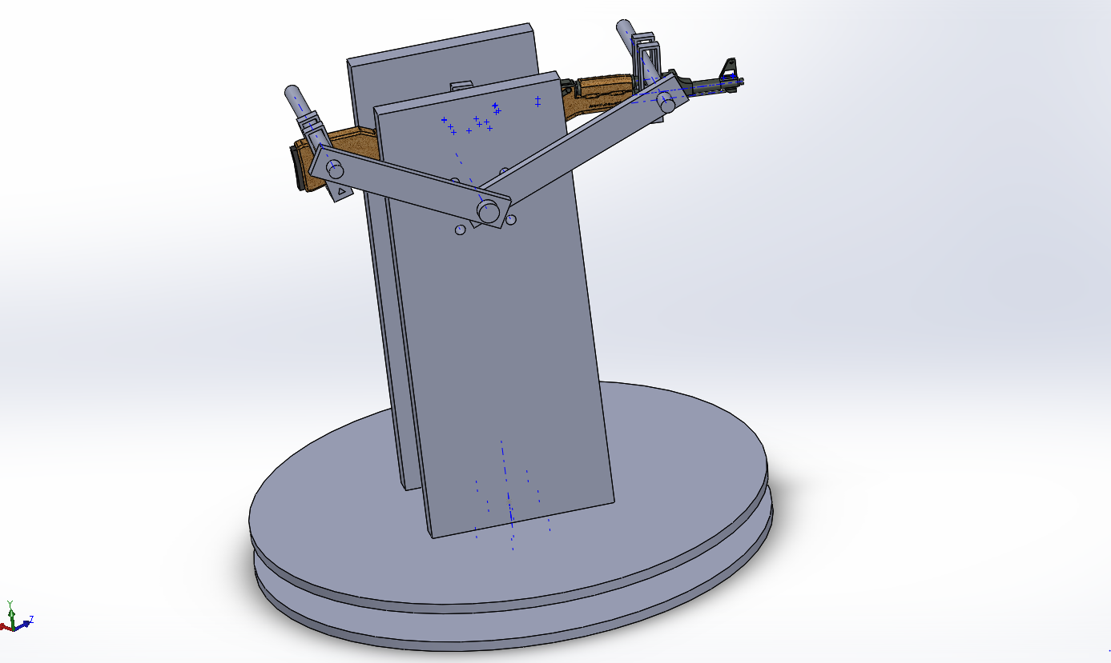
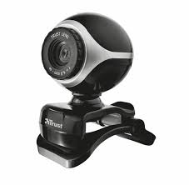
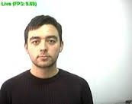


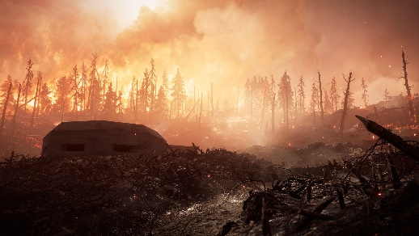
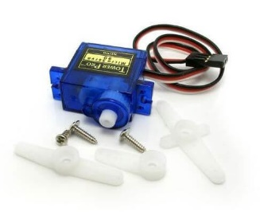
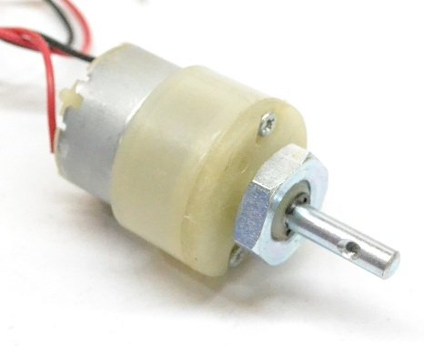
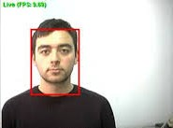
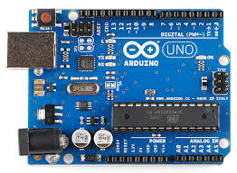
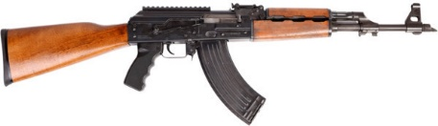
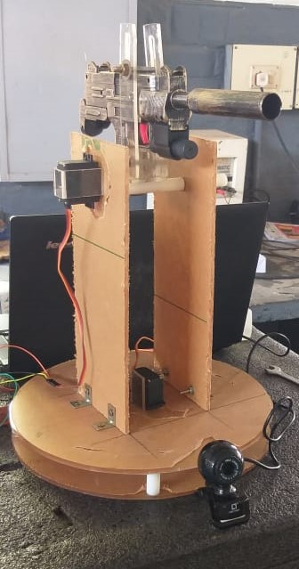
DESIGN AND SIMULATION OF SENTINEL GUN ASSISTED BY IMAGEPROCESSING FOR DEFENCE APPLICATION
AJEETH.A(15UMEC103),BARANI DHARAN.K(15UMEC102),THERIMUTHU SELVAM.A(15UMEC050)
Department of Mechanical Engineering, Kamaraj College of Engineering and Technology.
Madurai, Tamilnadu.
ABSTRACT
In this project we are going to develop a sentinel gun prototype which works on one of the method of Image Procesing. We adopt the Face Detection and Tracking Method from Image Processing. This prototype takes the input from a webcam and process the image using the spyder software and then finally the hardware are drive using the microprocessor called Arduino (UNO)It has two dc motors for rotating and tilting the gun according to the human movement. In order to trigger the gun we are going to use a servo motor.
INTRODUCTION
CONCEPTUAL DESIGN
This prototype is going to develop for protecting the nation from the foreign terrorist entry through the border by shooting them by a self triggered gun attached in a multiple gun holder.
OBJECTIVE
To avoid the soldiers suffering from over hotness and coldness due to winter and summer season.
To reduce the monitoring work of the soldier from morning to night.
To shoot an enemy if he cross the border when soldier is not there.
To reduce the death of border guard soldiers.
To guard the border 24×7.
To manage the sudden terrorist ingress.
To avoid the periodic alteration of soldiers from borders.
To trigger the gun automatically.
METHODOLOGY
IMAGE PROCESSING
Input
Face recognition
coding and face tracking
Image processing is an technique in which the input is an image or a series of images or videos, such as photographs or frames of video. The output of image processing can be either an image or a set of characteristics or parameters related to the image.
It also means "Analyzing and manipulating images with a computer". Image processing is performed this three steps
First, import images with an optical devices like a scanner or a camera or directly through digital processing.
Second, manipulate or analyze the images in some way. This step can be include image improvement and data summary, or the images are analyze to find rules that aren't seen by the human eyes. For example, meteorologists use this processing to analyze satellite photographs.
Last, output the result of image processing. The result might be the image changed by some way or it might be a report based on analysis or result of the images.
Triggering
Rotation
Arduino controlling
Output of spyder
FABRICATED PROTOTYPE
Design
Solidworks
Image processing
Anaconda
Spyder
Platform
Ardunio
Opencv
SOFTWARE USED
CONCLUSION
As per the design the prototype is simulated and fabricated and the microcontroller is coded with face detection and tracking algorithm to detect and track the human face.
REFERENCES
https://opencv.org/
https://www.anaconda.com/
Notes:
1

