Slide 1
Texas animal rentals
By: Chase Theriot

Slide 2
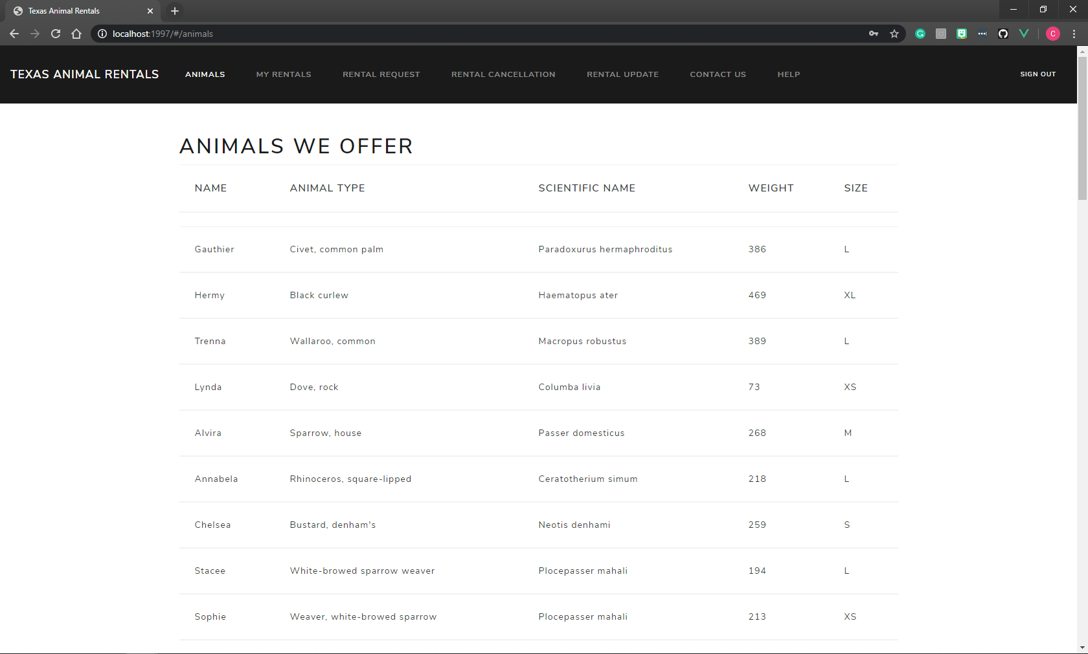
Animals page
This page allows the user to look at all of the animals that are offered.

Slide 3
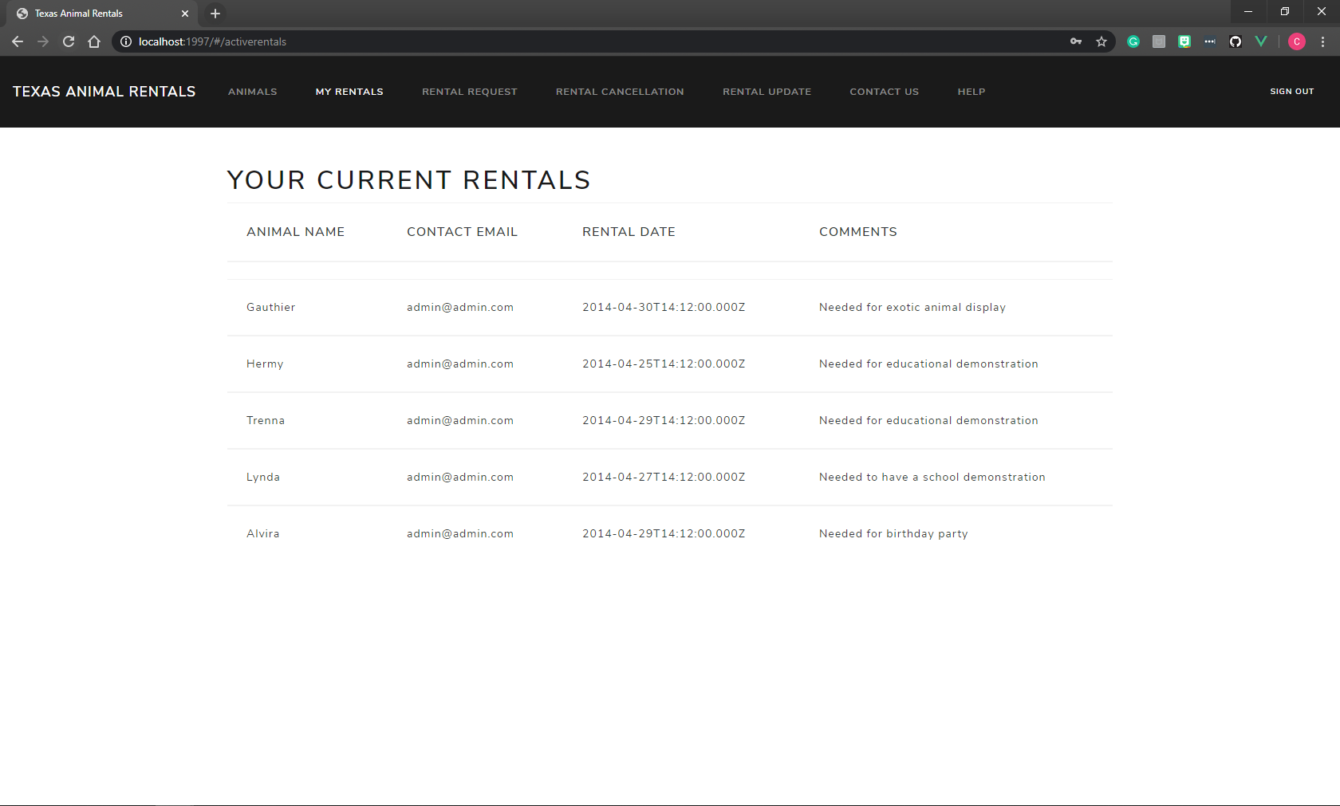
Current rentals page
This page allows the user to view the rentals that they currently hold.

Slide 4
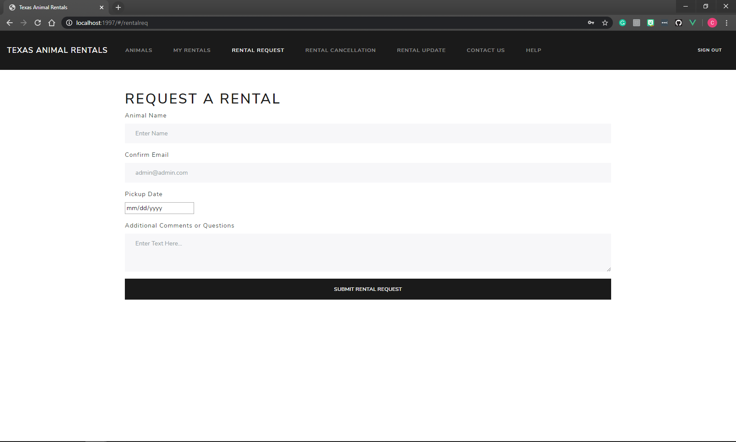
Request a rental page
This page allows the user to request a rental.

Slide 5
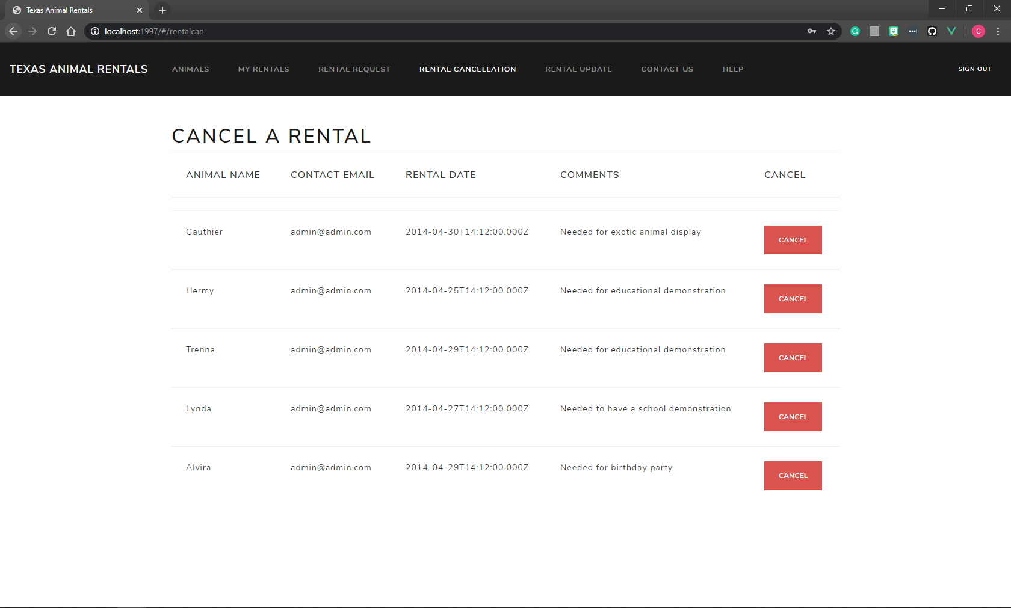
Cancel a rental page
This page allows the user to cancel a rental that they hold.

Slide 6
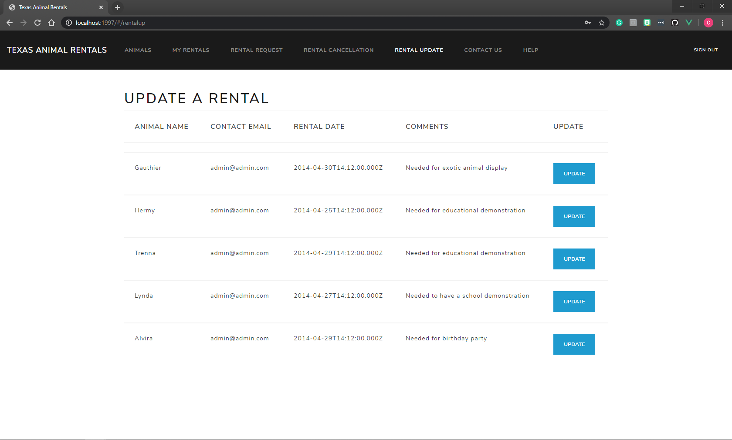
Rental update page
This page allows the user to update a rental that they currently hold.

Slide 7
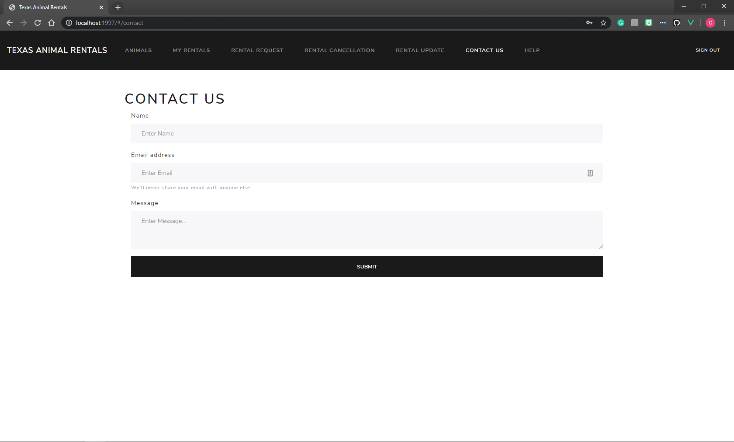
Contact us page
This page allows the user to contact the business to ask a question or comment on something.

