Slide 1
CLOUD RESOURCE ALLOCATION / PROJECT
STRATEGIC DECISION-MAKING IN CLOUD RESOURCE ALLOCATION
How cloud companies compete on price: a game theory model
GROUP MEMBERS
Rishi Bhardwaj - 2427030397
Jaskirat Singh - 2427030438
Yash Tyagi - 2427030042
Kunal Tyagi - 2427030660

Slide 2
The Problem and Our Goals
Treat each company as a player that picks a price
THE PROBLEM
1
Cloud companies sell almost the same product: computing power.
Higher price: more profit per sale, but customers leave.
Lower price: more customers, but less profit per sale.
The best price depends on rivals' prices, so it is a strategy game.
Model customers who prefer cheaper options
2
Work out profit from price, cost and demand
3
Find the stable prices (the Nash equilibrium)
4
Compare different costs and 2 to 6 rivals
5

Slide 3
Key Ideas in Simple Words
01
02
03
04
NASH EQUILIBRIUM
BEST RESPONSE
CUSTOMER CHOICE
PRICE SENSITIVITY
A stable set of prices. Once reached, no company can earn more by changing only its own price.
The best price for one company, given the prices its rivals are charging right now.
Customers lean towards cheaper providers, but not all of them switch. This is called the logit model.
A number called α (alpha). A bigger α means customers care more about price.
Think of it like this: two shops next door keep adjusting their prices against each other until neither gains by changing again. That stopping point is the equilibrium.

Slide 4
How the Model Works
01
02
03
04
CHOOSE A PRICE
SHARE CUSTOMERS
WORK OUT PROFIT
CHECK IF STABLE
Each company picks one of 200 prices (0.5 to 10), assuming rivals keep theirs fixed.
Cheaper companies win a bigger share of customers. s = share, p = price.
Profit per sale times the number of customers won.
Repeat until prices barely change (less than 0.001). Stop after 100 rounds at most.
s = e^(−α·p) / Σ e^(−α·p)
π = (p − c) × D
Goal: find the Nash equilibrium, the prices where no company can earn more by changing only its own price. α (alpha) shows how much customers care about price.

Slide 5
How We Built It
Set up companies
›
Share out customers
›
Calculate profit
›
Update best prices
›
Save tables & charts
PYTHON SCRIPT
CLOUD PRICING LAB DASHBOARD
File: cloud_pricing_game.py
NumPy does the maths
Matplotlib draws the charts
Two classes: CloudProvider and CloudPricingGame
Prints tables and saves 3 charts
Runs in the web browser, no cloud account needed
Sliders for total demand and α
Add or edit up to 6 companies and their costs
Click “Run Simulation” for instant results
Shows a results table and live charts

Slide 6
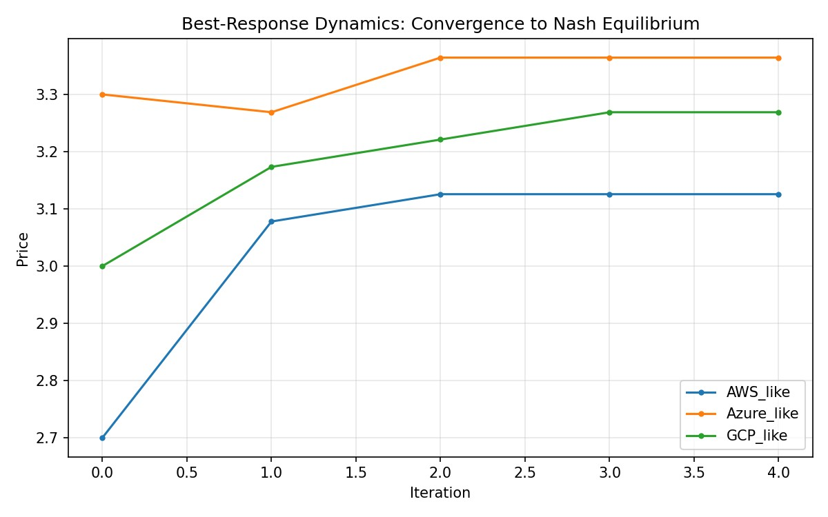
Results: Three Companies, Different Costs
Provider | Cost | Price | Demand | Profit
AWS_like | 1.80 | 3.126 | 771.3 | 1022.5
Azure_like | 2.20 | 3.364 | 579.2 | 674.4
GCP_like | 2.00 | 3.269 | 649.5 | 824.1
2,000
2,521
4
total demand
total profit
rounds needed
Prices settle down to stable values
Lowest cost wins. AWS_like charges the least, earns the most per sale, and gets 38.6% of customers and the top profit.

Slide 7
Results: What Happens When Competition Grows?
3.317 → 2.791
average price, 2 to 6 companies
438.9 → 263.8
average profit per company
More rivals means lower prices. Note: we raised total demand as companies were added, so only the price trend is a true model result.

Slide 8
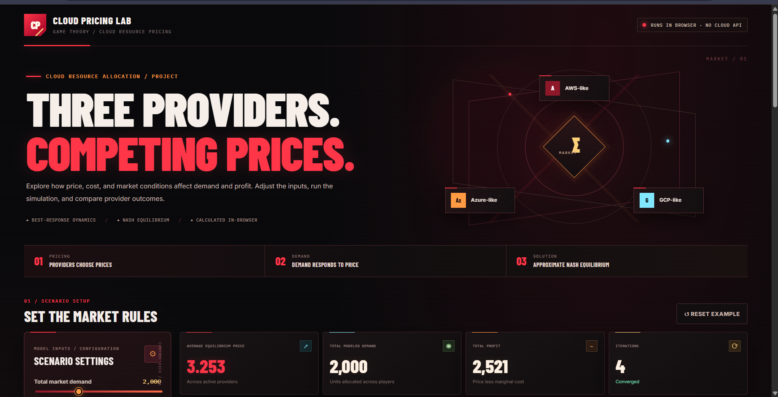
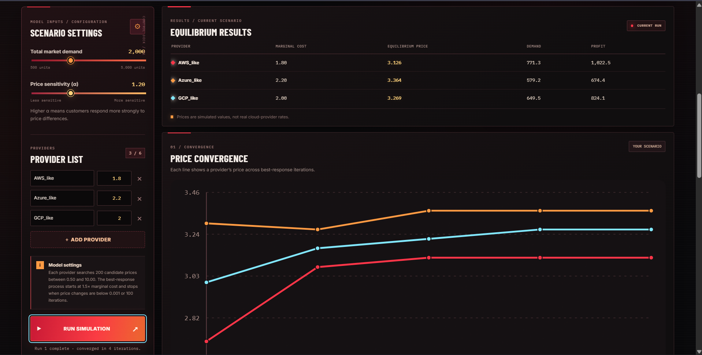
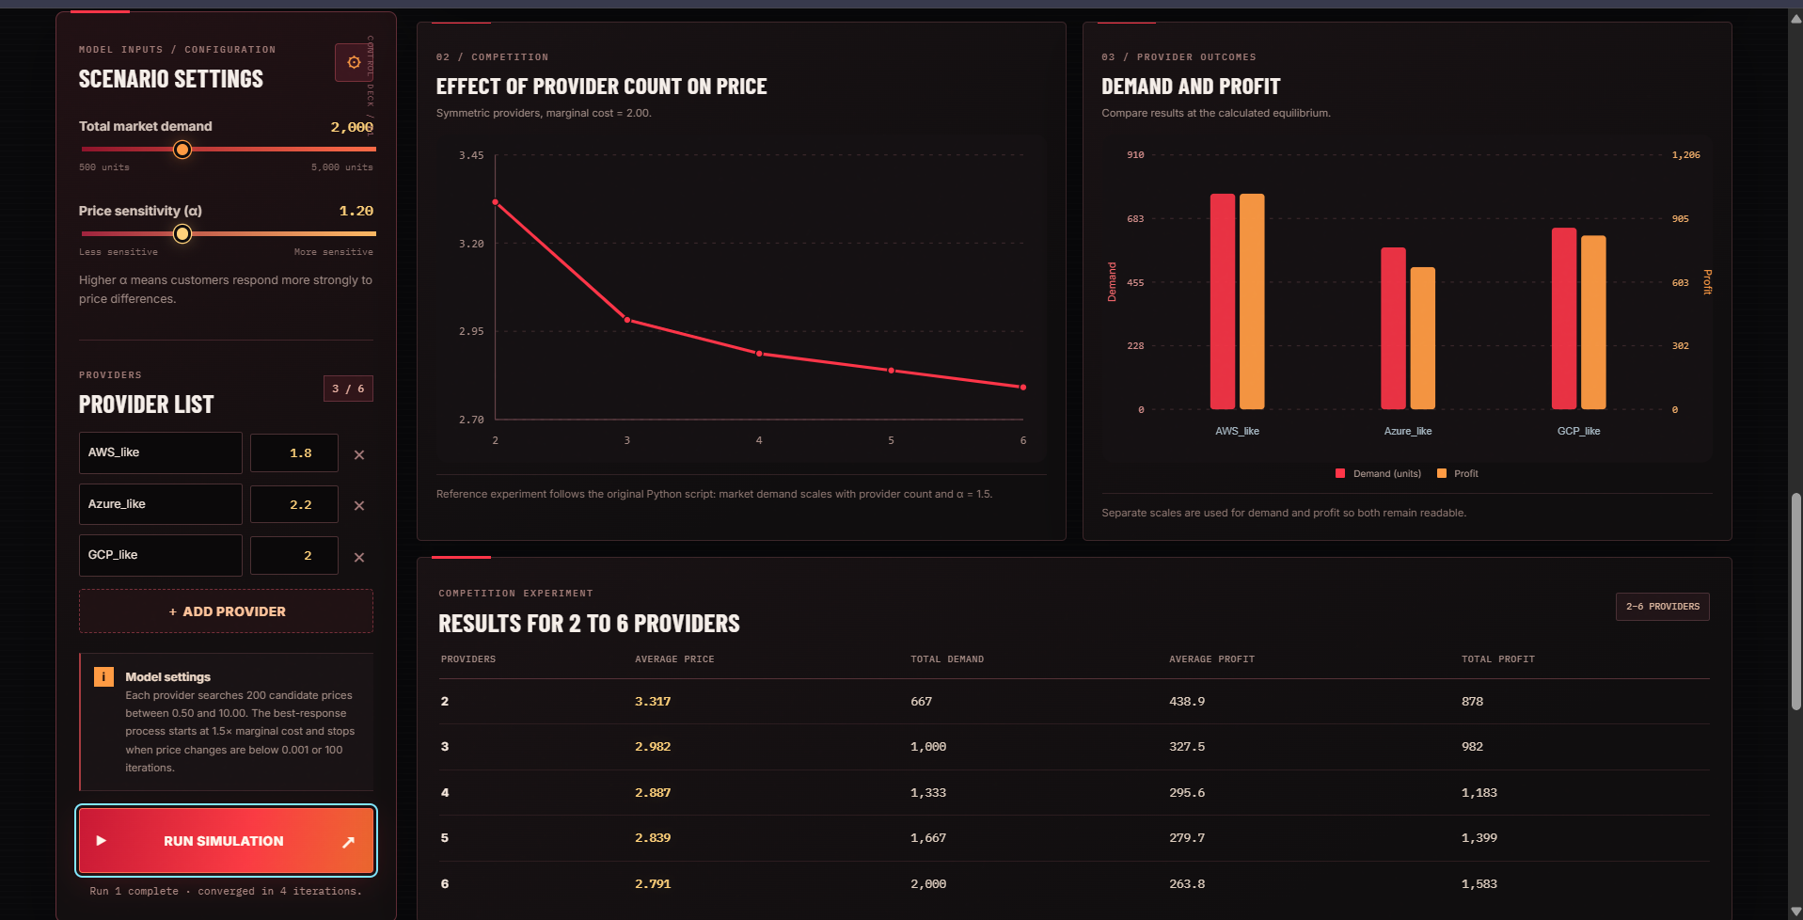
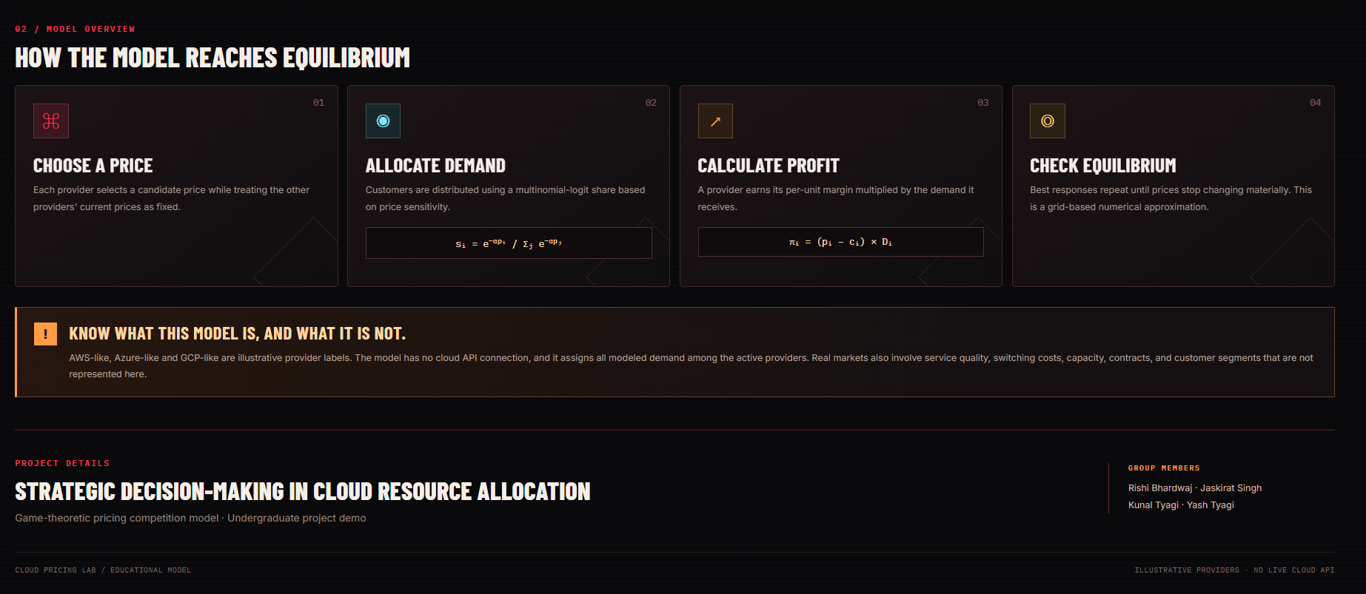
Project Screenshots: Cloud Pricing Lab
1. Home page and summary numbers
2. Settings, results table, convergence chart
3. Effect of competition and company results
4. Model overview and project details

Slide 9
Where It Helps and Where It Falls Short
WHERE IT HELPS
LIMITATIONS
Teaching what a Nash equilibrium and a best response are
Seeing how costs affect price, market share and profit
Studying how the number of rivals changes prices
Can be adapted to other services with several providers (needs new assumptions)
Prices come from a grid of 200 values, so the answer is approximate
No option to buy nothing: all customers must pick a provider
Numbers are made-up examples, not real market data
Ignores capacity limits, service quality and the cost of switching

Slide 10
Conclusion
01
02
03
04
IT WORKS
COST MATTERS
MORE RIVALS
EASY TO FOLLOW
The search for stable prices settled down in every scenario we tested.
The company with the lowest cost charges the lowest price and earns the most profit.
More competing companies means lower average prices.
A clear, simple way to study how companies set prices.
Takeaway: when companies compete on price, the lowest-cost company does best, and more competition pushes prices down.

