Slide 1
PBL-3 MTE · Rishi Bhardwaj · 2427030397
Numerical Simulation and Visualization of Radioactive Decay Chains
Guided by:
Dr. Jay Prakash Singh
Assistant Professor (Senior Scale)
Dept. of CSE

Slide 2
Introduction
Radioactive decay is a random, exponential process in which unstable nuclei transform into other nuclides over time. Simulating it numerically lets us visualize population behaviour without analytical solutions for complex chains.
PBL-3 MTE · A computational tool for modelling and visualizing decay

Slide 3
Problem Statement
THE DIFFICULTY
THE APPROACH
Analytical solutions become difficult to derive and interpret as the number of coupled isotopes in a decay chain increases.
A flexible numerical method can compute and visualize population changes over time for a single isotope and, eventually, for many.
Current stage: single-isotope simulation working · multi-isotope chain propagation planned next

Slide 4
Objectives
01
Implement
02
Visualize
Implement a numerical simulation of single-isotope radioactive decay
Visualize the decay curve of nuclei population over time
03
Establish
04
Extend
Establish a configurable framework (half-life, initial population, time range) for future extension
Extend the model to multi-isotope decay chains in the next implementation stage

Slide 5

Mathematical Model
Radioactive decay follows a first-order exponential law.
N(t) = N₀e^{-λt}
λ = $\frac{\ln{2}}{\text{T}\text{1/2​}}$
Decay constant:
N₀ initial number of nuclei · T½ half-life · t time

Slide 6
Methodology
Define the initial population N₀ and the half-life T_{1/2} as configurable parameters.
1
Compute the decay constant λ = $\frac{\ln{2}}{\text{T}\text{1/2​}}$.
2
3
Evaluate N(t) over a discrete time range using NumPy array operations.
Plot N(t) against t with Matplotlib and export the figure as an image file.
4
Four steps · parameters in, figure out

Slide 7
Current Implementation
Parameter | Value in this run
Language and libraries | Python · NumPy · Matplotlib
Initial population N_{0} | 1,000,000 nuclei
Half-life T_{1/2} | 10 arbitrary time units
Time domain t | 0 to 50 arbitrary time units
Output | decay_curve.png
Half-life is configurable; the values above are the current settings

Slide 8
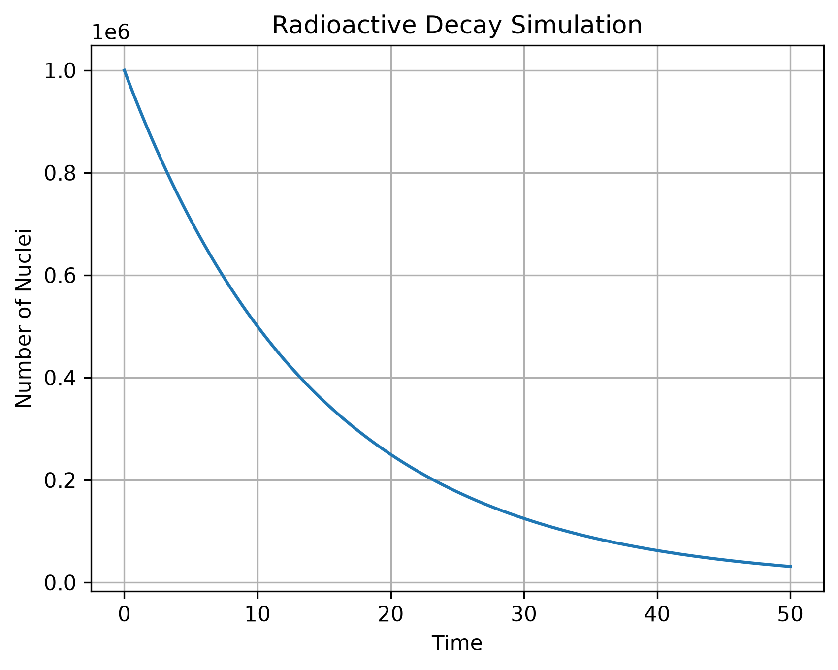
Results and Visualization
The simulation produces a smooth exponential decay curve of N(t) against time. The population falls to half its value with every elapsed half-life, consistent with the theoretical model.
The plot is saved locally as a static image, decay_curve.png, for inspection and reporting.

Slide 9
Future Scope
Extend the model to multi-isotope decay chains with sequential parent–daughter transformations
Implement the coupled differential equations governing chain propagation between isotopes
Add interactive or animated visualization of population evolution across the chain
Support comparison of multiple decay pathways and configurable branching ratios
Planned work · none of the above is implemented yet

Slide 10
Conclusion
REFERENCES
A working single-isotope decay simulation was implemented and visualized, establishing a computational foundation for extension to multi-isotope decay chains.
Foundational nuclear physics and radioactive decay theory (standard undergraduate physics texts)
NumPy and Matplotlib official documentation
PBL-3 MTE · Python · NumPy · Matplotlib

