Slide 1


Website
Optimization
Proposal
Bilingual website, content architecture
and lead management
Proposal 08 September 2026
Target delivery 14 September 2026
Notes:
This proposal covers five pages in Traditional Chinese and English, plus basic CRM lead management. FACES becomes a section within About Us. The September 14 target depends on assets, access and tool selection by September 9 and timely client decisions. The cover image comes from the current website and does not represent a new project result.
Content status: proposed website improvements. Distinguish existing website statements from proposed additions.
Source: https://www.thermoverse.com/about (reviewed 2026-09-08)

Slide 2
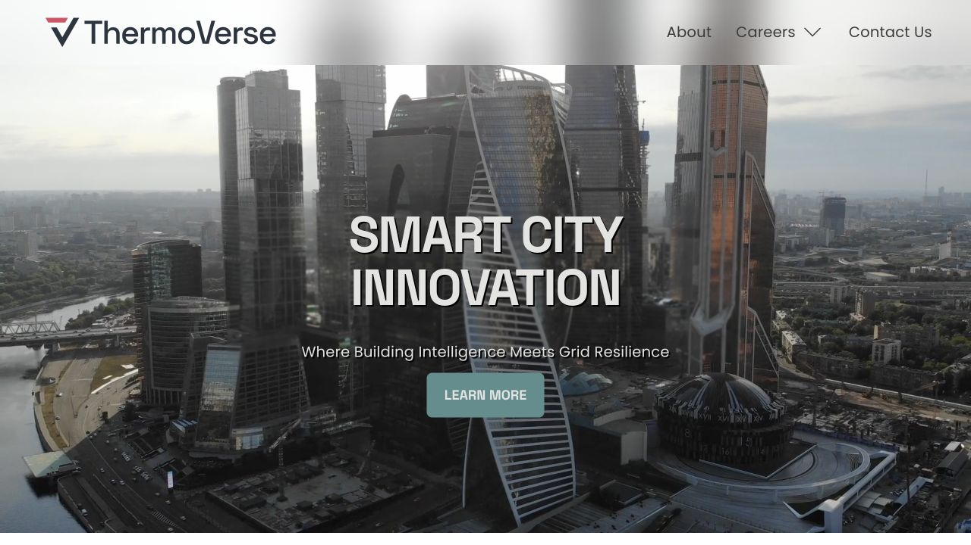
Help visitors understand the technology and inquire
Priorities: clearer content, working navigation and trackable inquiries
Product clarity
Explain operation, applications and assessment needs.
Complete navigation
Repair the broken Innovation and Services links.
Inquiry flow
Connect page actions to forms and CRM records.
Current homepage, 08 Sep 2026
Acceptance: complete pages, bilingual navigation and successful CRM capture
ThermoVerse
02
Notes:
The current homepage emphasizes smart-city positioning and imagery. On September 8, 2026, /innovation and /energyservices displayed page-not-found messages. The proposal addresses content and lead capture. Traffic and conversion performance have not been established; observe them after launch without promising an unverified uplift.
Content status: proposed website improvements. Distinguish existing website statements from proposed additions.
Source: https://www.thermoverse.com/ (reviewed 2026-09-08)
Source: https://www.thermoverse.com/innovation (reviewed 2026-09-08)
Source: https://www.thermoverse.com/energyservices (reviewed 2026-09-08)

Slide 3
5 main pages for first stage
Home | Technology | Use Cases | About Us | Contact Us
Brand, carbon, value, use case summary | How it works | Applications | Company and FACES | Inquiries
Visitor journeys
Technology partners
Home → Technology → Use Cases → Contact Us
Talent and training visitors
About Us → FACES section → Participation or partnership inquiry
Page actions preselect an inquiry type so the team can identify visitor intent.
ThermoVerse
03
Notes:
The fixed navigation is Home, Technology, Use Cases, About Us and Contact Us. FACES becomes a dedicated section within About Us rather than a primary navigation page. Technology and talent journeys share one contact and CRM workflow. Language switching keeps visitors on the corresponding page. Store source page separately from inquiry type; allow visitors to change the preselected type. Arrows show proposed visitor journeys.
Content status: proposed website improvements. Distinguish existing website statements from proposed additions.

Slide 4
Home: make ThermoVerse’s value clear
Purpose: explain what the company does, who it serves and what to do next
PROPOSED MESSAGE
Sections
Reduce building energy use
and emissions, supporting
carbon-credit eligibility
and carbon management
01
Hero: thermal management as a path to lower emissions
02
Peak demand, comfort and energy challenges
03
SIMs sensing, storage and control summary
04
Commercial, industrial and multifamily applications
05
How measured reductions can support credit eligibility and reporting
06
Partners and awards
PRIMARY CTA
Discuss a Project
Secondary action: Explore Our Technology
ThermoVerse
04
Notes:
The homepage adds a carbon value proposition: ThermoVerse aims to reduce building energy demand and measurable emissions through thermal management. Verified reductions may support carbon-credit eligibility or corporate carbon management when the applicable methodology, baseline, additionality, verification and registry requirements are met. The website must not guarantee credits or a quantity. Content order: 1 Hero and carbon value. 2 Building energy problem. 3 SIMs summary. 4 Application entry points. 5 Measured reductions and credit eligibility. 6 About Us and FACES entry. Primary CTA: Discuss a Project. Secondary CTA: Explore Our Technology.
Content status: proposed website improvements. Distinguish existing website statements from proposed additions.
Source: https://www.thermoverse.com/ (reviewed 2026-09-08)
Source: https://www.thermoverse.com/about (reviewed 2026-09-08)

Slide 5

Technology: explain operation and adoption
Purpose: explain how SIMs work and what a building assessment requires
Sections
01
SIMs technology overview
02
Phase-change materials and thermal storage
03
The sensing, storage and control process
04
Integration within ceilings and walls
05
Heat-flow control, peak management and demand response
Existing installation image from the website
06
FAQ: suitability, integration needs and assessment data
PRIMARY CTA
Discuss Your Requirements
Technology maturity, patents, compatibility and performance require client-approved evidence.
ThermoVerse
05
Notes:
The About page describes SIMs integrating sensing, thermal storage and control in ceilings and walls, along with phase-change materials, demand response and time-of-use optimization. The new page will explain these with a process and placement illustration. Product specifications and compatibility are not established here. FAQs cover building suitability, existing systems, operational data and assessment steps. Client approval is required for maturity, patent, compatibility and performance claims. Primary CTA: Discuss Your Requirements.
Content status: proposed website improvements. Distinguish existing website statements from proposed additions.
Source: https://www.thermoverse.com/about (reviewed 2026-09-08)

Slide 6
Use Cases: recruit POC site partners
Purpose: identify real sites for validating technology, carbon reduction and deployment needs
Partners provide a site, baseline data and testing support, then jointly define POC success metrics.
Application | Building challenge | Proposed application / value | Assessment inputs
Commercial | HVAC loads and operating hours | Assess thermal control and peak demand management | Operating hours, electricity and HVAC data
Industrial | Site-specific thermal needs | Assess thermal management against actual site conditions | Thermal loads, equipment and site conditions
Multifamily | Comfort and building energy use | Assess temperature stability and load flexibility | Building layout, HVAC and occupancy needs
PRIMARY CTA
Apply to Become a POC Site Partner
POC results, emissions reductions and credit eligibility depend on measurement, verification and applicable programs.
ThermoVerse
07
Notes:
The primary purpose of Use Cases changes to recruiting POC site partners across commercial, industrial and multifamily buildings. Explain each site challenge, potential application, validation value and initial assessment inputs. State partner requirements: an assessable site, available energy or HVAC baseline data, a designated contact, permission for necessary installation and measurement, and joint agreement on scope, period, metrics and data use. The application form captures site type, location, building size, HVAC system, available data, target timing and contact person. This is partnership recruitment, not evidence of completed client projects, and it does not guarantee energy savings, emissions reductions or carbon credits. Primary CTA: Apply to Become a POC Site Partner.
Content status: proposed website improvements. Distinguish existing website statements from proposed additions.
Source: https://www.thermoverse.com/about (reviewed 2026-09-08)

Slide 7
About Us: build trust with background and evidence
Purpose: show prospective partners the company’s origins, capabilities and direction
Sections
01
Company positioning and mission
2022
02
Founding story and founder introduction
03
Research and deployment milestones
Founding year stated
on the current website
04
Approved team profiles, research ties and partners
Separate completed work
from future targets
so milestones remain clear.
05
Company values and the FACES program
06
Location and contact details
PRIMARY CTA
Connect with Our Team
ThermoVerse
08
Notes:
The current About page states that Shantonio Birch founded ThermoVerse in 2022. The redesigned page covers positioning, origins, founder, research and deployment milestones, team and research partnerships, values, the FACES program, location and contact. FACES is a full section on this page and can be reached through an anchor link from the homepage or in-page navigation. The website’s 2027 expansion objective is a future target, not an achieved result. Client approval is required for logos, profiles and partnership statements. Primary CTA: Connect with Our Team.
Content status: proposed website improvements. Distinguish existing website statements from proposed additions.
Source: https://www.thermoverse.com/about (reviewed 2026-09-08)
Source: https://www.thermoverse.com/faces (reviewed 2026-09-08)

Slide 8
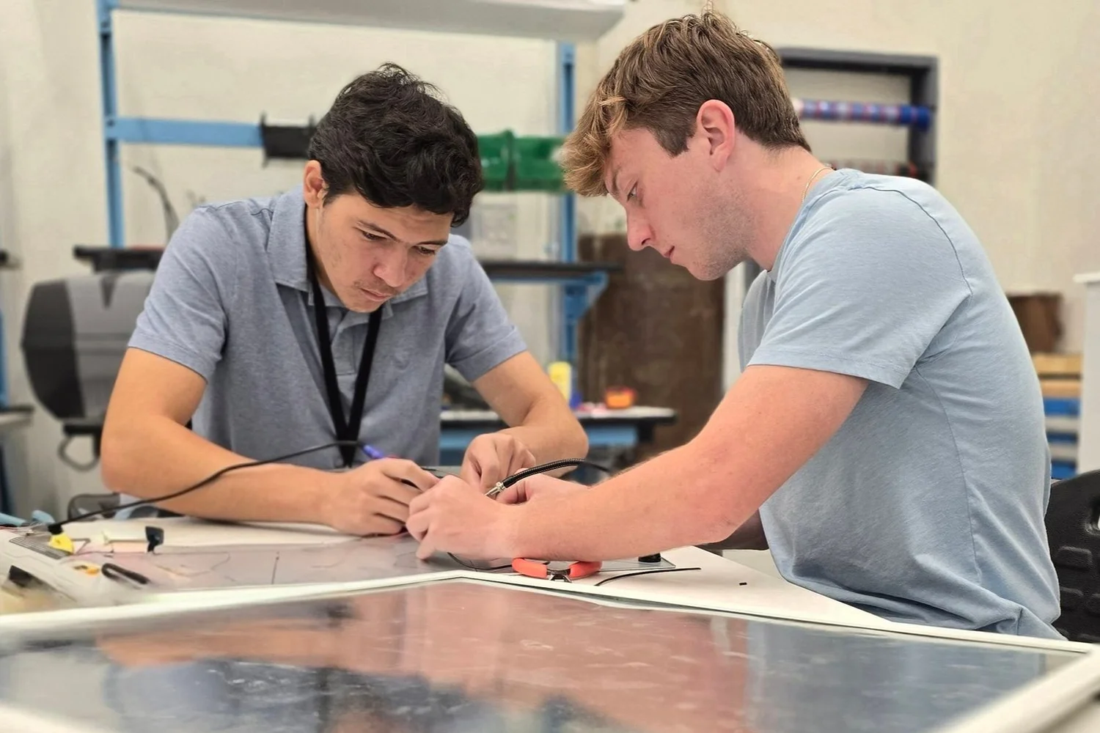
FACES within About Us
Purpose: introduce the workforce program after the company story
Sections
01
FACES program introduction
02
Early-career professionals and relevant graduates
03
Energy trades, engineering, operations and consulting
04
Express interest, check eligibility, confirm an opportunity, join
05
Approved partners, projects and participant stories
First release captures program interest
and training partnership inquiries.
06
FAQs and inquiry entry points
PRIMARY CTA
Register Your Interest
This content sits within About Us. Resume uploads and applicant screening are outside v1.
ThermoVerse
06
Notes:
FACES is no longer a primary-navigation page. It becomes a complete section within About Us after the company background, team and values. The section explains the program, audience, training, participation steps, approved stories and FAQs. Do not promise unconfirmed dates, fees, eligibility or employment outcomes. The first release collects interest and partnership inquiries; full recruitment, resume uploads and screening are excluded. Primary CTA: Register Your Interest. The workshop image comes from the website and must not be labeled as evidence of a specific cohort.
Content status: proposed website improvements. Distinguish existing website statements from proposed additions.
Source: https://www.thermoverse.com/faces (reviewed 2026-09-08)
Source: https://www.thermoverse.com/about (reviewed 2026-09-08)

Slide 9
Contact Us: capture useful inquiries with a short form
Purpose: capture enough context to start a conversation and identify intent
Form fields | Content
Required | Name, email, inquiry type and message
Optional | Company / school / organization and role
Inquiry types | POC site partnership, technology inquiry, FACES interest, other
Data use
Link the privacy policy. Marketing opt-in is optional and unchecked.
Submission feedback
Confirm success. Preserve input and offer retry if submission fails.
Response commitment
Publish a response time only after client confirmation.
ThermoVerse
09
Notes:
Page actions lead to Contact Us with an editable preselected inquiry type. Require name, email, type and message. Organization and role are optional. Use four categories: POC site partnership, technology inquiry, FACES interest and other. Selecting POC site partnership reveals site type, location, building size, HVAC system, available data and target timing. Explain data use and link the client-approved privacy policy. Marketing consent is optional and unchecked. Show success only when capture is confirmed. Preserve input on failure and allow retry. Do not publish an unconfirmed response SLA.
Content status: proposed website improvements. Distinguish existing website statements from proposed additions.
Source: https://www.thermoverse.com/contactus (reviewed 2026-09-08)

Slide 10
CRM: record every inquiry and track follow-up
First release: centralize leads, identify sources and support team follow-up
01 Submit form
02 Save inquiry
03 Notify owner
04 Track follow-up
Inquiry record | Management capability
Name, email, organization and message | List and detail views, search and filters
Received time, source page, language and type | Notes and CSV export
Preserve repeat inquiries from the same email | Admin login with restricted access
ThermoVerse
10
Notes:
After successful capture, save the inquiry and notify the designated owner. Admins log in to follow up. Store name, email, organization, optional role, message, timestamp, source page, language, type and marketing choice. Provide list/detail views, search, filters, notes, CSV export and status updates. Statuses are New, Contacted, Following up and Closed. Keep repeat inquiries from an email rather than overwriting prior messages. All website forms use one capture workflow. Select the CRM by September 9 based on the existing website, accounts, costs and integration conditions; no vendor is committed here. Marketing automation, quoting and a full sales pipeline are excluded. A notification failure must not lose a saved inquiry.
Content status: proposed website improvements. Distinguish existing website statements from proposed additions.

Slide 11
Bilingual delivery, verified end to end
Traditional Chinese and English cover content, forms and site interactions
Complete content
5 × 2
Navigation, copy, actions, forms and messages
Language consistency
Five pages × two languages
Shared terminology and page-preserving switching
10 localized pages
Checked on desktop and mobile
Working integrations
CRM capture, owner alerts and basic spam protection
Website handover
SEO titles/descriptions, URL fixes and admin guidance
Acceptance includes form success/failure, POC categorization, repeat inquiries, access restrictions and export.
ThermoVerse
11
Notes:
Deliver five pages in Traditional Chinese and English, for 10 localized pages. FACES is an anchored section within About Us. Translate navigation, body copy, CTAs, form labels, validation, success/failure messages and SEO titles/descriptions. Keep brand, technology, emissions and carbon-credit terminology consistent. Verify desktop/mobile layout, page-preserving language switching, navigation, URL preservation or redirects, POC site categorization, successful CRM capture, input retention on failure, owner notification, spam protection, login restrictions, search/filters, status/notes, CSV export and repeat inquiries. Deliver admin instructions and a basic handover. Observe commercial, emissions and conversion outcomes after launch and the POC.
Content status: proposed website improvements. Distinguish existing website statements from proposed additions.

Slide 12
Delivery schedule: bilingual website and CRM by Sep 14
Target delivery: 14 September 2026. Launch follows client approval.
Date | Workstream | Daily deliverable / decision
Sep 8 | Proposal and five-page structure | Confirm FACES placement, POC recruitment and CRM scope
Sep 9 | Copy, assets and systems | Provide brand, carbon and technical evidence and access; select CRM
Sep 10 | Homepage and inner-page design | Approve carbon message and POC recruitment content; start English copy
Sep 11 | Website build and CRM setup | Five-page draft, POC form capture and admin workflow
Sep 12 | Bilingual and responsive integration | Both language previews, mobile layouts, alerts and SEO
Sep 13 | Client review and consolidated fixes | Test languages, links, POC form and CRM; approve release
Sep 14 | Final checks and delivery | Complete bilingual site and CRM; confirm launch and handover
Schedule assumptions: assets, access and CRM choice by Sep 9; same-day client decisions; one consolidated revision round.
Delays to critical inputs or access require a scope or date adjustment.
ThermoVerse
12
Notes:
The project targets completion of a bilingual five-page website and basic CRM on September 14, 2026. FACES moves into About Us, and Use Cases recruits POC site partners. Sep 8: proposal and five-page architecture. Sep 9: copy, brand, carbon and technical evidence, access and CRM selection. Sep 10: homepage carbon-credit narrative, POC recruitment content, inner-page structure and English copy. Sep 11: five-page draft, POC form and CRM capture/admin. Sep 12: bilingual/mobile integration, notifications and SEO. Sep 13: client acceptance and one consolidated revision, including languages, links, POC form and CRM testing. Sep 14: final checks, delivery, client-confirmed launch and handover. Dependencies: same-day decisions and critical assets/access by Sep 9. Emissions reductions and carbon-credit eligibility require an applicable methodology, baseline, measurement, verification and program. Delayed critical access or data requires scope/date adjustment. This is a proposed schedule, not a statement that the website is already built.
Content status: proposed website improvements. Distinguish existing website statements from proposed additions.

