Slide 1
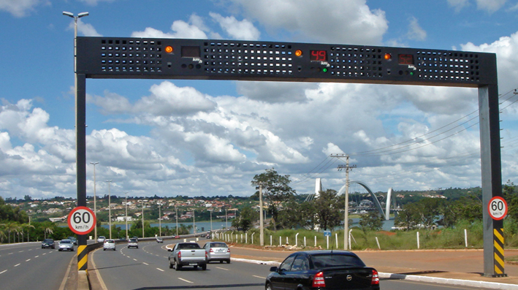
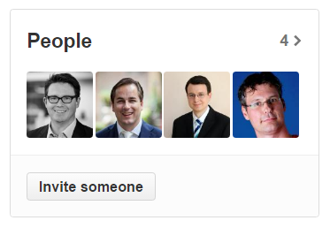



https://github.com/theroadrunners/ServiceFabricHackathon
Clemens Schotte
Martin Weber
Sander van den Hoven
Christian Geuer-Pollmann
The RoadRunners

Slide 2
Scenario
Dutch highways have traffic control bridges
Car entering measurement section → triggers “start” event
Car leaving section → triggers “end” event, average speed is calculated
Speed violations stored in longterm-storage, tickets sent, money collected

Slide 3
The Road Runners Architecture v1
Service Fabric
Long-term storage
HTTP POSTs
Web API
Visual Studio Load Tests
Web API
LicensePlate
StreetID
Start / End
Web API
Stateful Actor (per car, created by a start msg)
Stateless actor for batching event writes to backend

Slide 4
The Road Runners Architecture v2
Real-time Analytics for Live Dashboards
Stateful Actor (per car, created by a start msg)
AMQP
Stream Analytics
Stateless actor for batching event writes to backend
HTTP POSTs
Visual Studio Load Tests
Web Apps
Event Hub
Service Fabric
LicensePlate
StreetID
Start / End
Long-term storage
AMQP
Event Hub Readers
LicensePlate
CameraID
Event Hub Readers
Event Hub Readers

Slide 5
