Slide 1
Introduction to Data Structures
Dr. Machbah Uddin
Associate Professor
Dept of Computer Science and Math.
machbah.csm@bau.edu.bd

Slide 2
Course Overview
Week 1: Basic
Week 2: Array, Binary Search
Week 3: List, String
Week 4: Stack
Week 5: Queue
Week 6: Hashing
Week 7: Graph
Week 8: Graph
Week 9: Tree
Week 10: Tree

Slide 3
Course Structure and Evaluation
Time | Work
First day of week | Theory Lecture Problem discussion Group Presentation
2nd Day of week | Problem-solving in PC based on theory Evaluation Demonstration of the given problem
We will provide all lecture slides, practice problems in google classroom
CT on routine declared date
A Project submission
Detailed query or Feedback on Google Classroom

Slide 4
Evaluation Strategies
Theory Class | Lab Class
Attendance: 10% Class Tests/Quizes: 10% Assignment/Presentation: 10% Final Exam: 70% | Lab Attendance: 10% Continuous Performance Test: 20% Problem solving: 40% Viva: 5% Project: 25%

Slide 5
Expected Outcome
Develop skills to handle data in efficient ways for a target job.
Gain the ability to analyze and improve data retrieval and storing performance.
Learn to apply data structure and algorithmic thinking in real-world scenarios

Slide 6
Language
C/C++
Java
Python
Any other

Slide 7
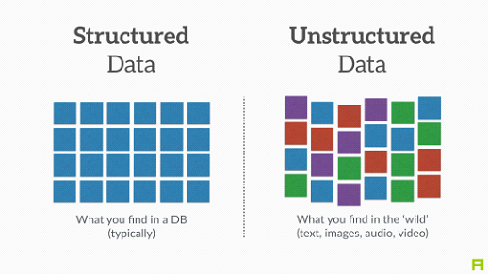
What is a Data Structure?

Slide 8
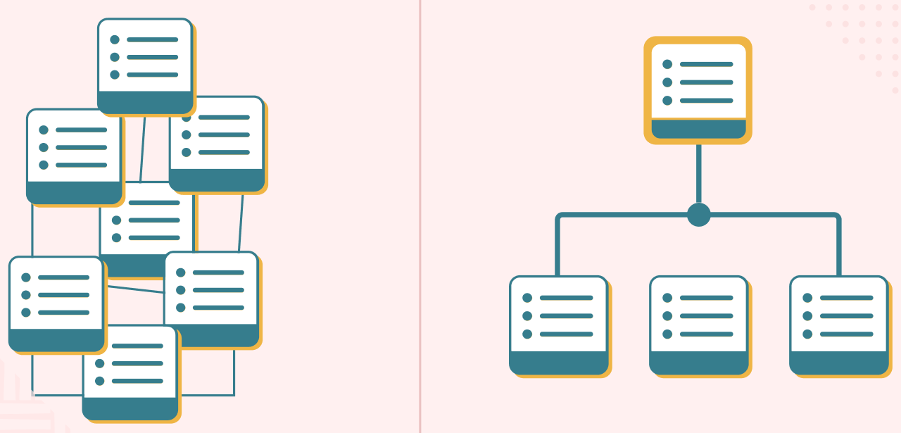
What is a Data Structure?

Slide 9
What is a Data Structure?
A data structure is a way of organizing and storing data efficiently.
Essential for efficient algorithm design and software development.

Slide 10
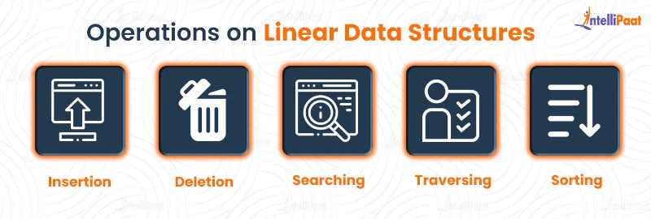
Operations in Data Structures

Slide 11
Importance of Data Structures
Efficiency: Enables fast searching, sorting, and data manipulation.
Memory Optimization: Reduces memory usage and improves performance.
Foundation of Algorithms: Used in dynamic programming, graph algorithms, etc.
Essential in Large-Scale Applications: Databases, operating systems, AI, etc.

Slide 12
Application Areas of Data Structures
Software Development: Efficient data handling in applications.
Databases & File Systems: Storing and retrieving large-scale data.
Operating Systems: Memory management, process scheduling.
AI & Machine Learning: Storing and accessing feature sets.
Networking: Routing algorithms, data packet transmission.
Bioinformatics: DNA sequence alignment, phylogenetic analysis.

Slide 13
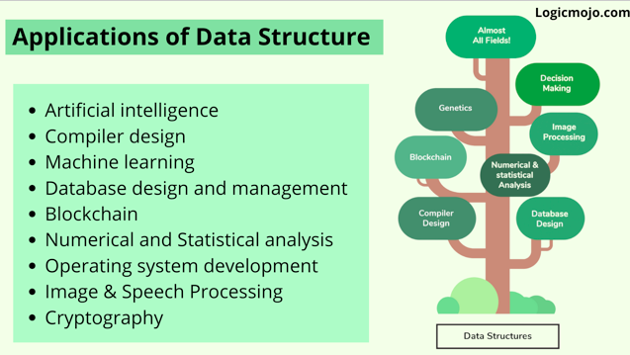
Application Areas of Data Structures

Slide 14
Classification of Data Structures
Linear Data Structures: Arrays, Linked Lists, Stacks, Queues.
Non-Linear Data Structures: Trees, Graphs.
Hashing Techniques.

Slide 15
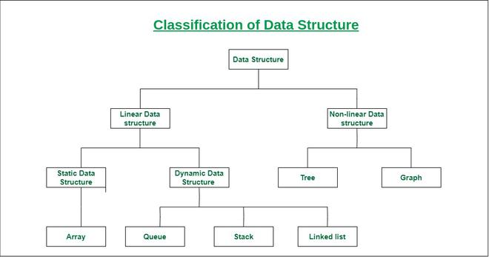
Classification of Data Structures

Slide 16
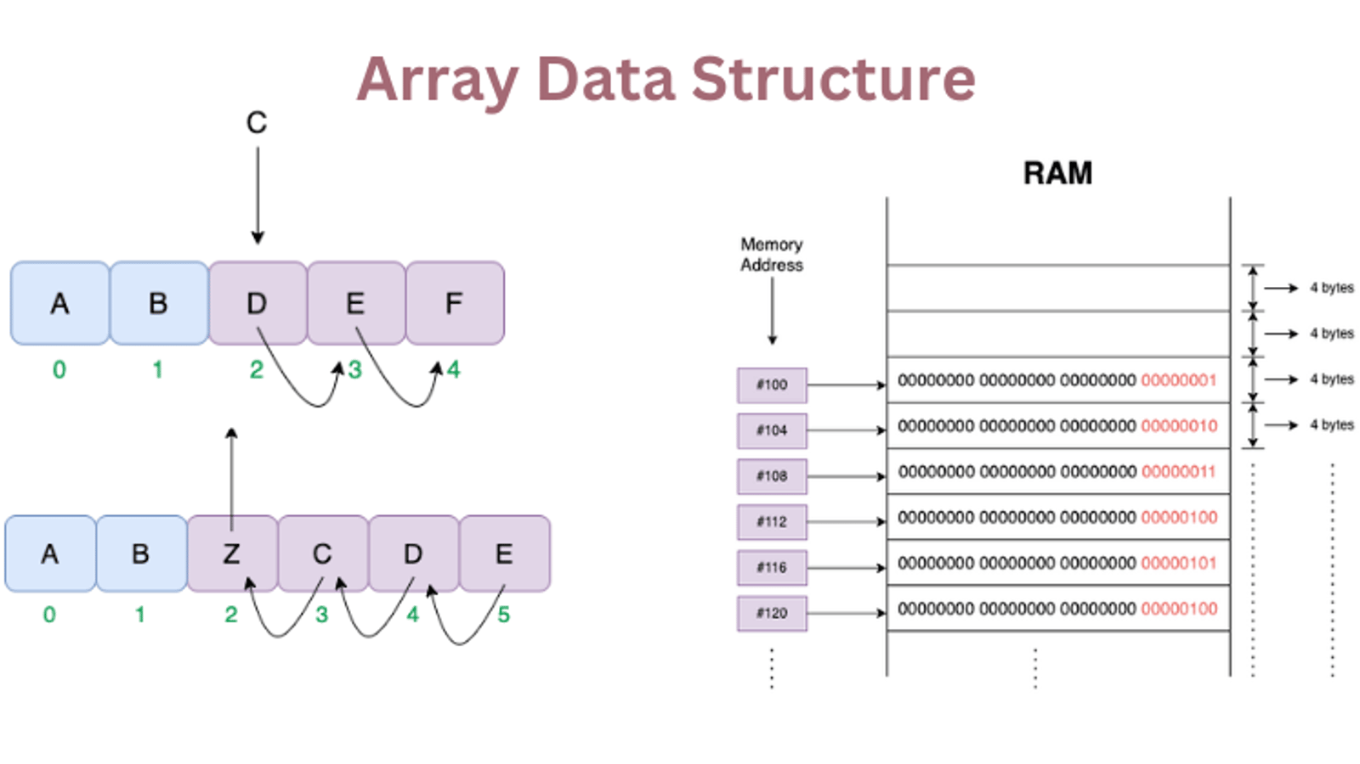
Array

Slide 17
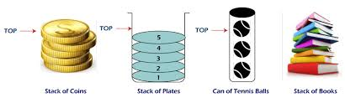
Stack

Slide 18

Queue

Slide 19
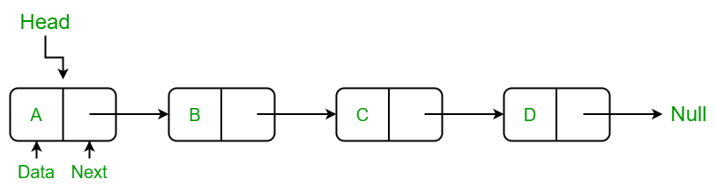

Linked List

Slide 20
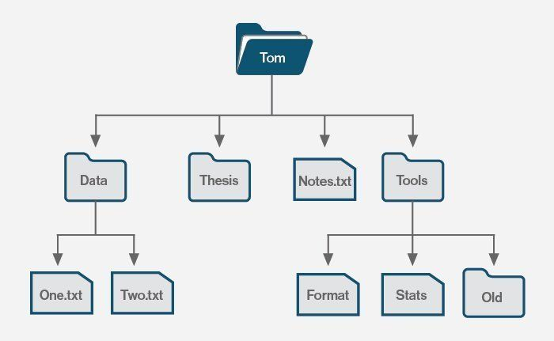
Tree

Slide 21
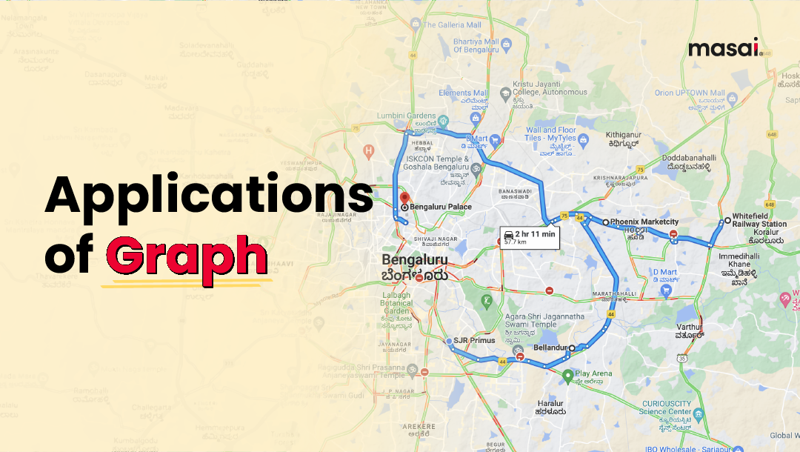
Graph

Slide 22
Limitations of Data Structures
Complexity: Some structures (e.g., graphs, trees) are difficult to implement.
Memory Overhead: Linked structures require extra storage for pointers.
Fixed Size (Arrays): Cannot dynamically grow or shrink.
Time-Consuming Operations: Insertions and deletions may be expensive.

Slide 23
Challenges in Using Data Structures
Choosing the Right Data Structure: Based on problem requirements.
Scalability Issues: Some structures degrade in performance with large data.
Optimization Trade-offs: Balancing speed vs. memory.
Concurrency & Parallelism: Managing data in multi-threaded environments.

Slide 24
Summary
Data structures improve computational efficiency.
Linear vs Non-Linear structures.
Applications in real-world scenarios.
Challenges and limitations in practical use.

Slide 25
The Lost Artifact
Story: A team of archaeologists has discovered an ancient underground maze where a legendary artifact is hidden. The maze consists of interconnected chambers, represented as a graph. Each chamber is a node, and the paths between them are edges. Some paths are one-way due to collapses. Your task is to help the archaeologists find the shortest path from the entrance to the chamber containing the artifact.
Input:
A number of chambers (nodes) and paths (edges).
The start chamber (entrance) and the target chamber (artifact location).

Slide 26
The Lost Artifact
Solution Approach:
Use Breadth-First Search (BFS) to find the shortest path in an unweighted graph.
If weighted paths are involved, use Dijkstra’s Algorithm.

Slide 27
The Lost Artifact
from collections import deque def find_shortest_path(n, edges, start, target): graph = {i: [] for i in range(n)} for u, v in edges: graph[u].append(v) queue = deque([(start, [start])]) visited = set() while queue: node, path = queue.popleft() if node == target: return path if node not in visited: visited.add(node) for neighbor in graph[node]: | queue.append((neighbor, path + [neighbor])) return "No path found" # Example usage: n = 6 edges = [(0,1), (1,2), (2,3), (3,4), (4,5), (1,3)] start, target = 0, 5 print(find_shortest_path(n, edges, start, target))

Slide 28
The Magic Spellbook
Story: A young wizard has discovered an ancient spellbook, but the pages are cursed! The book must be read in reverse order to unlock its secrets. The wizard can only flip one page at a time. Given a sequence of pages read by the wizard, your task is to output the correct sequence in reverse order.
Input:
A sequence of integers representing pages read in order.

Slide 29
The Magic Spellbook
Solution Approach:
Use a Stack (LIFO) to reverse the sequence.
def reverse_pages(pages):
stack = []
for page in pages:
stack.append(page)
reversed_order = []
while stack:
reversed_order.append(stack.pop())
return reversed_order
# Example usage:
pages_read = [3, 5, 7, 9, 11]
print(reverse_pages(pages_read)) # Output: [11, 9, 7, 5, 3]

Slide 30
The Treasure Hunt
Story:A group of pirates is searching for hidden treasures scattered across an island. Each treasure has a value (gold coins) and a difficulty level (effort required to dig it up). The captain wants to prioritize treasures that give the most gold while requiring the least effort. Help the pirates decide which treasure to dig up first.
Input:
A list of treasures, where each treasure is represented as (gold_coins, effort_required).

Slide 31
The Treasure Hunt
import heapq
def prioritize_treasures(treasures):
heap = []
for gold, effort in treasures:
heapq.heappush(heap, (-gold/effort, gold, effort)) # Max heap based on gold/effort ratio
best_treasures = []
while heap:
ratio, gold, effort = heapq.heappop(heap)
best_treasures.append((gold, effort))
return best_treasures
# Example usage:
treasures = [(100, 5), (200, 10), (50, 2), (300, 15)]
print(prioritize_treasures(treasures))
Solution Approach:
Use a Priority Queue (Min-Heap or Max-Heap) to prioritize treasures based on a gold-to-effort ratio.

Slide 32
Questions & Discussion

