Slide 1
Linked Lists
Dr. Machbah Uddin
Associate Professor
Dept of Computer Science and Math
BAU
machbah.csm@bau.edu.bd
‹#›

Slide 2
Linked List Basics
Linked lists and arrays are similar since they both store collections of data.
The array's features all follow from its strategy of allocating the memory for all its elements in one block of memory.
Linked lists use an entirely different strategy: linked lists allocate memory for each element separately and only when necessary.
‹#›

Slide 3
What is a Linked List?
Definition: A linear data structure where each element (node) contains data and a pointer to the next node.
Types of Linked Lists:
Singly Linked List.
Doubly Linked List.
Circular Linked List.
‹#›

Slide 4
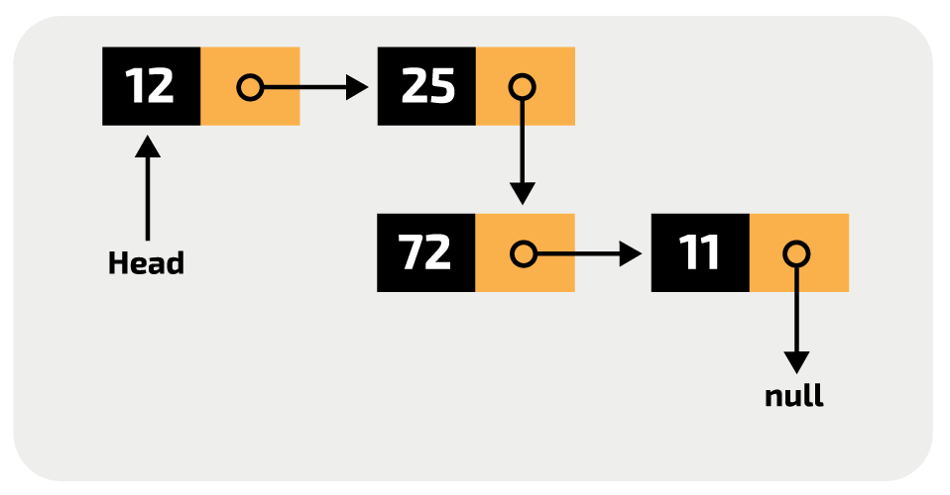
‹#›

Slide 5
Disadvantages of Arrays
The size of the array is fixed.
In case of dynamically resizing the array from size S to 2S, we need 3S units of available memory.
Programmers allocate arrays which seem "large enough” This strategy has two disadvantages: (a) most of the time there are just 20% or 30% elements in the array and 70% of the space in the array really is wasted. (b) If the program ever needs to process more than the declared size, the code breaks.
Inserting (and deleting) elements into the middle of the array is potentially expensive because existing elements need to be shifted over to make room
‹#›

Slide 6
Linked lists
Linked lists are appropriate when the number of data elements to be represented in the data structure at once is unpredictable.
Linked lists are dynamic, so the length of a list can increase or decrease as necessary.
Each node does not necessarily follow the previous one physically in the memory.
Linked lists can be maintained in sorted order by inserting or deleting an element at the proper point in the list.
‹#›

Slide 7
Importance of Linked Lists in Bioinformatics
Dynamic Data Storage:
Genome sequences can be stored as linked lists.
Efficient Insertion/Deletion:
Useful for modifying DNA sequences (e.g., mutations).
Example:
Storing protein sequences or gene annotations.
‹#›

Slide 8
Singly Linked Lists
head
next
next
next
next
a
b
c
d
First node
Last node
‹#›

Slide 9
Empty List
Empty Linked list is a single pointer having the value of NULL.
head = NULL;
head
‹#›

Slide 10
Basic Ideas
Let’s assume that the node is given by the following type declaration:
struct Node {
Object element;
Node *next;
};
‹#›

Slide 11
Basic Linked List Operations
List Traversal
Searching a node
Insert a node
Delete a node
‹#›

Slide 12
Traversing a linked list
Node *pWalker;
int count = 0;
cout <<“List contains:\n”;
for (pWalker=pHead; pWalker!=NULL;
pWalker = pWalker->next)
{
count ++;
cout << pWalker->element << endl;
}
‹#›

Slide 13
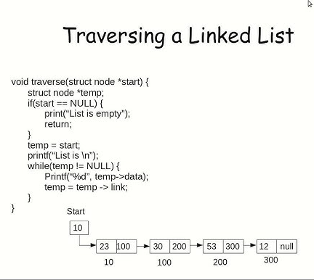
‹#›

Slide 14
#include <stdio.h>
#include <stdlib.h>
// Define the structure for a node
struct Node {
int data; // Data stored in the node
struct Node* next; // Pointer to the next node
};
// Function to create a new node
struct Node* createNode(int data) {
struct Node* newNode = (struct Node*)malloc(sizeof(struct Node));
newNode->data = data;
newNode->next = NULL;
return newNode;
}
‹#›

Slide 15
// Function to insert a node at the end of the linked list
void insertAtEnd(struct Node** head, int data) {
struct Node* newNode = createNode(data);
if (*head == NULL) {
*head = newNode; // If the list is empty, make the new node the head
} else {
struct Node* temp = *head;
while (temp->next != NULL) {
temp = temp->next; // Traverse to the last node
}
temp->next = newNode; // Link the new node to the last node
}
}
‹#›

Slide 16
// Function to traverse and print the linked list
void traverseList(struct Node* head) {
struct Node* temp = head;
printf("Linked List: ");
while (temp != NULL) {
printf("%d -> ", temp->data); // Print the data of the current node
temp = temp->next; // Move to the next node
}
printf("NULL\n");
}
‹#›

Slide 17
// Main function
int main() {
struct Node* head = NULL; // Initialize an empty linked list
// Insert elements into the linked list
insertAtEnd(&head, 10);
insertAtEnd(&head, 20);
insertAtEnd(&head, 30);
insertAtEnd(&head, 40);
// Traverse and print the linked list
traverseList(head);
return 0;
}
‹#›

Slide 18
Searching a node in a linked list
pCur = pHead;
// Search until target is found or we reach
// the end of list
while (pCur != NULL &&
pCur->element != target)
{
pCur = pCur->next;
}
//Determine if target is found
if (pCur) found = 1;
else found = 0;
‹#›

Slide 19
Insertion in a linked list
…
a
b
…
current
x
tmp
tmp = new Node;
tmp->element = x;
tmp->next = current->next;
current->next = tmp;
Or simply (if Node has a constructor initializing its members):
current->next = new Node(x,current->next);
‹#›

Slide 20
Deletion from a linked list
…
a
x
b
…
current
Node *deletedNode = current->next;
current->next = current->next->next;
delete deletedNode;
‹#›

Slide 21
Special Cases (1)
Inserting before the first node (or to an empty list):
tmp = new Node;
tmp->element = x;
if (current == NULL){
tmp->next = head;
head = tmp;
}
else { // Adding in middle or at end
tmp->next = curent->next;
current->next = tmp;
}
‹#›

Slide 22
Special Cases (2)
Node *deletedNode;
if (current == NULL){
// Deleting first node
deletedNode = head;
head = head ->next;
}
else{
// Deleting other nodes
deletedNode = current->next;
current->next = deletedNode ->next;
}
delete deletedNode;
‹#›

Slide 23
Header Nodes
One problem with the basic description: it assumes that whenever an item x is removed (or inserted) some previous item is always present.
Consequently removal of the first item and inserting an item as a new first node become special cases to consider.
In order to avoid dealing with special cases: introduce a header node (dummy node).
A header node is an extra node in the list that holds no data but serves to satisfy the requirement that every node has a previous node.
‹#›

Slide 24
List with a header node
header
a
b
c
d
Empty List
header
‹#›

Slide 25
Doubly Linked Lists
pHead
a
b
c
Advantages:
Convenient to traverse the list backwards.
Simplifies insertion and deletion because you no longer have to refer to the previous node.
Disadvantage:
Increase in space requirements.
‹#›

Slide 26
Deletion
head
current
oldNode = current;
oldNode->prev->next = oldNode->next;
oldNode->next->prev = oldNode->prev;
delete oldNode;
current = head;
‹#›

Slide 27
Insertion
head
current
newNode = new Node(x);
newNode->prev = current;
newNode->next = current->next;
newNode->prev->next = newNode;
newNode->next->prev = newNode;
current = newNode;
newNode
‹#›

Slide 28
The List ADT in C++
A list is implemented as three separate classes:
List itself (List)
Node (ListNode)
Position iterator(ListItr)
‹#›

Slide 29
Linked List Node
template <class Object>
class List; // Incomplete declaration.
template <class Object>
class ListItr; // Incomplete declaration.
template <class Object>
class ListNode
{
ListNode(const Object & theElement = Object(),
ListNode * n = NULL )
: element( theElement ), next( n ) { }
Object element;
ListNode *next;
friend class List<Object>;
friend class ListItr<Object>;
};
‹#›

Slide 30
Iterator class for linked lists
template <class Object>
class ListItr
{
public:
ListItr( ) : current( NULL ) { }
bool isValid( ) const
{ return current != NULL; }
void advance( )
{ if(isValid( ) ) current = current->next; }
const Object & retrieve( ) const
{ if( !isValid( ) ) throw BadIterator( );
return current->element; }
private:
ListNode<Object> *current; // Current position
ListItr( ListNode<Object> *theNode )
: current( theNode ) { }
friend class List<Object>; //Grant access to constructor
};
‹#›

Slide 31
List Class Interface
template <class Object>
class List
{
public:
List( );
List( const List & rhs );
~List( );
bool isEmpty( ) const;
void makeEmpty( );
ListItr<Object> zeroth( ) const;
ListItr<Object> first( ) const;
void insert(const Object &x, const ListItr<Object> & p);
ListItr<Object> find( const Object & x ) const;
ListItr<Object> findPrevious( const Object & x ) const;
void remove( const Object & x );
const List & operator=( const List & rhs );
private:
ListNode<Object> *header;
};
‹#›

Slide 32
Some List one-liners
/* Construct the list */
template <class Object>
List<Object>::List( )
{
header = new ListNode<Object>;
}
/* Test if the list is logically empty.
* return true if empty, false otherwise.*/
template <class Object>
bool List<Object>::isEmpty( ) const
{
return header->next == NULL;
}
‹#›

Slide 33
/* Return an iterator representing the header node. */
template <class Object>
ListItr<Object> List<Object>::zeroth( ) const
{
return ListItr<Object>( header );
}
/* Return an iterator representing the first node in the list. This operation is valid for empty lists.*/
template <class Object>
ListItr<Object> List<Object>::first( ) const
{
return ListItr<Object>( header->next );
}
‹#›

Slide 34
Other List methods
template <class Object>
ListItr<Object> List<Object>::find( const Object & x ) const
{
ListNode<Object> *itr = header->next;
while(itr != NULL && itr->element != x)
itr = itr->next;
return ListItr<Object>( itr );
}
‹#›

Slide 35
Deletion routine
/* Remove the first occurrence of an item x. */
template <class Object>
void List<Object>::remove( const Object & x )
{
ListItr<Object> p = findPrevious( x );
if( p.current->next != NULL )
{
ListNode<Object> *oldNode = p.current->next;
p.current->next = p.current->next->next;
delete oldNode;
}
}
‹#›

Slide 36
Finding the previous node
/* Return iterator prior to the first node containing an item x. */
template <class Object>
ListItr<Object> List<Object>::findPrevious( const Object & x ) const
{
ListNode<Object> *itr = header;
while(itr->next!=NULL && itr->next->element!=x)
itr = itr->next;
return ListItr<Object>( itr );
}
‹#›

Slide 37
Insertion routine
/* Insert item x after p */
template <class Object>
void List<Object>::insert(const Object & x,
const ListItr<Object> & p )
{
if( p.current != NULL )
p.current->next = new ListNode<Object>(x,
p.current->next );
}
‹#›

Slide 38
Memory Reclamation
/* Make the list logically empty */
template <class Object>
void List<Object>::makeEmpty( )
{
while( !isEmpty( ) )
remove( first( ).retrieve( ) );
}
/* Destructor */
template <class Object>
List<Object>:: ~List( )
{
makeEmpty( );
delete header;
}
‹#›

Slide 39
operator =
/* Deep copy of linked lists. */
template <class Object>
const List<Object> & List<Object>::operator=( const List<Object> & rhs )
{
ListItr<Object> ritr = rhs.first( );
ListItr<Object> itr = zeroth( );
if( this != &rhs )
{
makeEmpty( );
for( ; ritr.isValid(); ritr.advance(), itr.advance())
insert( ritr.retrieve( ), itr );
}
return *this;
}
‹#›

Slide 40
Copy constructor
/* copy constructor. */
template <class Object>
List<Object>::List( const List<Object> & rhs )
{
header = new ListNode<Object>;
*this = rhs; // operator= is used here
}
‹#›

Slide 41
Testing Linked List Interface
#include <iostream.h>
#include "LinkedList.h“
// Simple print method
template <class Object>
void printList( const List<Object> & theList )
{
if( theList.isEmpty( ) )
cout << "Empty list" << endl;
else {
ListItr<Object> itr = theList.first( );
for( ; itr.isValid( ); itr.advance( ) )
cout << itr.retrieve( ) << " ";
}
cout << endl;
}
‹#›

Slide 42
int main( )
{ List<int> theList;
ListItr<int> theItr = theList.zeroth( );
int i;
printList( theList );
for( i = 0; i < 10; i++ )
{ theList.insert( i, theItr );
printList( theList );
theItr.advance( );
}
for( i = 0; i < 10; i += 2 )
theList.remove( i );
for( i = 0; i < 10; i++ )
if((i % 2 == 0)!=(theList.find(i).isValid()))
cout << "Find fails!" << endl;
cout << "Finished deletions" << endl;
printList( theList );
List<int> list2;
list2 = theList;
printList( list2 );
return 0;
}
‹#›

Slide 43
Comparing Array-Based and Pointer-Based Implementations
Size
Increasing the size of a resizable array can waste storage and time
Storage requirements
Array-based implementations require less memory than a pointer-based ones
‹#›

Slide 44
Comparing Array-Based and Pointer-Based Implementations
Access time
Array-based: constant access time
Pointer-based: the time to access the i^{th} node depends on i
Insertion and deletions
Array-based: require shifting of data
Pointer-based: require a list traversal
‹#›

Slide 45
Saving and Restoring a Linked List by Using a File
Use an external file to preserve the list
Do not write pointers to a file, only data
Recreate the list from the file by placing each item at the end of the list
Use a tail pointer to facilitate adding nodes to the end of the list
Treat the first insertion as a special case by setting the tail to head
‹#›

Slide 46
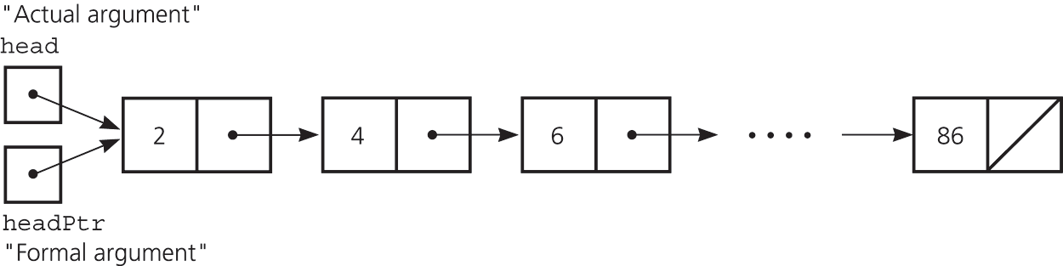
Passing a Linked List to a Function
A function with access to a linked list’s head pointer has access to the entire list
Pass the head pointer to a function as a reference argument
‹#›

Slide 47
Python implementation
import numpy as np
import pandas as pd
data = np.array([10, 20, 30, 40, 50])
# Convert to a Pandas Series
series = pd.Series(data)
# Add an element
series = series.append(pd.Series([60]))
# Remove an element
series = series.drop(2) # Remove the element at index 2
print("Pandas Series as List:")
for item in series:
print(item, end=" -> ")
print("None")
‹#›

Slide 48
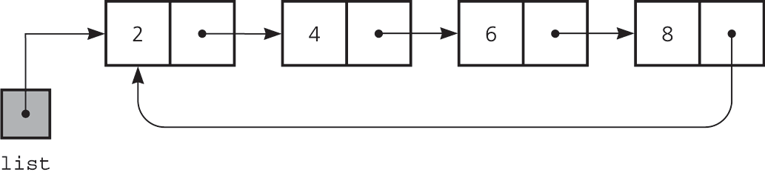
Circular Linked Lists
Last node references the first node
Every node has a successor
No node in a circular linked list contains NULL
A circular linked list
‹#›

Slide 49
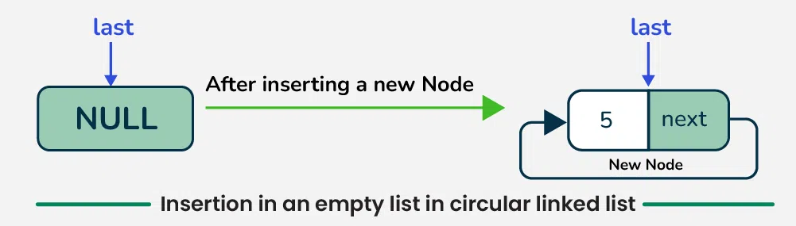
Circular insert
‹#›

Slide 50
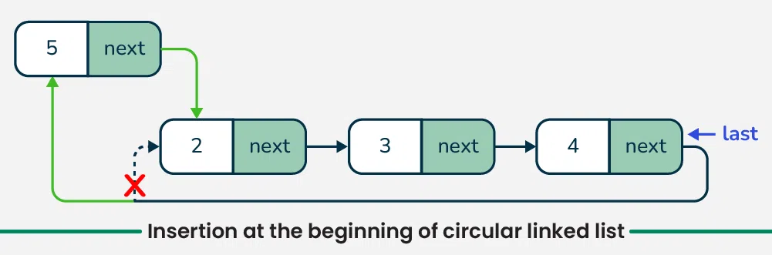
Circular insert beginning
‹#›

Slide 51
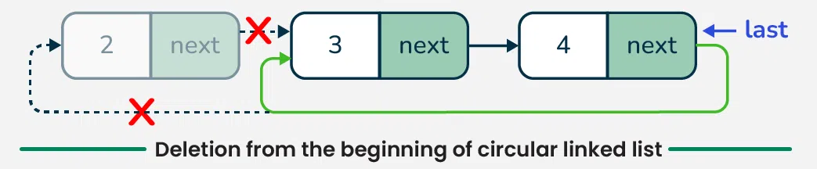
Delete circular list
‹#›

Slide 52
Circular Doubly Linked Lists
Circular doubly linked list
prev pointer of the dummy head node points to the last node
next reference of the last node points to the dummy head node
No special cases for insertions and deletions
‹#›

Slide 53
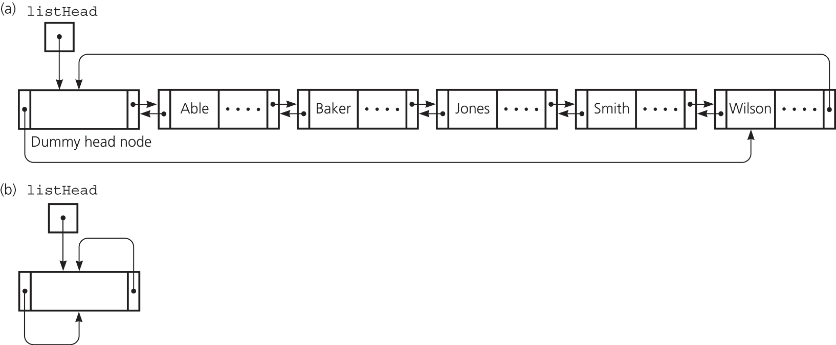
Circular Doubly Linked Lists
(a) A circular doubly linked list with a dummy head node
(b) An empty list with a dummy head node
‹#›

Slide 54
Processing Linked Lists Recursively
Recursive strategy to display a list
Write the first node of the list
Write the list minus its first node
Recursive strategies to display a list backward
writeListBackward strategy
Write the last node of the list
Write the list minus its last node backward
‹#›

Slide 55
Processing Linked Lists Recursively
writeListBackward2 strategy
Write the list minus its first node backward
Write the first node of the list
Recursive view of a sorted linked list
The linked list to which head points is a sorted list if
head is NULL or
head->next is NULL or
head->item < head->next->item, and
head->next points to a sorted linked list
‹#›

Slide 56
List in python
thislist = ["apple", "banana", "cherry", "apple", "cherry"] print(thislist)
Access list
thislist = ["apple", "banana", "cherry"] print(thislist[1])
‹#›

Slide 57
List in Python
Change list item
thislist = ["apple", "banana", "cherry"] thislist[1] = "blackcurrant" print(thislist)
Add list item
thislist = ["apple", "banana", "cherry"] thislist.append("orange") print(thislist)
‹#›

Slide 58
Remove list item
thislist = ["apple", "banana", "cherry"] thislist.remove("banana") print(thislist)
Loop list
thislist = ["apple", "banana", "cherry"] for x in thislist: print(x)
‹#›

Slide 59
Sort list
thislist = ["orange", "mango", "kiwi", "pineapple", "banana"] thislist.sort() print(thislist)
Copy list
thislist = ["apple", "banana", "cherry"] mylist = thislist.copy() print(mylist)
‹#›

Slide 60
Book Borrowing System
A university library wants to track books borrowed by a student. When a student borrows a book, it's added to their borrowed books list. If they return it, the book is removed from the list.
🔹 Data Structure: Single Linked List (1D) 🔹 Operations Needed: Insertion (Borrow), Deletion (Return), Traversal (List Borrowed Books)
‹#›

Slide 61
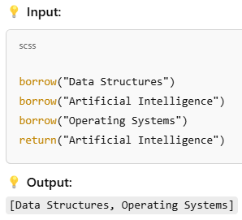
Book Borrowing System
‹#›

Slide 62
Train Compartment System
A railway system stores train compartments in a doubly linked list, allowing passengers to add or remove compartments from either end.
🔹 Data Structure: Doubly Linked List (1D) 🔹 Operations: Insertion (Add Compartment), Deletion (Remove Compartment), Bidirectional Traversal
‹#›

Slide 63
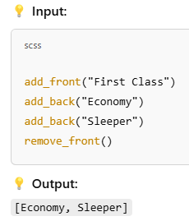
Train Compartment System
‹#›

Slide 64
Music Playlist 🎵
A music app lets users create a playlist where the last song loops back to the first. The user can skip forward or go back.
🔹 Data Structure: Circular Linked List (1D) 🔹 Operations: Next Song, Previous Song, Looping
‹#›

Slide 65
Multiplayer Game Lobby
A game has a player lobby where players take turns in a circular fashion. If a player leaves, the next in the list gets the turn.
🔹 Data Structure: Circular Linked List (1D) 🔹 Operations: Player Joins, Player Leaves, Next Turn
‹#›

Slide 66
Back and Forward in a Web Browser
A browser tracks a user's browsing history and allows forward and backward navigation.
🔹 Data Structure: Doubly Linked List (1D) 🔹 Operations: Go Back, Go Forward, Open New Page
‹#›

Slide 67
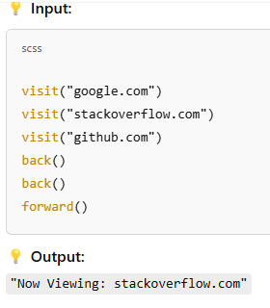
Back and Forward in a Web Browser
‹#›

Slide 68
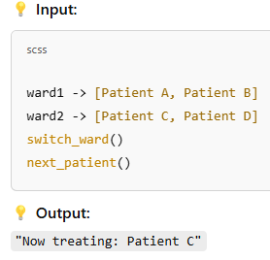
Hospital Patient Management
‹#›

Slide 69
University Course Registration
A university offers multiple courses, each having sections with different students.
🔹 Data Structure: Doubly Linked List (3D) 🔹 Operations: Move Between Courses, Move Between Sections, Move Between Students
‹#›

Slide 70
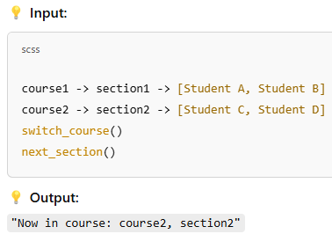
University Course Registration
‹#›

Slide 71
Time-Based City Traffic Analysis
A traffic monitoring system tracks city intersections at different times of the day across different seasons.
🔹 Data Structure: Doubly Linked List (4D) 🔹 Operations: Switch Time Slot, Switch Location, Switch Season
‹#›

Slide 72
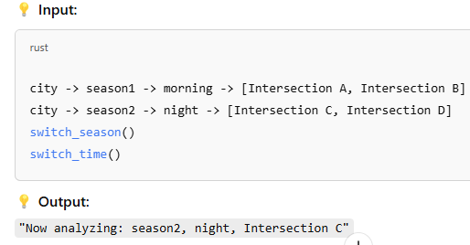
Time-Based City Traffic Analysis
‹#›

