Slide 1
Stacks and Applications
Dr. Machbah Uddin
Associate Professor
Dept. of Computer Science and Mathematics
machbah.csm@bau.edu.bd

Slide 2

Implementing and Using Stacks
"stack n.
The set of things a person has to do in the future. "I haven't done it yet because every time I pop my stack something new gets pushed." If you are interrupted several times in the middle of a conversation, "My stack overflowed" means "I forget what we were talking about."
-The Hacker's Dictionary
Friedrich L. Bauer
German computer scientist
who proposed "stack method
of expression evaluation"
in 1955.

Slide 3
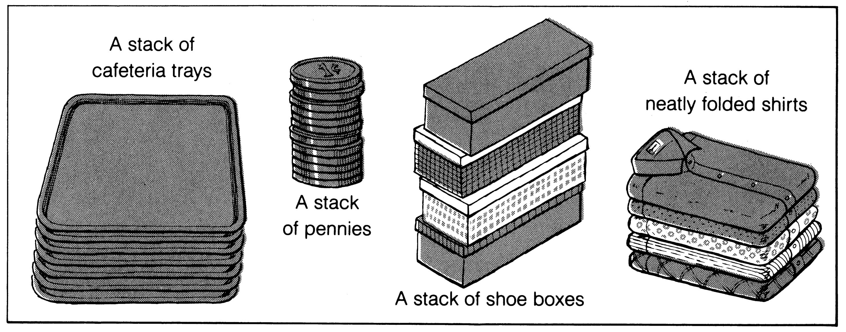
What is a stack?
It is an ordered group of homogeneous items of elements.
Elements are added to and removed from the top of the stack (the most recently added items are at the top of the stack).
The last element to be added is the first to be removed (LIFO: Last In, First Out).

Slide 4

Stack Overflow

Slide 5
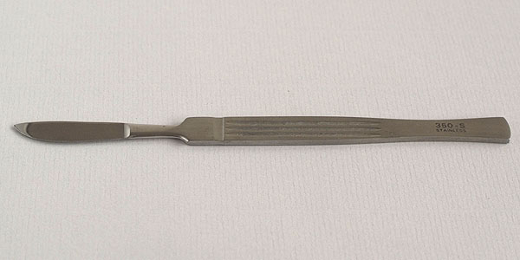

Sharper Tools
Stacks
Lists

Slide 6
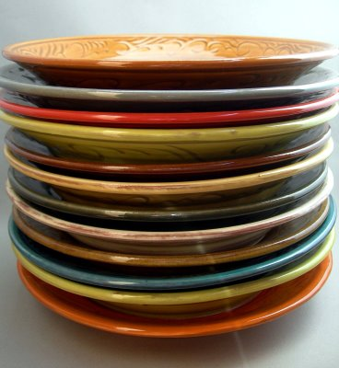
Stacks
Access is allowed only at one point of the structure, normally termed the top of the stack
  access to the most recently added item only
Operations are limited:
  push (add item to stack)
  pop (remove top item from stack)
  top (get top item without removing it)
  clear
  isEmpty
  size?
Described as a "Last In First Out"
(LIFO) data structure

Slide 7
Stack Operations
Assume a simple stack for integers.
Stack s = new Stack();
s.push(12);
s.push(4);
s.push( s.top() + 2 );
s.pop()
s.push( s.top() );
//what are contents of stack?

Slide 8
Stack Specification
Definitions: (provided by the user)
  MAX_ITEMS: Max number of items that might be on the stack
  ItemType: Data type of the items on the stack
Operations
  MakeEmpty
  Boolean IsEmpty
  Boolean IsFull
  Push (ItemType newItem)
  Pop (ItemType& item)

Slide 9
Push (ItemType newItem)
Function: Adds newItem to the top of the stack.
Preconditions: Stack has been initialized and is not full.
Postconditions: newItem is at the top of the stack.

Slide 10
Pop (ItemType& item)
Function: Removes topItem from stack and returns it in item.
Preconditions: Stack has been initialized and is not empty.
Postconditions: Top element has been removed from stack and item is a copy of the removed element.

Slide 11
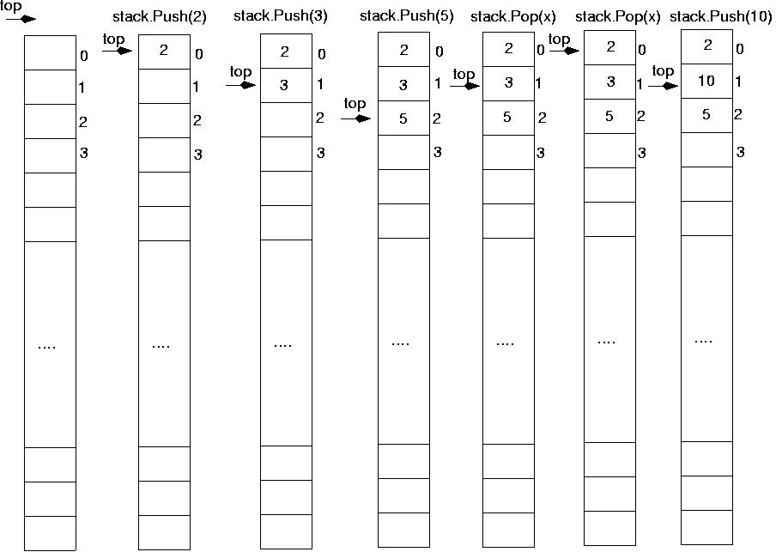

Slide 12
Stack Operations
Write a method to print out contents of stack in reverse order.

Slide 13
Common Stack Error
Stack s = new Stack();
// put stuff in stack
for(int i = 0; i < 5; i++)
s.push( i );
// print out contents of stack
// while emptying it. (??)
for(int i = 0; i < s.size(); i++)
System.out.print( s.pop() + “ “);
// What is output?

Slide 14
Attendance Question 1
What is output of code on previous slide?
A 0 1 2 3 4
B 4 3 2 1 0
C 4 3 2
D 2 3 4
E No output due to runtime error.

Slide 15
Corrected Version
Stack s = new Stack();
// put stuff in stack
for(int i = 0; i < 5; i++)
s.push( i );
// print out contents of stack
// while emptying it
int limit = s.size();
for(int i = 0; i < limit; i++)
System.out.print( s.pop() + “ “);
//or
// while( !s.isEmpty() )
// System.out.println( s.pop() );

Slide 16
Implementing a stack
need an underlying collection to hold the elements of the stack
2 basic choices
  array (native or ArrayList)
  linked list
array implementation
linked list implementation
Some of the uses for a stack are much more interesting than the implementation of a stack

Slide 17
Applications of Stacks

Slide 18
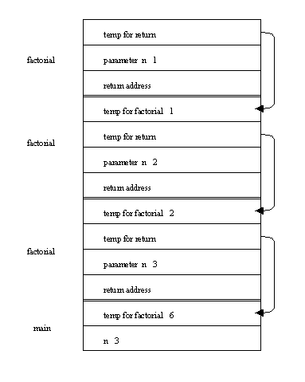
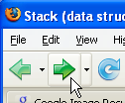

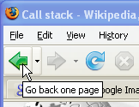
Problems that Use Stacks
The runtime stack used by a process (running program) to keep track of methods in progress
Search problems
Undo, redo, back, forward

Slide 19
Mathematical Calculations
What is 3 + 2 * 4? 2 * 4 + 3? 3 * 2 + 4?
The precedence of operators affects the order of operations. A mathematical expression cannot simply be evaluated left to right.
A challenge when evaluating a program.
Lexical analysis is the process of interpreting a program.
Involves Tokenization
What about 1 - 2 - 4 ^ 5 * 3 * 6 / 7 ^ 2 ^ 3

Slide 20
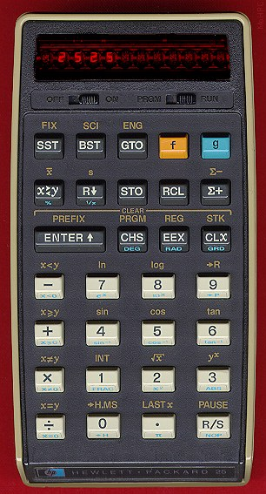
Infix and Postfix Expressions
The way we are use to writing expressions is known as infix notation
Postfix expression does not
require any precedence rules
3 2 * 1 + is postfix of 3 * 2 + 1
evaluate the following postfix expressions and write out a corresponding infix expression:
  2 3 2 4 * + * 1 2 3 4 ^ * +
  1 2 - 3 2 ^ 3 * 6 / + 2 5 ^ 1 -

Slide 21
Attendance Question 2
What does the following postfix expression evaluate to?
6 3 2 + *
18
36
24
11
30

Slide 22
Evaluation of Postfix Expressions
Easy to do with a stack
given a proper postfix expression:
  get the next token
  if it is an operand push it onto the stack
  else if it is an operator
    pop the stack for the right hand operand
    pop the stack for the left hand operand
    apply the operator to the two operands
    push the result onto the stack
  when the expression has been exhausted the result is the top (and only element) of the stack

Slide 23
Infix to Postfix
Convert the following equations from infix to postfix:
  2 ^ 3 ^ 3 + 5 * 1
  11 + 2 - 1 * 3 / 3 + 2 ^ 2 / 3
  Problems:
  Negative numbers?
  parentheses in expression

Slide 24
Infix to Postfix Conversion
Requires operator precedence parsing algorithm
  parse v. To determine the syntactic structure of a sentence or other utterance
Operands: add to expression
Close parenthesis: pop stack symbols until an open parenthesis appears
Operators:
Have an on stack and off stack precedence
Pop all stack symbols until a symbol of lower precedence appears. Then push the operator
End of input: Pop all remaining stack symbols and add to the expression

Slide 25
Simple Example
Infix Expression: 3 + 2 * 4
PostFix Expression:
Operator Stack:
Precedence Table
Symbol Off Stack On Stack
Precedence Precedence
+ 1 1
- 1 1
* 2 2
/ 2 2
^ 10 9
( 20 0

Slide 26
Simple Example
Infix Expression: + 2 * 4
PostFix Expression: 3
Operator Stack:
Precedence Table
Symbol Off Stack On Stack
Precedence Precedence
+ 1 1
- 1 1
* 2 2
/ 2 2
^ 10 9
( 20 0

Slide 27
Simple Example
Infix Expression: 2 * 4
PostFix Expression: 3
Operator Stack: +
Precedence Table
Symbol Off Stack On Stack
Precedence Precedence
+ 1 1
- 1 1
* 2 2
/ 2 2
^ 10 9
( 20 0

Slide 28
Simple Example
Infix Expression: * 4
PostFix Expression: 3 2
Operator Stack: +
Precedence Table
Symbol Off Stack On Stack
Precedence Precedence
+ 1 1
- 1 1
* 2 2
/ 2 2
^ 10 9
( 20 0

Slide 29
Simple Example
Infix Expression: 4
PostFix Expression: 3 2
Operator Stack: + *
Precedence Table
Symbol Off Stack On Stack
Precedence Precedence
+ 1 1
- 1 1
* 2 2
/ 2 2
^ 10 9
( 20 0

Slide 30
Simple Example
Infix Expression:
PostFix Expression: 3 2 4
Operator Stack: + *
Precedence Table
Symbol Off Stack On Stack
Precedence Precedence
+ 1 1
- 1 1
* 2 2
/ 2 2
^ 10 9
( 20 0

Slide 31
Simple Example
Infix Expression:
PostFix Expression: 3 2 4 *
Operator Stack: +
Precedence Table
Symbol Off Stack On Stack
Precedence Precedence
+ 1 1
- 1 1
* 2 2
/ 2 2
^ 10 9
( 20 0

Slide 32
Simple Example
Infix Expression:
PostFix Expression: 3 2 4 * +
Operator Stack:
Precedence Table
Symbol Off Stack On Stack
Precedence Precedence
+ 1 1
- 1 1
* 2 2
/ 2 2
^ 10 9
( 20 0

Slide 33
Example
1 - 2 ^ 3 ^ 3 - ( 4 + 5 * 6 ) * 7
Show algorithm in action on above equation

Slide 34
Balanced Symbol Checking
In processing programs and working with computer languages there are many instances when symbols must be balanced
  { } , [ ] , ( )
  A stack is useful for checking symbol balance. When a closing symbol is found it must match the most recent opening symbol of the same type.
Algorithm?

Slide 35
Algorithm for Balanced Symbol Checking
Make an empty stack
read symbols until end of file
  if the symbol is an opening symbol push it onto the stack
  if it is a closing symbol do the following
    if the stack is empty report an error
    otherwise pop the stack. If the symbol popped does not match the closing symbol report an error
At the end of the file if the stack is not empty report an error

Slide 36
Algorithm in practice
list[i] = 3 * ( 44 - method( foo( list[ 2 * (i + 1) + foo( list[i - 1] ) ) / 2 * ) - list[ method(list[0])];
Complications
  when is it not an error to have non matching symbols?
Processing a file
  Tokenization: the process of scanning an input stream. Each independent chunk is a token.
Tokens may be made up of 1 or more characters

Slide 37
Example: postfix expressions
Postfix notation is another way of writing arithmetic expressions.
In postfix notation, the operator is written after the two operands.
infix: 2+5 postfix: 2 5 +
Expressions are evaluated from left to right.
Precedence rules and parentheses are never needed!!

Slide 38
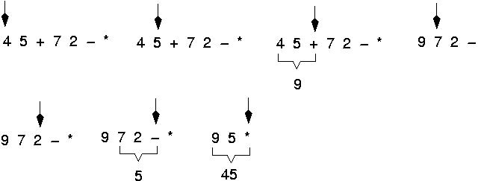
Example: postfix expressions
(cont.)

Slide 39
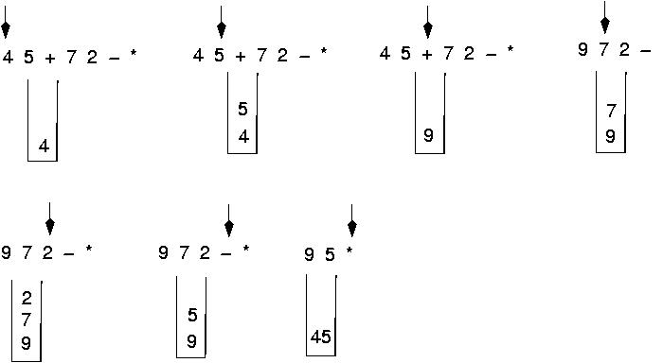
Postfix expressions:
Algorithm using stacks (cont.)

Slide 40
Postfix expressions:
Algorithm using stacks
WHILE more input items exist
Get an item
IF item is an operand
stack.Push(item)
ELSE
stack.Pop(operand2)
stack.Pop(operand1)
Compute result
stack.Push(result)
stack.Pop(result)

Slide 41
Write the body for a function that replaces each copy of an item in a stack with another item. Use the following specification. (this function is a client program).
ReplaceItem(StackType& stack, ItemType oldItem, ItemType newItem)
Function: Replaces all occurrences of oldItem with newItem.
Precondition: stack has been initialized.
Postconditions: Each occurrence of oldItem in stack has been replaced by newItem.
(You may use any of the member functions of the StackType, but you may not assume any knowledge of how the stack is implemented).

Slide 42
Stack
tempStack
{
ItemType item;
StackType tempStack;
while (!Stack.IsEmpty()) {
Stack.Pop(item);
if (item==oldItem)
tempStack.Push(newItem);
else
tempStack.Push(item);
}
while (!tempStack.IsEmpty()) {
tempStack.Pop(item);
Stack.Push(item);
}
}
3
1
2
5
1
3
Stack
3
oldItem = 2
newItem = 5
5
1

Slide 43
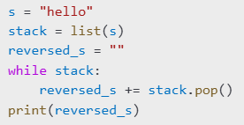
Problem 1: Reverse a String
Input: "hello“
Output: "olleh“

Slide 44
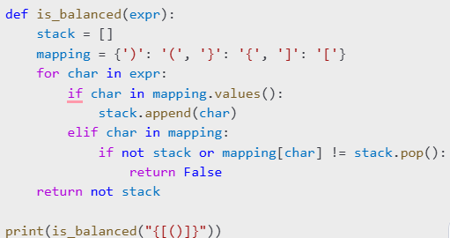
Problem 2: Balanced Parentheses
Input: "{[()]}“
Output: True

Slide 45
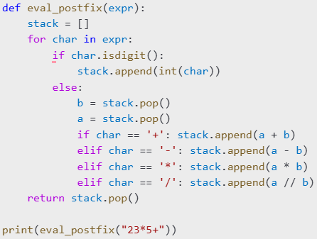
Problem 3: Evaluate Postfix Expression
Input: "23*5+“
Output: 11

Slide 46

Problem 5: Palindrome Check using Stack
Input: "madam“
Output: True

Slide 47
6. Next Greater Element
Problem: For each element in an array, find the next greater element to its right.
Input: [4, 5, 2, 25] → Output: [5, 25, 25, -1]

Slide 48
8. Infix to Postfix Conversion
Problem: Convert an infix expression like "a+b*c" to "abc*+"

Slide 49
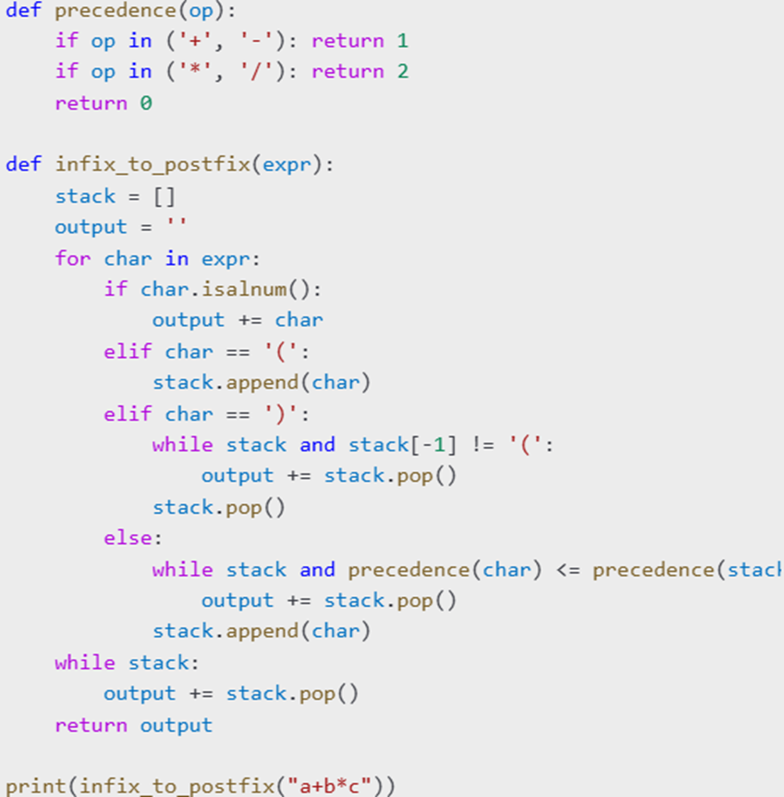

Slide 50
More problems
10. Decode Encoded StringProblem: Decode strings like "3[a2[c]]" → "accaccacc" using stack.
13. Stock Span ProblemProblem: For each day, find the number of consecutive previous days with less/equal price.Input: [100, 80, 60, 70, 60, 75, 85] → Output: [1, 1, 1, 2, 1, 4, 6]
15. Expression Evaluation (with precedence)Problem: Evaluate complex expressions with parentheses and precedence:"3 + 5 * (2 - 1)" → 8

Slide 51
More problems
16. Remove Duplicate LettersProblem: Remove duplicate letters so that every letter appears once and the result is the smallest in lexicographical order.Input: "cbacdcbc" → Output: "acdb“
18. Trapping Rain WaterProblem: Given an array of heights, compute how much water it can trap after raining.Input: [0,1,0,2,1,0,1,3,2,1,2,1] → Output: 6
19. Remove K DigitsProblem: Given a number as a string, remove k digits to get the smallest possible number.Input: "1432219", k = 3 → Output: "1219"

