Slide 1
Queue Data Structure
Dr. Machbah Uddin
Associate Professor
Dept of Computer Science and Mathematics
Bangladesh Agricultural University
machbah.csm@bau.edu.bd

Slide 2
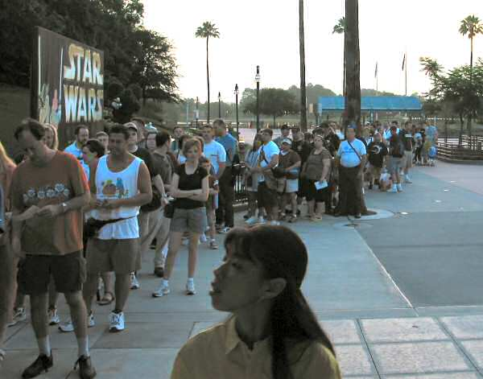
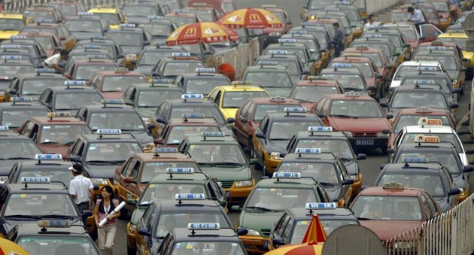
Queues
A sharp tool, like stacks
A line
  In England people don’t “get in line”
  they “queue up”.

Slide 3
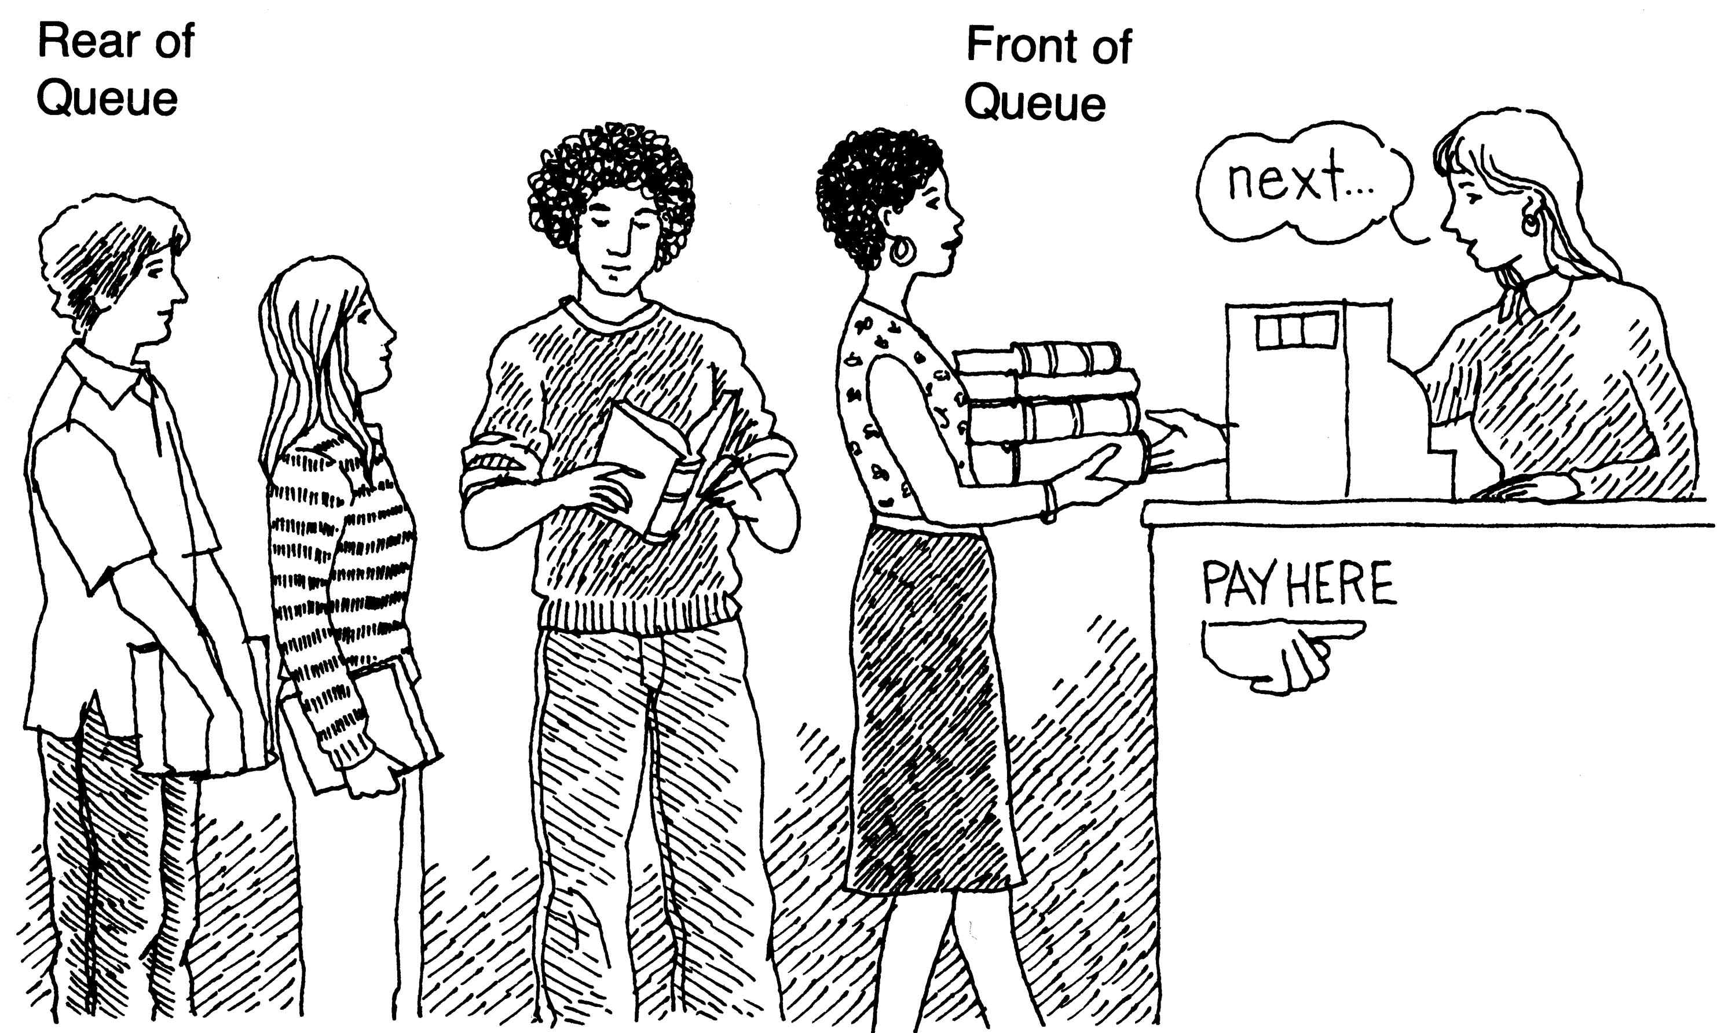
What is a queue?
It is an ordered group of homogeneous items of elements.
Queues have two ends:
  Elements are added at one end.
  Elements are removed from the other end.
The element added first is also removed first (FIFO: First In, First Out).

Slide 4

Queue Properties
Queues are a first in first out data structure
  FIFO (or LILO, but I guess that sounds a bit silly)
Add items to the end of the queue
Access and remove from the front
  Access to the element that has been in the structure the longest amount of time
Used extensively in operating systems
  Queues of processes, I/O requests, and much more

Slide 5
Queue Specification
Definitions: (provided by the user)
  MAX_ITEMS: Max number of items that might be on the queue
  ItemType: Data type of the items on the queue
Operations
  MakeEmpty
  Boolean IsEmpty
  Boolean IsFull
  Enqueue (ItemType newItem)
  Dequeue (ItemType& item)

Slide 6
Enqueue (ItemType newItem)
Function: Adds newItem to the rear of the queue.
Preconditions: Queue has been initialized and is not full.
Postconditions: newItem is at rear of queue.

Slide 7
Dequeue (ItemType& item)
Function: Removes front item from queue and returns it in item.
Preconditions: Queue has been initialized and is not empty.
Postconditions: Front element has been removed from queue and item is a copy of removed element.

Slide 8
Types of Queues
Simple Queue
Circular Queue
Priority Queue
Double-Ended Queue (Deque)

Slide 9
Simple Queue
Standard FIFO queue
Python: collections.deque

Slide 10
Circular Queue
Reuses memory space
Prevents overflow
Used in scheduling/buffering

Slide 11
Priority Queue
Serves based on priority
Bioinformatics: Task scheduling

Slide 12
Deque
Add/remove both ends
Behaves like stack and queue

Slide 13
Implementation issues
Implement the queue as a circular structure.
How do we know if a queue is full or empty?
Initialization of front and rear.
Testing for a full or empty queue.

Slide 14
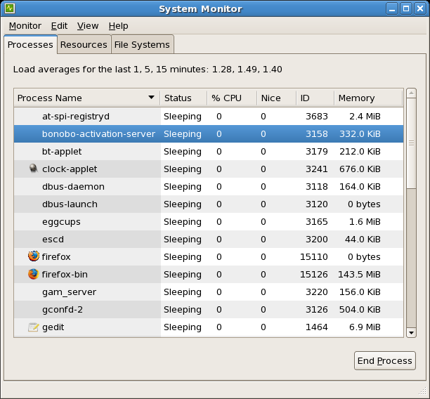
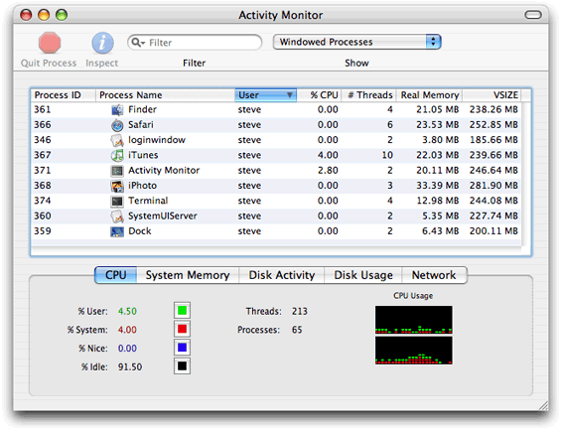
Queues in Operating Systems
On a computer with N cores on the CPU, but more than N processes, how many processes can actually be executing at one time?
One job of OS, schedule the processes for the CPU

Slide 15
Queue operations
void enqueue(E item)
  a.k.a. add(E item)
E front()
  a.k.a. E peek()
E dequeue()
  a.k.a. E remove()
boolean isEmpty()
Specify methods in an interface, allow multiple implementations.

Slide 16
Queue interface, version 1
public interface Queue314<E> {
//place item at back of this queue
public void enqueue(E item);
//access item at front of this queue
//pre: !isEmpty()
public E front();
//remove item at front of this queue
//pre: !isEmpty()
public E dequeue();
public boolean isEmpty();
}

Slide 17
Implementing a Queue
Given the internal storage container and choice for front and back of queue what are the Big O of the queue operations?
ArrayList LinkedList LinkedList
(Singly Linked) (Doubly Linked)
enqueue
front
dequeue
isEmpty

Slide 18
Clicker 1
If implementing a queue with a singly linked list with references to the first and last nodes (head and tail) which end of the list should be the front of the queue in order to have all queue operations O(1)?
The front of the list should be the front of the queue.
The back of the list should be the front of the queue.
Either end will work to make all ops O(1).
Neither end will allow all ops to be O(1).

Slide 19
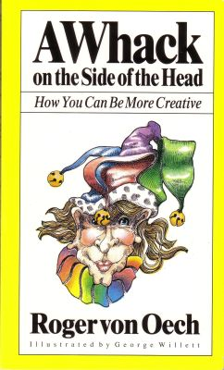
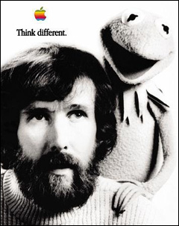
Alternate Implementation
How about implementing a Queue with a native array?
  Seems like a step backwards

Slide 20
Application of Queues
Radix Sort
  radix is a synonym for base. base 10, base 2
Multi pass sorting algorithm that only looks at individual digits during each pass
Use queues as buckets to store elements
Create an array of 10 queues
Starting with the least significant digit place value in queue that matches digit
empty queues back into array
repeat, moving to next least significant digit

Slide 21
Memory Representation
Array-based
Linked list
Pros and cons of each

Slide 22
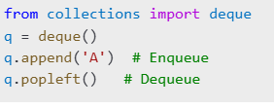
Python Queue Example

Slide 23
Importance in Data Structures
Used in task scheduling
Streaming processing
Memory management

Slide 24
Importance in Bioinformatics
Gene sequencing queues
Mutation detection
Data buffering

Slide 25
Bioinformatics Scenario
Queue for genome alignment
Priority to high-coverage samples

Slide 26
Challenges
Overflow in arrays
Dynamic priority issues
Concurrent synchronization

Slide 27
Limitations
Wasted space in linear queue
No random access
Not for all data needs

Slide 28
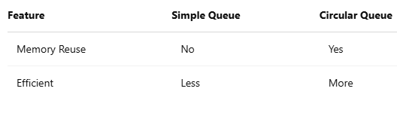
Circular vs Simple Queue

Slide 29
Queue Applications
Print spooling
Call centers
CPU Scheduling
Bioinformatics pipelines

Slide 30
Choosing a Queue
Simple: General list
Circular: Buffers
Priority: Critical tasks
Deque: Mixed access

Slide 31
Radix Sort in Action: 1s place
original values in array
  9, 113, 70, 86, 12, 93, 37, 40, 252, 7, 79, 12
Look at ones place
  9, 113, 70, 86, 12, 93, 37, 40, 252, 7, 79, 12
Array of Queues (all empty initially):
  0 5
  1 6
  2 7
  3 8
  4 9

Slide 32
Radix Sort in Action: 1s
original values in array
  9, 113, 70, 86, 12, 93, 37, 40, 252, 7, 79, 12
Look at ones place
  9, 113, 70, 86, 12, 93, 37, 40, 252, 7, 79, 12
Queues:
  0 70, 40 5
  1 6 86
  2 12, 252, 12 7 37, 7
  3 113, 93 8
  4 9 9, 79

Slide 33
Radix Sort in Action: 10s
Empty queues in order from 0 to 9 back into array
  70, 40, 12, 252, 12, 113, 93, 86, 37, 7, 9, 79
Now look at 10's place
  70, 40, 12, 252, 12, 113, 93, 86, 37, 7, 9, 79
Queues:
  0 7, 9 5 252
  1 12, 12, 113 6
  2 7 70, 79
  3 37 8 86
  4 40 9 93

Slide 34
Radix Sort in Action: 100s
Empty queues in order from 0 to 9 back into array
  7, 9, 12, 12, 113, 37, 40, 252, 70, 79, 86, 93
Now look at 100's place
  __7, __9, _12, _12, 113, _37, _40, 252, _70, _79, _86, _93
Queues:
  0 7, 9, _12, _12, _37, _40, _70, _79, _86, _93 5
  1 113 6
  2 252 7
  3 8
  4 9

Slide 35
Radix Sort in Action: Final Step
Empty queues in order from 0 to 9 back into array
  7, 9, 12, 12, 40, 70, 79, 86, 93, 113, 252

Slide 36
Radix Sort Code
public static void sort(int[] data){
ArrayList<Queue<Integer>> queues
= new ArrayList<Queue<Integer>>();
for(int i = 0; i < 10; i++)
queues.add(new LinkedList<Integer>());
int passes = numDigits(getMax(data));// helper methods
for(int i = 0; i < passes; i++){
for(int j = 0; j < data.length; j++) {
int digit = valueOfDigit(data[j], i);
queues.get(digit).add(data[j]);
}
int pos = 0;
for(Queue<Integer> q : queues){
while(!q.isEmpty())
data[pos++] = q.remove();
}
}
}

Slide 37
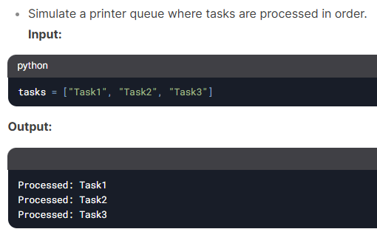
Task Scheduler

Slide 38
Task Scheduler
from collections import deque
def task_scheduler(tasks):
q = deque(tasks)
while q:
print(f"Processed: {q.popleft()}")
task_scheduler(["Task1", "Task2", "Task3"])

Slide 39
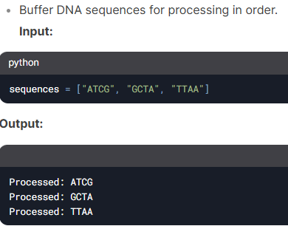
DNA Sequence Buffering

Slide 40
DNA Sequence Buffering
from collections import deque
def dna_buffer(sequences):
q = deque(sequences)
while q:
print(f"Processed: {q.popleft()}")
dna_buffer(["ATCG", "GCTA", "TTAA"])

Slide 41
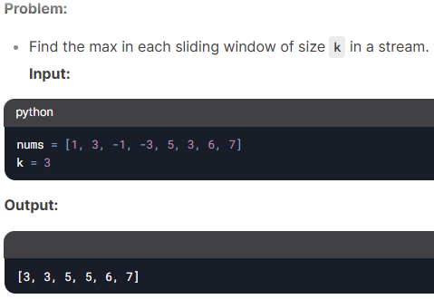
Sliding Window Maximum

Slide 42
Sliding Window Maximum
from collections import deque
def max_sliding_window(nums, k):
q = deque()
res = []
for i, num in enumerate(nums):
while q and nums[q[-1]] <= num:
q.pop()
q.append(i)
if q[0] == i - k:
q.popleft()
if i >= k - 1:
res.append(nums[q[0]])
return res

