Slide 1
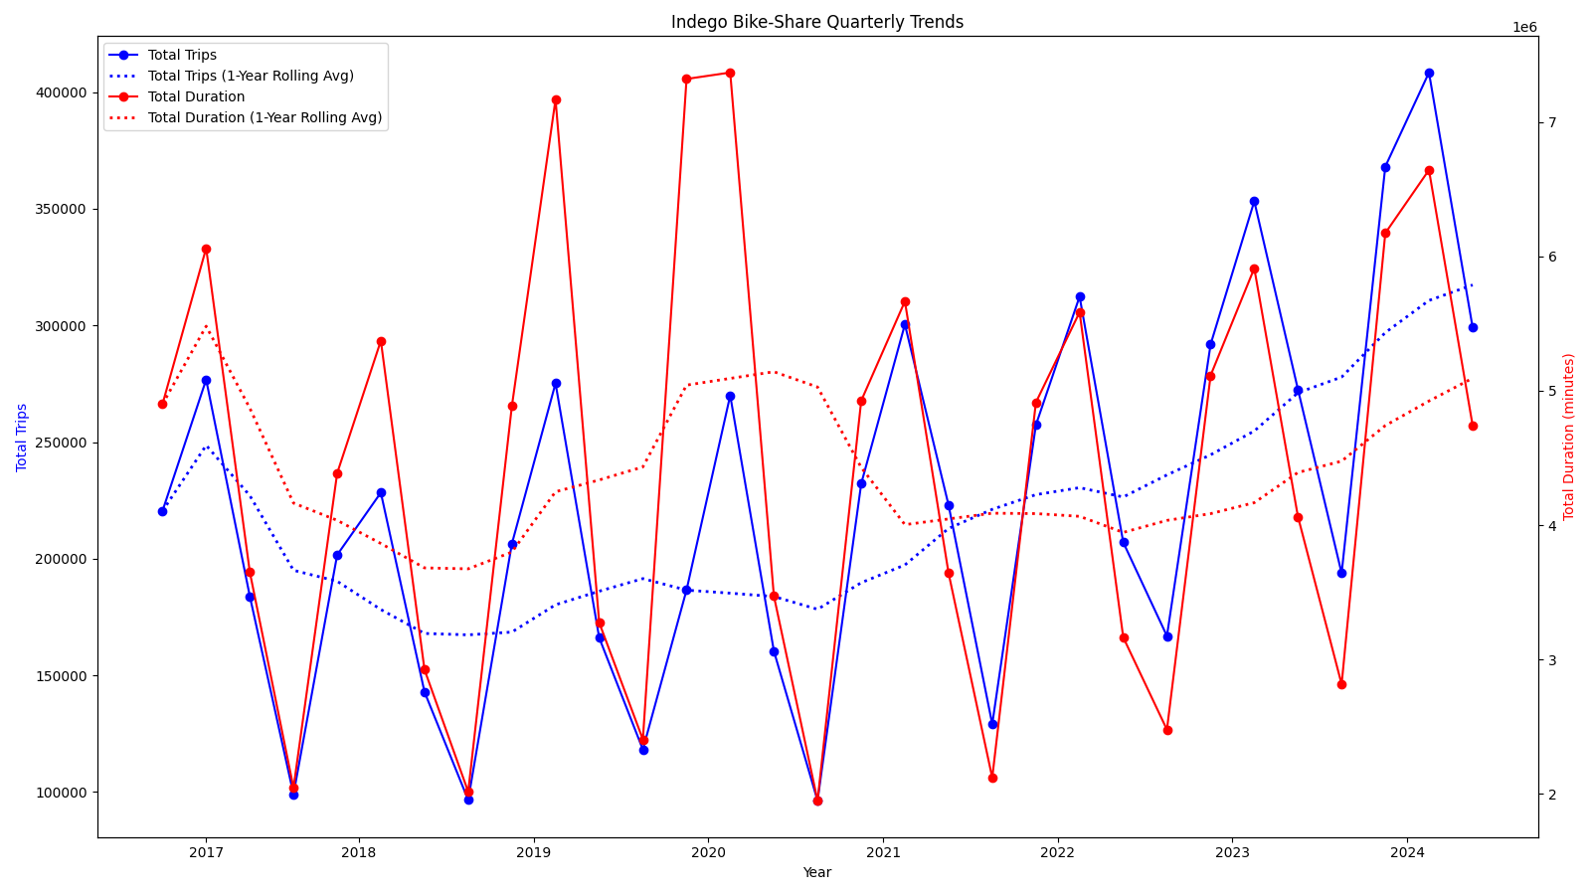
Program Growth Overview
• Latest YoY growth: 9.8% (Baseline: 16.9%)
• Long-term average growth rate: 7.9%
• Average trip duration trend: Decreasing

Slide 2
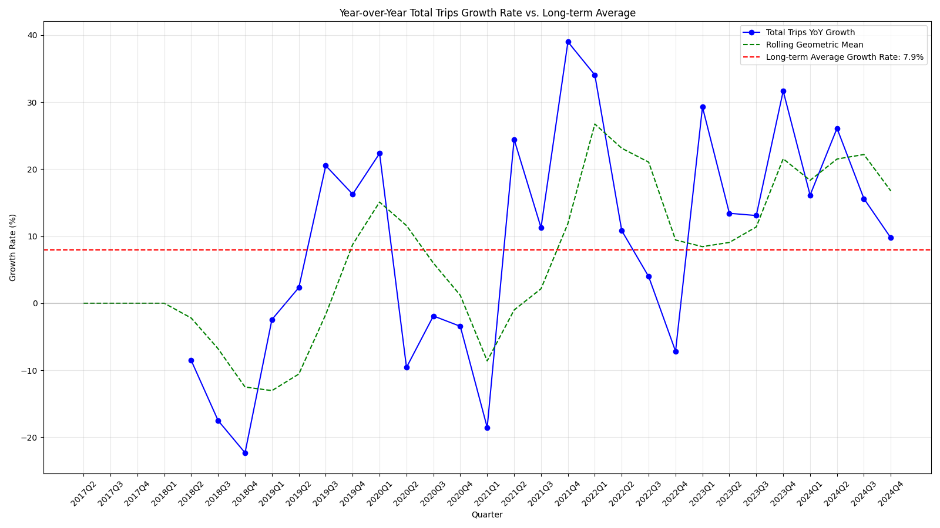
Growth Rate Analysis
• Current growth rate: 9.8% vs. long-term average: 7.9%
• Growth trend: Decelerating

Slide 3
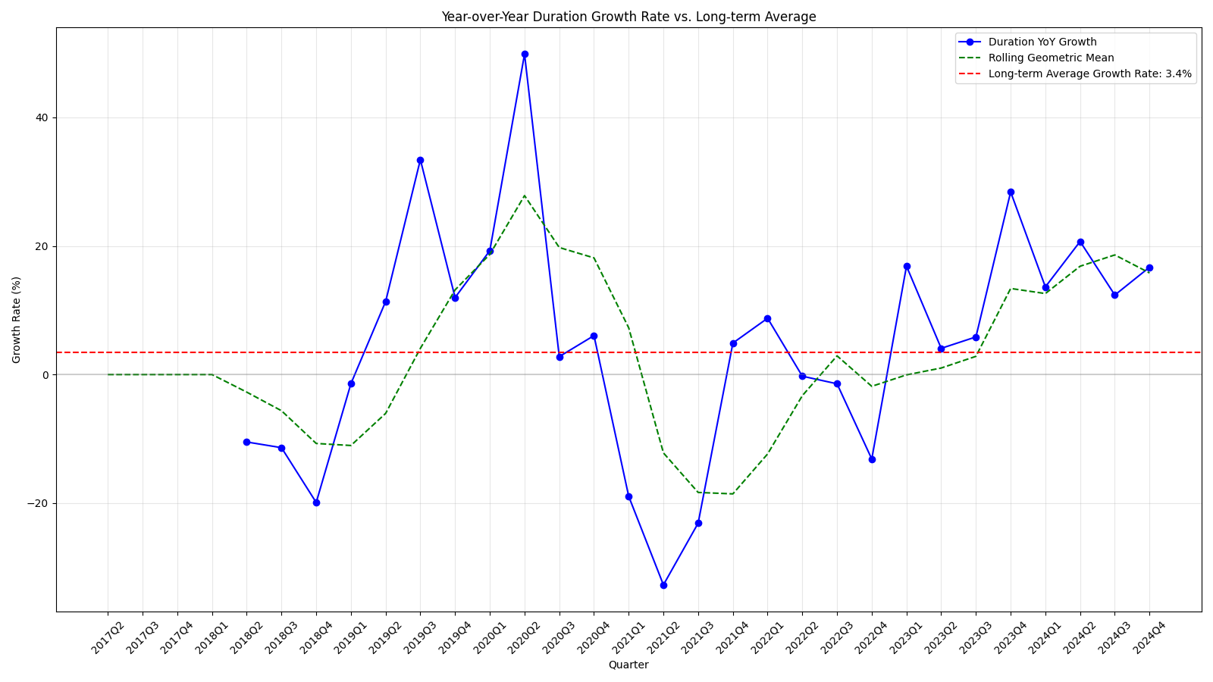
Duration Growth Analysis
• Current duration growth rate: 16.7% vs. long-term average: 3.4%
• Duration growth trend: Accelerating

Slide 4
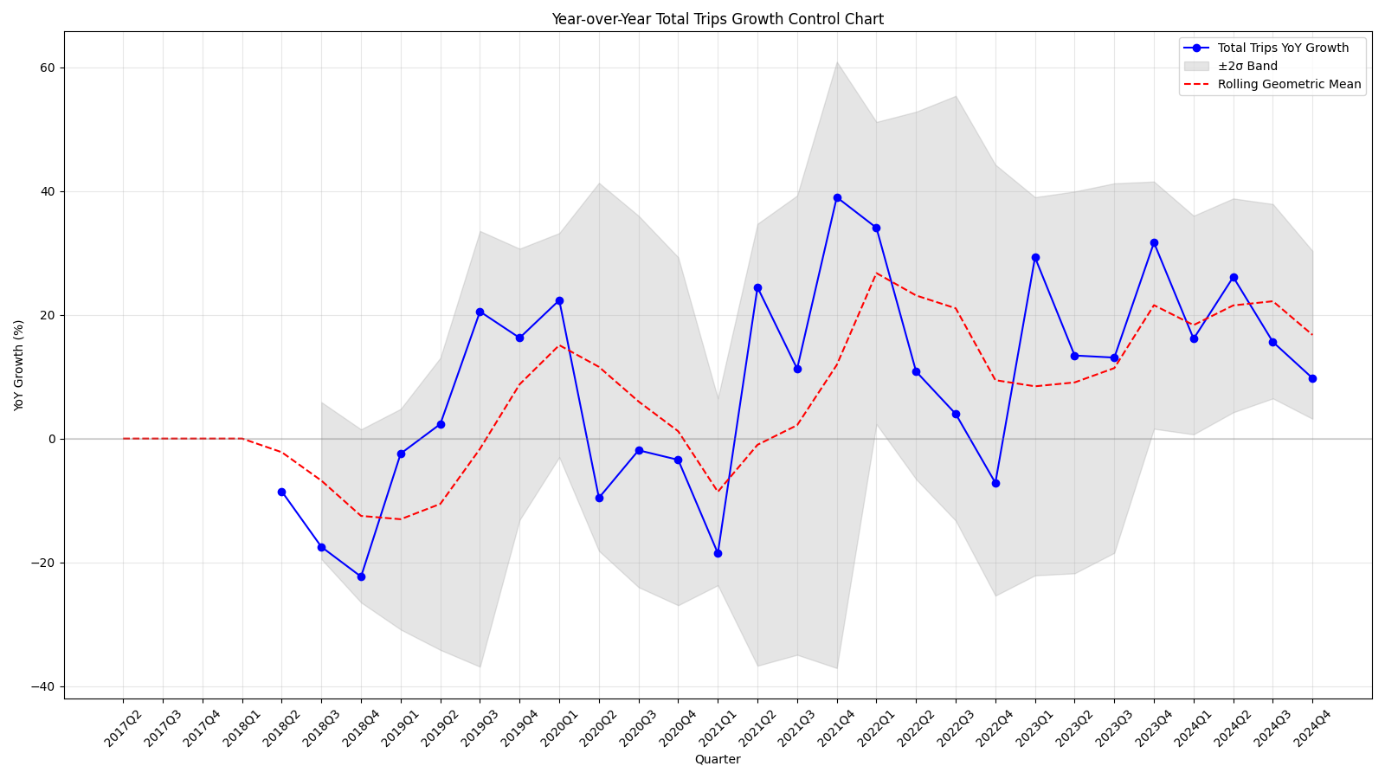
Anomaly Detection & Recommendations
• Anomalous quarters: None detected
• Recommend station expansion in 32 locations (see expansion_recommendations.csv for details)

