Slide 1
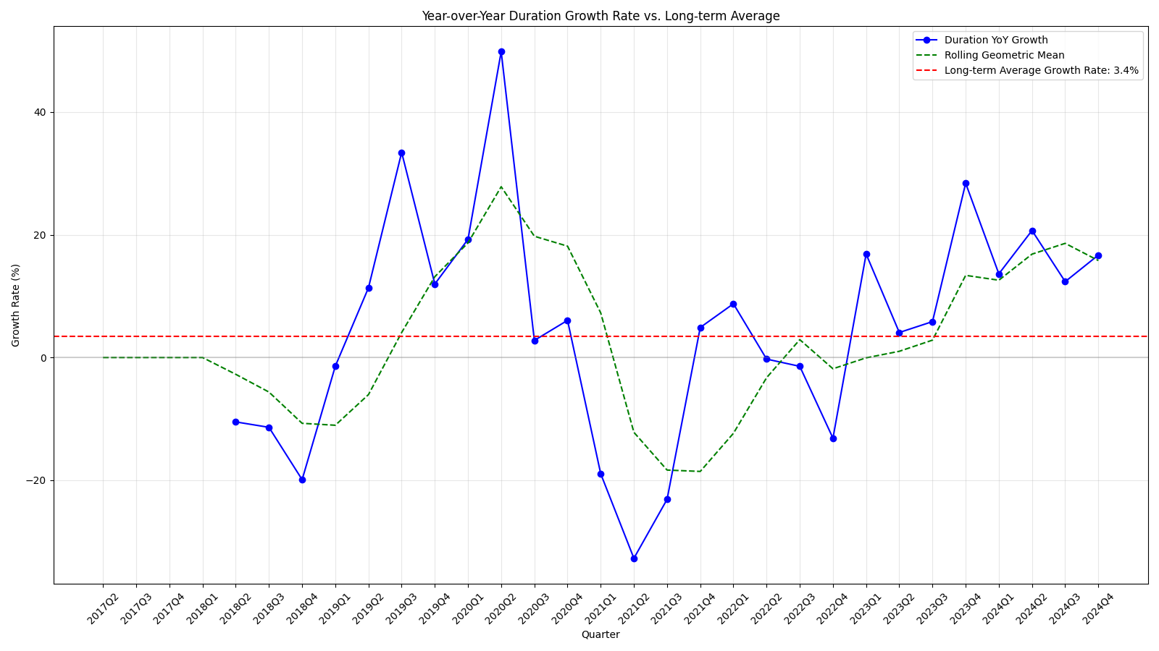
Program Growth Overview
Program has strong indication of effectiveness:
8 quarters of above average growth
7/8 quarters with YOY > Short Term Growth (STG)
5 quarters of excess STG
Notes:
Quantify current / recent growth using a combination of YOY growth and 1-year rolling average (geometric) growth (referred to as short-term growth). Compared against long term geometric average growth
When YOY growth is more than short term growth performance is improving at an increasing rate, relative to recent performance.
When short term growth is more than the long-term growth this indicates that the current growth program is causing better growth than the baseline Has been for past 5 quarters.
The growth rate exhibited in the data is high relative to history but has lower amplitude than historical spikes and seems to be more in line

Slide 2
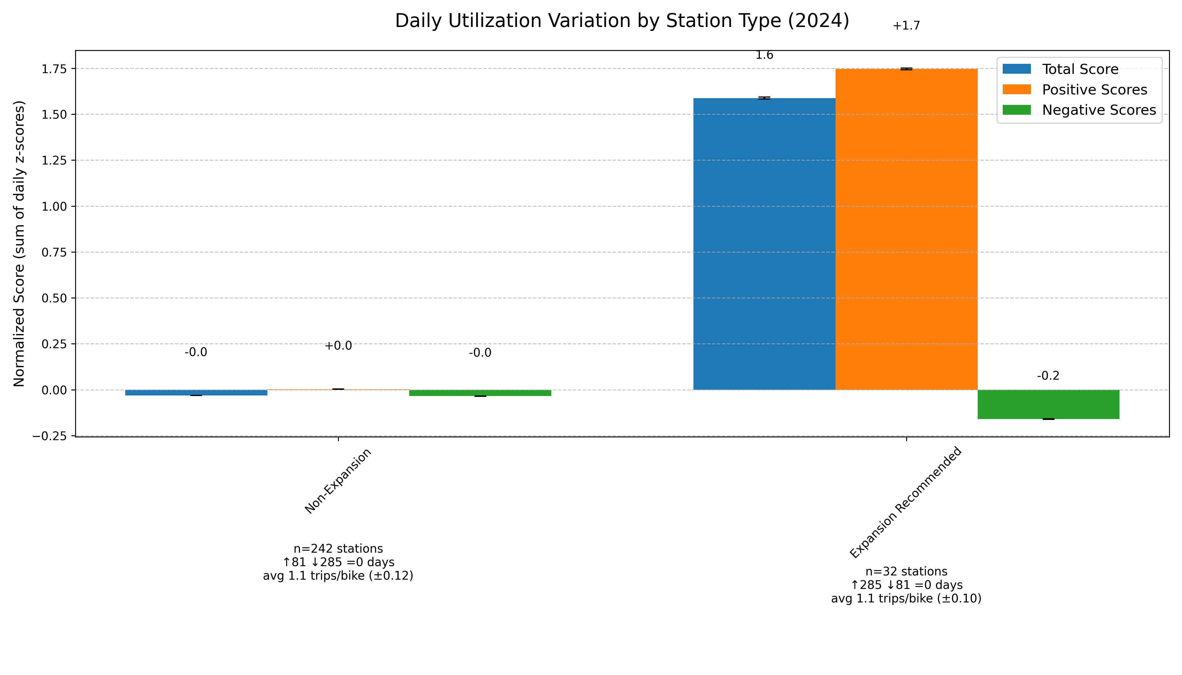
Recommendations
Recommendations:
32 stations identified as highly utilized
Expand capacity of these stations
Further analysis of geography of highly utilized stations
Further analysis on demand planning to effectively manage supply of bikes
Notes:
Stations were recommended for expansion based on a cascading list of criteria:
- 1 of the last 4 quarter with quarterly trips per bike greater than 3 st. dev. From the mean (6 stations)
– 2 of the last 4 quarters with quarterly trips per bike greater than 2 st. dev. From the mean (8 Stations)
– 3 of the last 4 quarters with quarterly trips per bike greater than 1 st. dev. From the mean. (18 stations)
Being in the top 5 percent of all stations by trips per bike (0 stations)
Above graph shows the sum of deviations of bike usage per station between this recommended group and unrecommended group.
As you can see a very large share of excess bike utilization each day comes from these stations.
The core assumptions of this is that utilization can be measured by the number of trips a given bike takes form a given station each day.
Recommend investing in growing the most utilized stations based on the largest average trips per bike over the last year.
Recommend exploring if there is potential for new stations in areas around these high usage stations.
Recommend further analysis on demand planning to allow better planning for variable availability as is practical.
Full Analysis and code can be found at: https://github.com/theroyalbob/perpay-application

