Slide 1
Perpay Funnel Analysis
Andrew Stewart

Slide 2
Agenda
Data
Methodology
Insights
Recommendations
Next Steps
Questions
Appendix

Slide 3
Data Sources
Found that user data only reflects users who created accounts from October 13, 2020 - November 6, 2020.
53% of orders in the data are made by these ‘new users’
New users demonstrate unique behaviors when compared to existing users.
More likely to be approved.
More likely to enter repayment.

Slide 4
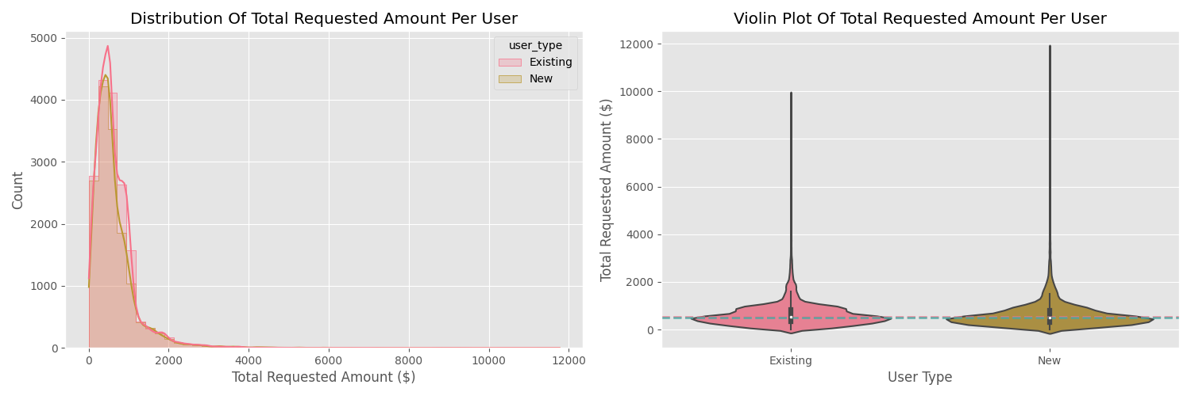
Data – Summary of Statistics: Application Amounts
Application Average Amounts
Existing: $645
New: $634

Slide 5
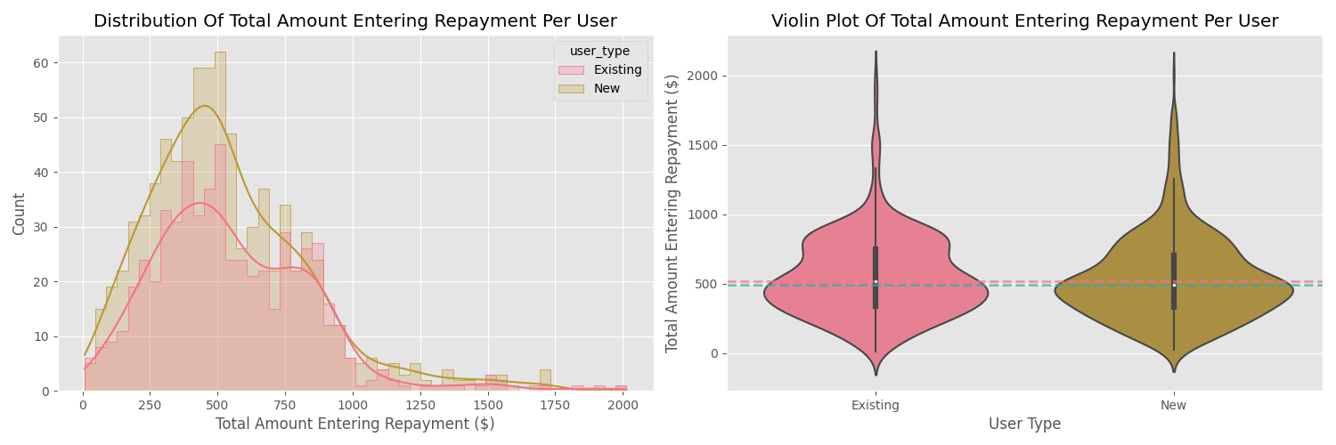
Data – Summary of Statistics: Converted Amounts
Converted Average Amounts
$555
$538
Notes:
Note that the rate of converted spend is approximately equal, across the two groups.

Slide 6
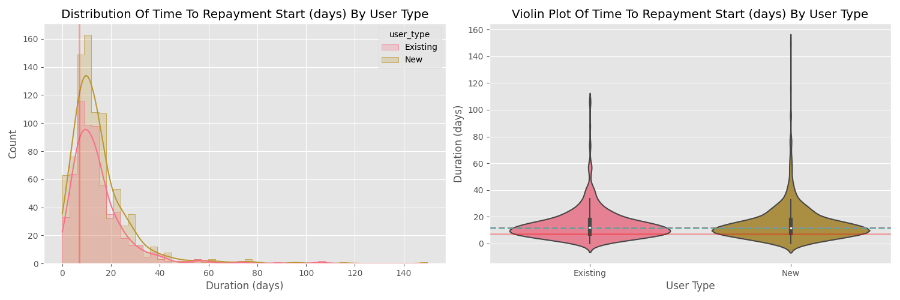
Data – Summary of Statistics: Repayment
Time to Repayment
Median: 12 days
Average: 15 days

Slide 7
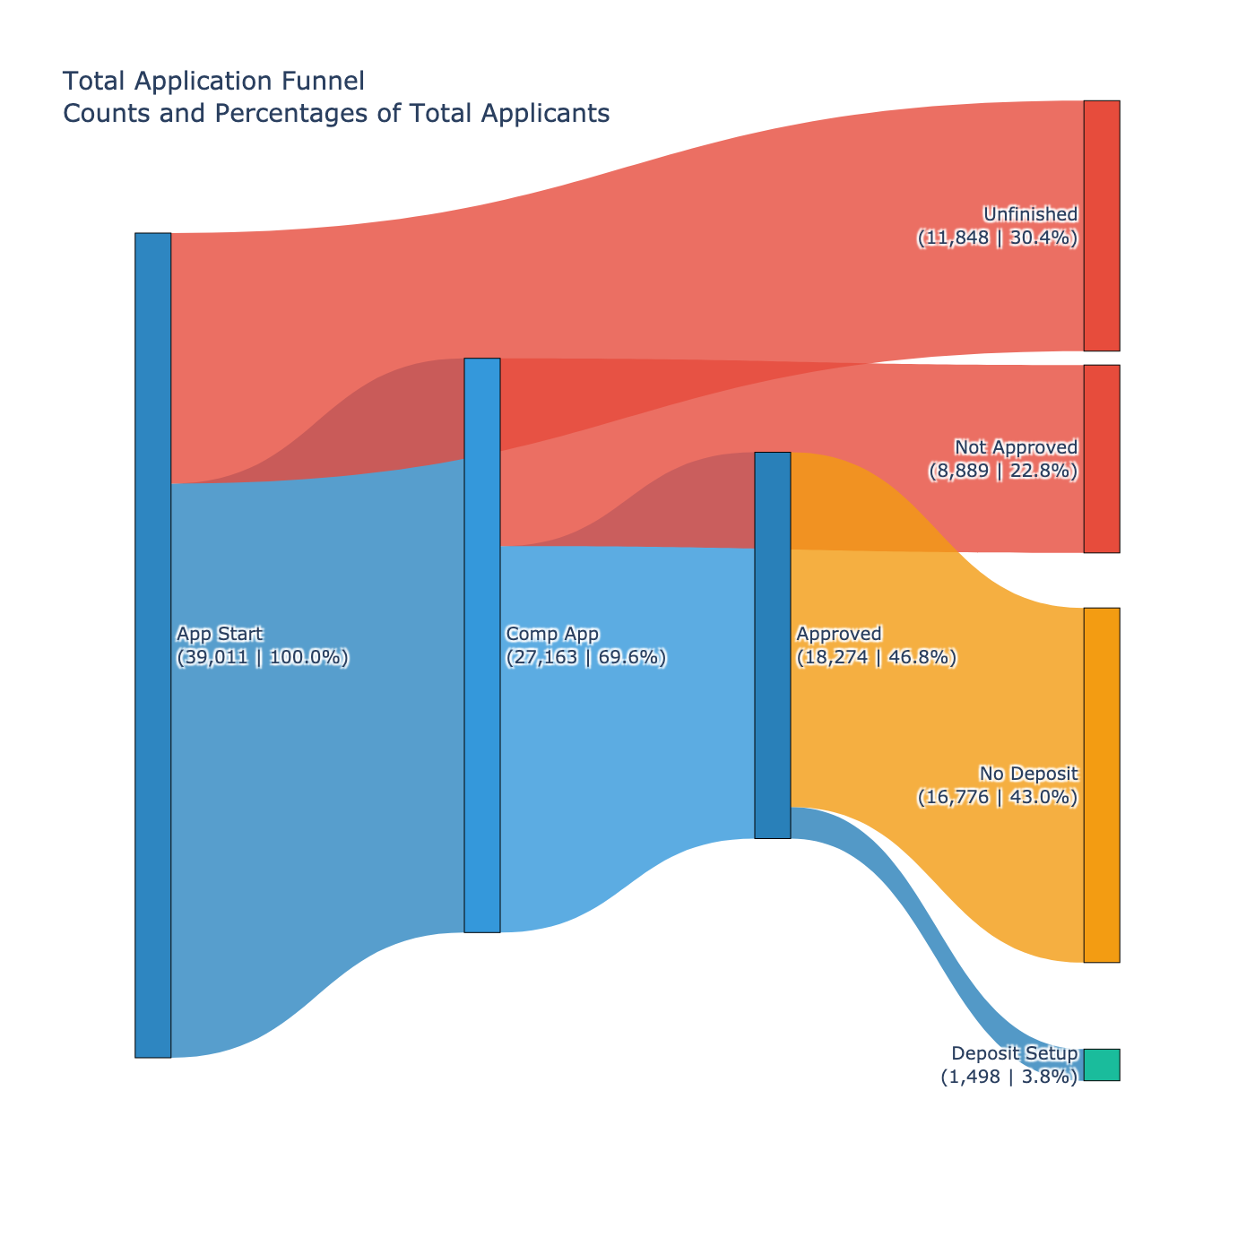
Data – Funnel Sankey

Slide 8
Funnel Improvement – Methodology
Approval Process is not able to be changed. A relaxation of underwriting criteria are not within the scope of this project and would likely lead to higher conversion but lower profitability.
We can address Application, and Deposit Setup processes
The rate of progressing through a step indicates pain points
Differences between user groups can indicate directional funnel improvements

Slide 9
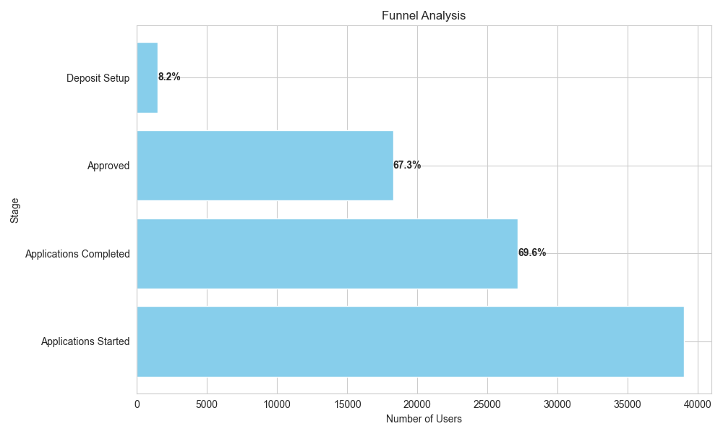
Insights – Funnel Progression
Largest loss is after approval moving into repayment.
Greater than 90% of approved applications do not setup a deposit

Slide 10
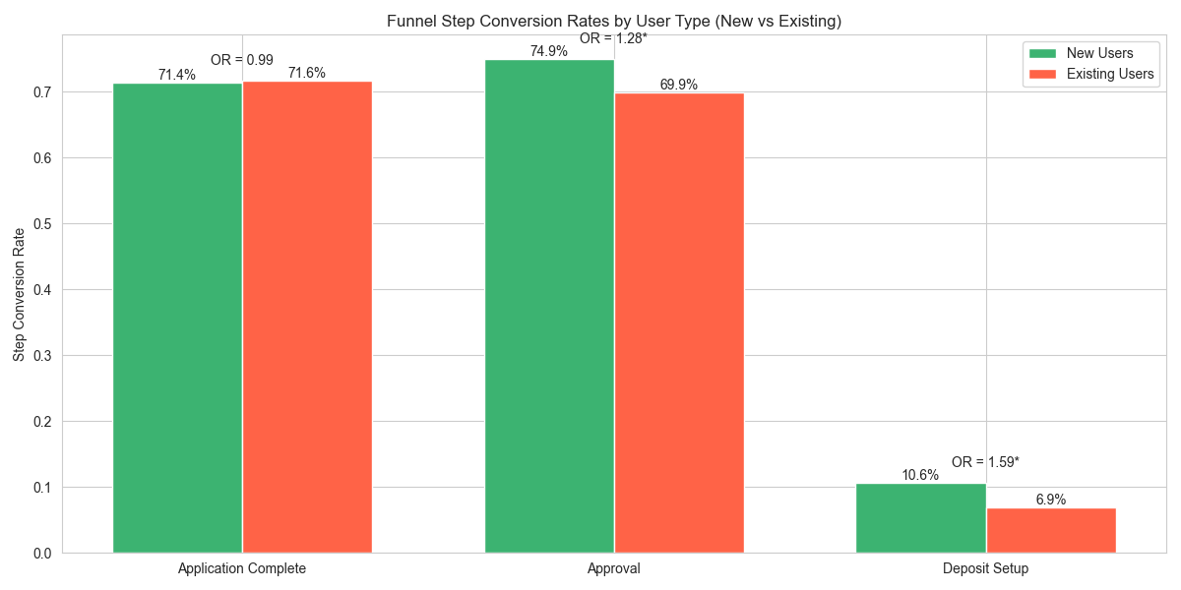
Insights – New / Old Cohort Analysis
New users are significantly more likely to be approved.
Similarly, more likely to setup deposit and enter repayment.
Recommendation:
Look at Deposit setup process differences between new and existing users.
Notes:
Hypothesis: there is a nudge behavior that is present with new users that is not present with existing users and causes their conversion to be lower.
Alternative: Existing customers are more likely to exhbit behaviors of trying on a product. This is counter indicated in my summation by the fact they do complete application at the same rate.

Slide 11
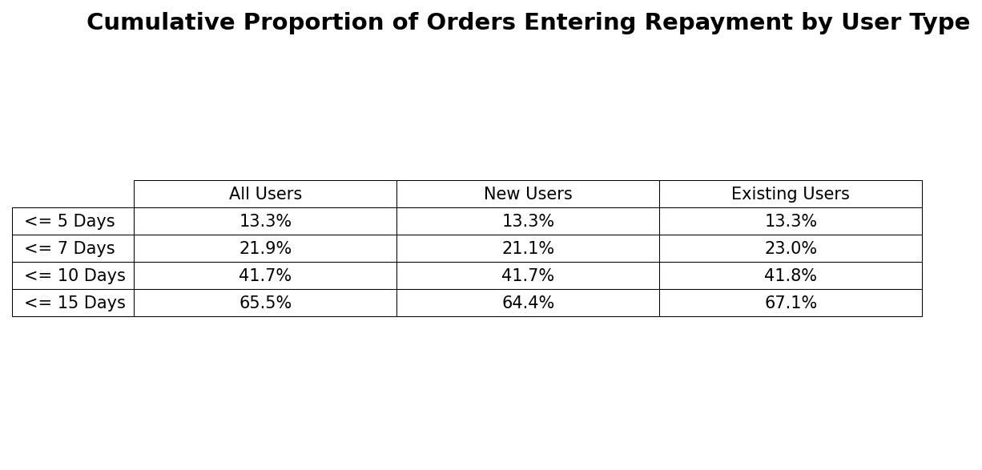
Insights – Repayment Windows
Notice that existing users and new users are in approximate parity until 15-day timeline. In the 15+ day timeline new users out convert existing users. This is further evidence that their may be nudges or other processes that need to be moved to the existing user base from the new user flow.

Slide 12
Recommendation
Focus on existing customers. Existing customers have a higher ticket price and should have lower acquisition costs.
Analyze differences in the order flow for new and existing users
If new users are nudged more implement similar nudges to existing users
If flows have approximately equal nudges, consider how to engage existing users especially beyond 15 days after approval.

Slide 13
Next Steps
Further Analysis of process for new and existing users.
Look deeper into approval process.
Consider non-underwriting improvements to the approval process.

Slide 14
Thank You!
Any Questions?

Slide 15
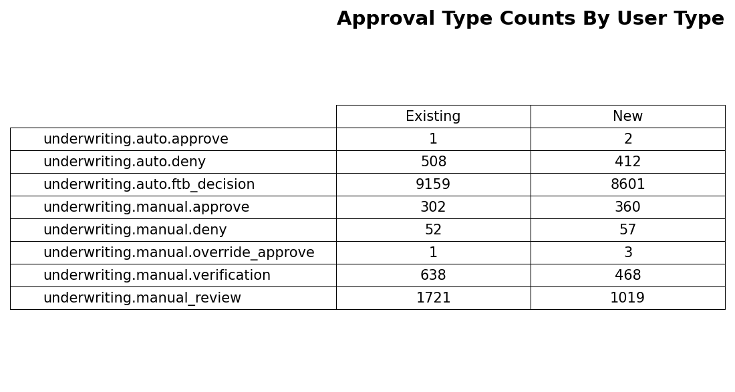
Appendix: Approvals

Slide 16
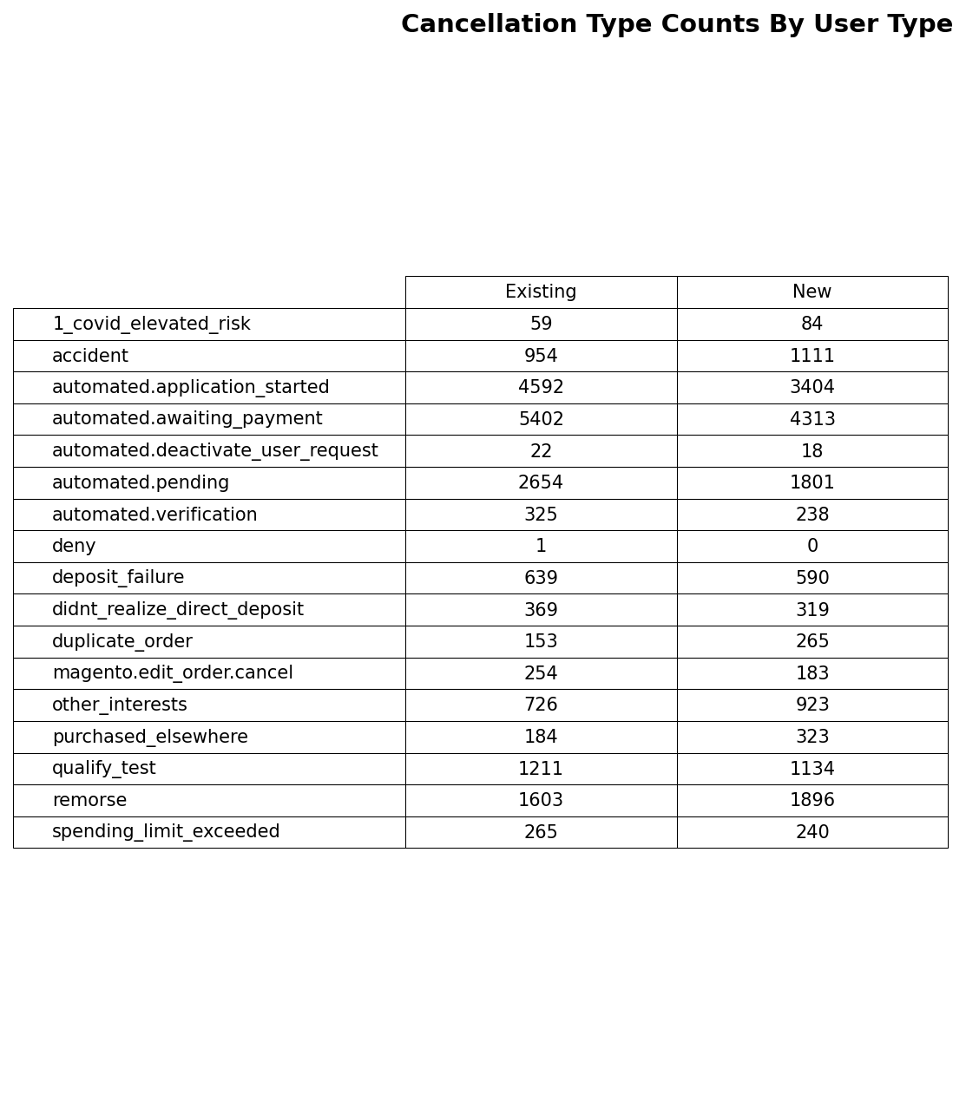
Apendix: Cancellations

Slide 17
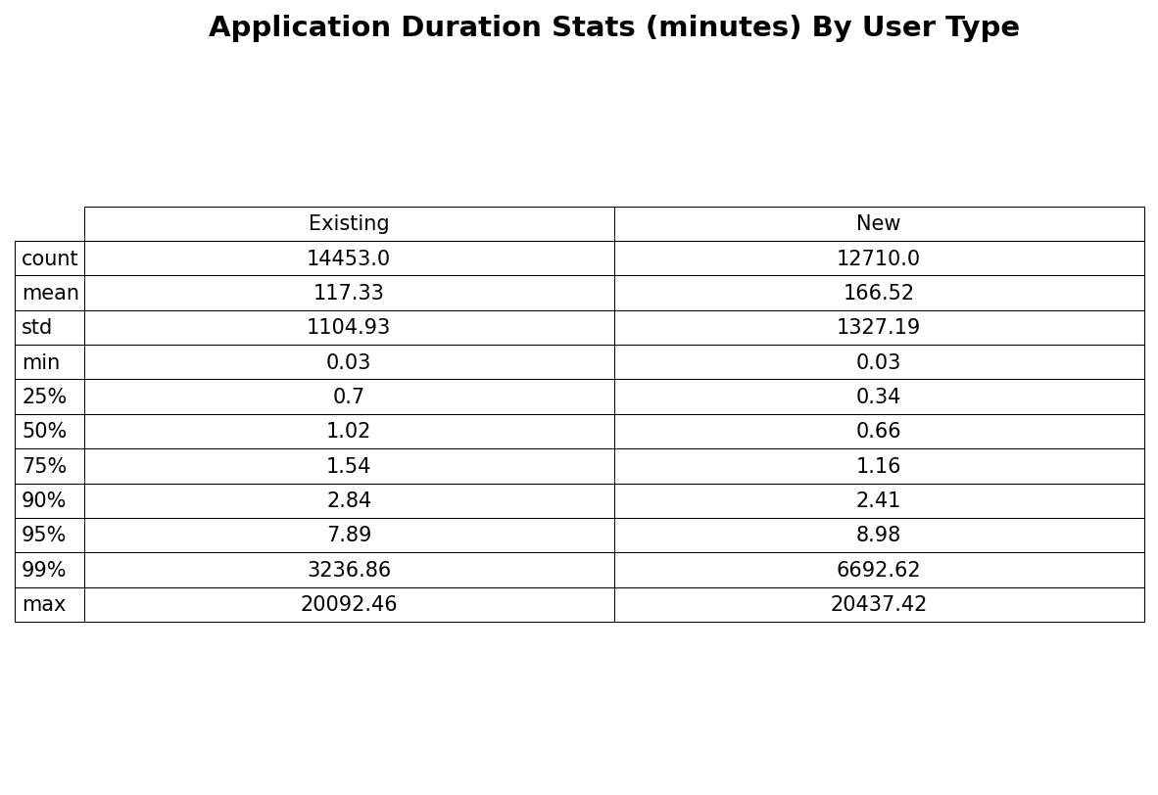
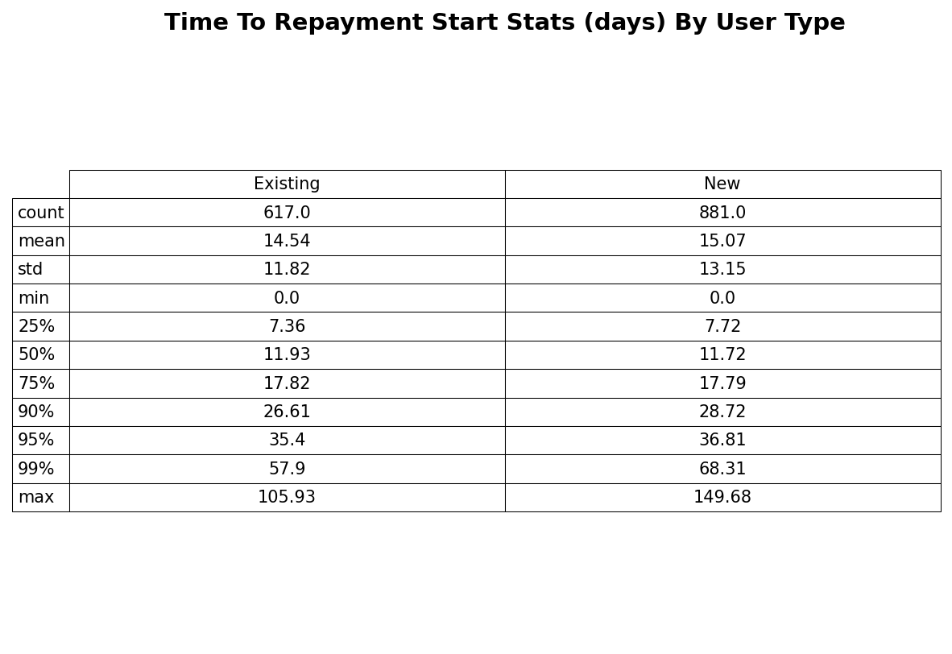
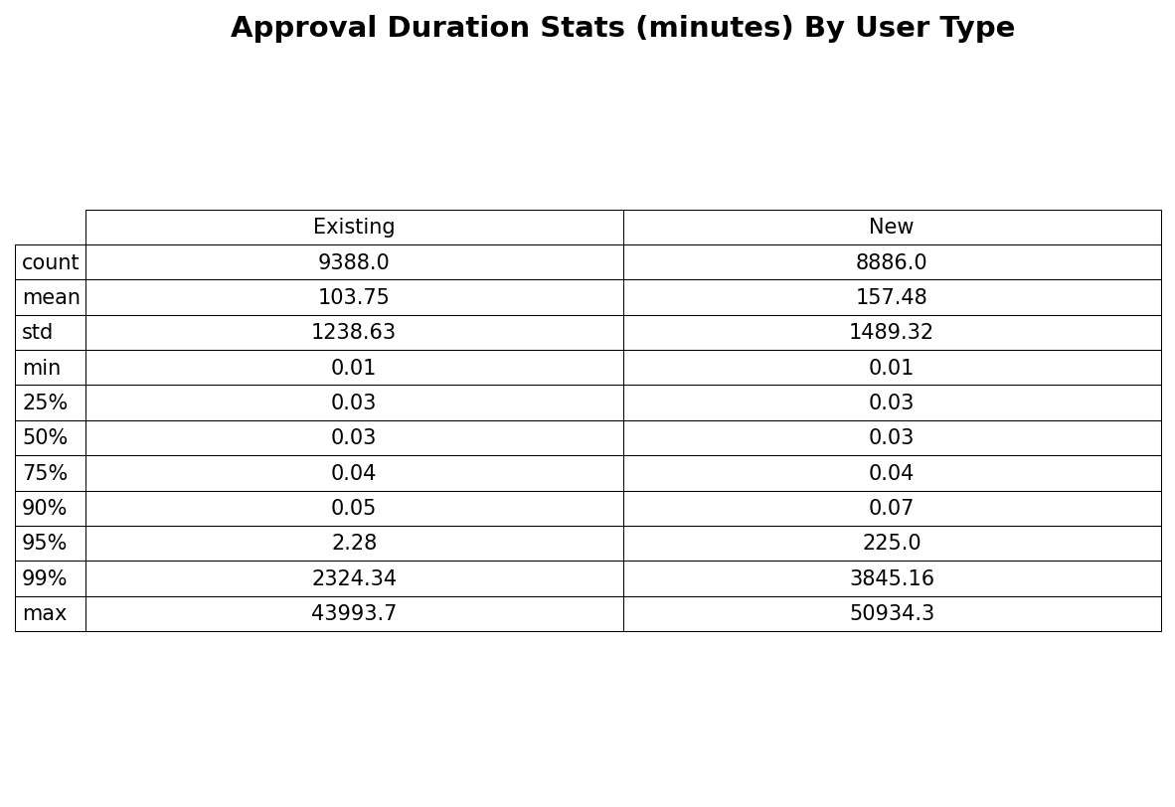
Appendix: Duration Statistics

Slide 18
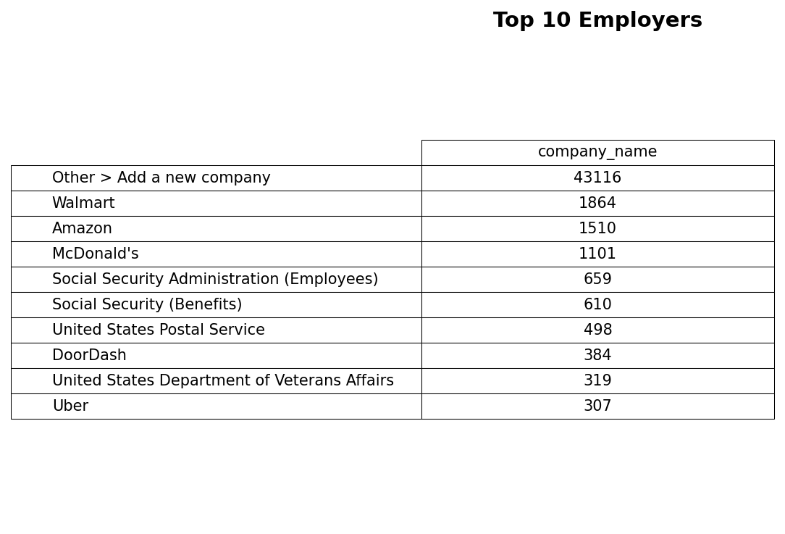
Appendix: Employers

