Slide 1
NASA SPACE APPS-2020
SONA COLLEGE OF TECHNOLOGY
TEAM MESSIAHS
Mr.Dhayanithi Jaganathan
Ms.Vidhushavarshini S
Viruchit Ga
Harini K K
Raja Vignesh Pherumal R
Shyam Prasadh S

Slide 2
OBJECTIVE
Breezy webapp determines whether the city is safe enough to travel for an individual depending on their existing health conditions and that city's environmental parameters like Carbon Monoxide(CO)

Slide 3
DATASET
The dataset used for this project is taken from MOPITT sensor NASA,available in CSV for last 20 years.
Parameters of DataSet are
Latitude
Longitude
PPBV Of Carbon Monoxide In Air

Slide 4
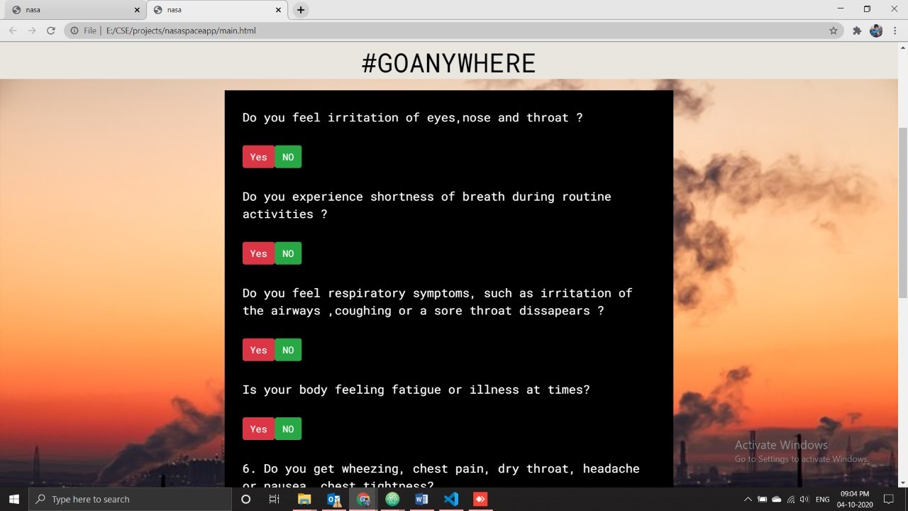

Slide 5
Thank You.

