Slide 1
Portfolio Assignment T1A3

Slide 2
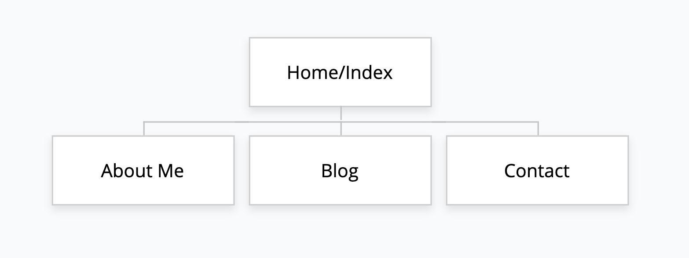
Sitemap
Pretty simple, like I imagined most of them were.

Slide 3
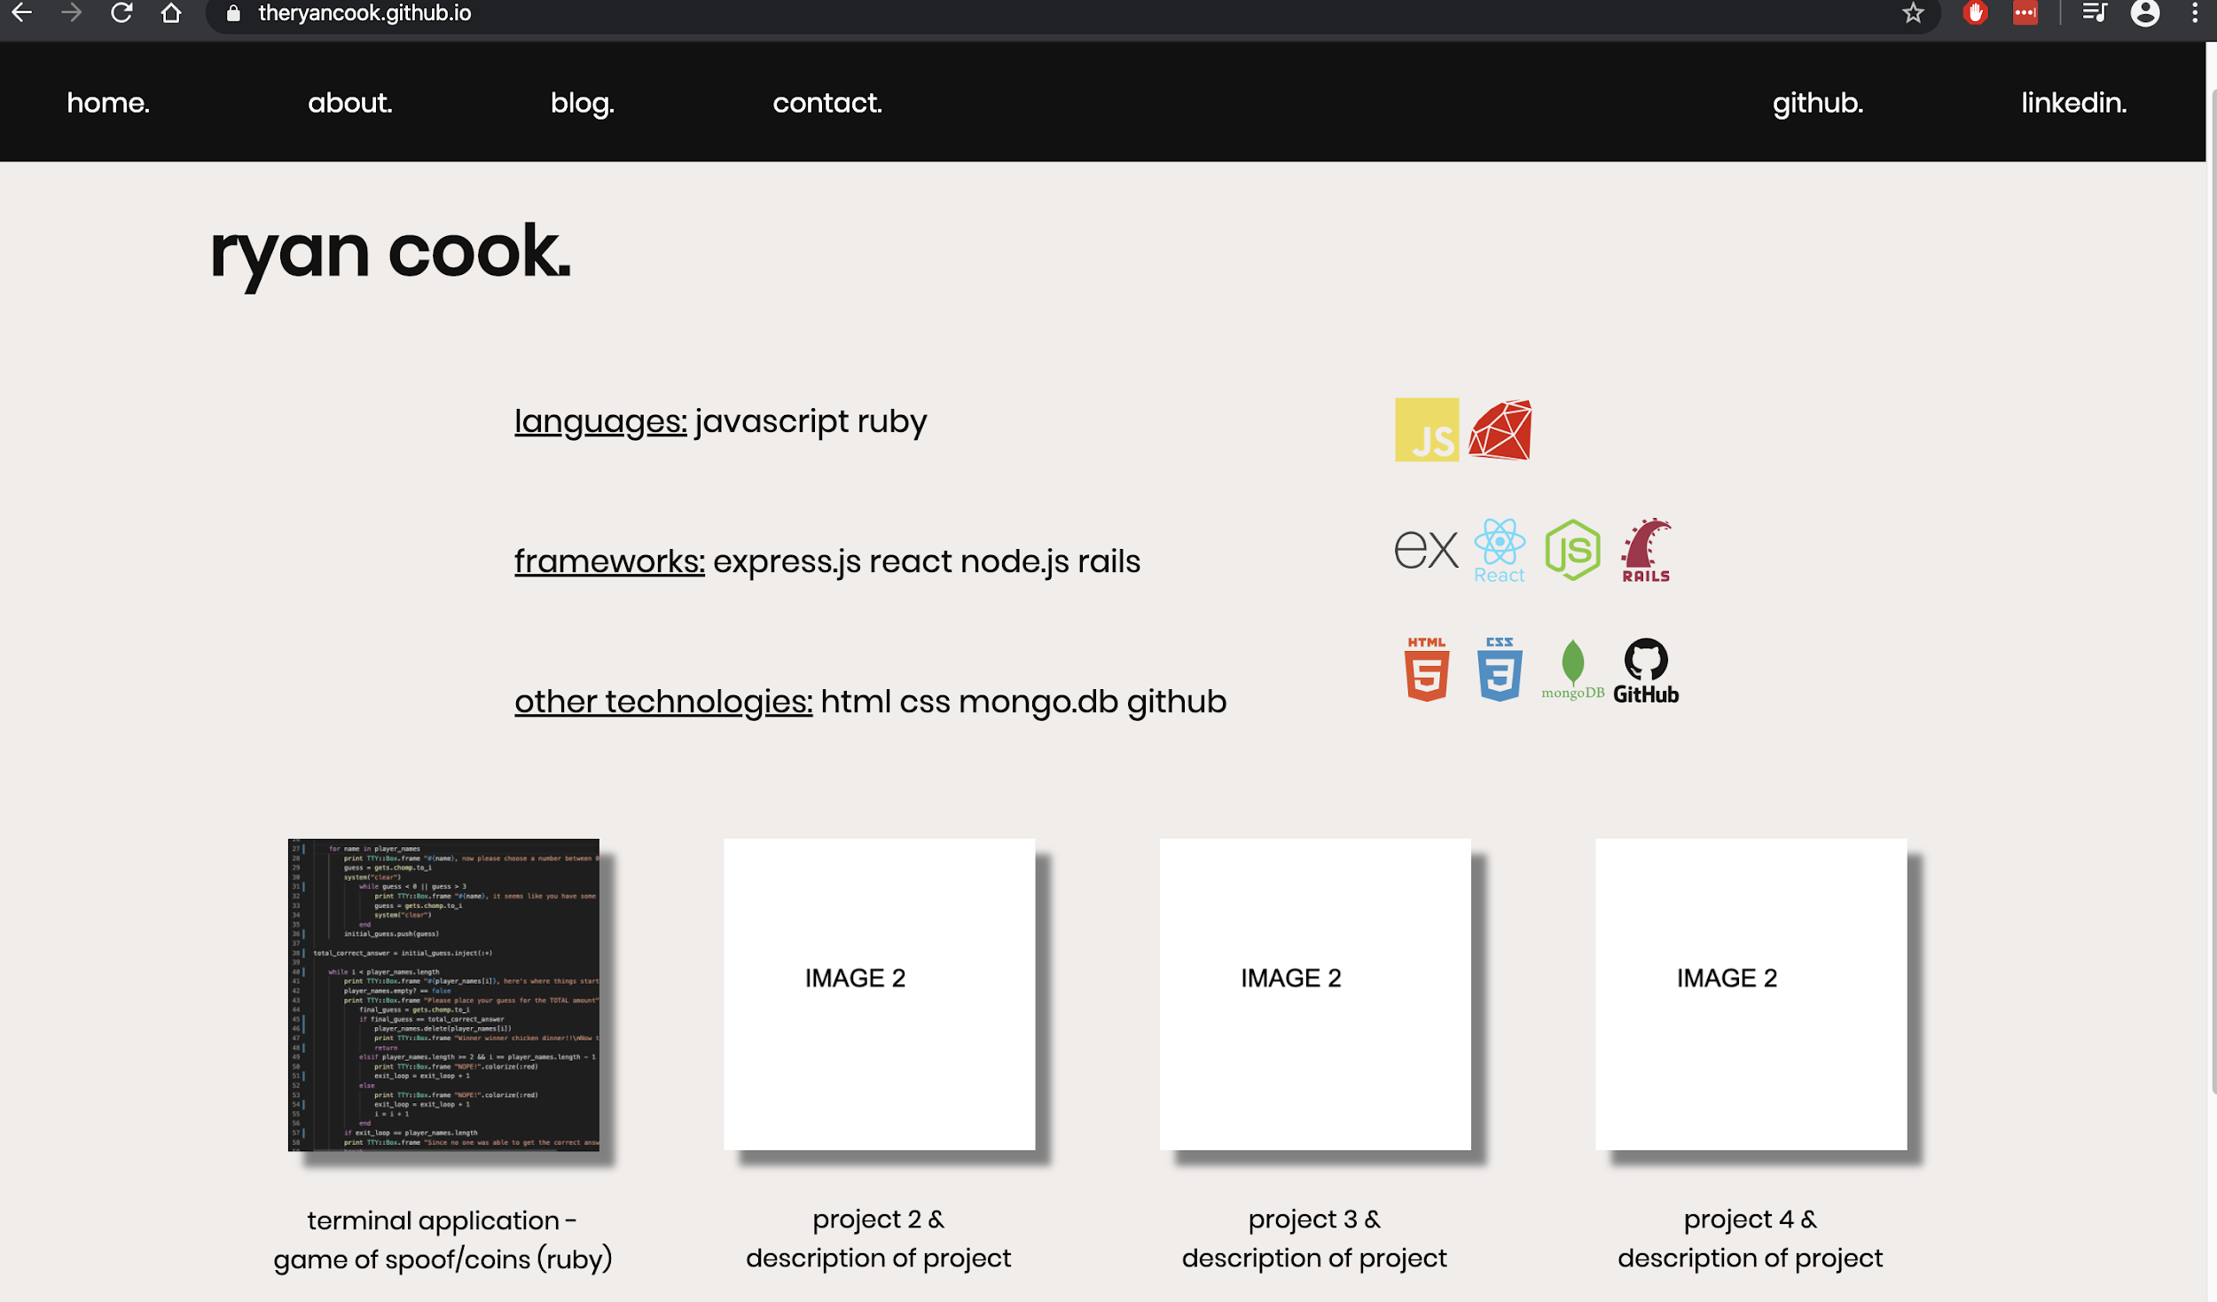
Website & Features - Home Page
I personally really like simple block colours, so I went for minimalist style
Wanted users to do the least clicks possible to get to what they want to do. That’s why I have projects with links and links to my code
Share a lot of information on main page for easy with the recruiters

Slide 4
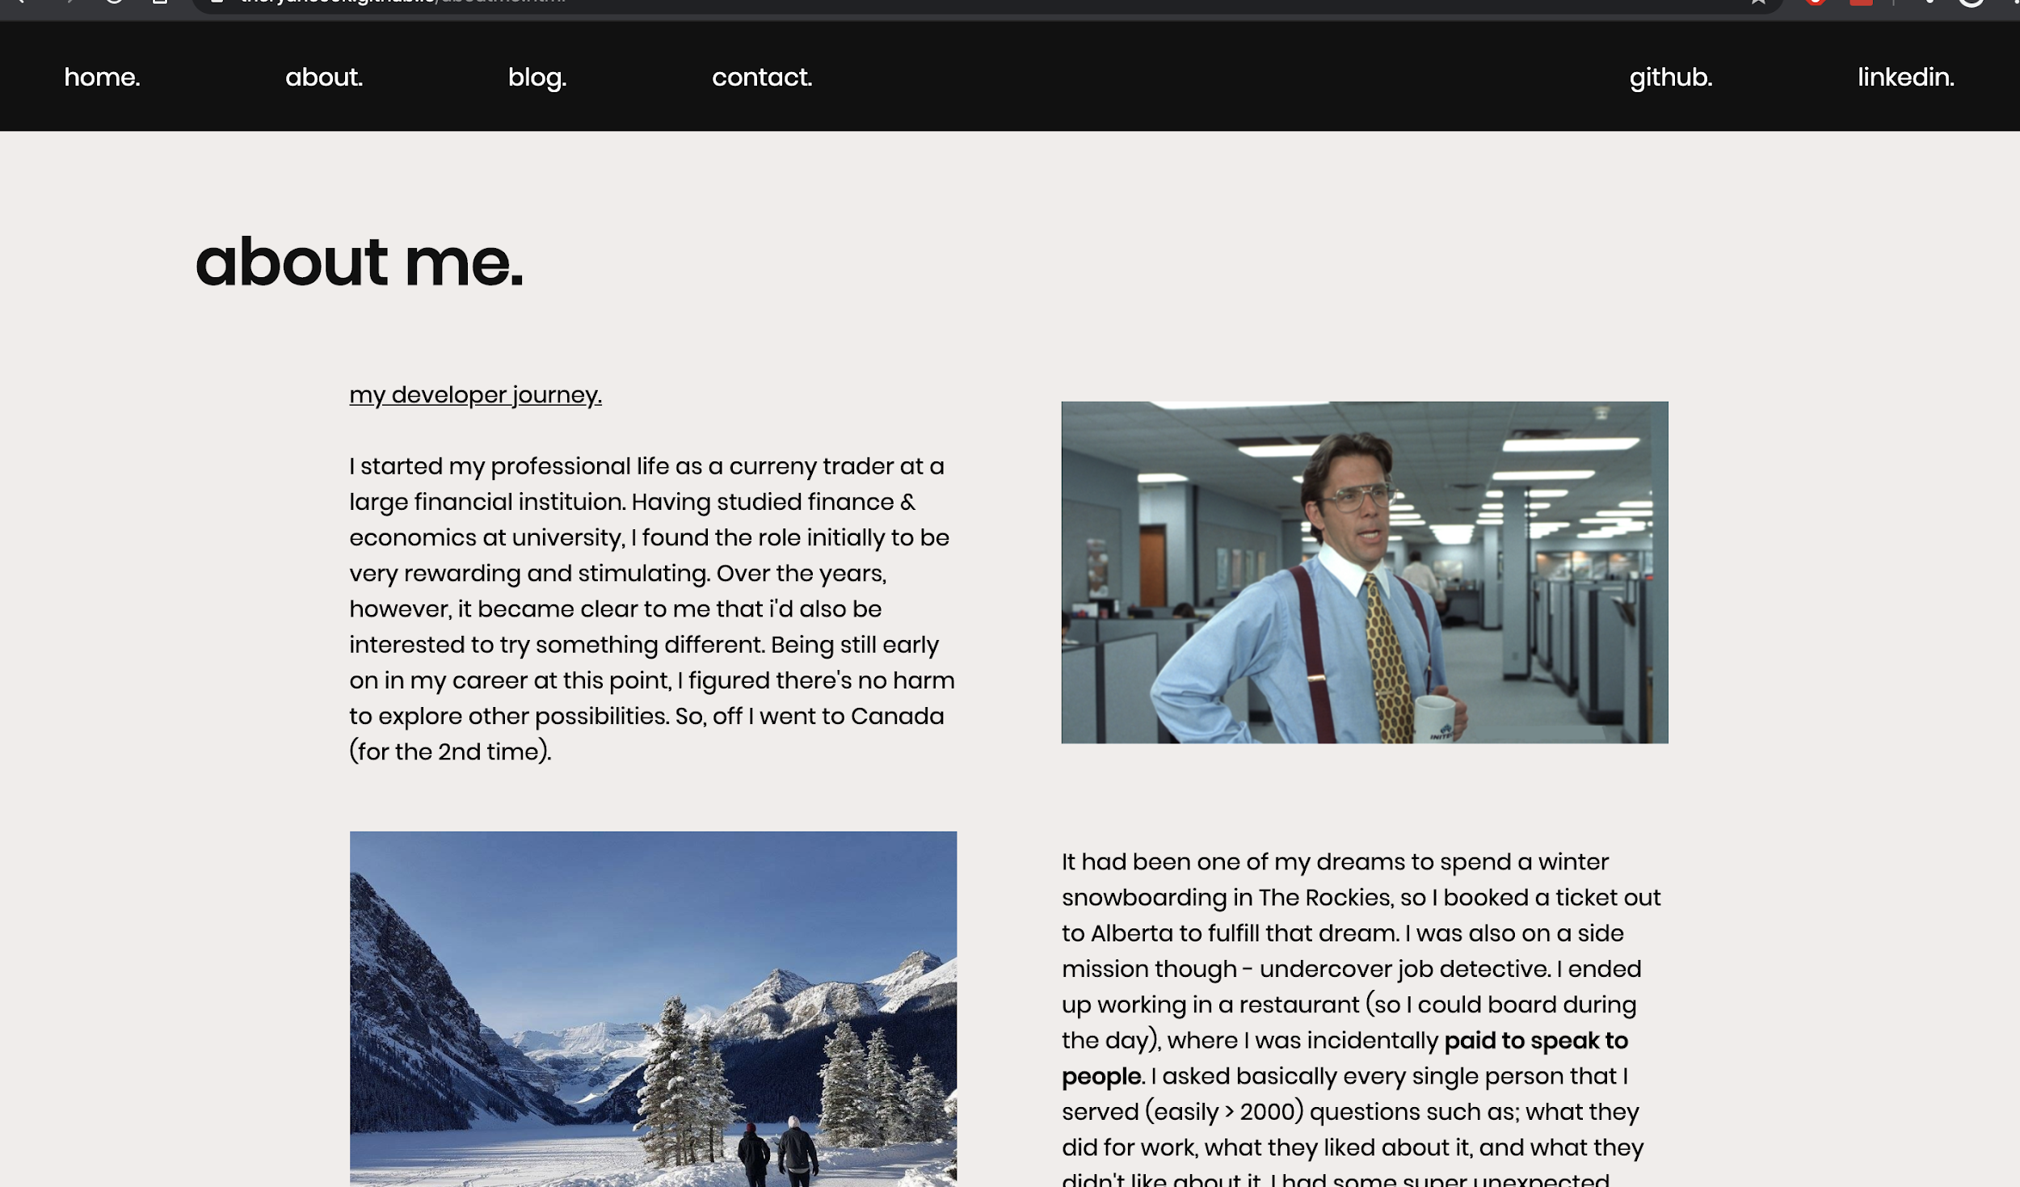
Website & Features - About Me
Included a lot of information on home page, so used this to tell the story of my journey to developer
Tried to keep it interesting with some images.
Lets recruiters know a little bit more about me

Slide 5
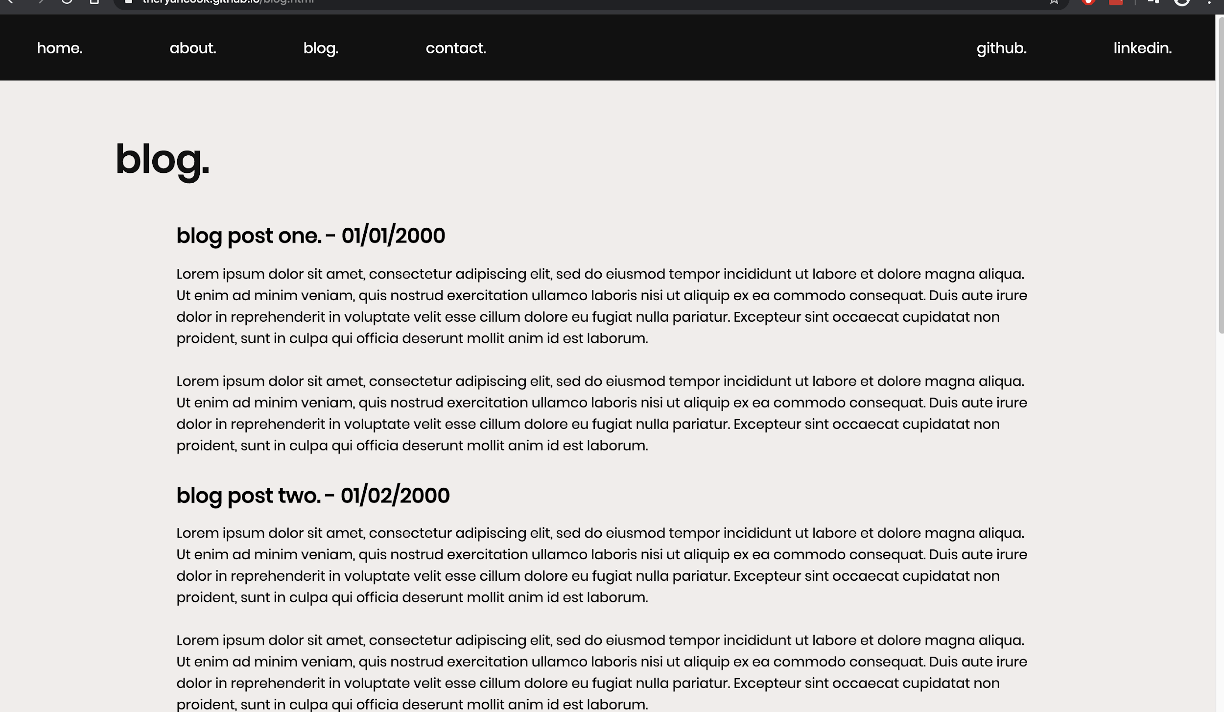
Website & Features - Blog
Blogging isn’t really my thing, so i’ll remove this page later
Just used dummy text
Styling has been consistent throughout

Slide 6
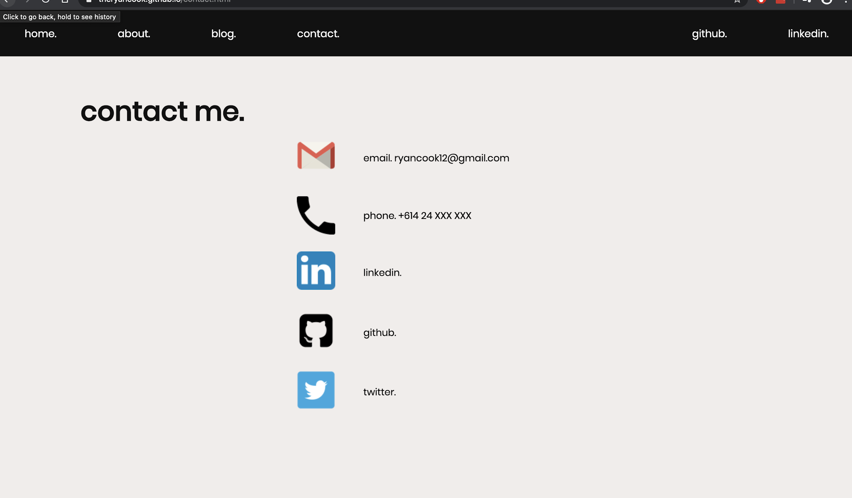
Website & Features - Contact Me
All clickable links
Again, making it all very simple if people were to want to get in touch

Slide 7
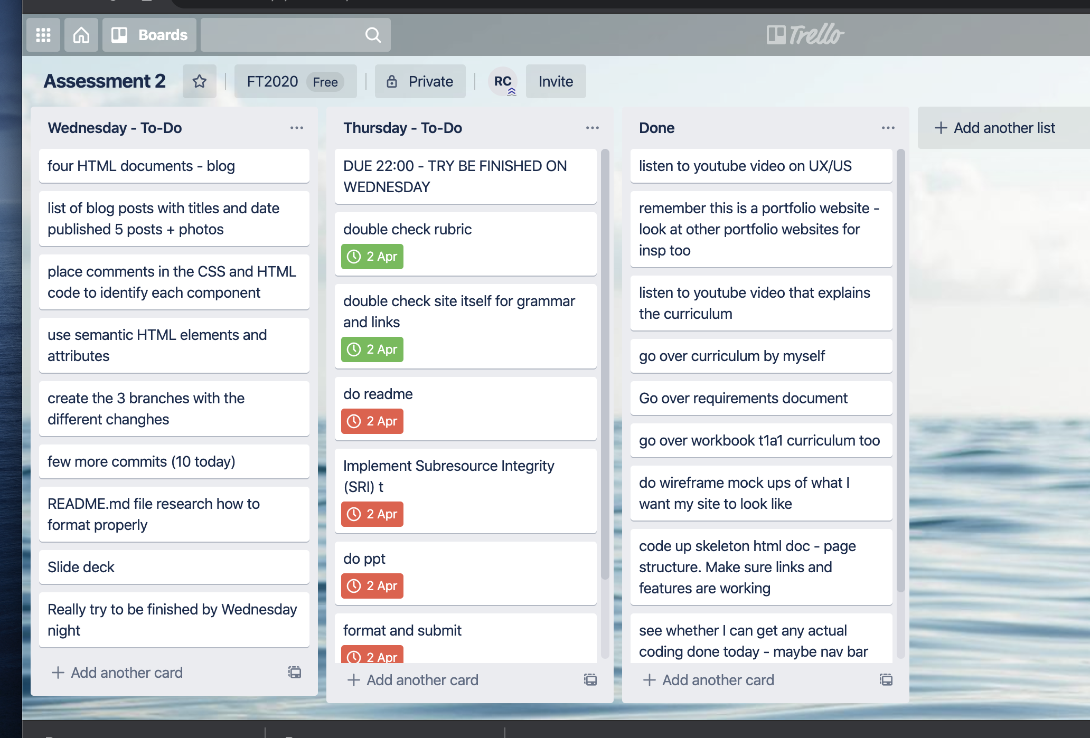
Project Planning
Used a Trello board from day 1 to plan out each day
Made a list of everything that needed to be done and slid it around as needed
Tried to finish a day early, and in the end needed the extra day

Slide 8
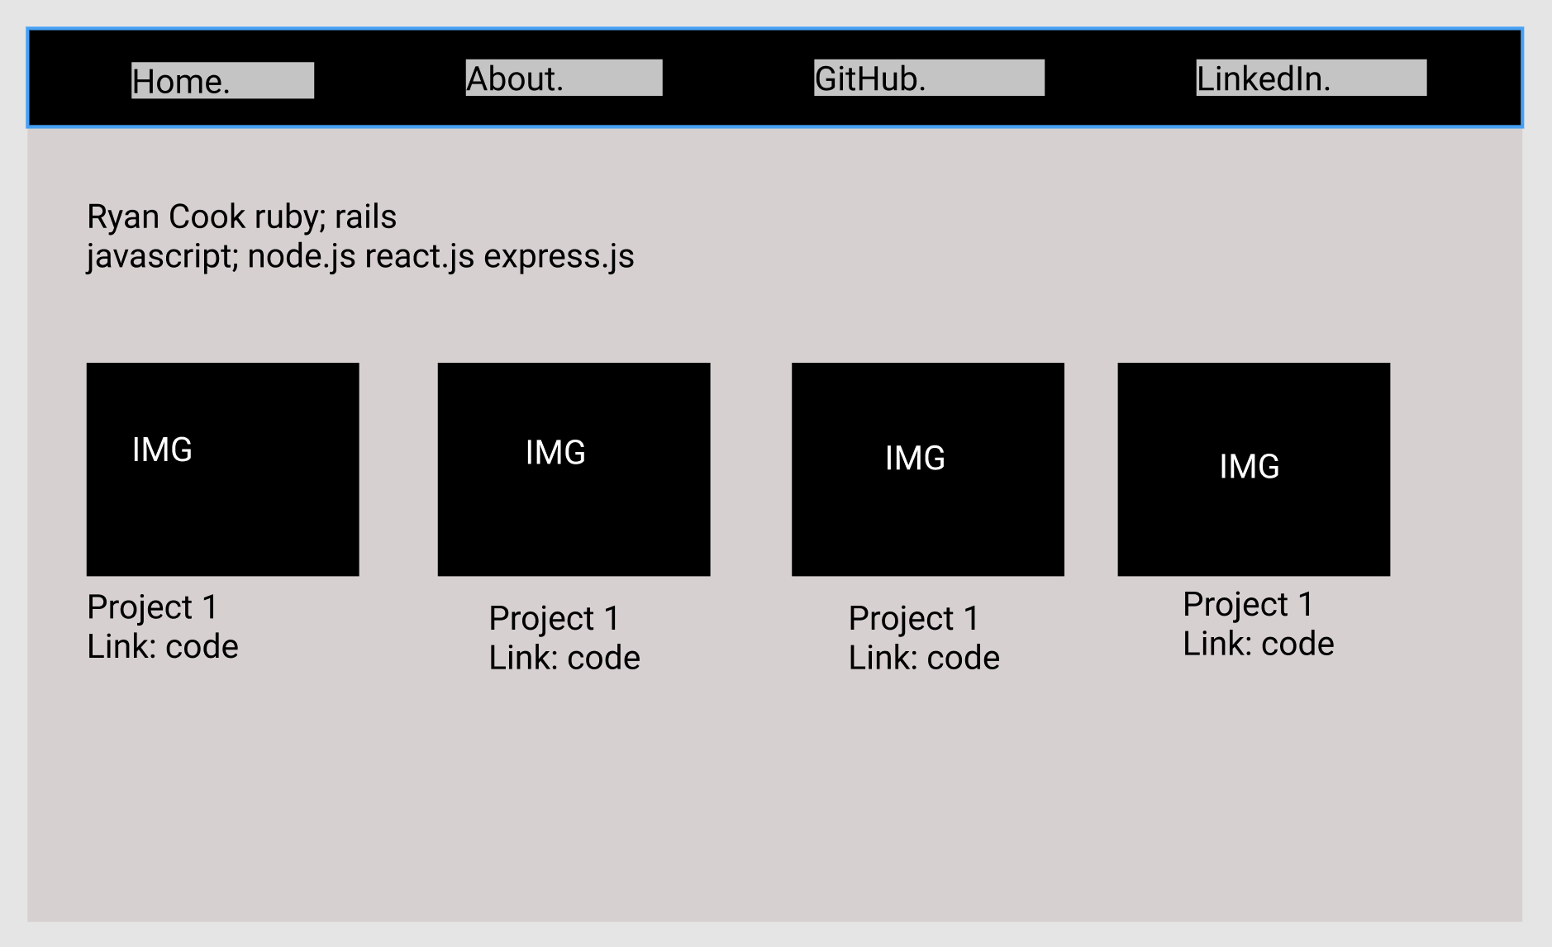
Wireframes
As you can see, stuck pretty close to the early concept
Had a decent idea of the colour scheme that I wanted to go for
Kept the minimal clicks in mind

Slide 9
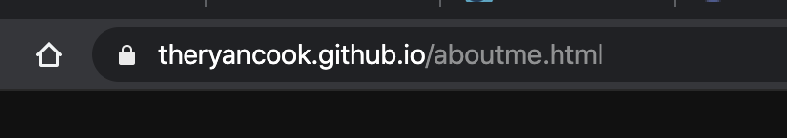
Favourite Part
Getting it hosted on GitHub
I did have a couple of problems with Git, so I learnt a lot and was up until 9p on Wednesday but now i’m a pro
First thing i’ve ever made and uploaded onto the internet so i’m pretty proud of that

