Slide 1
SWIFTCOURIER
A Courier Service Management System

Slide 2
Introduction to the Project
This project aims to streamline the complete courier delivery workflow by enabling customers to place orders, track shipments, and provide feedback; allowing courier staff to update delivery statuses; and empowering a centralized admin to manage orders, assign staff, and oversee parcel movement between warehouses.
Key Scope Highlights:
Customer: Order placement, tracking, feedback, and order history.
Admin: Assign deliveries, manage warehouses, monitor routing and delivery flow.
Courier Staff: Handle pickups, deliveries, and status updates.
Warehouse Routing: Supports parcel movement through one or more warehouses.
Database: Fully normalized MySQL schema for clean, scalable storage.
Architecture: RESTful APIs, role-based access, Spring Boot + React stack.
This system is ideal for small to medium-sized courier businesses and can be scaled in the future to support additional features such as real-time GPS tracking, billing, and multi-admin access.

Slide 3
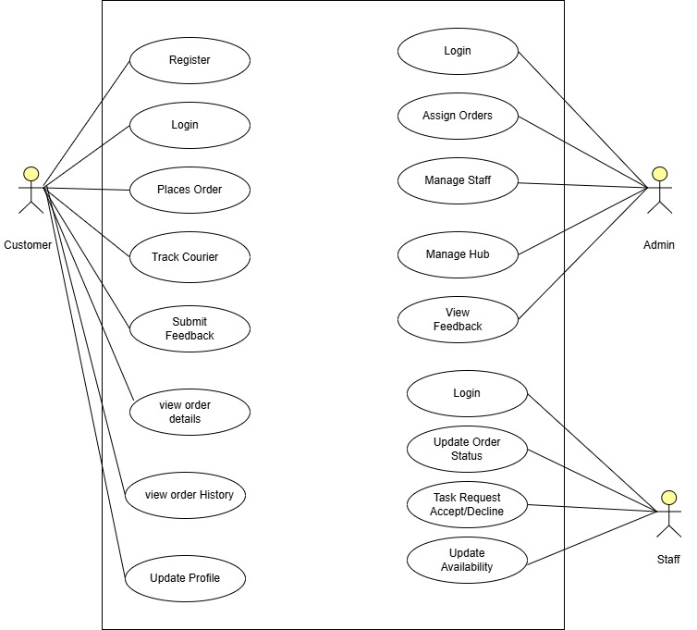
Use Case Diagram

Slide 4
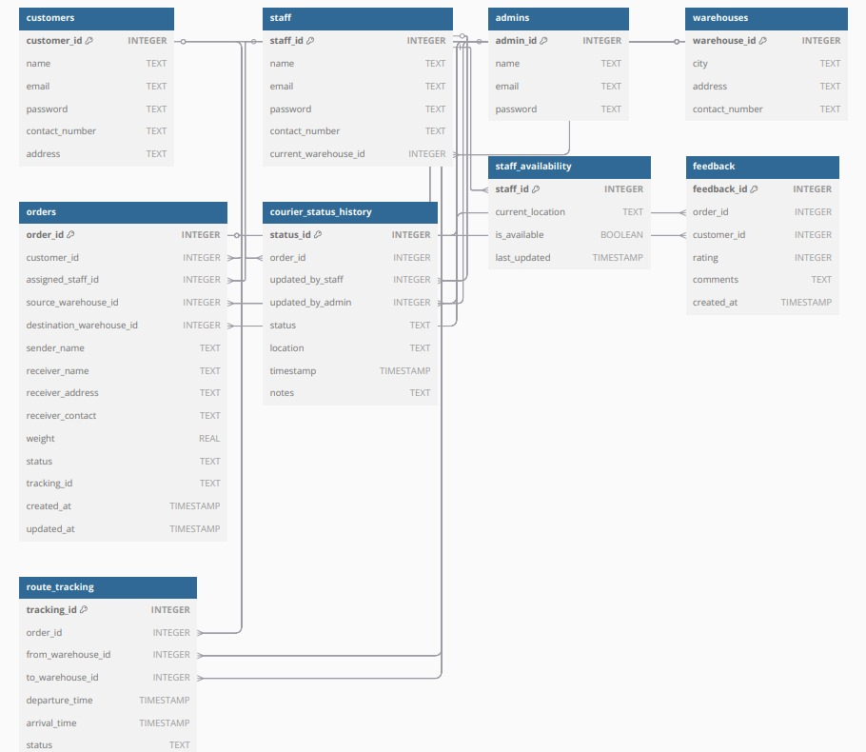
Entity- Relationship Diagram

Slide 5
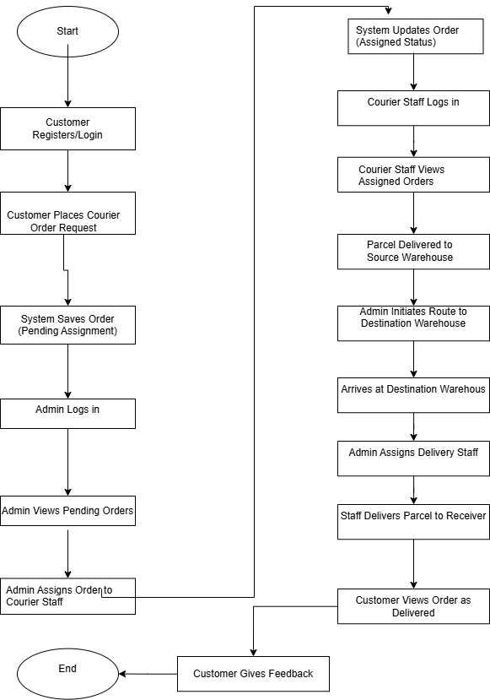
Work Flow Diagram

Slide 6
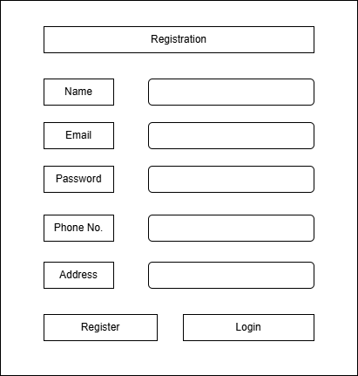
Registration

Slide 7
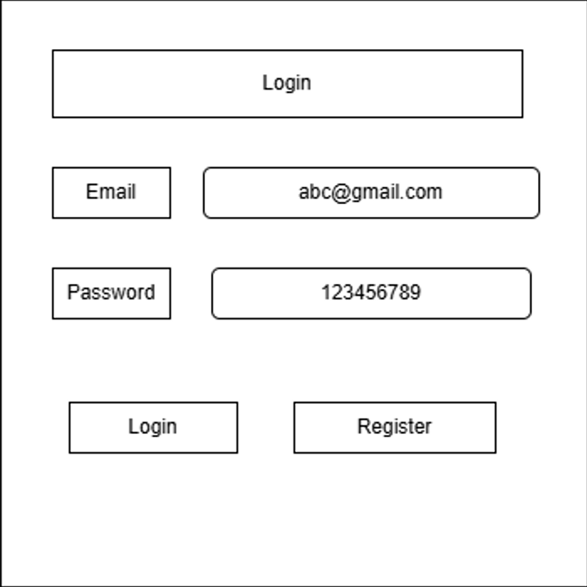
Login

Slide 8
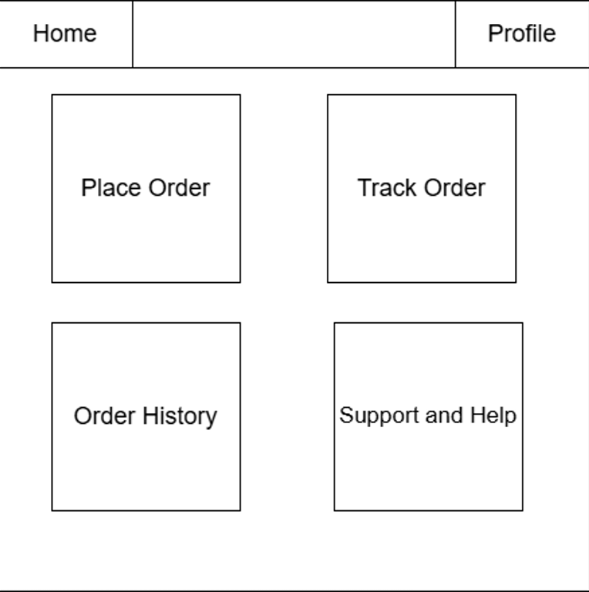
Customer: Dashboard

Slide 9
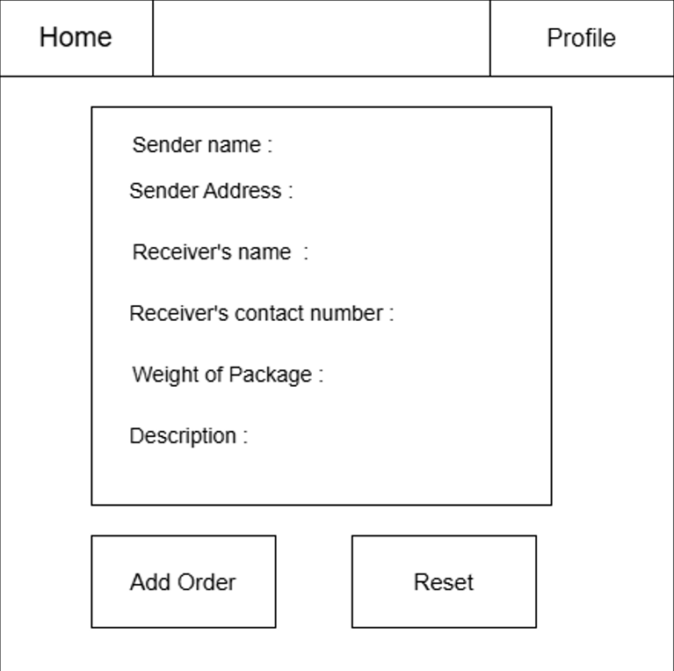
Customer : Place Order

Slide 10
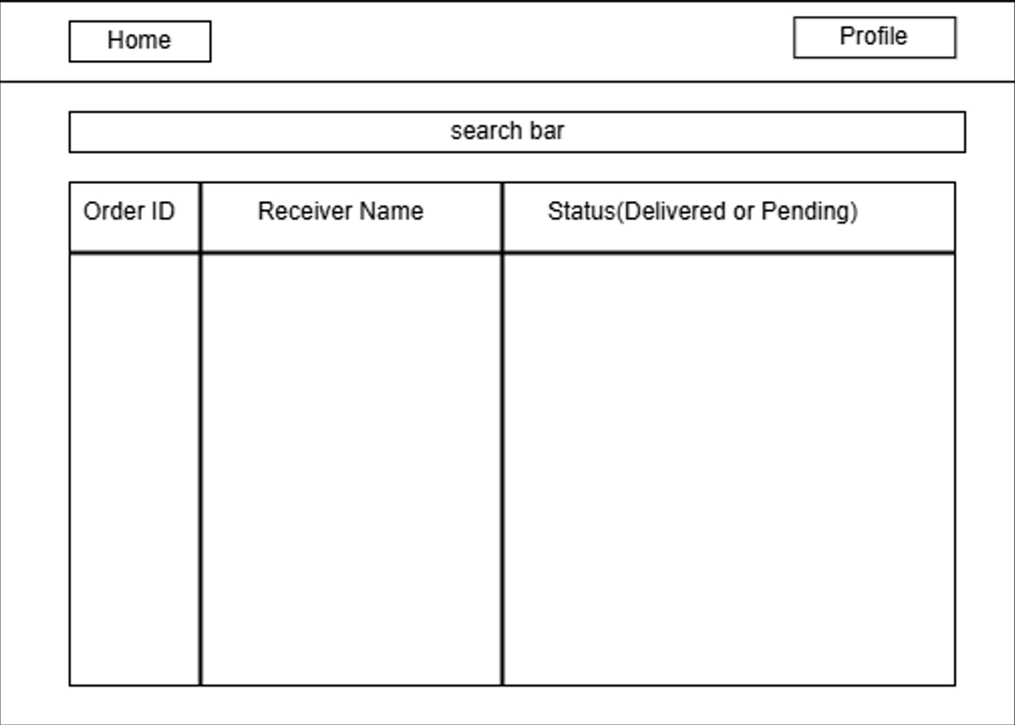
Customer : Track Order

Slide 11
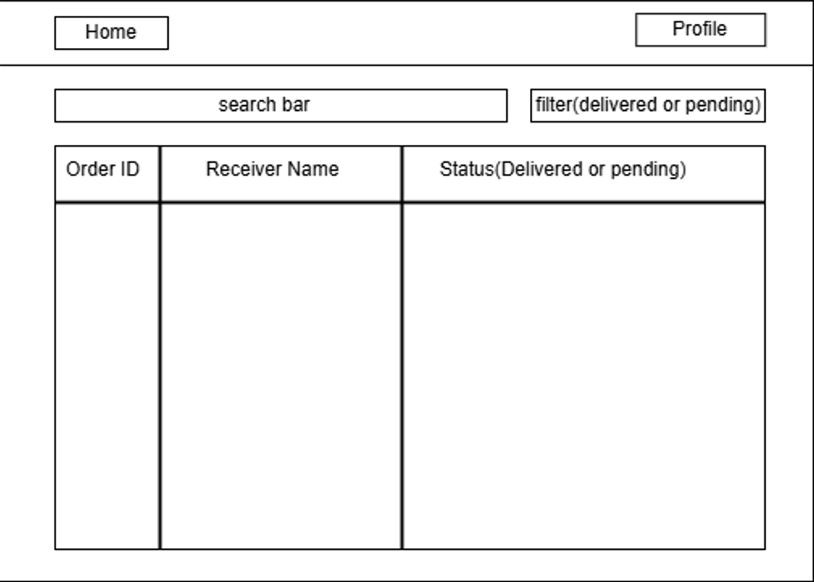
Customer : Order History

Slide 12
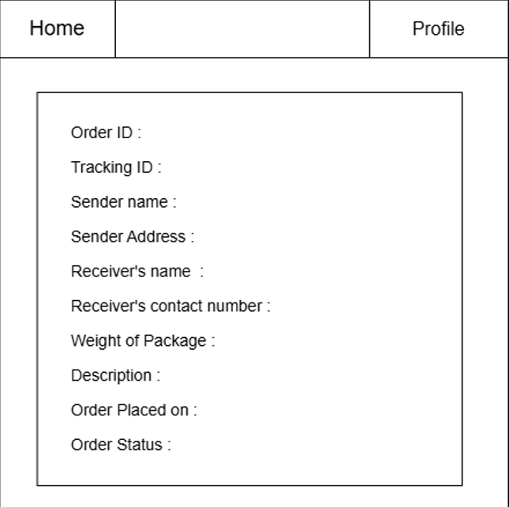
Customer : Order Details

Slide 13
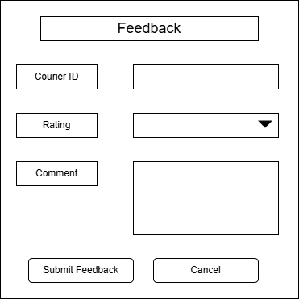
Customer Feedback

Slide 14
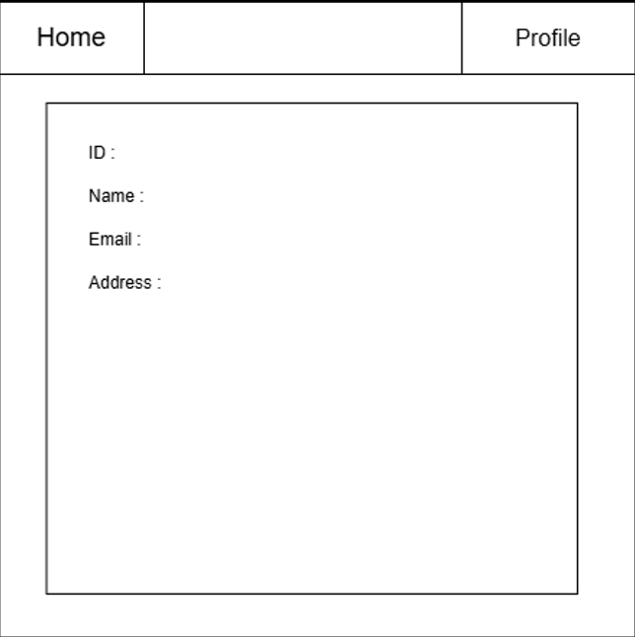
Customer : Profile

Slide 15
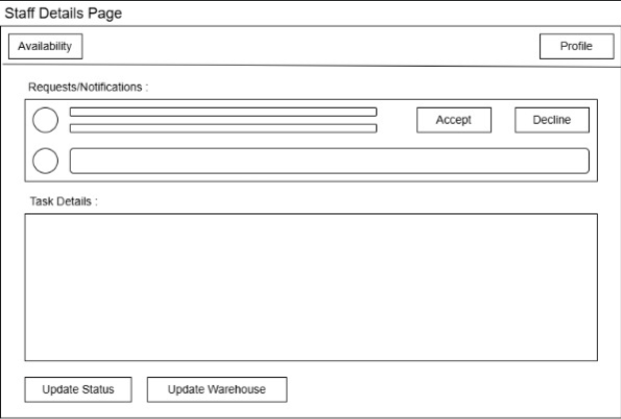
Staff Member :Staff Details

Slide 16
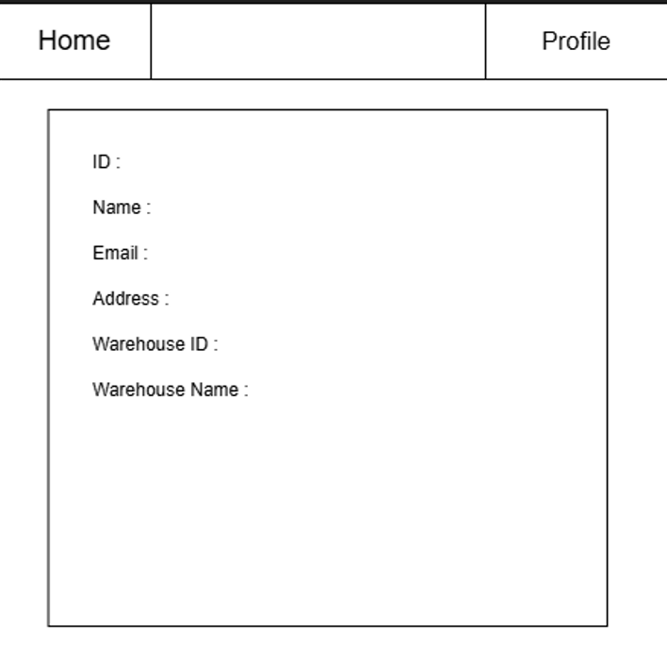
Staff Member : Profile

Slide 17
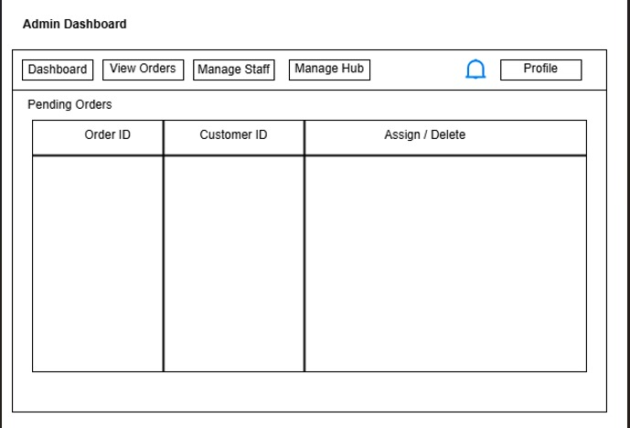
Admin : Dashboard

Slide 18
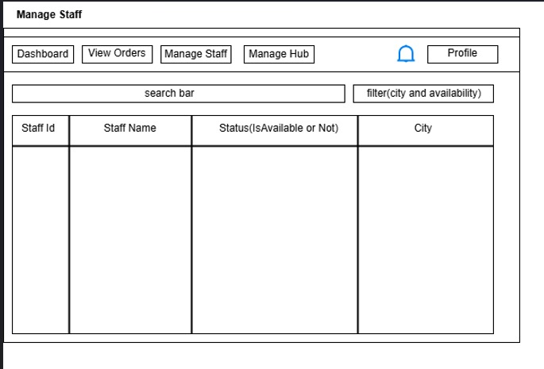
Admin : Manage Staff

Slide 19
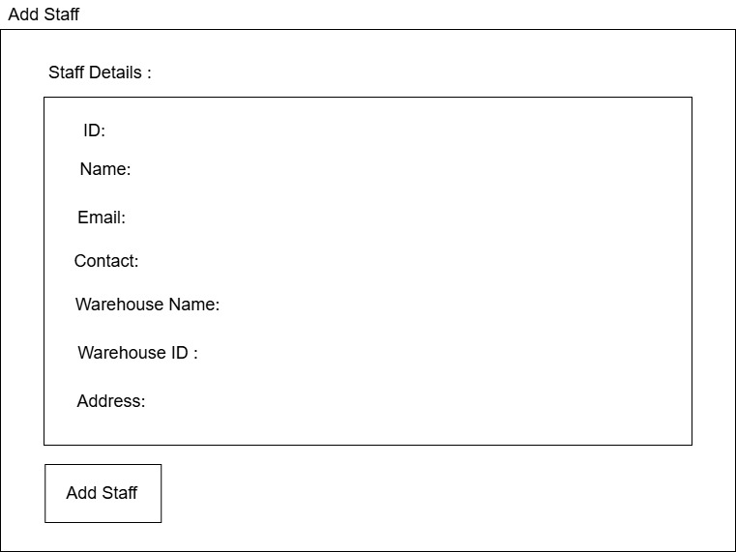
Admin : Add Staff

Slide 20
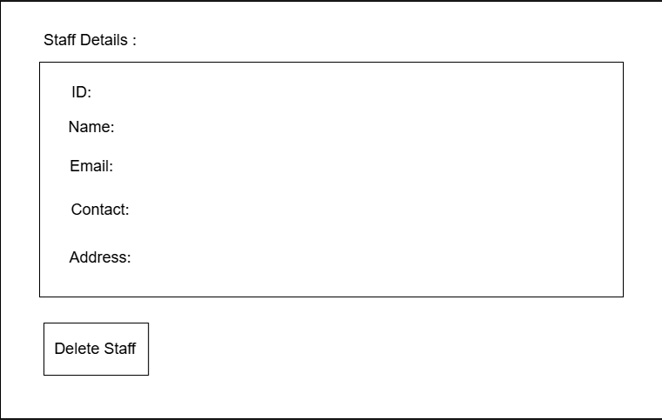
Admin : Delete Staff

Slide 21
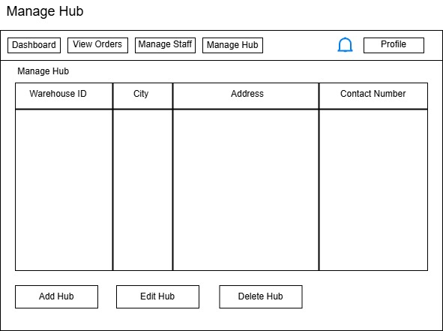
Admin :Manage Hub

Slide 22
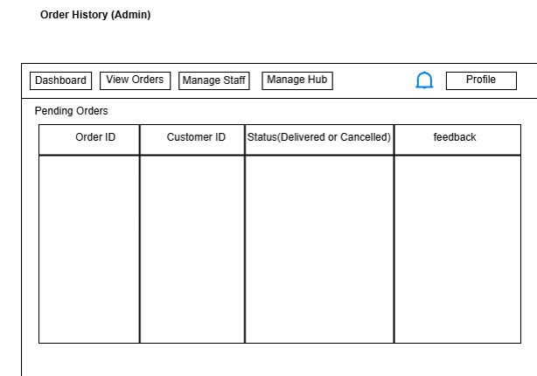
Admin : Order History

Slide 23
Thank You.

