Slide 1

Movie Recommendation Engine
Sakshi Pandey Amit Pandey Anand Patel
Team Name: Ledger-ndary (24m2115, 24m0792, 24m2119)
Under the Guidance of
Prof. Om Damani
Computer Science and Engineering Department
Indian Institute of Technology, Bombay
CS699 Course Project (2024)

Slide 2

Table of Contents
Task Description
Motivation
Exploration
Datasets
5. Evaluation Metrics
Roadmap
Summary
References

Slide 3
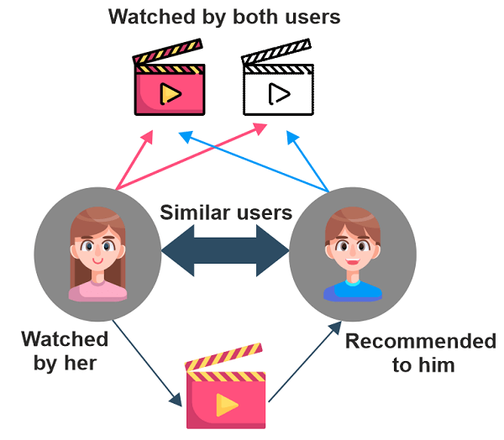
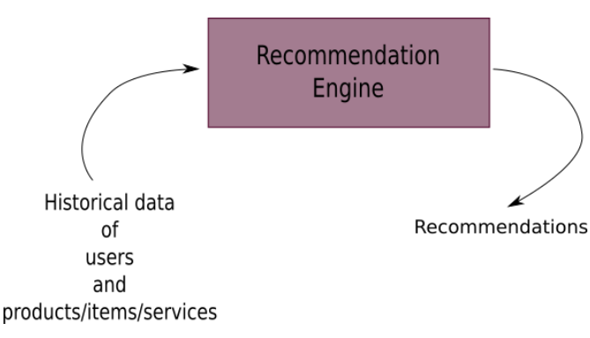
Task Description
https://static.javatpoint.com/python/images/using-python-create-own-movies-recommendation-engine2.png

Slide 4
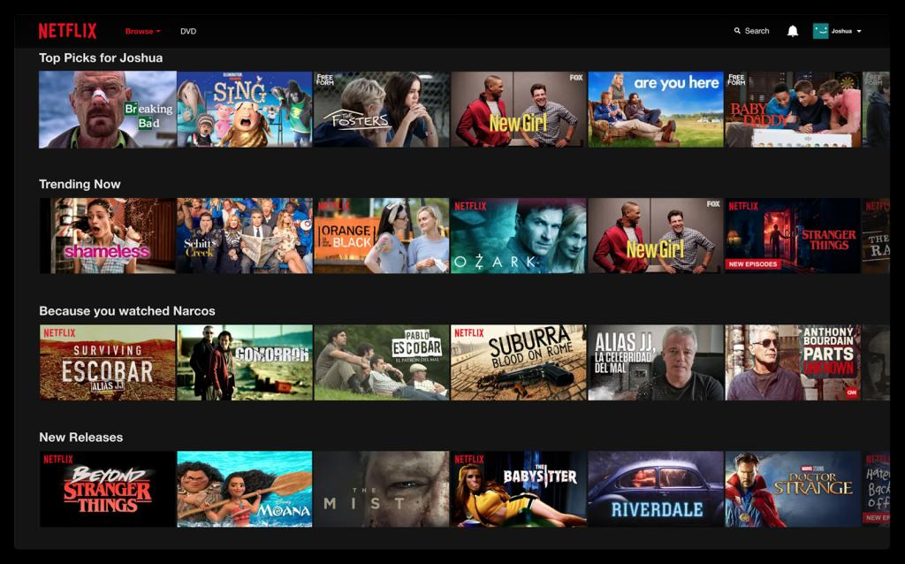
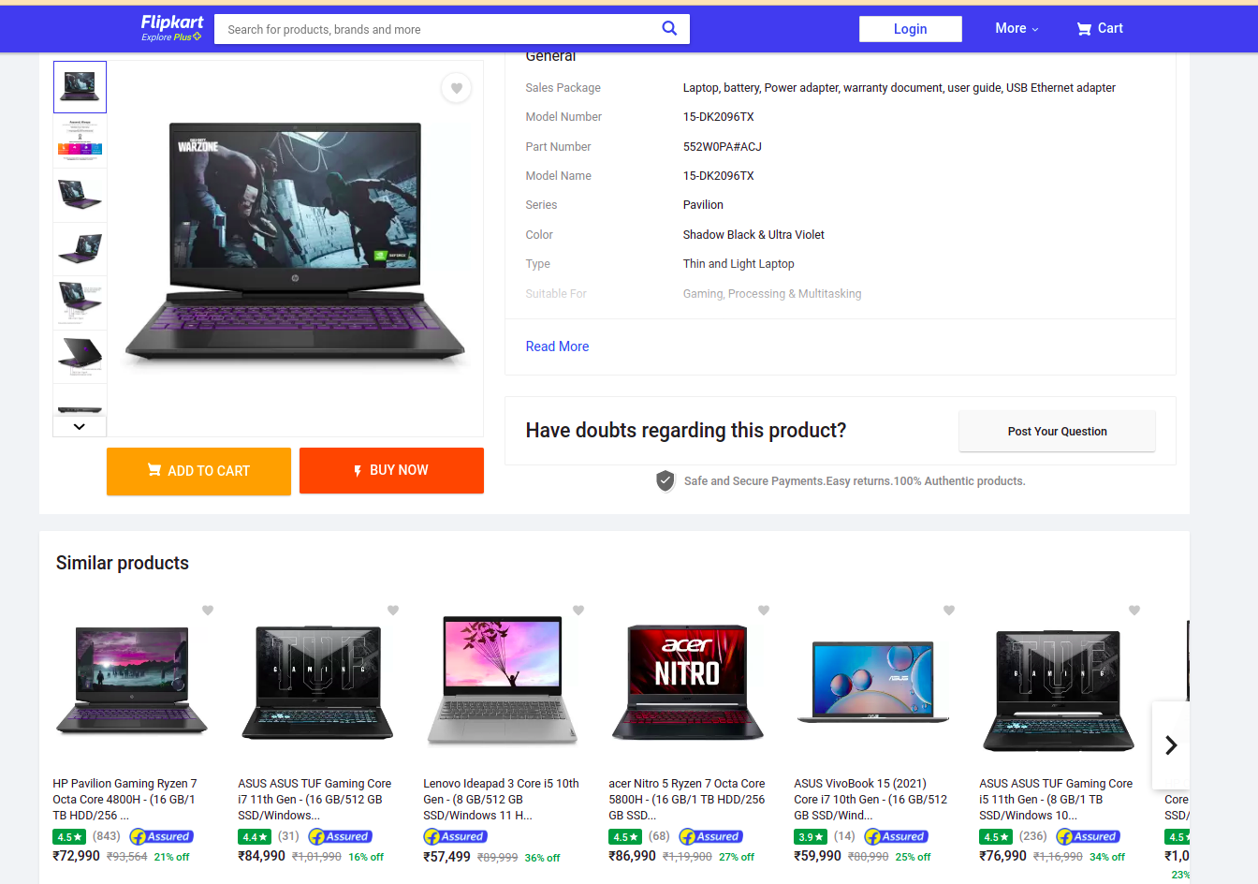
Motivation
Entertainment & Social Media
E-commerce & Retail

Slide 5
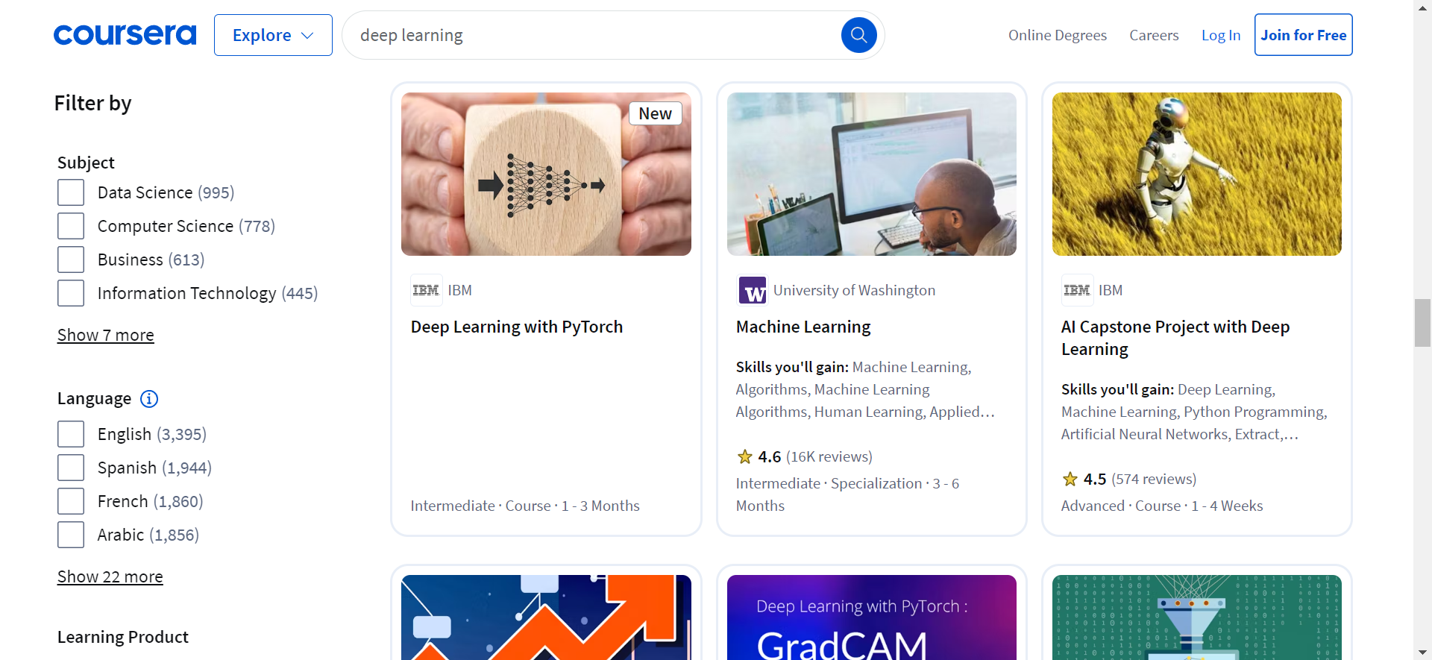
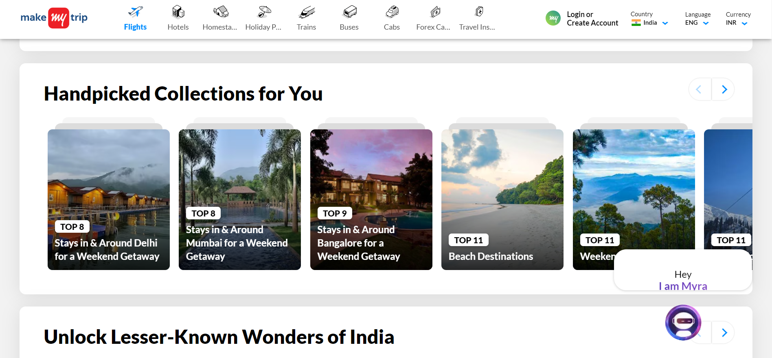
Motivation
Online Learning & Education
Travel & Hospitality

Slide 6
Exploration
Background Material
Types of Recommendation System
Matrix Factorization Technique
Exploration of Datasets
Data Handling and Preprocessing
Model Evaluation Metrics (Rating Prediction Metrics, Top-N Recommendation Metrics)

Slide 7
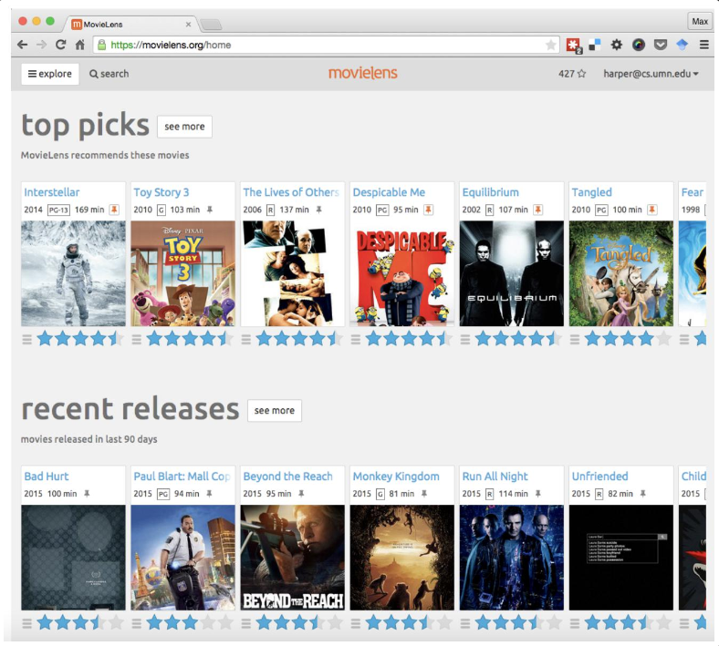
Datasets
MovieLens Dataset
Key Features:
User Ids, Movie Ids, Ratings, Tags
Dataset Compositions:
1,682 Movies, 943 Users, 1 Lakh Ratings
https://files.grouplens.org/datasets/movielens/ml-latest-small-README.html

Slide 8
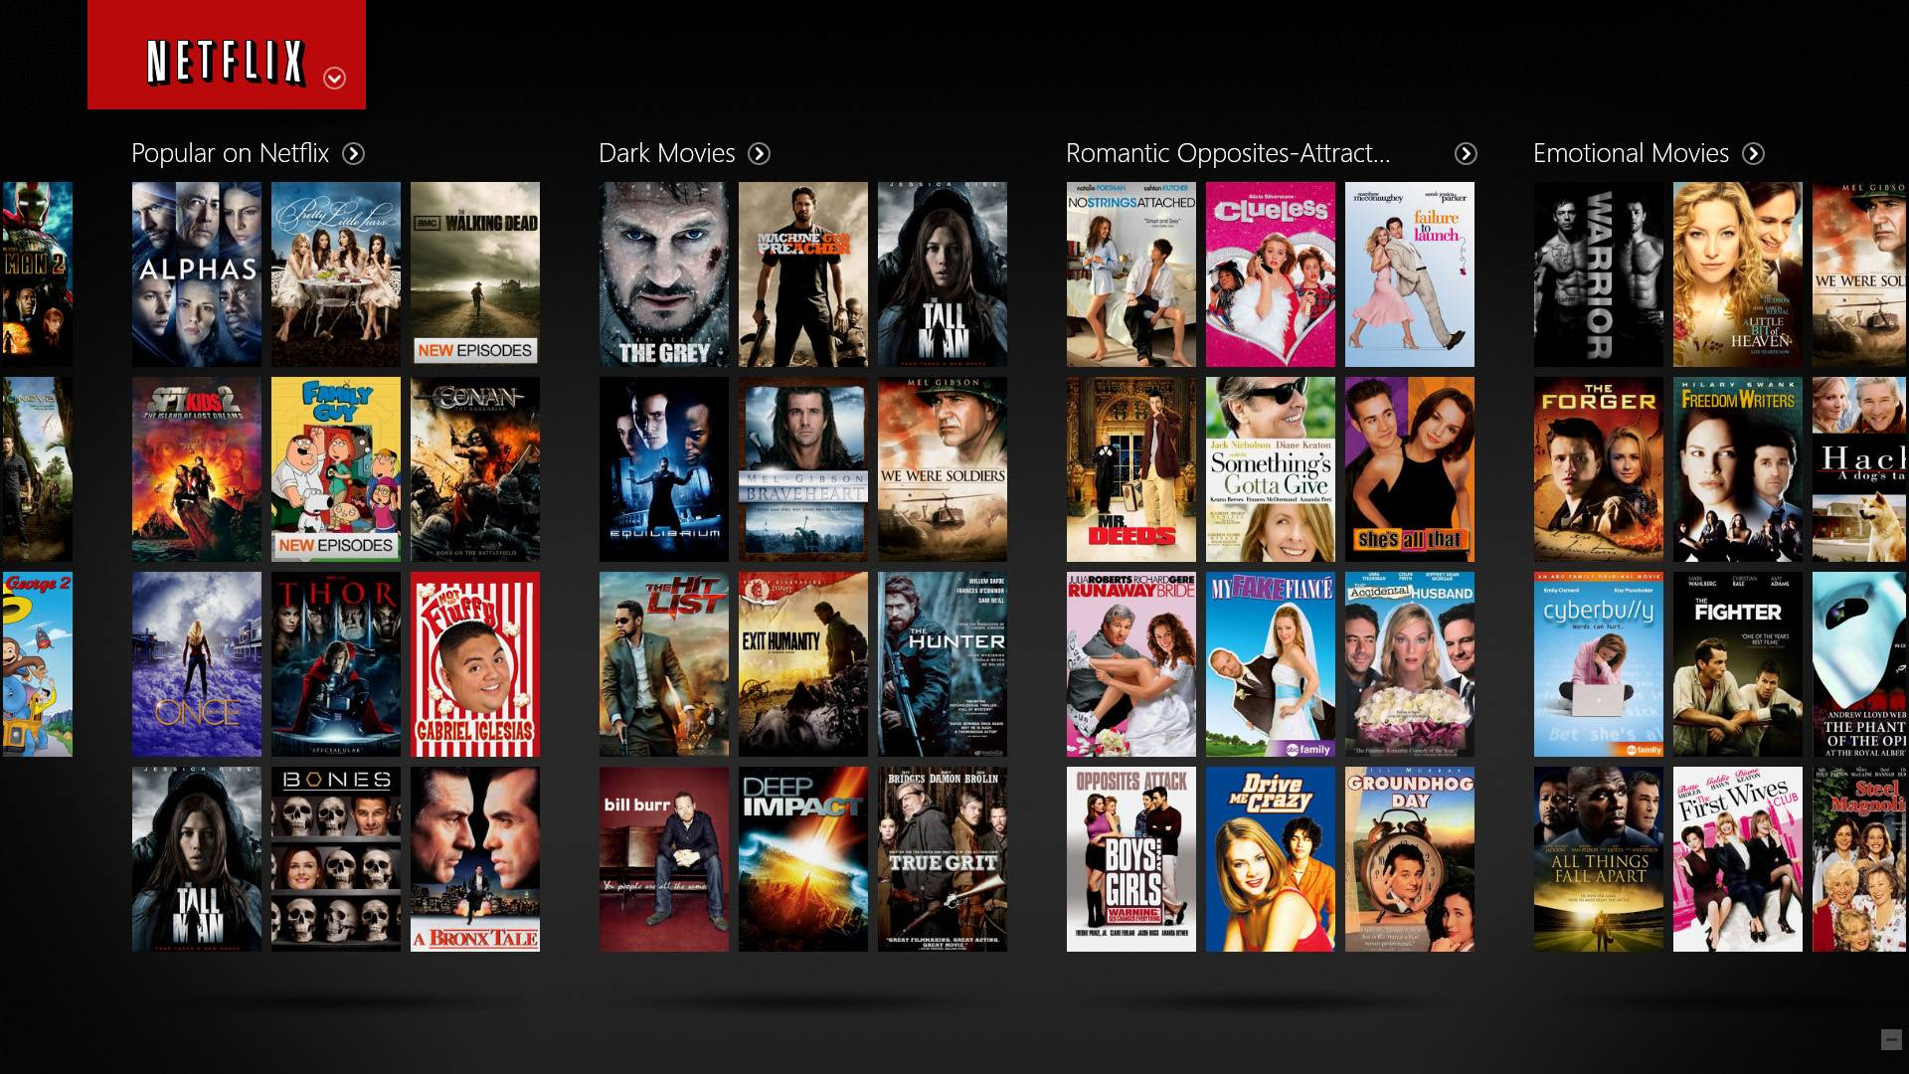
Datasets
Netflix Dataset
Key Features:
Users, Movies, Ratings, Dates
Datasets:
480K Users, 17,770 Movies & 100M Ratings
https://www.kaggle.com/datasets/netflix-inc/netflix-prize-data

Slide 9
Roadmap
Integrating Model with Interface
08
Designing and Interface
07
Model Training & Evaluation
06
03
05
04
Dataset Selection & Preprocessing
Model Selection
Model Implementation
01
02
Brain Storming on Problem
Explore Background Material

Slide 10
Summary
Hybrid Recommendation System: Combines content-based filtering (recommending based on movie features) and collaborative filtering (recommending based on user behavior and preferences).
Exploratory Data Analysis (EDA): Identifies different user personas to tailor movie recommendations to specific audience preferences.
Web Scraping & Sentiment Analysis: Gathers reviews from platforms, particularly Twitter, and uses sentiment analysis to recommend movies based on public opinion and trends.

Slide 11
References
https://static.javatpoint.com/python/images/using-python-create-own-movies-recommendation-engine2.png
https://files.grouplens.org/datasets/movielens/ml-latest-small-README.html
https://www.kaggle.com/datasets/netflix-inc/netflix-prize-data
https://towardsdatascience.com/metrics-of-recommender-systems-cde64042127a
https://www.freecodecamp.org/news/how-to-build-a-movie-recommendation-system-based-on-collaborative-filtering/

