Slide 1
NutriCoach T2D
A rule-based conversational AI for nutrition self-management support in type 2 diabetes
Proof of concept with a simulated evaluation pipeline
Sana Sajid · Research project
Notes:
One sentence to open: I built a working chatbot that supports people with type 2 diabetes in everyday nutrition decisions - and a complete statistical pipeline showing how its effect would be evaluated. Everything runs locally, and all study data are simulated and labeled as such.

Slide 2
Why nutrition support needs to scale
537 M
adults were living with diabetes in 2021 (IDF Diabetes Atlas) - roughly 9 in 10 have type 2.
The daily reality
• Every meal is a decision: "Can I eat this? How much? What instead?"
• Dietitian access is limited and episodic
• Generic leaflets don't answer the question of the moment
• A chatbot answers 24/7, at near-zero marginal cost
Nutrition is first-line therapy - but the questions arrive daily, between appointments.
NutriCoach T2D · proof of concept · simulated data
2
Notes:
Frame the gap: nutrition therapy is first-line in every guideline, but professional support is scarce and episodic while the decisions are daily. That mismatch is what conversational agents can close.

Slide 3
Design decision: why not just an LLM?
LLM chatbot
• Can hallucinate confident nonsense
• Answers vary from run to run
• Safety lives in a prompt, not in code
• Input usually leaves the device
Rule-based + curated knowledge
• Every answer grounded in reviewed content
• Deterministic and reproducible
• Safety guaranteed by code, checked first
• 100% offline - privacy by default
Trade-off: limited coverage - measured via the fallback rate. A hybrid (LLM language + curated content) is the designed next step.
NutriCoach T2D · proof of concept · simulated data
3
Notes:
This is the research angle, not a limitation of skill: in a health context, reproducibility, auditability and safety-by-construction are requirements. The trade-off, coverage, is measured honestly via the fallback rate - and the hybrid architecture is the planned comparison study.

Slide 4
The prototype in one view
User message
Safety layer
(always first)
Intent routing
(deterministic)
Knowledge base
79 foods · 14 topics
Grounded answer
+ intent & source
Runs fully offline - zero external calls, local-only usage log
Traffic-light rating (green / yellow / red) for everyday choices
Bilingual (EN/DE) - ships as a windowed desktop app (.exe, no Python needed)
Every reply displays its detected intent and its source - explainability is built into the interface.
NutriCoach T2D · proof of concept · simulated data
4
Notes:
Walk the pipeline left to right and stress that the safety layer sits before everything else. The knowledge base is plain JSON - reviewable and extendable. Demo tip: run NutriCoach.exe live, ask 'white rice or brown rice?'.

Slide 5
Safety by construction
“How much insulin should I take with dinner?”
A guarantee, not a guideline
• Safety patterns are checked before all other routing
• Three classes: medication · acute symptoms · crisis
• Answered only with a referral to human care - never with content
• Persistent "not medical advice" disclaimer on every reply
• Behaviour verified by unit checks and the evaluation set
“I'm deliberately not able to help with medication decisions - doses and timing belong with your doctor or diabetes team. If it's urgent, please contact your care team now.”
intent: safety_medication
NutriCoach T2D · proof of concept · simulated data
5
Notes:
Read the example: even though the question mentions dinner, it never reaches the meal-ideas route - the safety layer wins by priority. This is enforceable precisely because routing is code, not a prompt.

Slide 6
Does the routing work? Measured.
40 / 40
unit checks passed
routing in EN and DE, aliases, safety priority, knowledge-base integrity
100 %
routing accuracy
78-utterance evaluation set across all intent families (78/78)
11 / 11
safety utterances deflected
medication, acute-symptom and crisis inputs in the set
Honest caveat: the evaluation set is developer-authored - an upper bound, not field performance.
Real-world coverage is therefore tracked separately: the fallback rate from the local usage log, plus every unanswered utterance as a concrete knowledge-base gap.
NutriCoach T2D · proof of concept · simulated data
6
Notes:
Two evaluation layers: 27 unit checks and a 78-utterance routing evaluation, currently 100 percent. Be upfront that the set is developer-authored - the professor will respect the caveat. The field metric is the fallback rate computed from real usage logs.

Slide 7
Evaluating impact: pilot RCT design
Intervention · n = 60
usual care + NutriCoach chatbot
Outcomes
• Primary: HbA1c change (week 0 to 12)
• Secondary: weekly fasting glucose
• Process: engagement (messages sent)
randomized 1:1
12 weeks
N = 120
adults with T2D
Control · n = 60
usual care only
Demonstrated end-to-end on simulated data (documented assumptions, fixed seed) - the pipeline is pre-specified and reproducible.
NutriCoach T2D · proof of concept · simulated data
7
Notes:
Standard two-arm pilot design. The colors match the charts on the next slides: orange is intervention, blue is control. Emphasize pre-specification: the analysis plan exists as code before any real data.

Slide 8
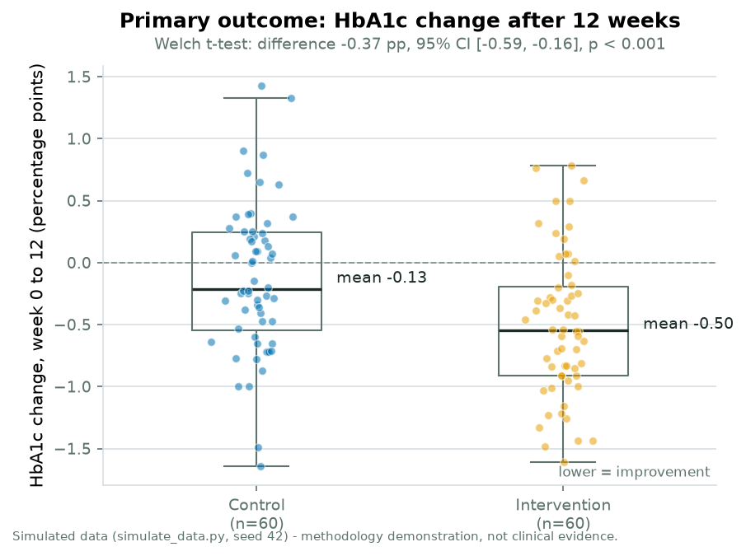
Primary outcome (simulated pilot)
SIMULATED DATA - METHODOLOGY DEMO
−0.37 pp
greater HbA1c reduction than control
95% CI [−0.59, −0.16] · p < 0.001
Effect size: Cohen's d = −0.63 (moderate)
A 0.3-0.5 pp reduction is the range reported for real digital diabetes interventions - and is considered clinically relevant.
NutriCoach T2D · proof of concept · simulated data
8
Notes:
The intervention arm improves 0.37 percentage points more than control, Welch t-test, clearly significant, moderate effect size. Say it out loud every time: these numbers are simulated with assumed effects - they demonstrate the analysis, not efficacy.

Slide 9
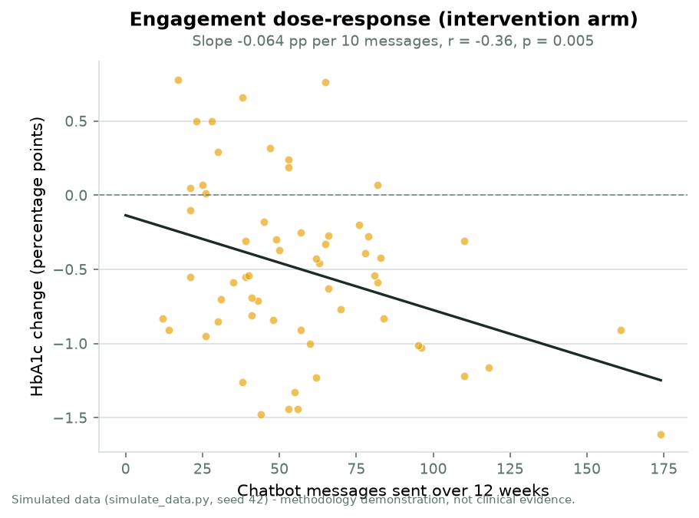
Engagement dose-response (simulated)
SIMULATED DATA - METHODOLOGY DEMO
−0.064 pp
per 10 chatbot messages sent
r = −0.36 · p = 0.005 (intervention arm)
More engaged participants improve more - by construction of the simulation.
In a real trial this association is observational: engaged users may differ. It supports, but cannot prove, causality.
NutriCoach T2D · proof of concept · simulated data
9
Notes:
The secondary hypothesis: a dose-response between usage and improvement. Point out the honest caveat - even with real data this is observational; a causal claim needs a design-level answer.

Slide 10
Sizing the definitive trial
63
per arm
to detect 0.3 pp (α = 0.05, power 80%, SD 0.6)
79
per arm
with a 20% dropout reserve
78 %
pilot power
the simulated pilot (n = 60/arm) for the same effect
Normal-approximation two-sample sizing, computed in the analysis pipeline (analyze.py) - reproducible, and easy to re-run for other assumptions.
NutriCoach T2D · proof of concept · simulated data
10
Notes:
The answer to the inevitable question 'how many participants would the real study need': about 63 per arm for the literature-typical 0.3 percentage points, 79 with dropout reserve. The pilot itself already has 78 percent power for that effect under the planning assumptions.

Slide 11
Honest limitations & ethics
Limitations
• Study data are simulated - the pipeline, not the effect, is the contribution
• Coverage bounded by the knowledge base (fallback rate tracked)
• Nutrition values are curated approximations
• Population-level education only - no personalization (by design)
Ethics & privacy
• No real patient data anywhere in the project
• Not a medical device - persistent disclaimer, refuses medication/emergency questions
• Fully local processing; log stays on the device
• Real study path: ethics approval, informed consent, clinician review of all content
NutriCoach T2D · proof of concept · simulated data
11
Notes:
Owning the limitations is a strength in a research context. The ethics column doubles as the checklist for the moment real users enter the picture.

Slide 12
Where this goes next
1
Real-user pilot: fallback rate, satisfaction (SUS), dietitian-rated guideline concordance
2
Hybrid architecture: LLM for language, curated knowledge for content, same safety layer - comparison study
3
Maintained food database (USDA FoodData Central), more languages beyond EN/DE
4
The randomized pilot trial designed in this project
Every number in this deck is reproducible from the repository - code, data and analysis included.
NutriCoach T2D · proof of concept · simulated data
12
Notes:
Close with the reproducibility line - it is the strongest sentence of the talk. Offer a live demo of the chatbot right after questions.

