Slide 1
Customer Churn & Retention Analysis
Data Driven Insights on Reducing Customer Churn
Sanket Kulkarni
March 2026

Slide 2
Business Problem
The telecom company is experiencing a high churn rate (25-30%).
This is leading to:
An exponential loss in revenue.
An increase in customer acquisition costs (CAC).
Reduction in Customer Lifetime Value (CLV).
Need to identify key drivers of churn and reduce customer attrition.

Slide 3
Key Insights 1 — Customer Behaviour (Contracts and Tenure)
Month-to-month contract type shows highest churn rate (43%)
New customer group of tenure 0 to 12 months show high churn rate (~47%)
Churn rate decreases with increase in contract type:
One year contract show around 11% churn rate.
Two year contract show around 3% churn rate.
Churn rate decreases with increase in customer lifecycle:
Early retention stage (12-24 months) show around 29% churn rate.
Medium-term (24-36 months) show around around 20% churn rate.
Long-term customers (36-48 months) show around 10% churn rate.
Insight: Less commitment and short lifecycle are churn drivers.

Slide 4
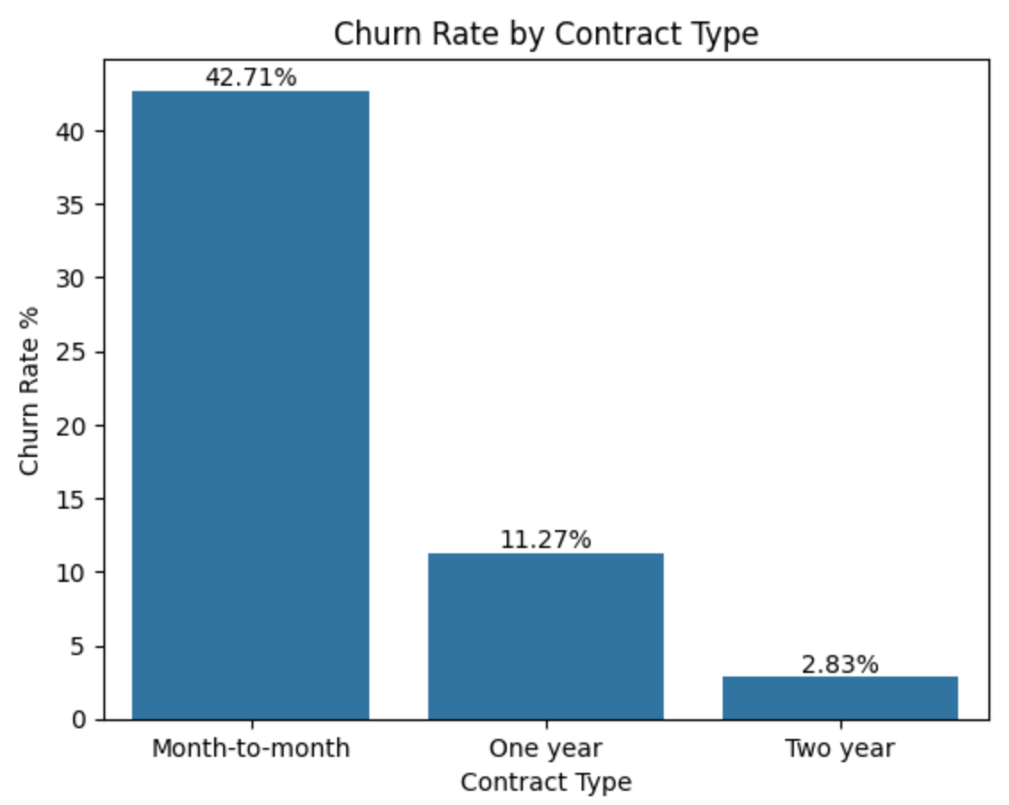
Visualization – Contract Type vs Churn Rate

Slide 5
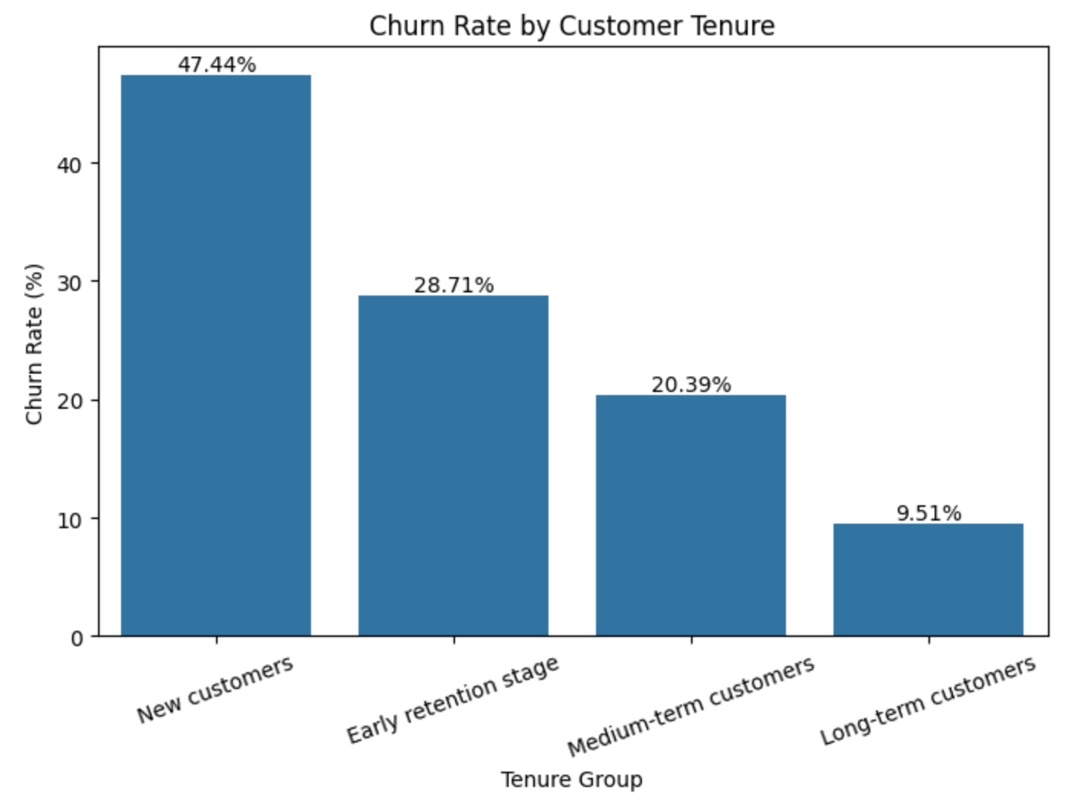
Visualization – Tenure vs Churn Rate

Slide 6
Key Insights 2 — Payment & Services
Customers with electronic check payment method show high churn rate (~45%).
Customers opting for automatic payment services show low churn rate (~ 16%).
Customers who do not use services like Tech Support, Online Security and Backup show high churn rate (39-41%).
Customers who are using these add on services show low churn rate.
Insights: Payment methods and add-on service usage influence the churn rate.

Slide 7
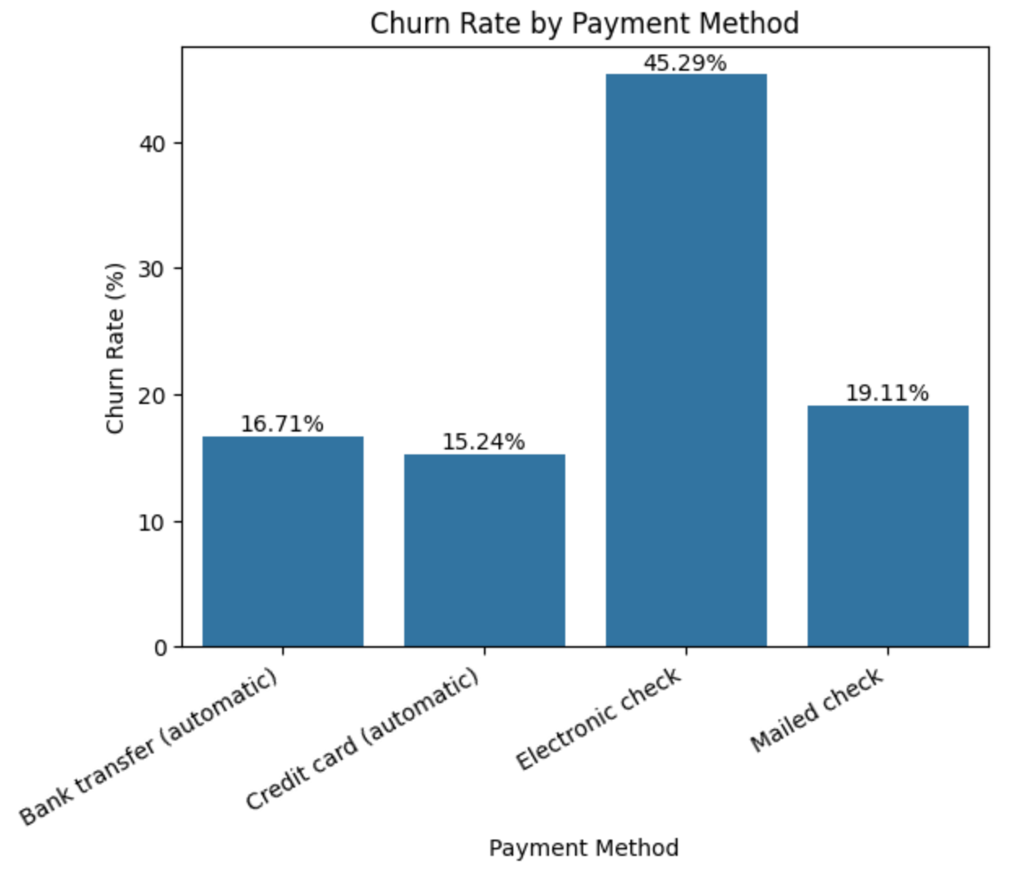
Visualization – Payment Methods vs Churn Rate

Slide 8
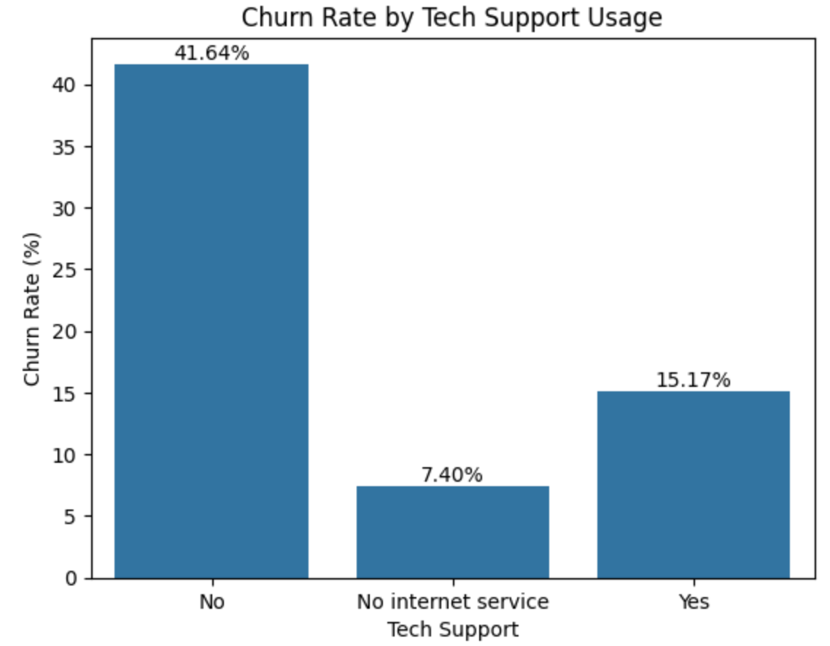
Visualization – Tech Support Usage vs Churn Rate

Slide 9
High-Risk and Low-Risk Customer Segments
High-Risk Customer Segment:
Fiber optic internet service
Month-to-month contract type
Electronic check payment method
New customers group tenure (0-12 months)
no tech support services
Churn Rate: ~ 72 %
Low-Risk Segment:
Two-year contract
Auto payment methods
Long-term customers
Add on services adoption
Churn Rate: ~2 %

Slide 10
Recommendations
Improve customer onboarding experience through guided service activation and proactive tech support.
Encourage customers on opting for long term contracts by offering small discounts and upgrade incentives.
Offer bundled value-added services and trial periods on streaming services.
Promote auto-payment methods and cashless online payment methods highlighting the ease, secure and seamless method of transaction.
Target high risk segment customers with personalized strategies and offers for retention.

