Slide 1
Regression Diagnostics and Outputs

Slide 2
What is it? And why use it?
Why do we use regression??
  To test associations based on assumptions of linear and/or non-linear relationships
  To predict an outcome or probability of an outcome based on one or more measures or predictive variables
What is it actually doing??

Slide 3
What are the assumptions
y=β₀+β₁x represents a linear relationship between variables Important!!!
This translates into three (major) assumptions: (there are others)
1) The model is good (that is, the relationship is linear and not, say, quadratic, exponential or something else)
2) The residuals have a normal distribution
3) The residuals have equal variance (are homoscadastic)

Slide 4
We should be checking these when using GLM, are we?
To test if model fit is good,
  Plot residuals versus predicted fit – check for pattern
To test if residuals are normally distributed
  Perform a normal probability plot
To test if residuals have equal variance
  Plot the residual versus predicted fit – check for spread of points

Slide 5
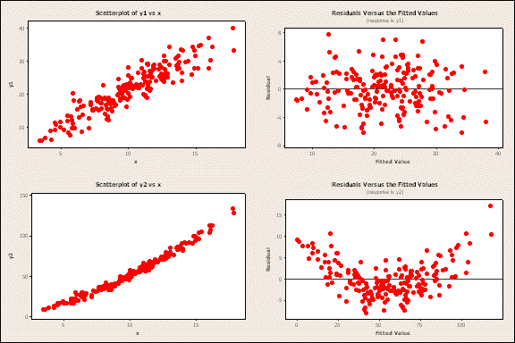
To test assumption
To test if model fit is good

Slide 6
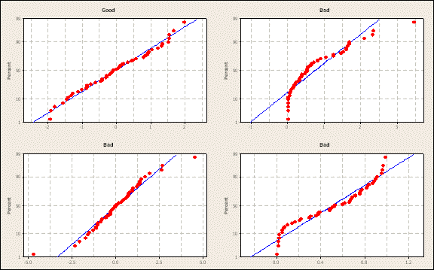
To test assumptions
To test if residuals are normally distributed

Slide 7
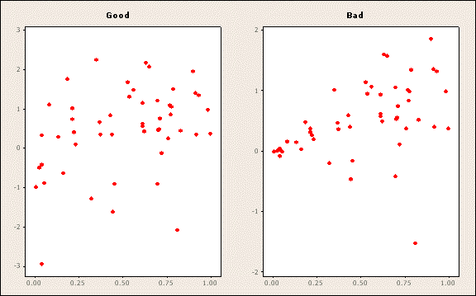
To test model fit
To test if residuals have equal variance

Slide 8
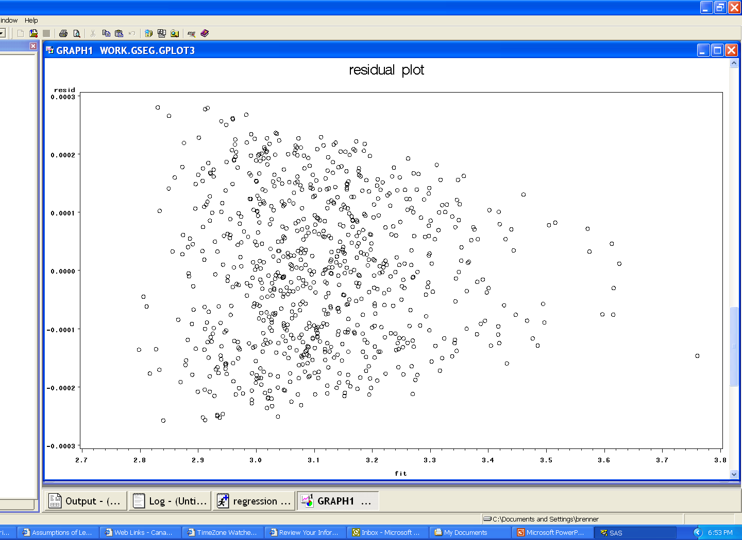
Example of Residual Plot
Model BMI=Height2 Weight
Not an even spread of residuals
Height and Weight are skewed, transformations are needed to better fit a linear model

Slide 9
Using GLM to predict
Use GLM to provide measures of prediction and determination such as R2 to find the best predictive models
Example - lets predict BMI using only height sq.
        new dataset with reg. outputs
        Gives predicted values gives residuals
        From model
proc glm data=bitter;
model bmi=height2;
output out=mydata.resid1 predicted=fit residual=resid ;
run;

Slide 10
Using GLM to predict
The GLM Procedure
Dependent Variable: BMI
Sum of
Source DF Squares Mean Square F Value Pr > F
Model 1 87.405457 87.405457 7.48 0.0064
Error 817 9543.394216 11.681021
Corrected Total 818 9630.799673
R-Square Coeff Var Root MSE BMI Mean
0.009076 15.10509 3.417751 22.62648
Source DF Type I SS Mean Square F Value Pr > F
height2 1 87.40545653 87.40545653 7.48 0.0064
Source DF Type III SS Mean Square F Value Pr > F
height2 1 87.40545653 87.40545653 7.48 0.0064
Standard
Parameter Estimate Error t Value Pr > |t|
Intercept 19.64813625 1.09532597 17.94 <.0001
height2 0.00010635 0.00003888 2.74 0.0064

Slide 11
Using GLM to predict
Now plot the actual value versus the predicted values from the model
symbol1 value=circle h=1;
proc gplot data=mydata.resid1;
plot bmi*fit/;
title ‘predicted vs. actual plot';
run;

Slide 12
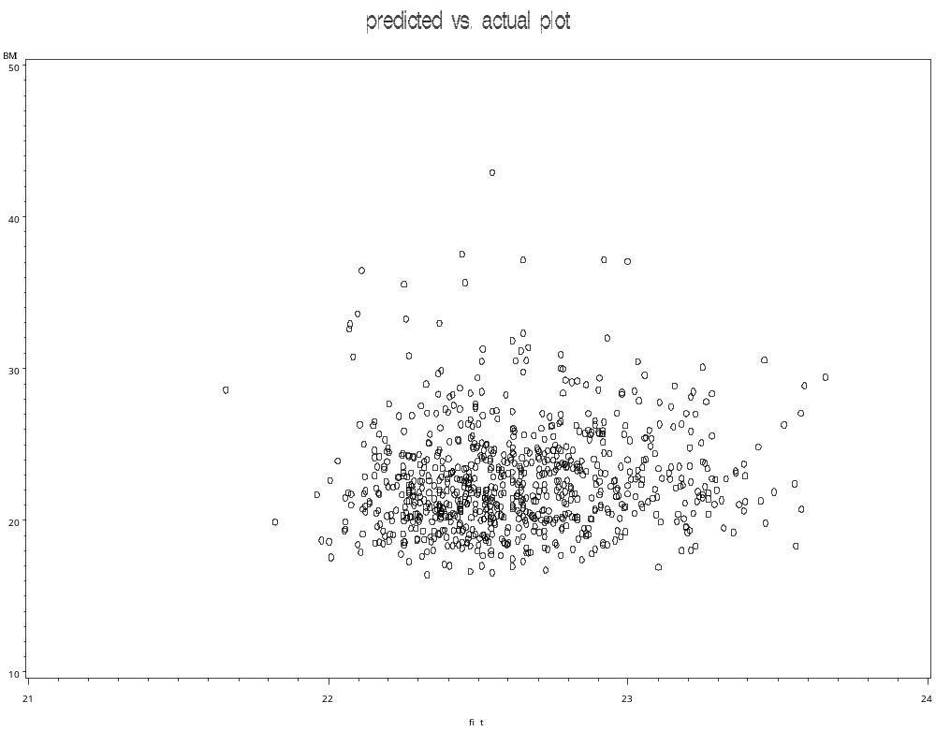

Slide 13
Exporting Data Method
To output variables of interest to a dataset for export to excel
data mydata.resid1;
set mydata.resid1;
keep fit resid subjectid bmi height weight;
run;

Slide 14
Using GLM to predict
Lets use same model, now using weight to predict BMI
proc glm data=bitter;
model bmi=weight;
output out=mydata.resid2 predicted=fit residual=resid;
run;
Proc gplot same as previous example for plot
Note resid.2 – then output to a new dataset as above for excel

Slide 15
Dependent Variable: BMI
Sum of
Source DF Squares Mean Square F Value Pr > F
Model 1 6485.672211 6485.672211 1684.76 <.0001
Error 817 3145.127462 3.849605
Corrected Total 818 9630.799673
R-Square Coeff Var Root MSE BMI Mean
0.673430 8.671436 1.962041 22.62648
Source DF Type I SS Mean Square F Value Pr > F
Weight 1 6485.672211 6485.672211 1684.76 <.0001
Source DF Type III SS Mean Square F Value Pr > F
Weight 1 6485.672211 6485.672211 1684.76 <.0001
Standard
Parameter Estimate Error t Value Pr > |t|
Intercept 8.255996023 0.35675765 23.14 <.0001
Weight 0.226370004 0.00551505 41.05 <.0001

Slide 16
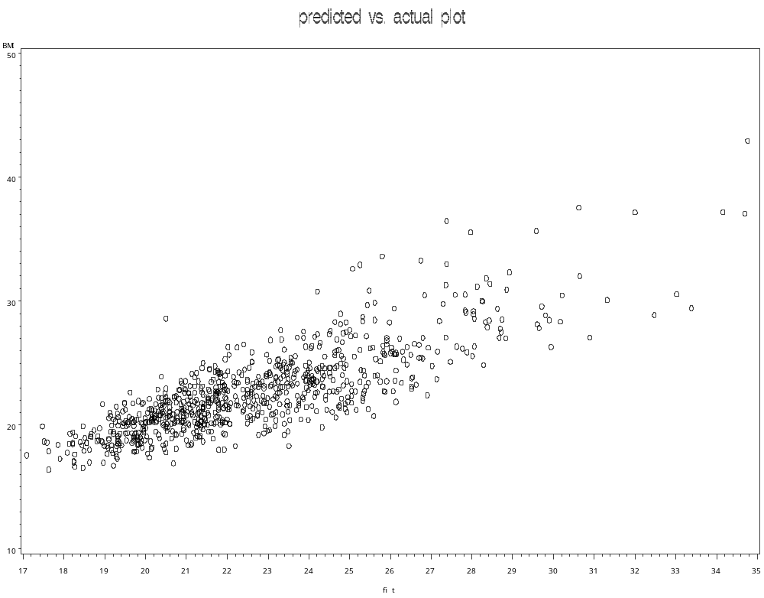

Slide 17
Using GLM to predict
Lets use same model examining weight and height to predict BMI
proc glm data=bitter;
model bmi=weight;
output out=mydata.resid3 predicted=fit residual=resid;
run;
Proc plot same as above
Note resid.3 – then output to a new dataset as above for excel

Slide 18
The GLM Procedure
Dependent Variable: BMI
Sum of
Source DF Squares Mean Square F Value Pr > F
Model 2 9510.385504 4755.192752 32224.1 <.0001
Error 816 120.414168 0.147566
Corrected Total 818 9630.799673
R-Square Coeff Var Root MSE BMI Mean
0.987497 1.697761 0.384144 22.62648
Source DF Type I SS Mean Square F Value Pr > F
height2 1 87.405457 87.405457 592.31 <.0001
Weight 1 9422.980048 9422.980048 63855.9 <.0001
Source DF Type III SS Mean Square F Value Pr > F
height2 1 3024.713293 3024.713293 20497.3 <.0001
Weight 1 9422.980048 9422.980048 63855.9 <.0001
Standard
Parameter Estimate Error t Value Pr > |t|
Intercept 22.88556954 0.12377577 184.90 <.0001
height2 -0.00081464 0.00000569 -143.17 <.0001
Weight 0.35531131 0.00140608 252.70 <.0001

Slide 19
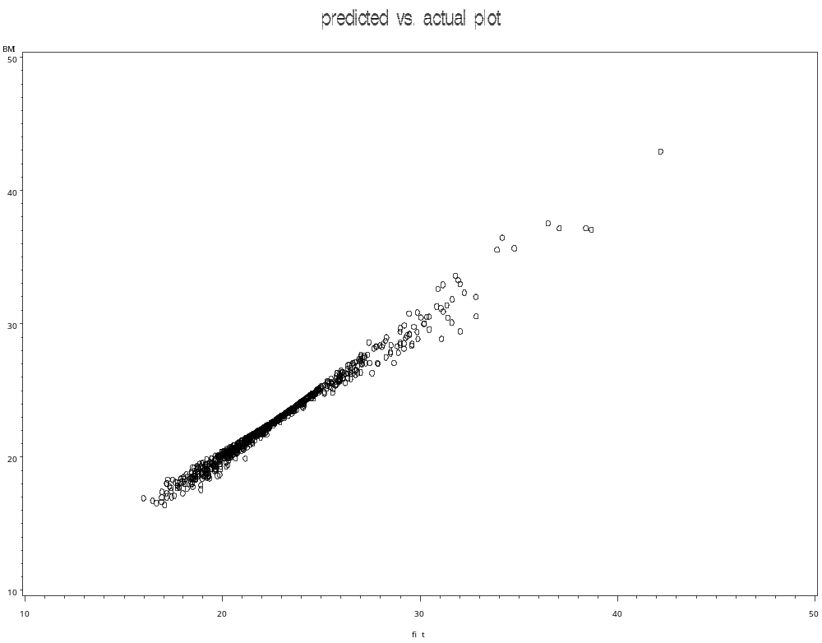

Slide 20
Showing the differences in predictive ability
Export the values and the predicted fit values to excel from all three models to excel. This will allow you to plot on the same graph the fit of the different models with regards to r2

Slide 21
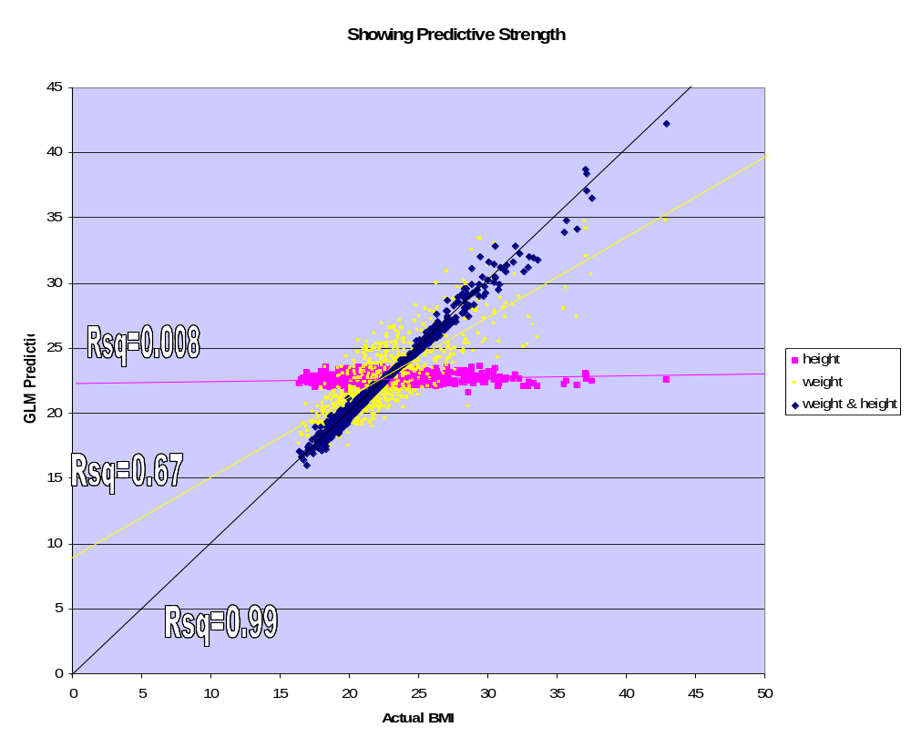

Slide 22
Additional Output options
The following can be obtained in the output dataset from the GLM
  the raw residuals (raw), the standardised residuals (standard), the studentised residuals (student) and the fitted values of the response variables (fit).

Slide 23
To test for multicollinearity in model
Use the Variance Inflation Factor in your model
If this value if over 10 (general rule of thumb, not set in stone) then some multicollinearity may exist and may be biasing your model
proc reg data=whatever;
model y=x1 x3 x4/VIF;
run;

Slide 24
To Check for Outliers
To observe whether potential outliers exist
proc gplot data=c2;
plot student*hii;
title ‘outlier plot’
run;

Slide 25
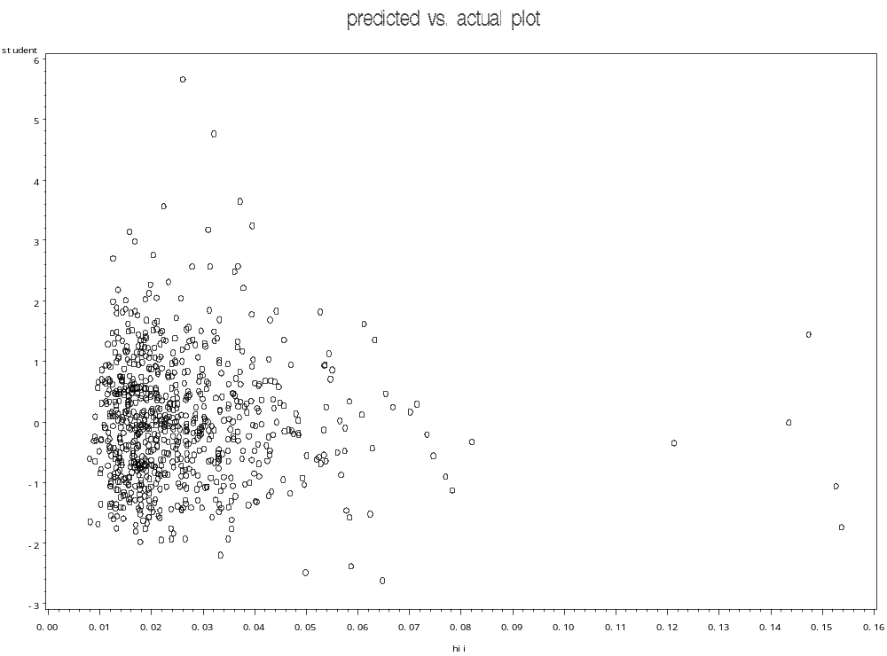
Potential Outliers potential cluster, check using proc print

Slide 26
Additional Notes
To get a plot of bmi vs. predicted
A normal probability plot is called a qqplot in SAS, meaning that it is a quantile-quantile plot: the quantiles of the residuals against the quantiles of a standard normal distribution.
The diagonal elements hii are saved in the column `hii'. The following program produces the plot, and a printout of the variables and the values of and, which is used to identify the possible outliers and leverage points.

