Slide 1

NYC MOTOR VEHICLE COLLISIONS: INSIGHTS FOR SAFER STREETS
SAURAV

Slide 2
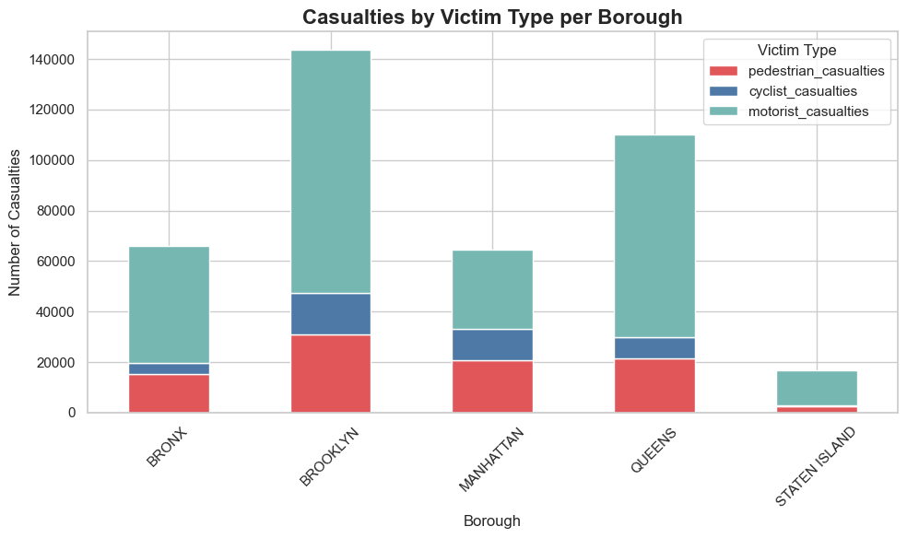
Where Do Collisions Occur?
Casualties by Victim Type per Borough
1
Brooklyn and Queens see the highest number of reported collisions.
2
Manhattan has fewer collisions overall but a high rate of pedestrian involvement.
3
Missing borough data accounts for ~35% of records.
Learn More

Slide 3
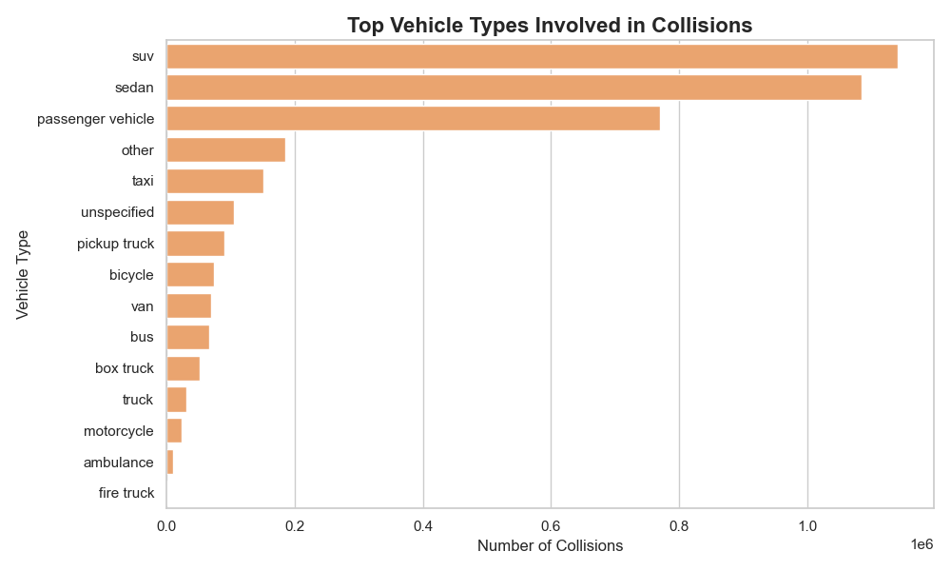
Who's Involved?
Vehicle Types
1
Sedans and SUVs together account for over 55% of all reported vehicle collisions.
2
Taxis appear frequently, especially in high-density areas like Manhattan, with over 150,000 incidents.
Learn More
3
Emergency vehicles contributes to a negligible share of incidents.
Top Vehicle Types Involved in Collisions

Slide 4
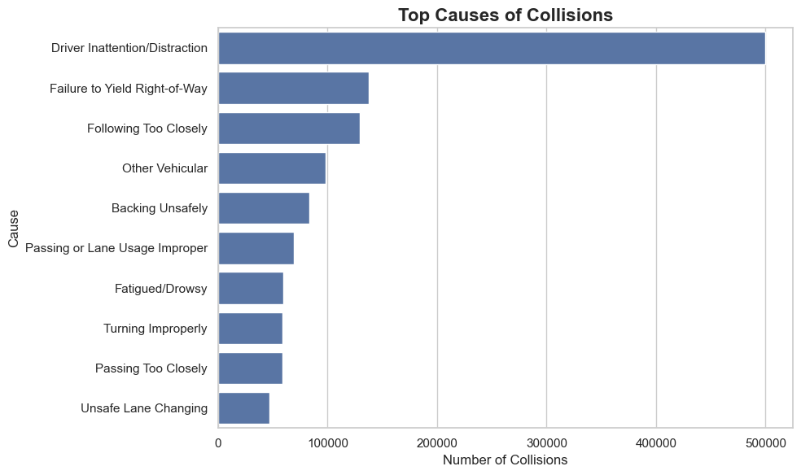
What Causes Collisions?
1
Driver inattention/distraction
caused over 480,000 collisions, making it the single most reported contributing factor.
2
Failure to yield right-of-way & following too closely
suggest gaps in driving etiquette and response time.
3
Behavioral factors
Top causes of Collisions
dominate the list, signaling a need for targeted education and stricter enforcement of traffic rules.

Slide 5
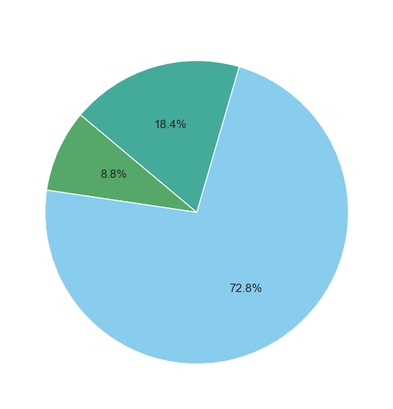
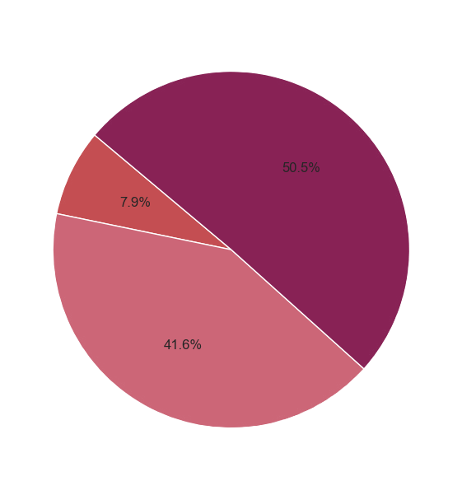
Casualties by Victim Type
Pedestrian
Pedestrian
Cyclist
Cyclist
Motorist
Motorist
Injuries By Victim Type
Fatalities By Victim Type
Motorists
Pedestrians
make up nearly 73% of injuries, but just 42% of fatalities..
while only 18% of the injured, represent over 50% of deaths.

Slide 6
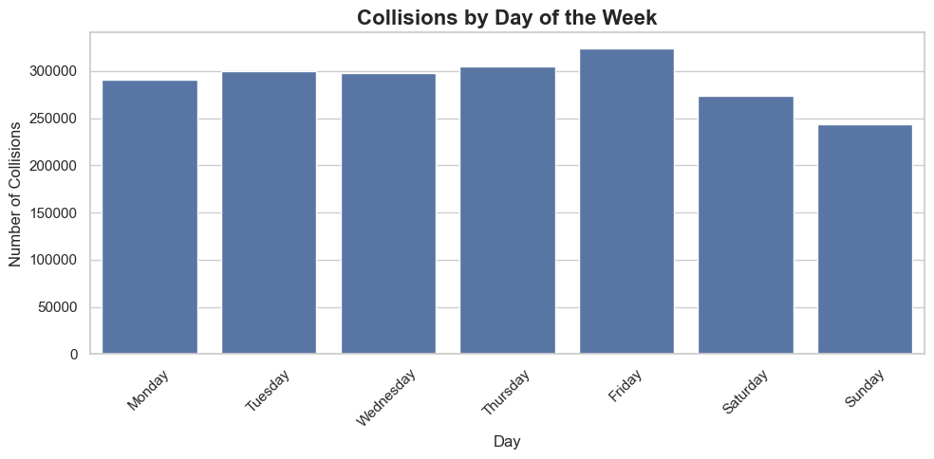
When Do Collisions Occur?
FRIDAY
Friday records the highest number of collisions, likely driven by increased traffic from both commuters and early weekend activity.
TUESDAY
Tuesday through Thursday show steady collision volumes, reflecting routine weekday travel patterns.
SUNDAY
Collisions by Day of the Week
Sunday has the lowest collision rate, aligned with reduced work and school traffic.

Slide 7
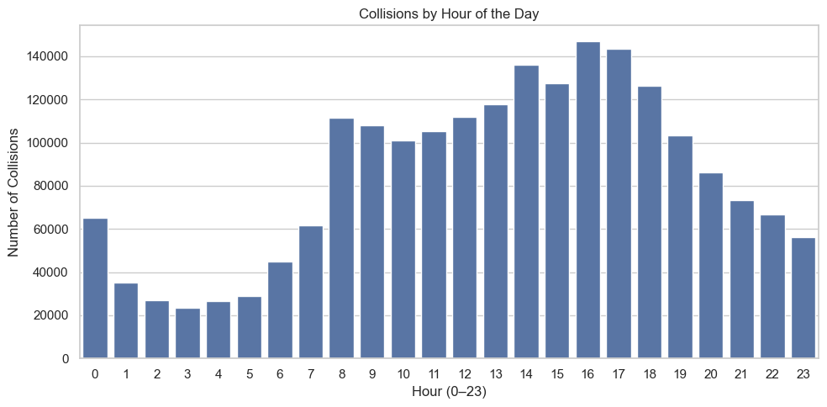
When Do Collisions Occur?
Let’s Narrow it down more
3PM - 5PM
Collisions spike during the afternoon rush (3 PM to 5 PM), with a smaller peak in the morning around 8 AM.
7A ONWARDS
Crash frequency climbs sharply from 7 AM onward and drops significantly after 8 PM.
2AM - 5AM
The lowest activity occurs between 2 AM and 5 AM, when roads are least active.
Collisions by Hour of the Week

Slide 8
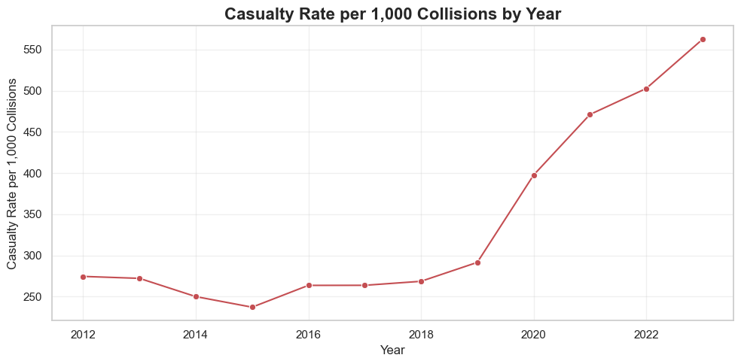
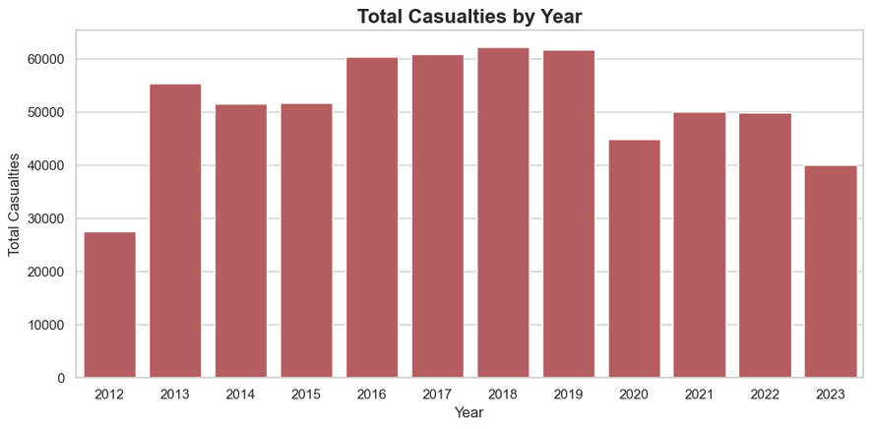
Are Collisions Getting More Severe?
Casualty Rate
Casualties By Year
1
2
3
⁠While total casualties declined slightly after 2019, the casualty rate per 1,000 collisions rose sharply.
The increase during 2020–2021 suggests *riskier driving during lower traffic volumes.
⁠Indicates a shift from frequency to severity enforcement may need to adapt.

Slide 9

Key take aways!
1
Pedestrians represent over 50% of all fatalities despite making up less than 20% of those injured.
2
Fridays and rush hour periods (3–5 PM) account for the highest collision volumes.
3
Driver inattention is the top cause of collisions, contributing to nearly half a million incidents.

Slide 10
THANK YOU

