Slide 1
LESSON PLAN 1 OF 2 · TEACHER SLIDE · SKIP WHEN PRESENTING
COM
TH
PS
ELL3 — Unit 1: The Exact Thing — Lesson 2: Cold Start: First Reading
Objective Read a short unseen story without help, and answer questions about it in writing. Outcomes W1 familiar and some academic language · W5 complex sentences with because · W14 complete sentences with very few errors
Materials Deck · worksheet (7 pages, one per student) · ‘The Long Way Home’ story pages (lines 1–25 + word list only — not its question pages) · exercise books · duotangs · help slips cut and in a box students can reach · pencils
TIMED SEQUENCE · about 105 minutes in all — carry over as needed
1
10 min
How our class works — Hand out exercise books and duotangs. The exercise book goes HOME: notes, review, assignments, announcements; bring it every class. The duotang STAYS in the room; finished work goes into it at the end of every lesson. Demonstrate the help slip: take one from the box, tick what to check, write the question in words, hand it in — it comes back with an answer.
2
7 min
Warm-up (exercise book) — Students write in their exercise books: when you meet an unknown English word, what do you do first? Is it the same in your first language? Take two or three answers aloud.
3
3 min
Title and goals — Name the three goals; say plainly that today there WILL be words they do not know, and that is planned.
4
12 min
Vocabulary + Part A — Hand out the worksheet. Teach the ten words, then students complete Part A (example word already crossed out). Reveal answers one at a time.
5
10 min
Two kinds of question + Part B — Literal = you can point at a line; inference = you work it out. Hood-up example. Students complete Part B; reveal one at a time.
6
4 min
Guessing is allowed — Read to the end of the sentence; underline and keep going; the right idea with the wrong word still counts.
7
15 min
Read ‘The Long Way Home’ — First read straight through, no stopping, no word list. Second read with a pencil: underline unsure words, star what you pictured, ? beside anything confusing. Story is on the slides in full; the word list slide follows.

Slide 2
LESSON PLAN 2 OF 2 · TEACHER SLIDE · SKIP WHEN PRESENTING
COM
TH
PS
ELL3 — Unit 1: The Exact Thing — Lesson 2: Cold Start: First Reading
TIMED SEQUENCE (continued) · about 105 minutes in all — carry over as needed
8
20 min
Parts C and D (independent) — C: literal answers with line numbers. D: inference — a claim AND the evidence (sentence frame in the box). Circulate; help slips in use. Reveal C and D answers after.
9
7 min
Talk it through (partners) — Compare underlines, stars and question marks with the frames. They do not have to agree.
10
10 min
Parts E, F, G — E: list own strategies. F: why an inference needs a because; write a literal + an inference question. G: tick-box check before handing in.
11
5 min
Exit ticket (Part H) — Last Part on the sheet. Then the whole worksheet goes into the duotang — collect duotangs.
12
2 min
Next class + exercise books — Next class is a class write. Students write that in their exercise books.
Differentiation
SUPPORT: word list on screen during the SECOND read; Part D sentence frame; for Part C a line number with key words is a full answer; first-language partner for the warm-up talk. EXTENSION: Part D — add a second piece of evidence; Part E — rank your strategies, most useful first.
Assessment (formative)
Part C: literal retrieval with line references. Part D: does every inference carry evidence (W5 because-sentences)? Part F and exit ticket read from the duotangs after class.
Homework
None. Write in exercise books: next class is a class write — bring the exercise book.
Watch for
Students stopping at the first unknown word (point back to ‘Guessing is allowed’); Part D answers with a claim and no quote, or a quote and no claim; students reading the word list before the first read.

Slide 3
OBJECTIVE
Read a short unseen story without help, and answer questions about it in writing.
COM
TH
PS
Outcomes W1 academic language · W5 sentences with because · W14 complete sentences
ELL3 · Unit 1 · Lesson 2
SHAPE OF THE DAY
Today
1
How our class works (routines)
7
Parts C and D (independent writing)
2
Warm-up (exercise book)
8
Talk it through (partner talk)
3
Key vocabulary — Part A (word bank)
9
Parts E, F and G (independent writing)
4
Two kinds of question — Part B (mini-lesson)
10
Exit ticket — Part H (quick write)
5
Guessing is allowed (mini-lesson)
11
Next class (exercise book)
6
Read ‘The Long Way Home’ (silent reading)
Next → How our class works

Slide 4

BEFORE WE START
How our class works
Next → Your exercise book

Slide 5

OBJECTIVE
Read a short unseen story without help, and answer questions about it in writing.
COM
TH
PS
Outcomes W1 academic language · W5 sentences with because · W14 complete sentences
ELL3 · Unit 1 · Lesson 2
HOW OUR CLASS WORKS
Your exercise book goes home
Write notes in it, so you can review at home.
1
Write down assignments and due dates.
2
Write down announcements and reminders.
3
Take it home.
Bring it back.
Warm-ups go in here — starting today.
4
Next → Your duotang

Slide 6

OBJECTIVE
Read a short unseen story without help, and answer questions about it in writing.
COM
TH
PS
Outcomes W1 academic language · W5 sentences with because · W14 complete sentences
ELL3 · Unit 1 · Lesson 2
HOW OUR CLASS WORKS
Your duotang stays in class
Your worksheets and class work go in your duotang.
1
At the end of every lesson, put today’s work in it.
2
Hand it in — I read your work from it.
3
It lives here.
It never goes home.
It is here for you at the start of every class.
4
Next → Help slips

Slide 7
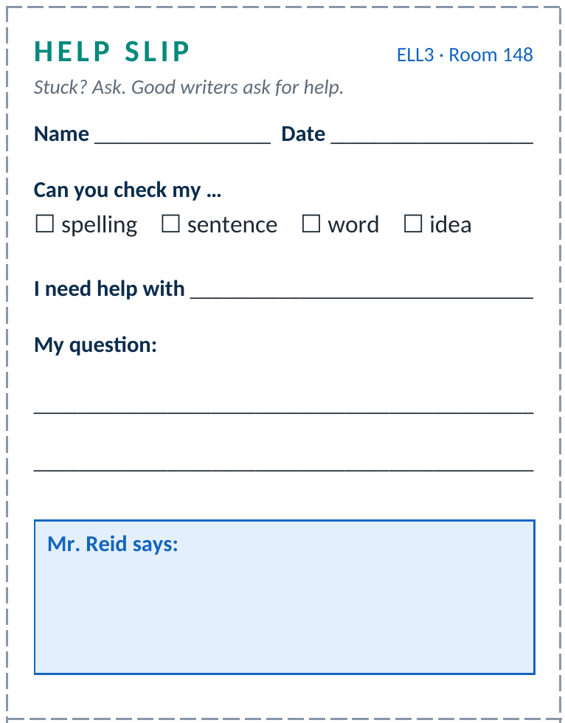
OBJECTIVE
Read a short unseen story without help, and answer questions about it in writing.
COM
TH
PS
Outcomes W1 academic language · W5 sentences with because · W14 complete sentences
ELL3 · Unit 1 · Lesson 2
HOW OUR CLASS WORKS
Stuck? Use a help slip
Take a slip from the box. You do not need to ask me first.
1
Tick what you want me to check.
2
Write exactly what you need help with, and your question in words.
3
Hand it to me and keep working. It comes back with my answer in the box.
4
Next → What a help slip looks like

Slide 8
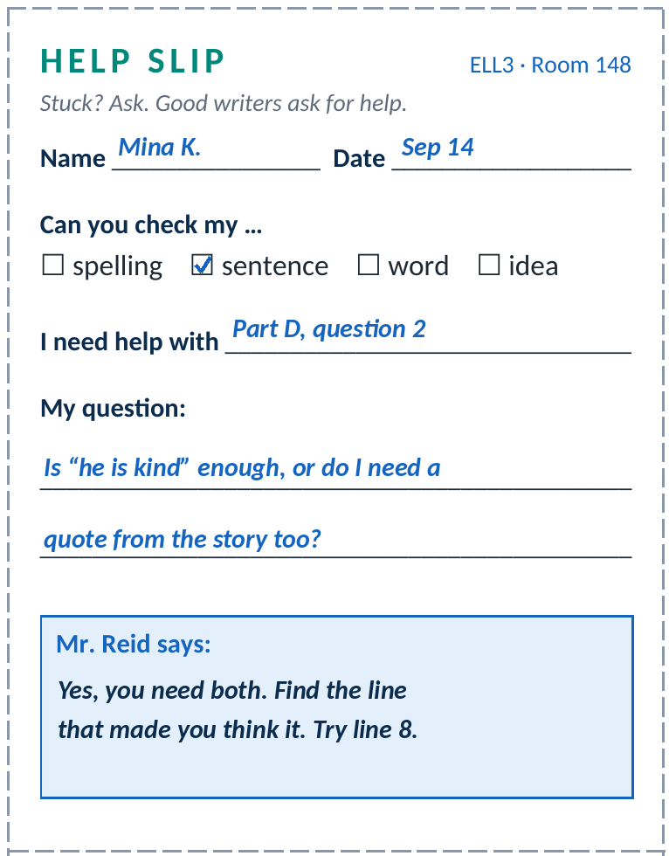
OBJECTIVE
Read a short unseen story without help, and answer questions about it in writing.
COM
TH
PS
Outcomes W1 academic language · W5 sentences with because · W14 complete sentences
ELL3 · Unit 1 · Lesson 2
HOW OUR CLASS WORKS
A help slip, filled in
What makes this a good help slip
It says exactly where: Part D, question 2.
It asks a real question in words — not just “I don’t get it.”
Mina kept working while she waited.
Asking for help is not a problem. It is how writers get better.
Next → Warm-up

Slide 9
OBJECTIVE
Read a short unseen story without help, and answer questions about it in writing.
COM
TH
PS
Outcomes W1 academic language · W5 sentences with because · W14 complete sentences
ELL3 · Unit 1 · Lesson 2
WARM-UP
Warm-up — in your exercise book
Open your exercise book. Write today’s date, then write your answers.
When you read in English and hit a word you do not know, what do you do first?
1
Is that the same thing you do when you read in your first language?
2
Next → Today’s lesson

Slide 10
THE EXACT THING · SEPTEMBER
Lesson 2
Cold Start: First Reading
Multicultural Voices
Next → Today’s goals

Slide 11
OBJECTIVE
Read a short unseen story without help, and answer questions about it in writing.
COM
TH
PS
Outcomes W1 academic language · W5 sentences with because · W14 complete sentences
ELL3 · Unit 1 · Lesson 2
GOALS
By the end of this lesson you can:
Read a short, unseen story without help.
1
Answer questions on the page and underneath the page, in writing.
2
Name the reading strategies you already use.
3
Next → Hand out the worksheet

Slide 12
OBJECTIVE
Read a short unseen story without help, and answer questions about it in writing.
COM
TH
PS
Outcomes W1 academic language · W5 sentences with because · W14 complete sentences
ELL3 · Unit 1 · Lesson 2
YOUR WORKSHEET
Hand out the worksheet now
Name and date at the top first. We fill in each Part as we go.
Part A Vocabulary
Part E Your reading strategies
Part B Which kind of question?
Part F Check your understanding
Part C On the page
Part G Check your work
Part D Underneath the page
Part H Exit ticket
The exit ticket is the last Part. The whole sheet goes in your duotang at the end.
Next → Worksheet page 1

Slide 13
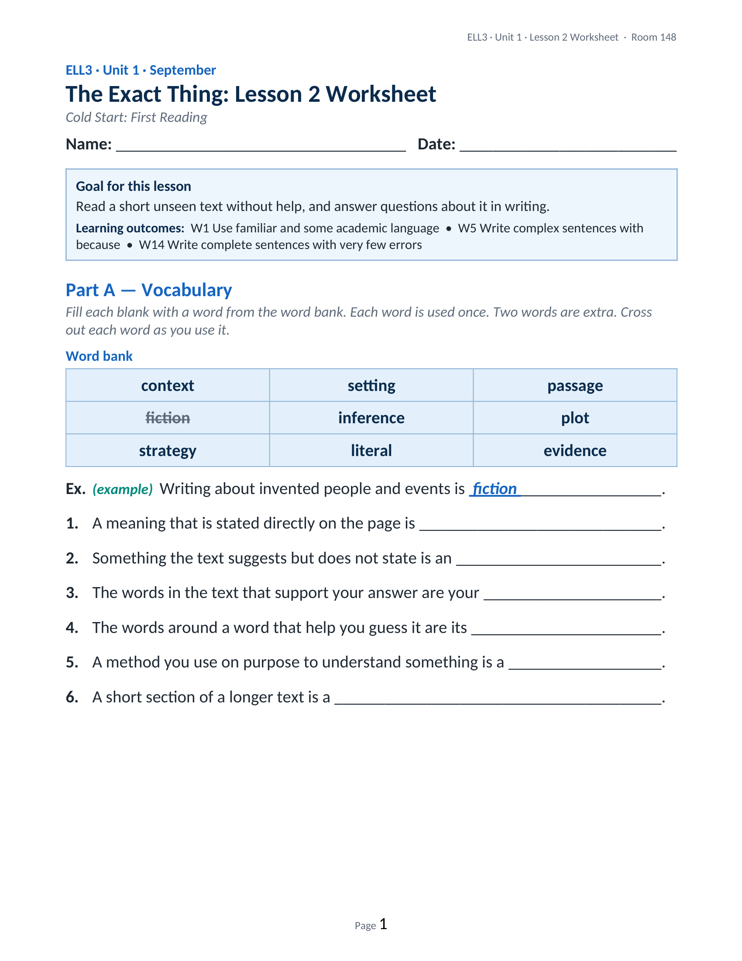
OBJECTIVE
Read a short unseen story without help, and answer questions about it in writing.
COM
TH
PS
Outcomes W1 academic language · W5 sentences with because · W14 complete sentences
ELL3 · Unit 1 · Lesson 2
YOUR WORKSHEET
WORKSHEET
Page 1 of 7
Next → Worksheet page 2

Slide 14
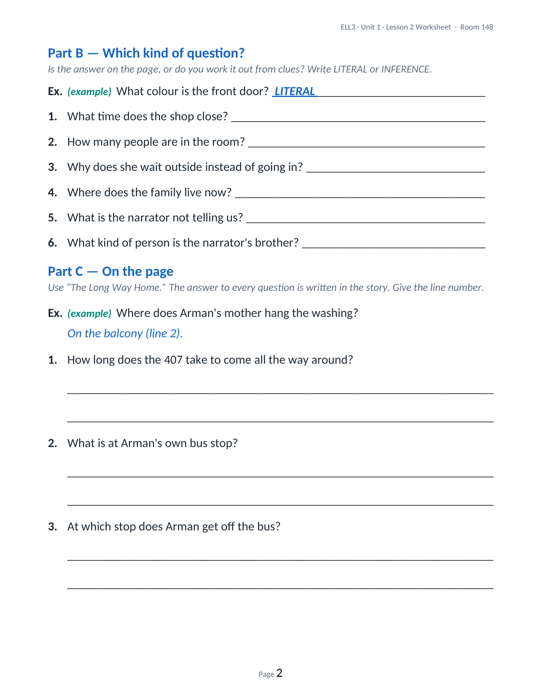
OBJECTIVE
Read a short unseen story without help, and answer questions about it in writing.
COM
TH
PS
Outcomes W1 academic language · W5 sentences with because · W14 complete sentences
ELL3 · Unit 1 · Lesson 2
YOUR WORKSHEET
WORKSHEET
Page 2 of 7
Next → Worksheet page 3

Slide 15
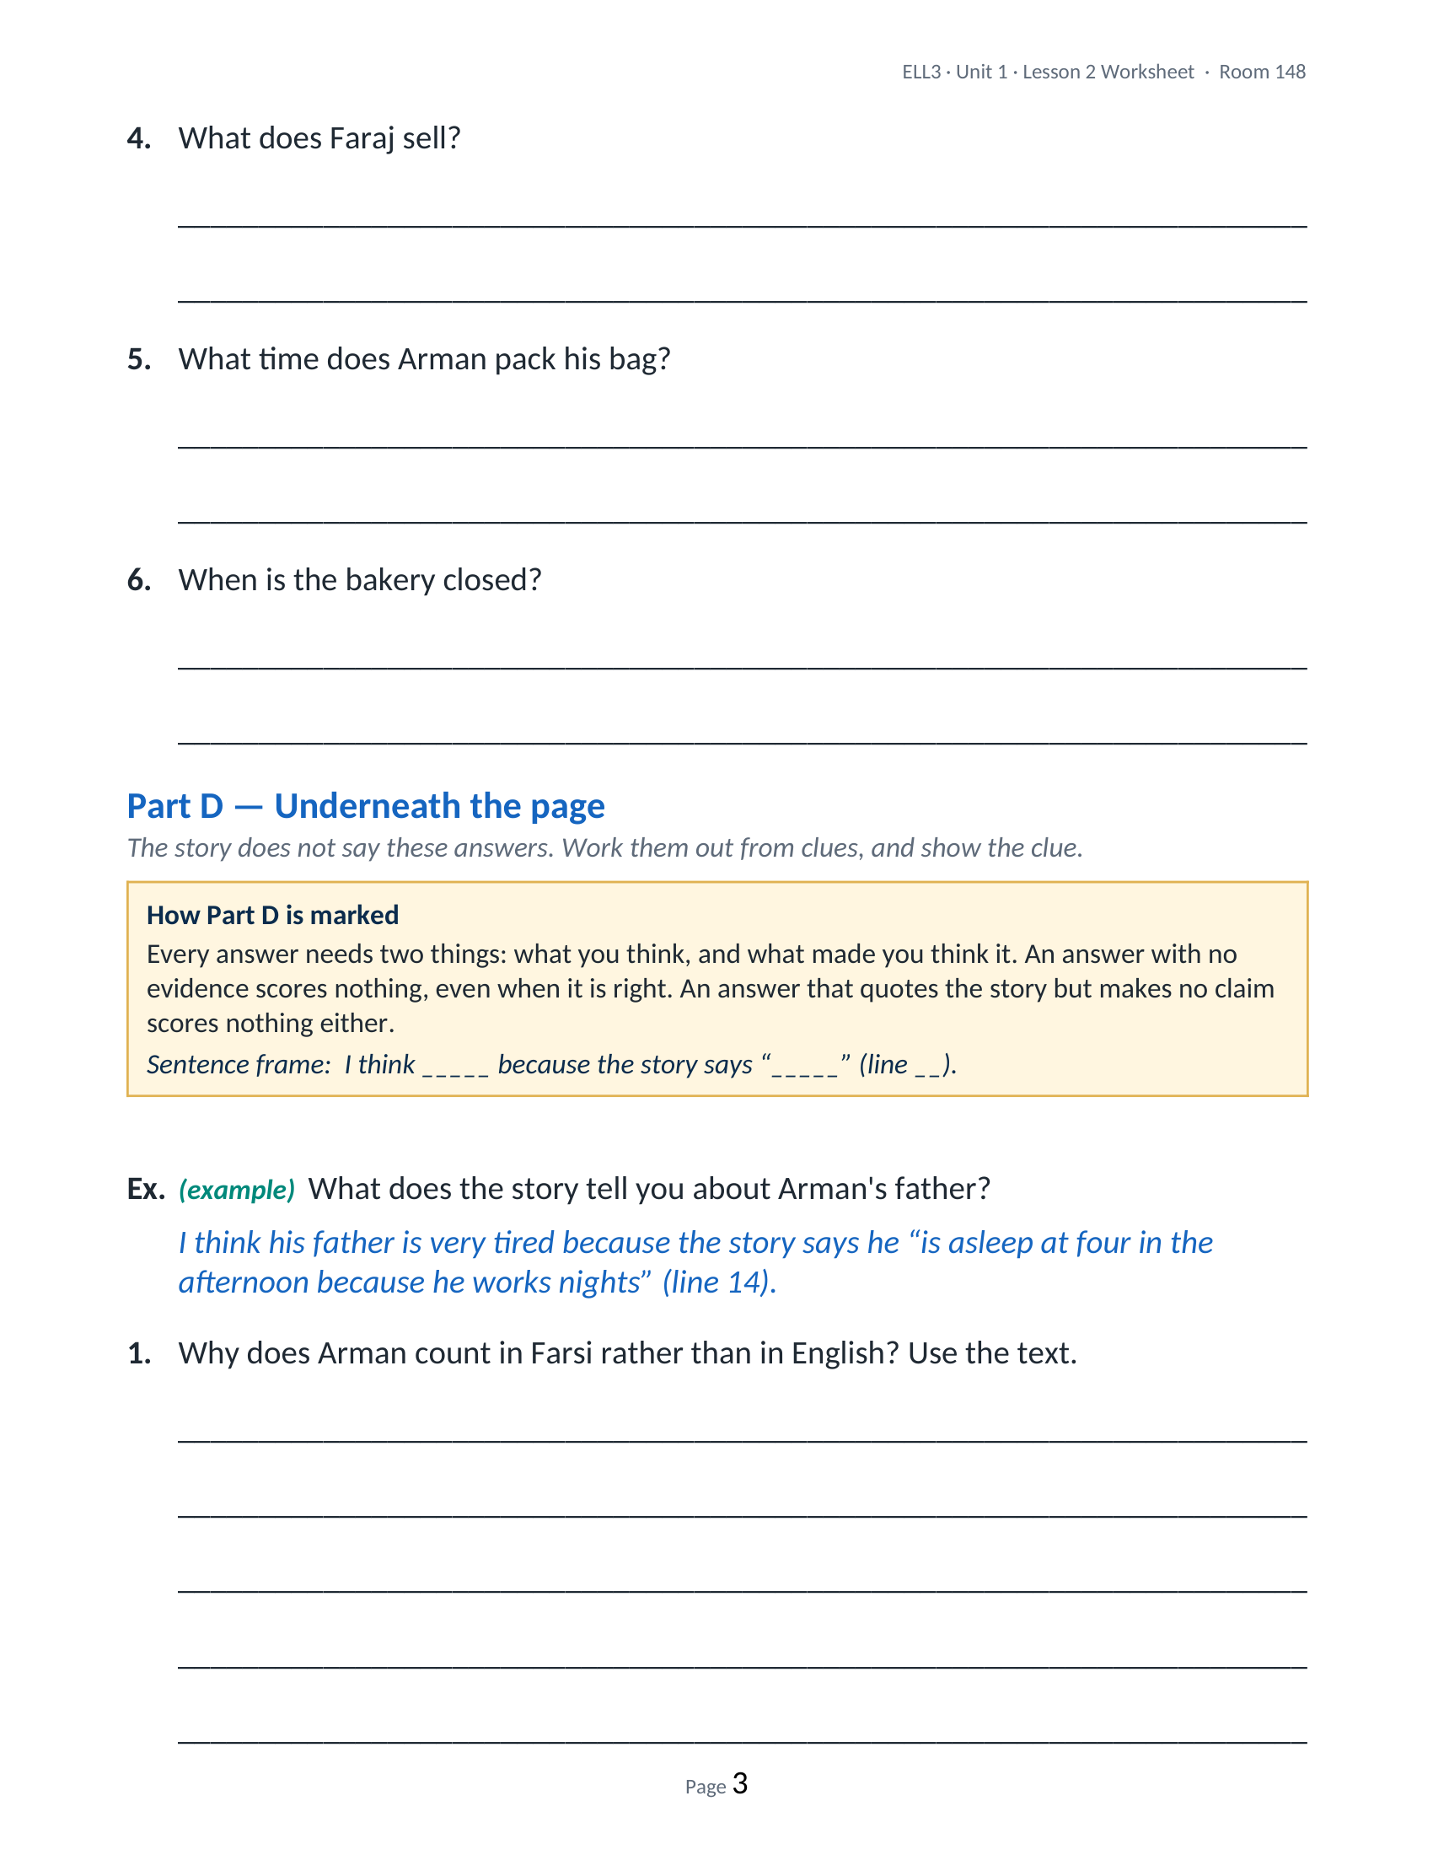
OBJECTIVE
Read a short unseen story without help, and answer questions about it in writing.
COM
TH
PS
Outcomes W1 academic language · W5 sentences with because · W14 complete sentences
ELL3 · Unit 1 · Lesson 2
YOUR WORKSHEET
WORKSHEET
Page 3 of 7
Next → Worksheet page 4

Slide 16
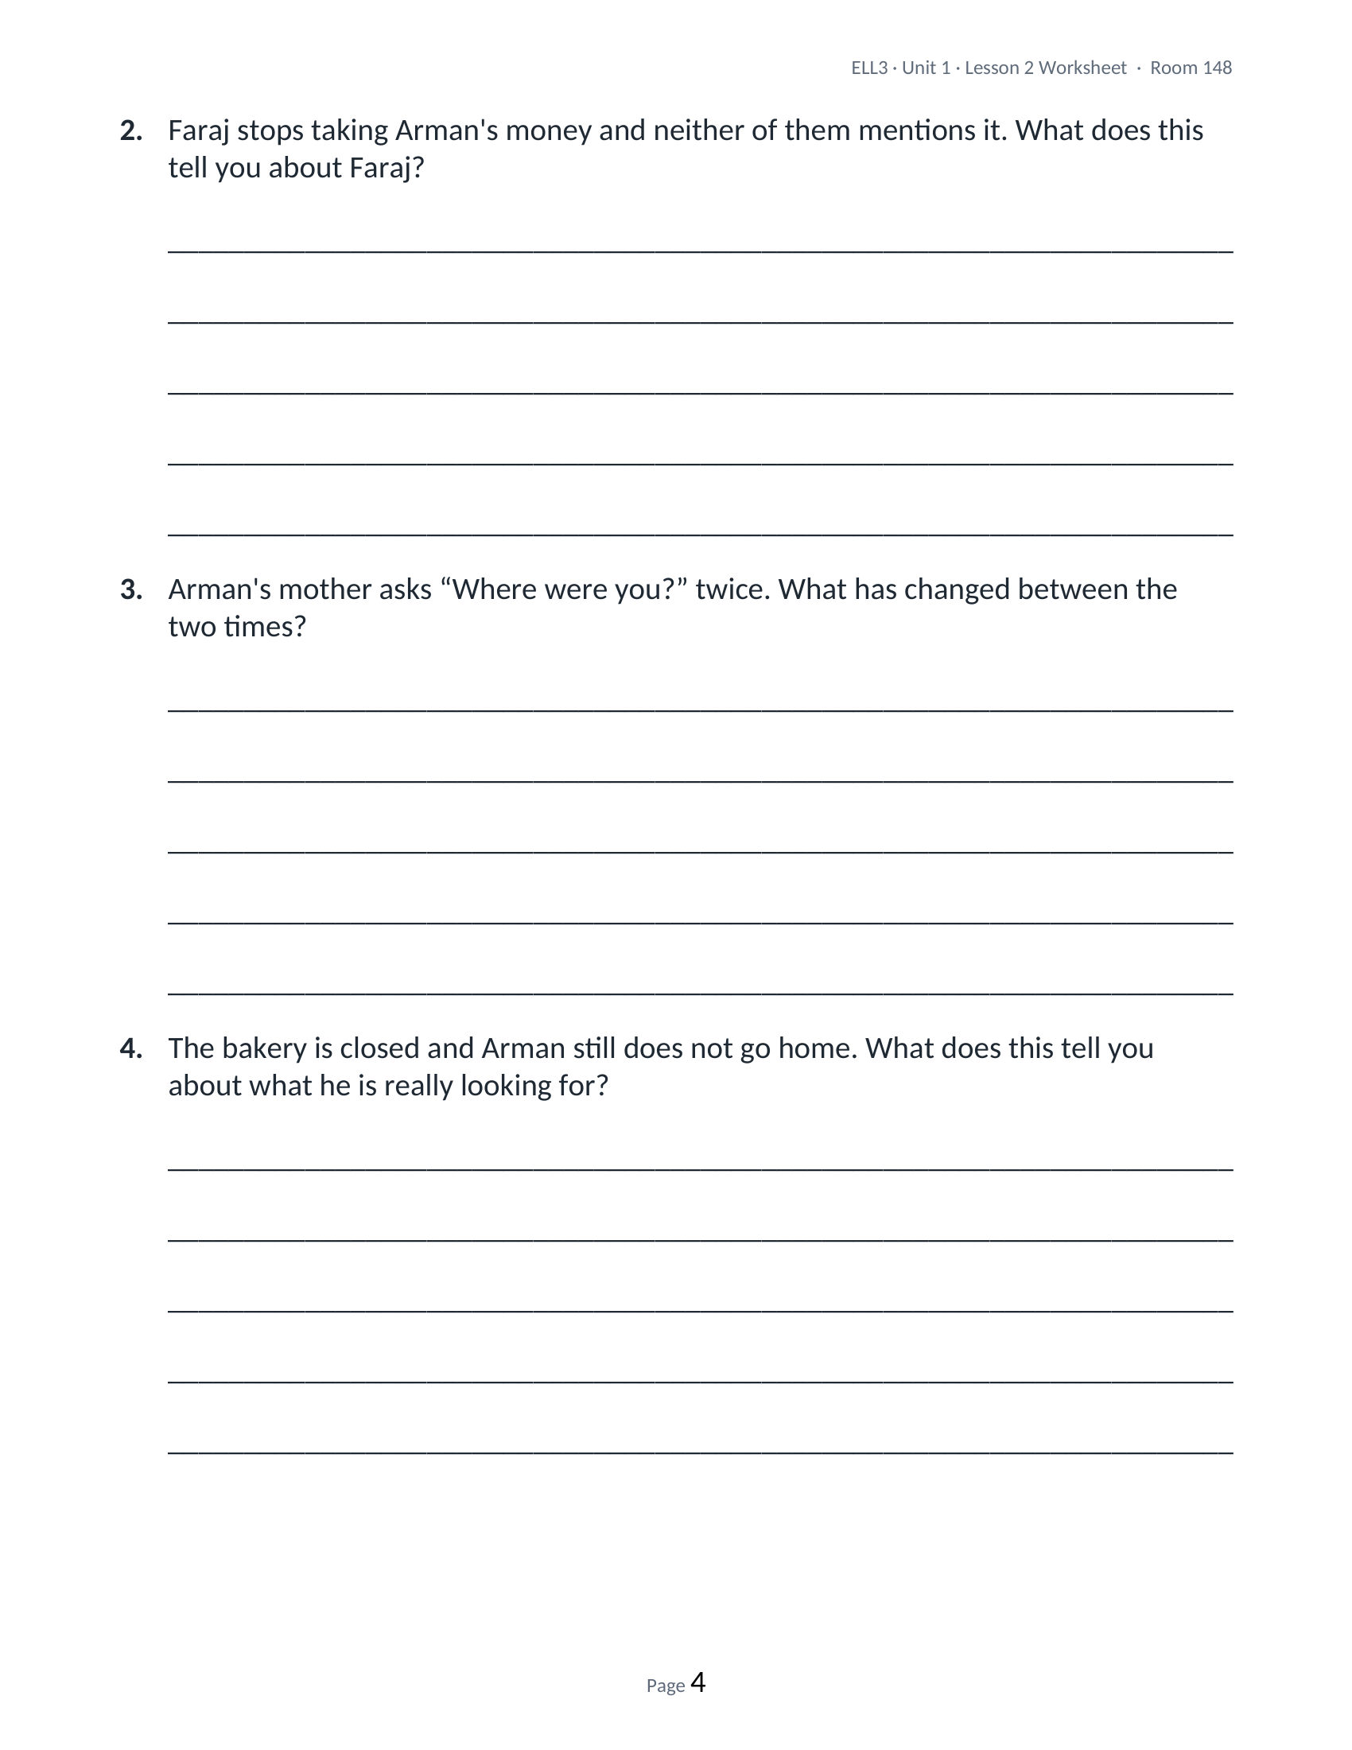
OBJECTIVE
Read a short unseen story without help, and answer questions about it in writing.
COM
TH
PS
Outcomes W1 academic language · W5 sentences with because · W14 complete sentences
ELL3 · Unit 1 · Lesson 2
YOUR WORKSHEET
WORKSHEET
Page 4 of 7
Next → Worksheet page 5

Slide 17
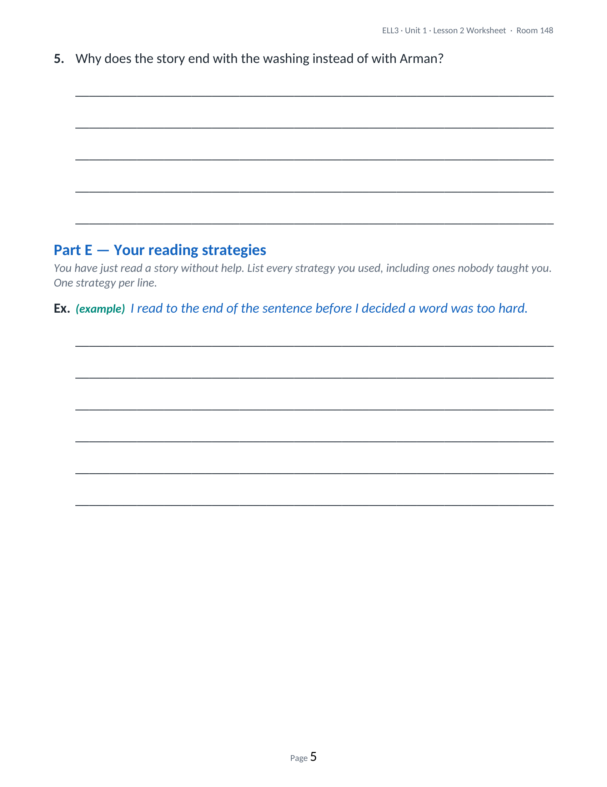
OBJECTIVE
Read a short unseen story without help, and answer questions about it in writing.
COM
TH
PS
Outcomes W1 academic language · W5 sentences with because · W14 complete sentences
ELL3 · Unit 1 · Lesson 2
YOUR WORKSHEET
WORKSHEET
Page 5 of 7
Next → Worksheet page 6

Slide 18
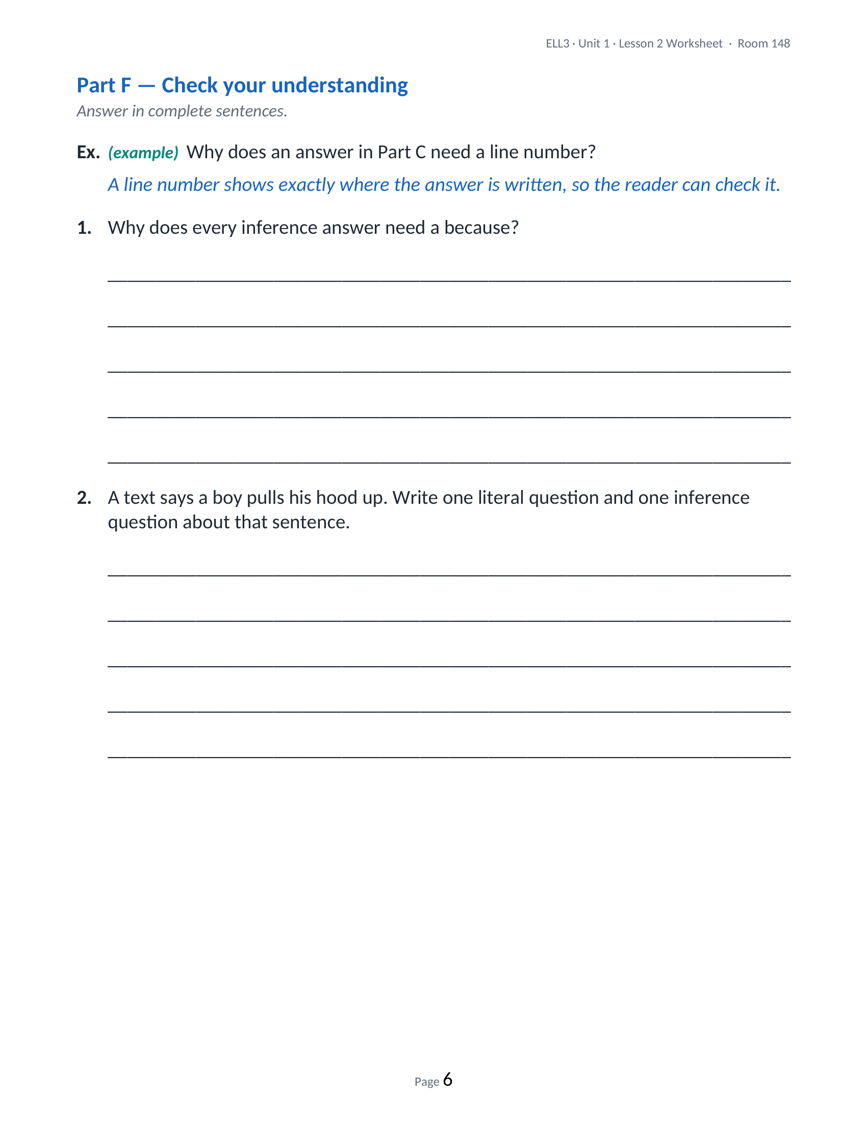
OBJECTIVE
Read a short unseen story without help, and answer questions about it in writing.
COM
TH
PS
Outcomes W1 academic language · W5 sentences with because · W14 complete sentences
ELL3 · Unit 1 · Lesson 2
YOUR WORKSHEET
WORKSHEET
Page 6 of 7
Next → Worksheet page 7

Slide 19
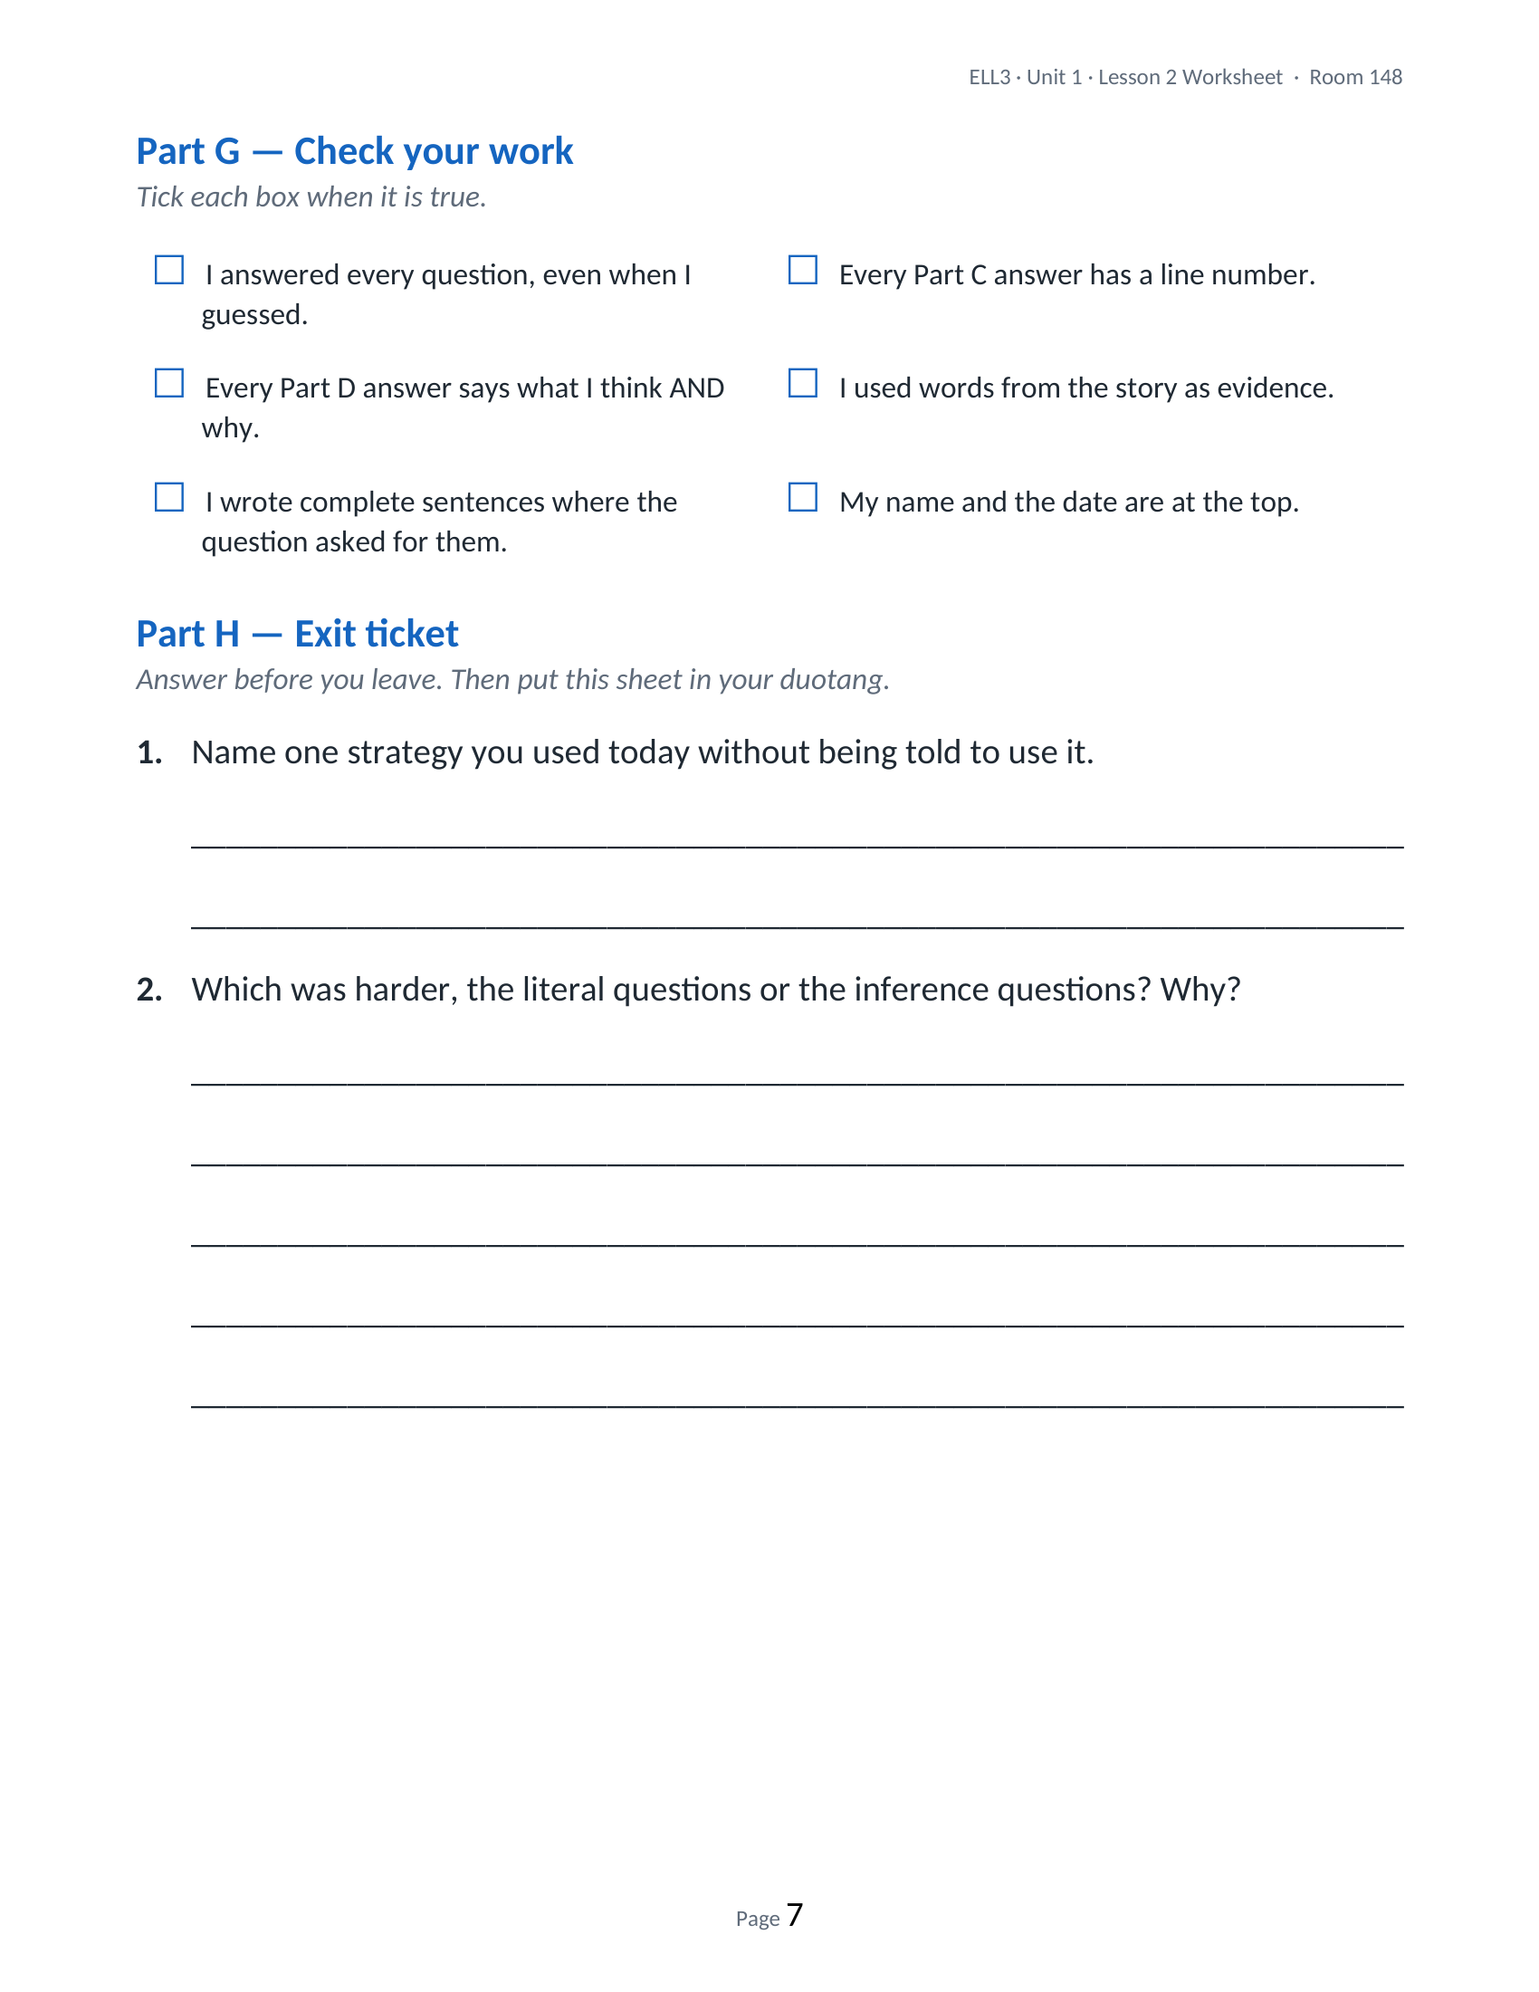
OBJECTIVE
Read a short unseen story without help, and answer questions about it in writing.
COM
TH
PS
Outcomes W1 academic language · W5 sentences with because · W14 complete sentences
ELL3 · Unit 1 · Lesson 2
YOUR WORKSHEET
WORKSHEET
Page 7 of 7
Next → Key vocabulary

Slide 20
OBJECTIVE
Read a short unseen story without help, and answer questions about it in writing.
COM
TH
PS
Outcomes W1 academic language · W5 sentences with because · W14 complete sentences
ELL3 · Unit 1 · Lesson 2
VOCABULARY
Key vocabulary
fiction
character
setting
plot
literal
writing about invented people and events
a person in a story
where and when a story happens
the events of a story, in order
the direct meaning; what the words actually say
inference
evidence
strategy
context
passage
something the text suggests but does not say directly
the words in the text that support your answer
a method you use on purpose to understand something
the words around a word, which help you guess it
a short section of a longer text
Next → Part A — Vocabulary

Slide 21
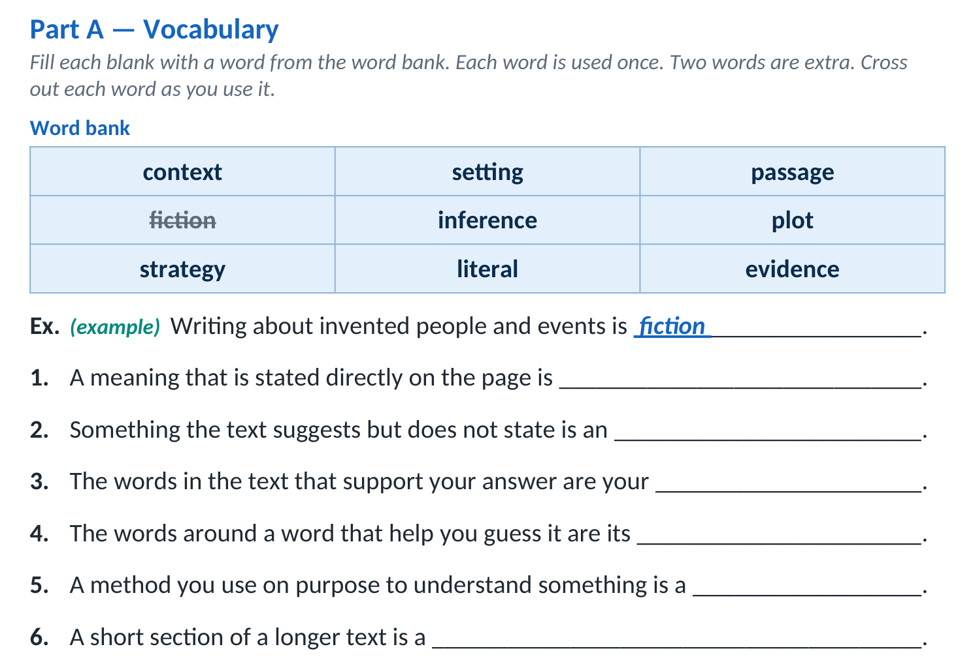
OBJECTIVE
Read a short unseen story without help, and answer questions about it in writing.
COM
TH
PS
Outcomes W1 academic language · W5 sentences with because · W14 complete sentences
ELL3 · Unit 1 · Lesson 2
WORKSHEET WALKTHROUGH
Part A — Vocabulary
HOW TO COMPLETE IT
Read each sentence. Choose the word from the bank that completes it. Cross the word out when you use it. Two words are extra — you will not use them.
Next → Part A answers

Slide 22
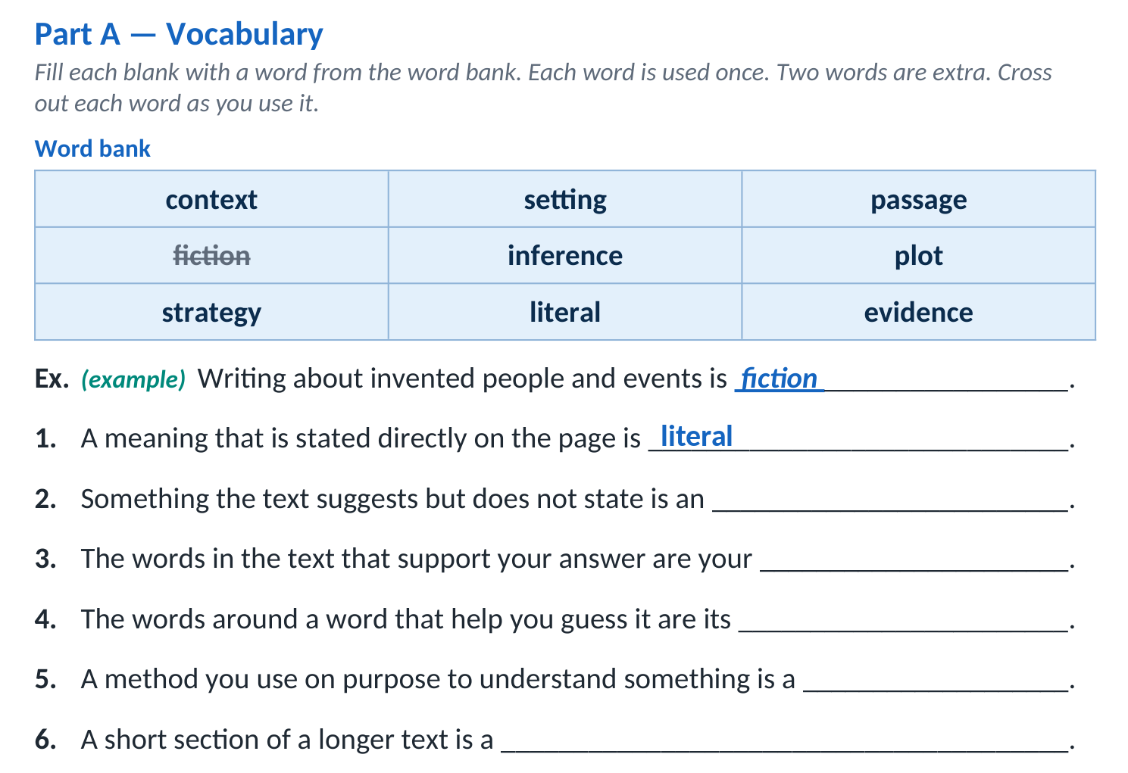
OBJECTIVE
Read a short unseen story without help, and answer questions about it in writing.
COM
TH
PS
Outcomes W1 academic language · W5 sentences with because · W14 complete sentences
ELL3 · Unit 1 · Lesson 2
ANSWERS · 1 OF 6
Part A answers — Vocabulary

Slide 23
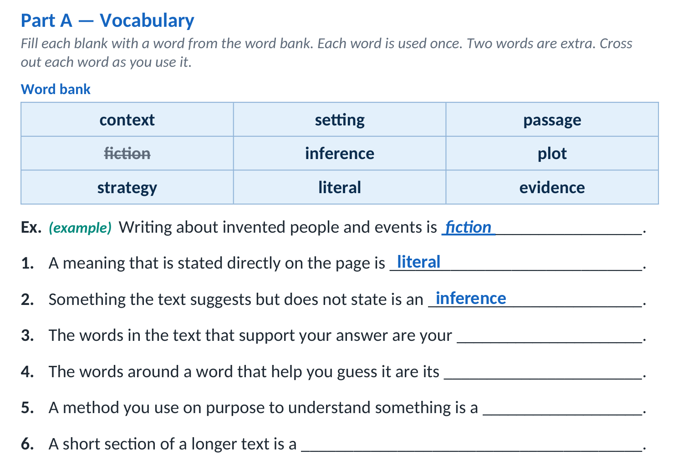
OBJECTIVE
Read a short unseen story without help, and answer questions about it in writing.
COM
TH
PS
Outcomes W1 academic language · W5 sentences with because · W14 complete sentences
ELL3 · Unit 1 · Lesson 2
ANSWERS · 2 OF 6
Part A answers — Vocabulary

Slide 24
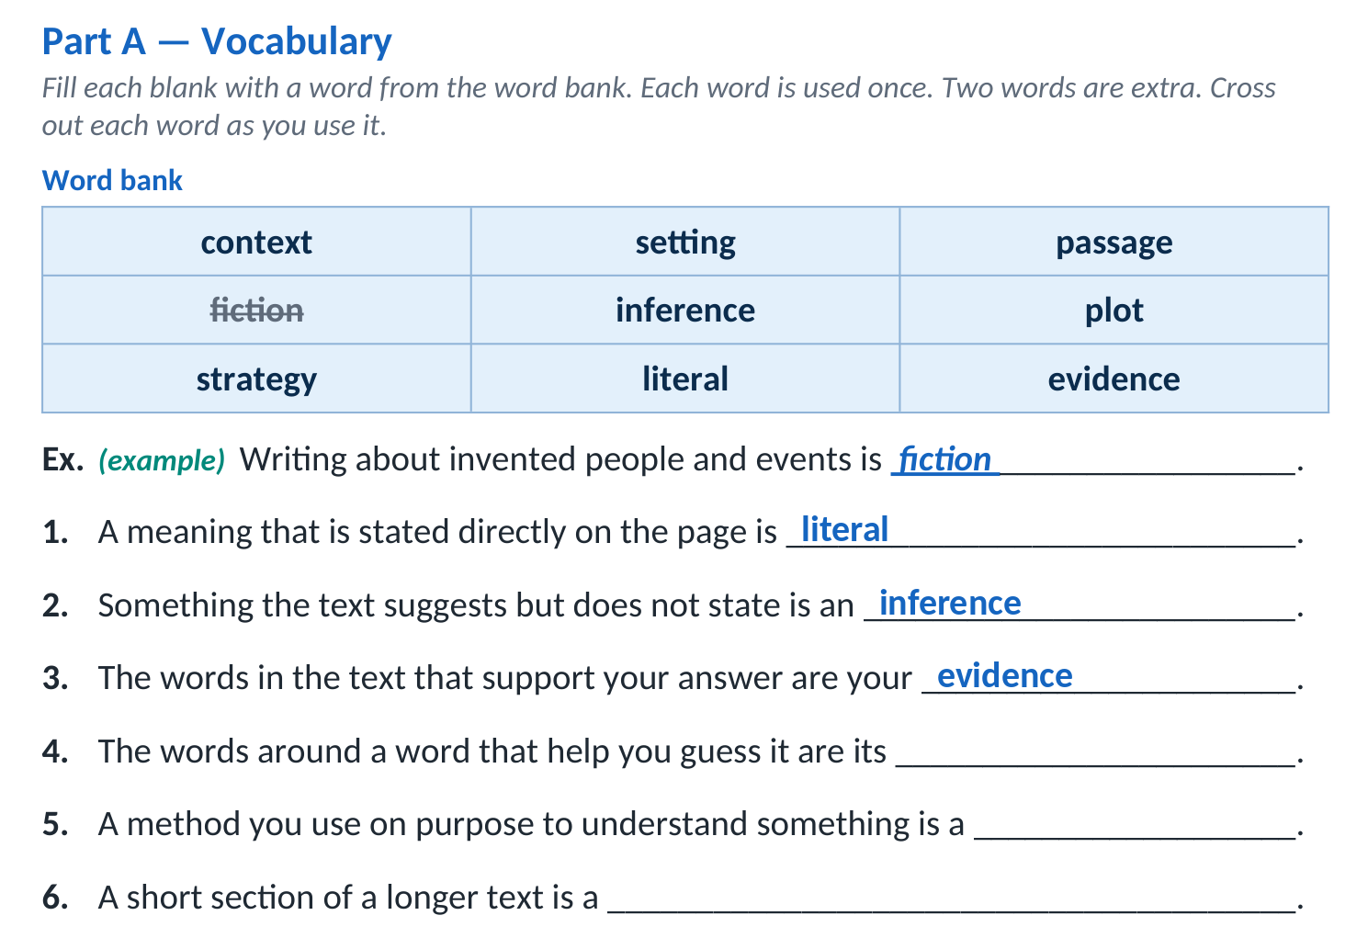
OBJECTIVE
Read a short unseen story without help, and answer questions about it in writing.
COM
TH
PS
Outcomes W1 academic language · W5 sentences with because · W14 complete sentences
ELL3 · Unit 1 · Lesson 2
ANSWERS · 3 OF 6
Part A answers — Vocabulary

Slide 25
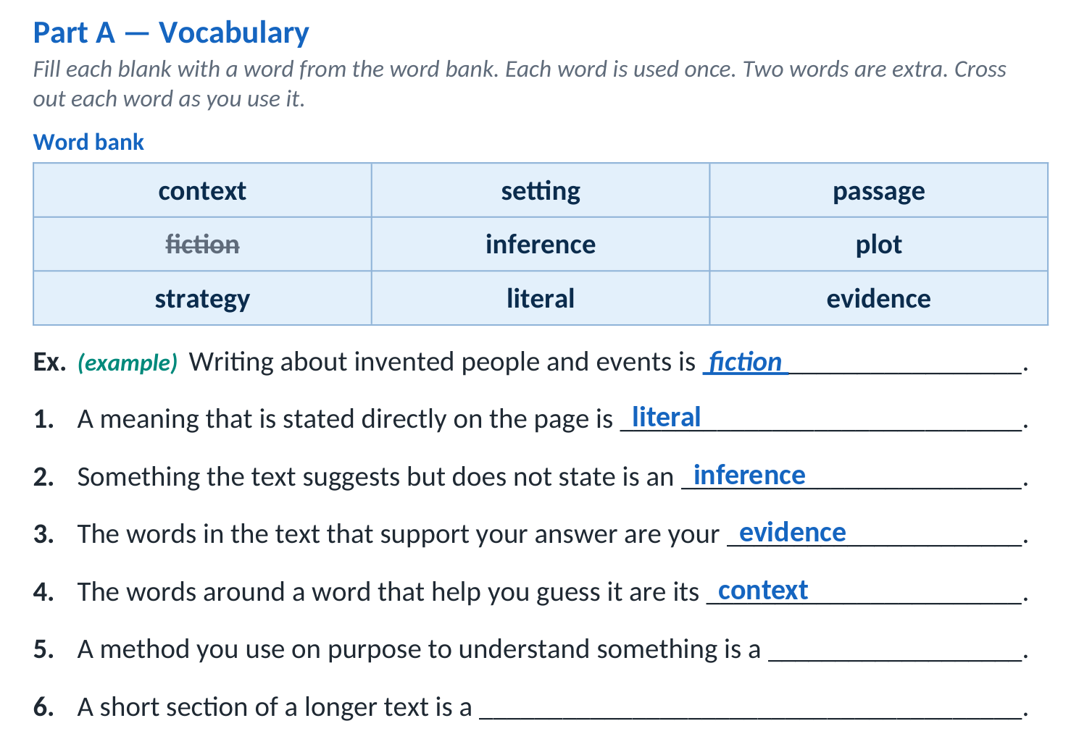
OBJECTIVE
Read a short unseen story without help, and answer questions about it in writing.
COM
TH
PS
Outcomes W1 academic language · W5 sentences with because · W14 complete sentences
ELL3 · Unit 1 · Lesson 2
ANSWERS · 4 OF 6
Part A answers — Vocabulary

Slide 26
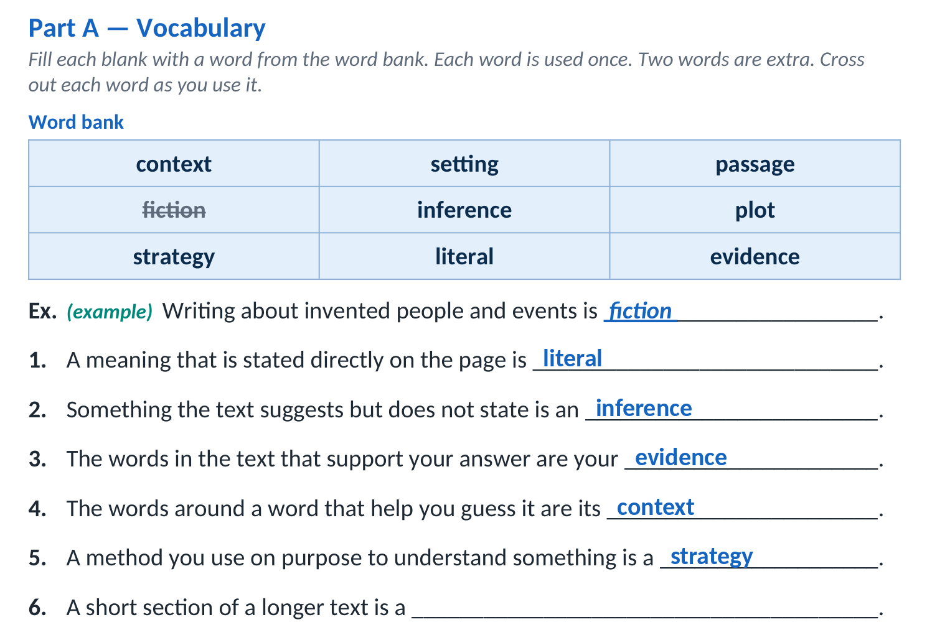
OBJECTIVE
Read a short unseen story without help, and answer questions about it in writing.
COM
TH
PS
Outcomes W1 academic language · W5 sentences with because · W14 complete sentences
ELL3 · Unit 1 · Lesson 2
ANSWERS · 5 OF 6
Part A answers — Vocabulary

Slide 27
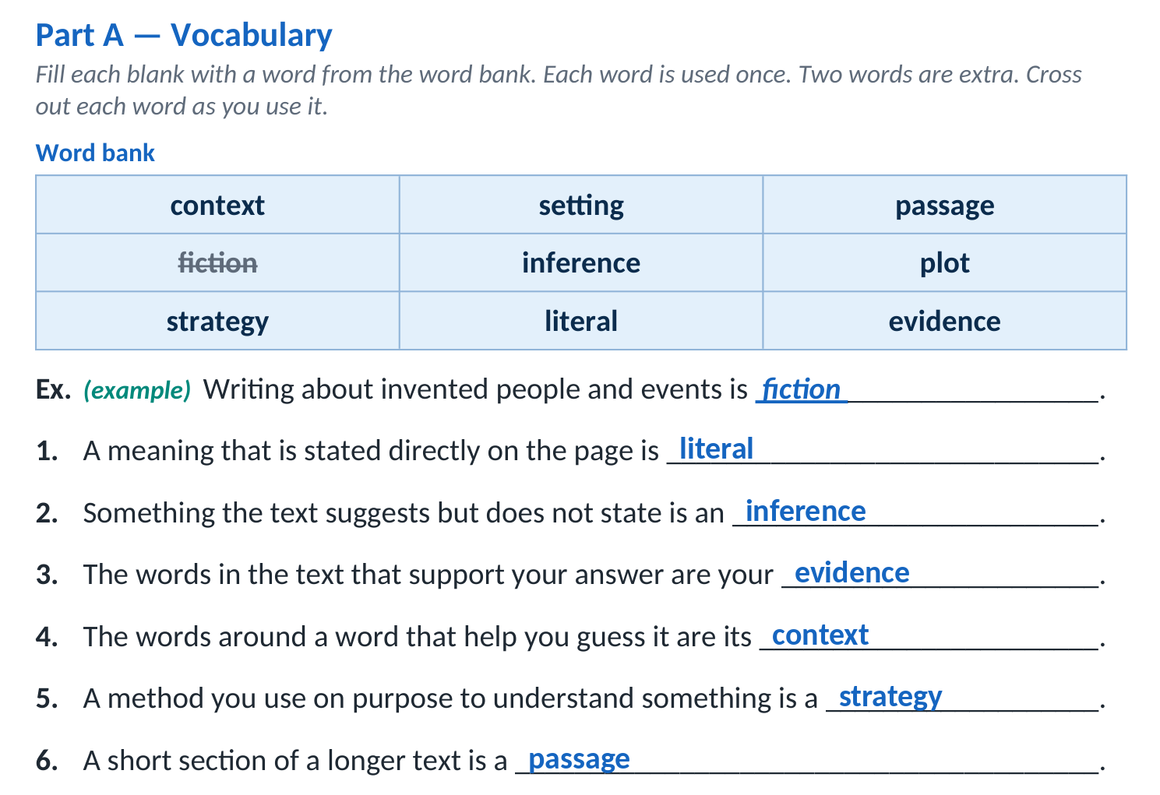
OBJECTIVE
Read a short unseen story without help, and answer questions about it in writing.
COM
TH
PS
Outcomes W1 academic language · W5 sentences with because · W14 complete sentences
ELL3 · Unit 1 · Lesson 2
ANSWERS · 6 OF 6
Part A answers — Vocabulary
Next → Two kinds of question

Slide 28
OBJECTIVE
Read a short unseen story without help, and answer questions about it in writing.
COM
TH
PS
Outcomes W1 academic language · W5 sentences with because · W14 complete sentences
ELL3 · Unit 1 · Lesson 2
TEACHING 1 OF 2
Two kinds of question
LITERAL
You can answer it by pointing at a line. The answer is on the page.
INFERENCE
You cannot point at it. The text suggests it, and you work it out.
The text says:
“The boy pulls his hood up.”
Literal: What does he do?
Inference: What is the weather like? The text never says — but you know.
Next → Part B — Which kind of question?

Slide 29
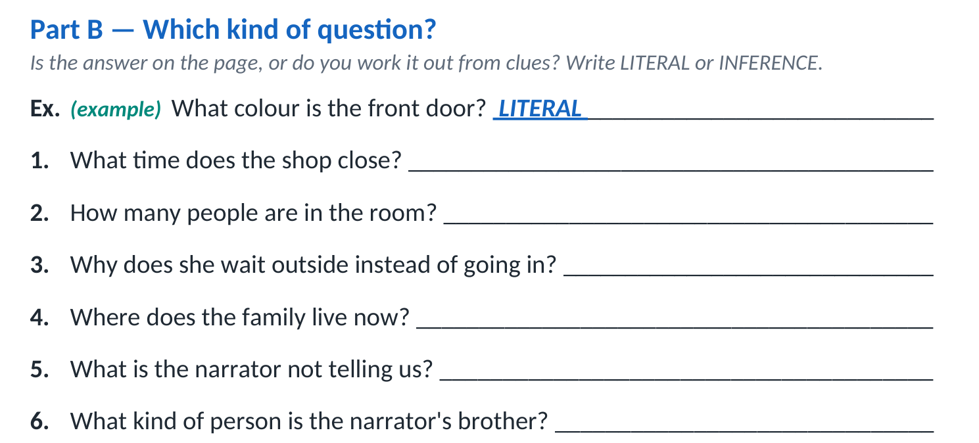
OBJECTIVE
Read a short unseen story without help, and answer questions about it in writing.
COM
TH
PS
Outcomes W1 academic language · W5 sentences with because · W14 complete sentences
ELL3 · Unit 1 · Lesson 2
WORKSHEET WALKTHROUGH
Part B — Which kind of question?
HOW TO COMPLETE IT
Ask yourself: can I point at the answer in the text? Yes → LITERAL. No, I have to work it out from clues → INFERENCE.
Next → Part B answers

Slide 30
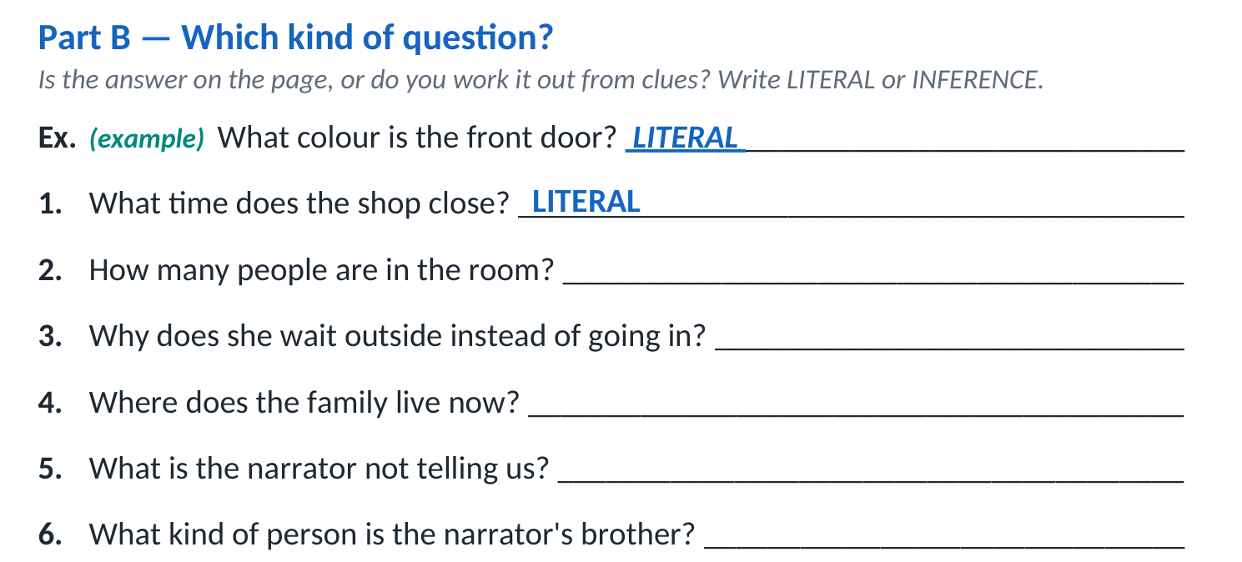
OBJECTIVE
Read a short unseen story without help, and answer questions about it in writing.
COM
TH
PS
Outcomes W1 academic language · W5 sentences with because · W14 complete sentences
ELL3 · Unit 1 · Lesson 2
ANSWERS · 1 OF 6
Part B answers — Which kind of question?

Slide 31
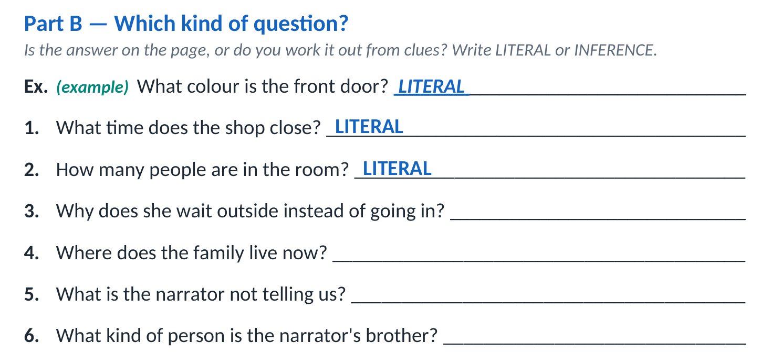
OBJECTIVE
Read a short unseen story without help, and answer questions about it in writing.
COM
TH
PS
Outcomes W1 academic language · W5 sentences with because · W14 complete sentences
ELL3 · Unit 1 · Lesson 2
ANSWERS · 2 OF 6
Part B answers — Which kind of question?

Slide 32
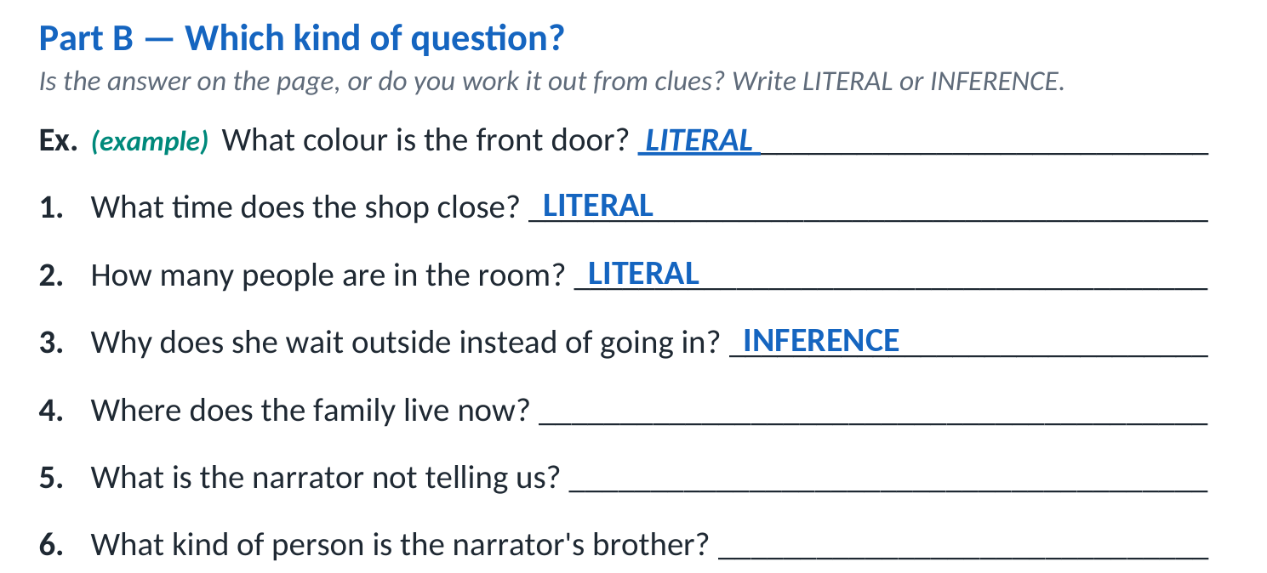
OBJECTIVE
Read a short unseen story without help, and answer questions about it in writing.
COM
TH
PS
Outcomes W1 academic language · W5 sentences with because · W14 complete sentences
ELL3 · Unit 1 · Lesson 2
ANSWERS · 3 OF 6
Part B answers — Which kind of question?

Slide 33
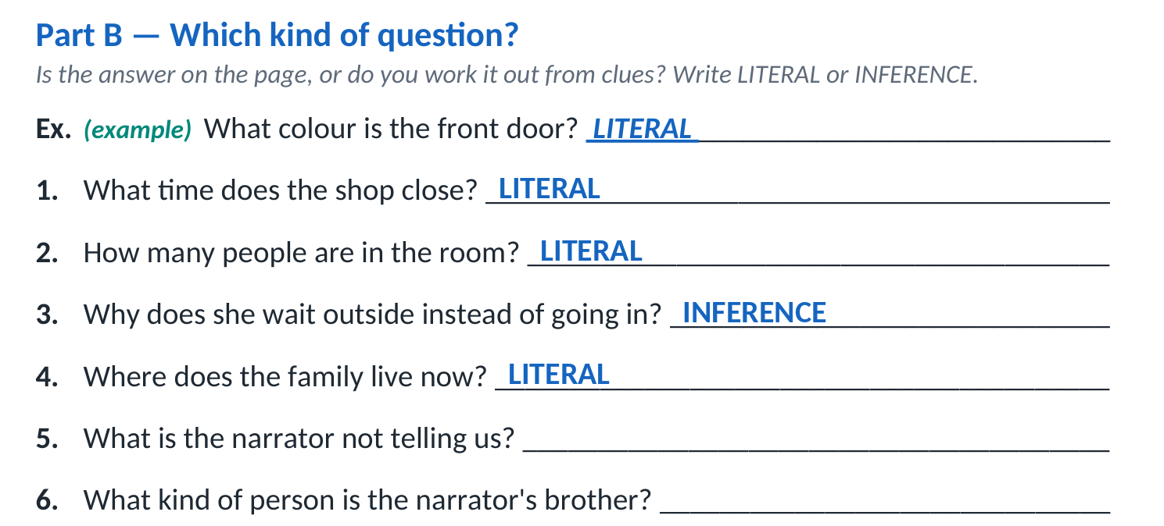
OBJECTIVE
Read a short unseen story without help, and answer questions about it in writing.
COM
TH
PS
Outcomes W1 academic language · W5 sentences with because · W14 complete sentences
ELL3 · Unit 1 · Lesson 2
ANSWERS · 4 OF 6
Part B answers — Which kind of question?

Slide 34
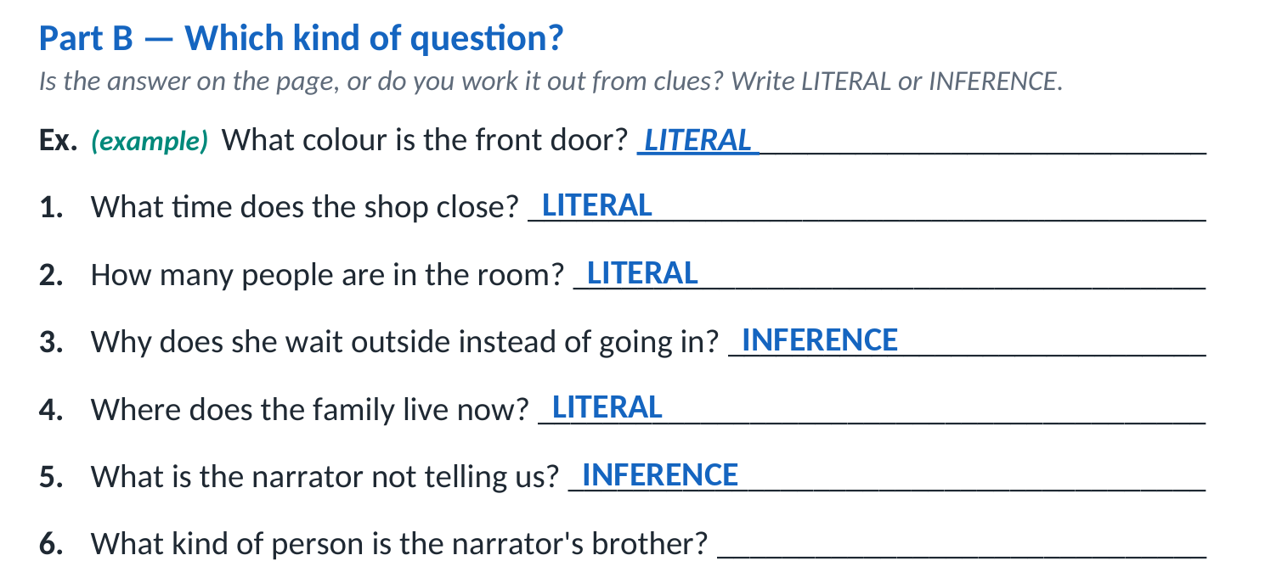
OBJECTIVE
Read a short unseen story without help, and answer questions about it in writing.
COM
TH
PS
Outcomes W1 academic language · W5 sentences with because · W14 complete sentences
ELL3 · Unit 1 · Lesson 2
ANSWERS · 5 OF 6
Part B answers — Which kind of question?

Slide 35
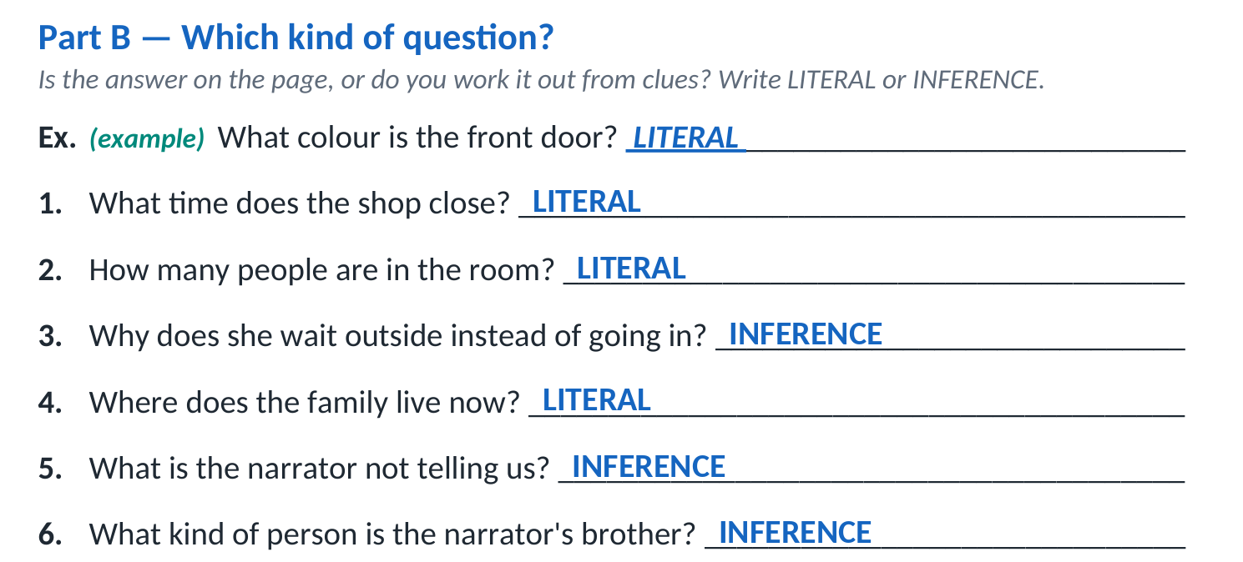
OBJECTIVE
Read a short unseen story without help, and answer questions about it in writing.
COM
TH
PS
Outcomes W1 academic language · W5 sentences with because · W14 complete sentences
ELL3 · Unit 1 · Lesson 2
ANSWERS · 6 OF 6
Part B answers — Which kind of question?
Next → Guessing is allowed

Slide 36
OBJECTIVE
Read a short unseen story without help, and answer questions about it in writing.
COM
TH
PS
Outcomes W1 academic language · W5 sentences with because · W14 complete sentences
ELL3 · Unit 1 · Lesson 2
TEACHING 2 OF 2
Guessing is allowed
Planned
You will meet words you do not know today. That is planned, not a mistake.
Keep going
Read to the end of the sentence before you decide you are stuck.
Mark it
Underline the word and keep reading. Come back to it at the end.
It still counts
The right idea with the wrong word still shows me what I need to see.
Next → Read the story

Slide 37

OBJECTIVE
Read a short unseen story without help, and answer questions about it in writing.
COM
TH
PS
Outcomes W1 academic language · W5 sentences with because · W14 complete sentences
ELL3 · Unit 1 · Lesson 2
READING
Read ‘The Long Way Home’
First read
Straight through. Do not stop. Do not look anything up.
Second read
With a pencil. Underline every word you are unsure of.
Read twice.
★
Put a star beside any sentence that made you picture something.
?
Put a question mark beside anything that confused you.
Next → The story

Slide 38
OBJECTIVE
Read a short unseen story without help, and answer questions about it in writing.
COM
TH
PS
Outcomes W1 academic language · W5 sentences with because · W14 complete sentences
ELL3 · Unit 1 · Lesson 2
THE LONG WAY HOME · 1 OF 10
The Long Way Home · lines 1–3
1 The 407 bus takes forty minutes to go all the way around and come back to the same stop. Arman worked this out in his second week here, and he has not told anybody.
2 His stop is the one by the pharmacy with the green cross. He knows it is his stop. He can see the corner of his building from the window, the balcony where his mother hangs the washing even in October, when nothing dries.
3 He stays in his seat.
Next → The story continues

Slide 39
OBJECTIVE
Read a short unseen story without help, and answer questions about it in writing.
COM
TH
PS
Outcomes W1 academic language · W5 sentences with because · W14 complete sentences
ELL3 · Unit 1 · Lesson 2
THE LONG WAY HOME · 2 OF 10
The Long Way Home · lines 4–4
4 The bus goes on past the pharmacy, past the school, past the place where they are building something that has been a hole in the ground since he arrived. Arman counts the stops under his breath. Yek. Do. Se. Nobody hears him. The woman across from him has headphones in and her eyes shut, and the driver is watching the road.
Next → The story continues

Slide 40
OBJECTIVE
Read a short unseen story without help, and answer questions about it in writing.
COM
TH
PS
Outcomes W1 academic language · W5 sentences with because · W14 complete sentences
ELL3 · Unit 1 · Lesson 2
THE LONG WAY HOME · 3 OF 10
The Long Way Home · lines 5–6
5 He counts in Farsi because that is how numbers arrive. In class he has to push them into English one at a time, and by the time he has the right word the question has moved on. On the bus there is no question. There is only the counting, and the window, and the same shops going by in the same order.
6 At the eleventh stop the bus reaches the bakery on Ackroyd, and this is where Arman gets off.
Next → The story continues

Slide 41
OBJECTIVE
Read a short unseen story without help, and answer questions about it in writing.
COM
TH
PS
Outcomes W1 academic language · W5 sentences with because · W14 complete sentences
ELL3 · Unit 1 · Lesson 2
THE LONG WAY HOME · 4 OF 10
The Long Way Home · lines 7–7
7 The bakery is run by a man called Faraj who is not from Arman's country and does not speak his language. They speak English to each other, badly, and it does not matter. Faraj sells bread and small cakes with pistachio in them and he has one table by the window with two chairs.
Next → The story continues

Slide 42
OBJECTIVE
Read a short unseen story without help, and answer questions about it in writing.
COM
TH
PS
Outcomes W1 academic language · W5 sentences with because · W14 complete sentences
ELL3 · Unit 1 · Lesson 2
THE LONG WAY HOME · 5 OF 10
The Long Way Home · lines 8–9
8 Arman sits at the table. He buys nothing. In the first week he bought a cake, and Faraj took his money, and then on the second day Faraj put a cake down in front of him and waved his hand at the coins, and after that Arman stopped bringing any.
9 He does his homework there. It takes about an hour. Sometimes Faraj turns the radio up when a song comes on that he likes, and sings a line, and stops.
Next → The story continues

Slide 43
OBJECTIVE
Read a short unseen story without help, and answer questions about it in writing.
COM
TH
PS
Outcomes W1 academic language · W5 sentences with because · W14 complete sentences
ELL3 · Unit 1 · Lesson 2
THE LONG WAY HOME · 6 OF 10
The Long Way Home · lines 10–13
10 At half past five Arman packs his bag and walks the twenty minutes home, and by then the light has gone and his mother is in the kitchen and the washing is still on the balcony, still wet.
11 “Where were you?” she asks.
12 “School,” he says.
13 She nods. She does not ask again, and he thinks about this sometimes, on the bus, going past the pharmacy with the green cross.
Next → The story continues

Slide 44
OBJECTIVE
Read a short unseen story without help, and answer questions about it in writing.
COM
TH
PS
Outcomes W1 academic language · W5 sentences with because · W14 complete sentences
ELL3 · Unit 1 · Lesson 2
THE LONG WAY HOME · 7 OF 10
The Long Way Home · lines 14–15
14 In the house there is his mother, and there is his father who is asleep at four in the afternoon because he works nights at the airport now, and there is the second bedroom where his sister does her university applications with the door shut. In the house everybody is doing something difficult and quiet.
15 Arman is eleven stops away, in a warm room that smells of pistachio, counting in the only language where the numbers come first.
Next → The story continues

Slide 45
OBJECTIVE
Read a short unseen story without help, and answer questions about it in writing.
COM
TH
PS
Outcomes W1 academic language · W5 sentences with because · W14 complete sentences
ELL3 · Unit 1 · Lesson 2
THE LONG WAY HOME · 8 OF 10
The Long Way Home · lines 16–18
16 On the Thursday before the long weekend, the bakery is closed. There is a paper sign in the window in Faraj's handwriting, and Arman stands and reads it three times, although he understood it the first time.
17 He does not go home early.
18 He walks the twenty minutes anyway, and then he keeps walking, down to the river where the boats are, and he sits on the wall until his hands are cold. He has nothing to do there. There is no table and no radio and no bread.
Next → The story continues

Slide 46
OBJECTIVE
Read a short unseen story without help, and answer questions about it in writing.
COM
TH
PS
Outcomes W1 academic language · W5 sentences with because · W14 complete sentences
ELL3 · Unit 1 · Lesson 2
THE LONG WAY HOME · 9 OF 10
The Long Way Home · lines 19–23
19 When he finally gets home his mother is standing at the window.
20 “Where were you?” she says, and this time she is looking at him.
21 “The bakery,” says Arman. “On Ackroyd. I go there after school.”
22 His mother is quiet for a moment. Then she says: “Is it warm there?”
23 “Yes.”
Next → The story continues

Slide 47
OBJECTIVE
Read a short unseen story without help, and answer questions about it in writing.
COM
TH
PS
Outcomes W1 academic language · W5 sentences with because · W14 complete sentences
ELL3 · Unit 1 · Lesson 2
THE LONG WAY HOME · 10 OF 10
The Long Way Home · lines 24–25
24 “Good,” she says, and she turns back to the window. “The washing will not dry. I keep putting it out.”
25 Arman stands beside her and they look at the balcony together, at the shirts hanging heavy in the dark, and neither of them says anything else about it.
Next → Words in this story

Slide 48
OBJECTIVE
Read a short unseen story without help, and answer questions about it in writing.
COM
TH
PS
Outcomes W1 academic language · W5 sentences with because · W14 complete sentences
ELL3 · Unit 1 · Lesson 2
SUPPORT
Words in this story
Use this on your SECOND read, not the first. Everything else you can work out from around it.
pharmacy
a shop that sells medicine
balcony
a platform outside an upper window
stop
a place where a bus picks up passengers
pistachio
a green nut, common in Middle Eastern baking
packs
puts things into a bag
applications
forms you fill in to ask for a place or a job
sign
a notice with writing on it
wall
here, a low wall by the river that people sit on
heavy
here, wet enough to hang down
quiet
here, saying nothing
Next → Parts C and D

Slide 49

OBJECTIVE
Read a short unseen story without help, and answer questions about it in writing.
COM
TH
PS
Outcomes W1 academic language · W5 sentences with because · W14 complete sentences
ELL3 · Unit 1 · Lesson 2
YOUR TURN
Your turn: Parts C and D
Part C — On the page
Six questions. The answer is written in the story. Give the line number.
Part D — Underneath the page
Five questions. Work it out, then show the clue: what you think AND why.
On your own.
Stuck?
Fill in a help slip and keep going.
Next → Part C — On the page

Slide 50
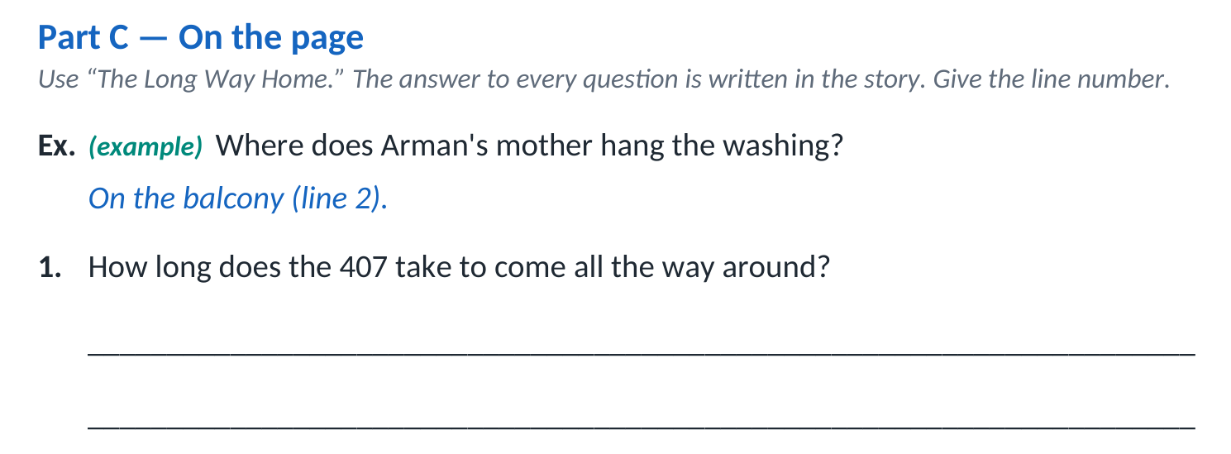
OBJECTIVE
Read a short unseen story without help, and answer questions about it in writing.
COM
TH
PS
Outcomes W1 academic language · W5 sentences with because · W14 complete sentences
ELL3 · Unit 1 · Lesson 2
WORKSHEET WALKTHROUGH
Part C — On the page
HOW TO COMPLETE IT
Find the answer in the story. Write the key words and the line number, like the example. “Line 12” shows exactly where.
Next → Part C answers

Slide 51
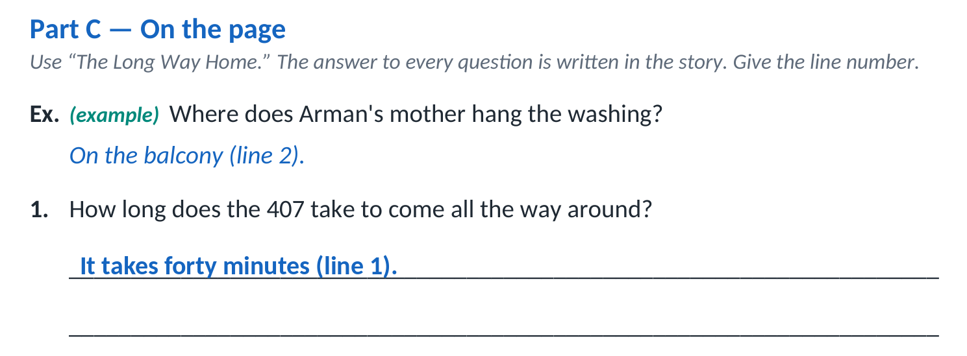
OBJECTIVE
Read a short unseen story without help, and answer questions about it in writing.
COM
TH
PS
Outcomes W1 academic language · W5 sentences with because · W14 complete sentences
ELL3 · Unit 1 · Lesson 2
ANSWERS · 1 OF 6
Part C answers — On the page

Slide 52
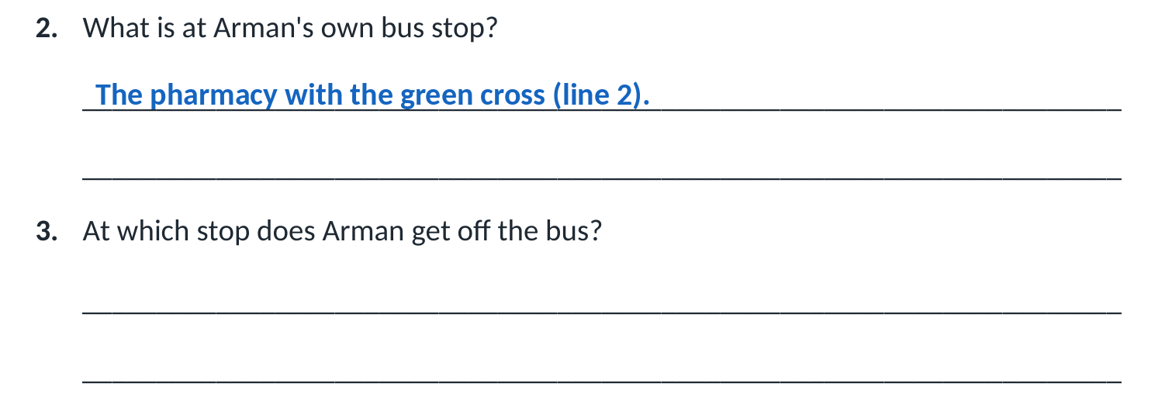
OBJECTIVE
Read a short unseen story without help, and answer questions about it in writing.
COM
TH
PS
Outcomes W1 academic language · W5 sentences with because · W14 complete sentences
ELL3 · Unit 1 · Lesson 2
ANSWERS · 2 OF 6
Part C answers — On the page

Slide 53
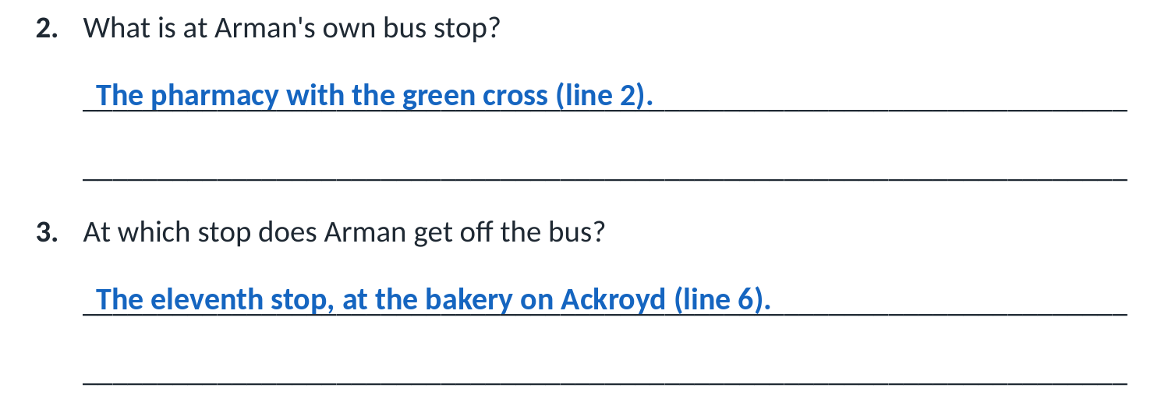
OBJECTIVE
Read a short unseen story without help, and answer questions about it in writing.
COM
TH
PS
Outcomes W1 academic language · W5 sentences with because · W14 complete sentences
ELL3 · Unit 1 · Lesson 2
ANSWERS · 3 OF 6
Part C answers — On the page

Slide 54
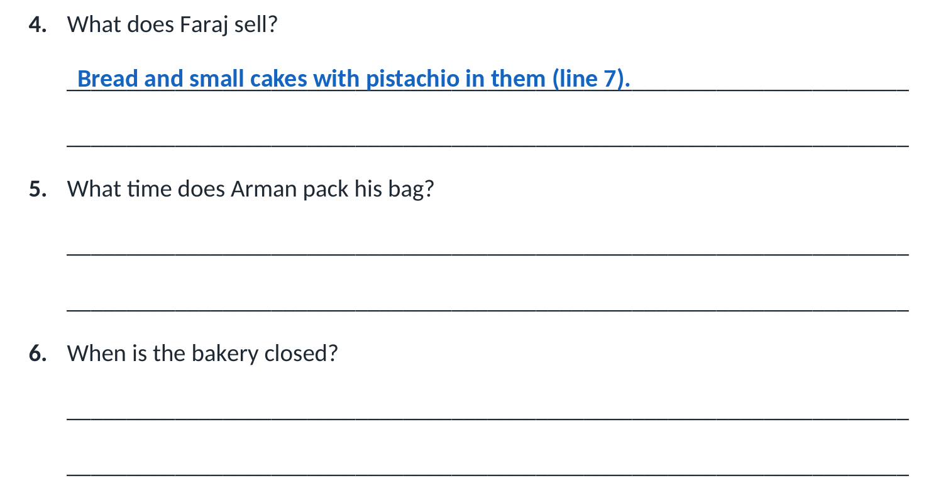
OBJECTIVE
Read a short unseen story without help, and answer questions about it in writing.
COM
TH
PS
Outcomes W1 academic language · W5 sentences with because · W14 complete sentences
ELL3 · Unit 1 · Lesson 2
ANSWERS · 4 OF 6
Part C answers — On the page

Slide 55
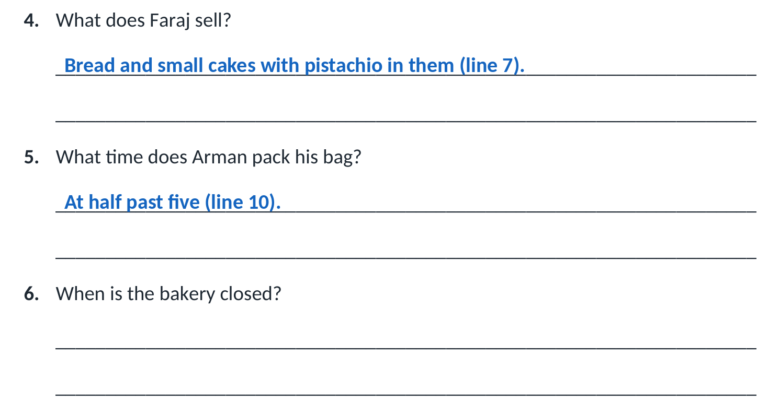
OBJECTIVE
Read a short unseen story without help, and answer questions about it in writing.
COM
TH
PS
Outcomes W1 academic language · W5 sentences with because · W14 complete sentences
ELL3 · Unit 1 · Lesson 2
ANSWERS · 5 OF 6
Part C answers — On the page

Slide 56
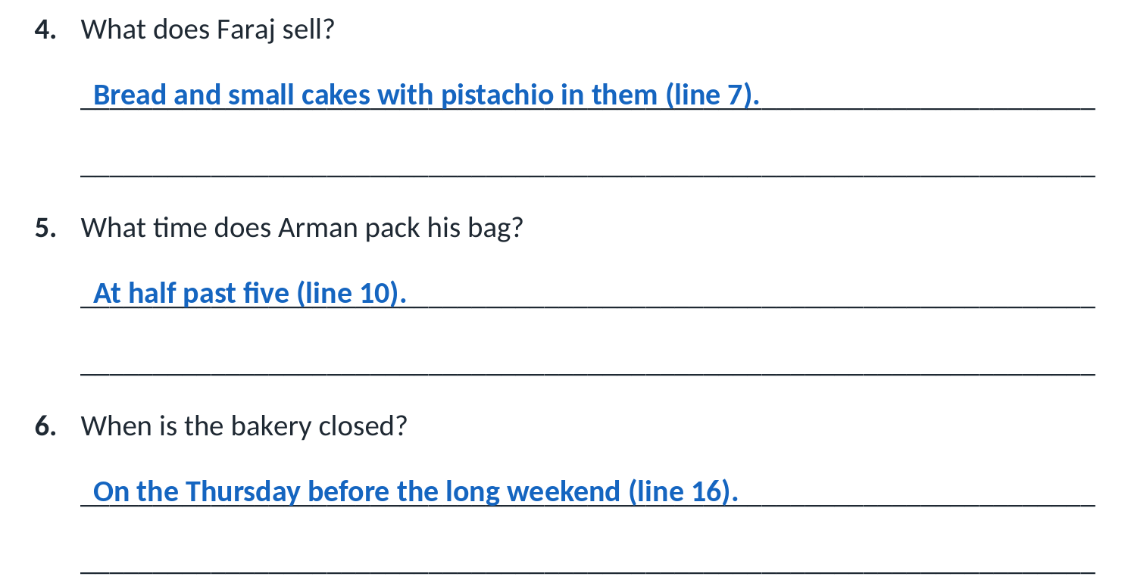
OBJECTIVE
Read a short unseen story without help, and answer questions about it in writing.
COM
TH
PS
Outcomes W1 academic language · W5 sentences with because · W14 complete sentences
ELL3 · Unit 1 · Lesson 2
ANSWERS · 6 OF 6
Part C answers — On the page
Next → Part D — Underneath the page

Slide 57
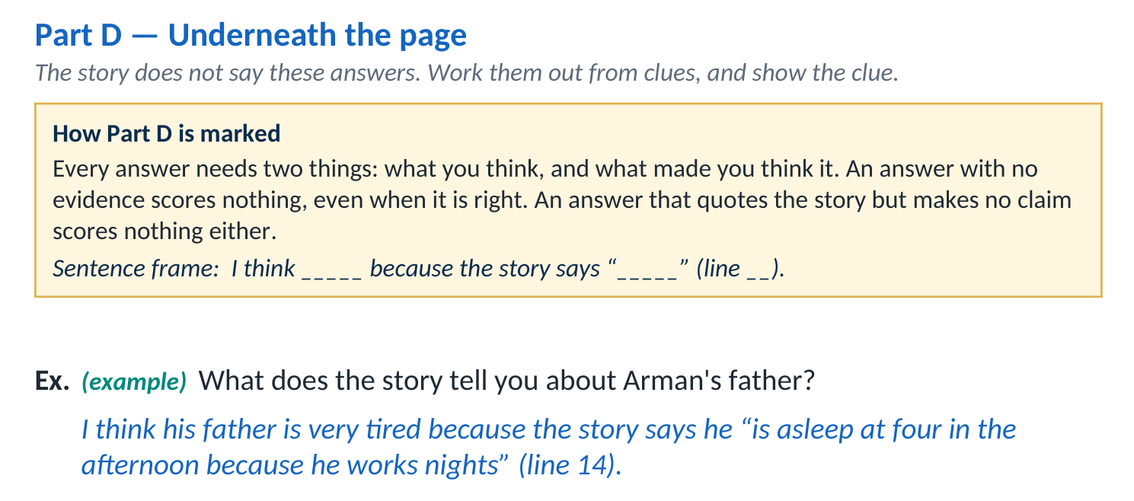
OBJECTIVE
Read a short unseen story without help, and answer questions about it in writing.
COM
TH
PS
Outcomes W1 academic language · W5 sentences with because · W14 complete sentences
ELL3 · Unit 1 · Lesson 2
WORKSHEET WALKTHROUGH
Part D — Underneath the page
HOW TO COMPLETE IT
Say what you think, then what made you think it. Use the sentence frame in the box. Quote the story and give the line number.
Next → Part D answers

Slide 58
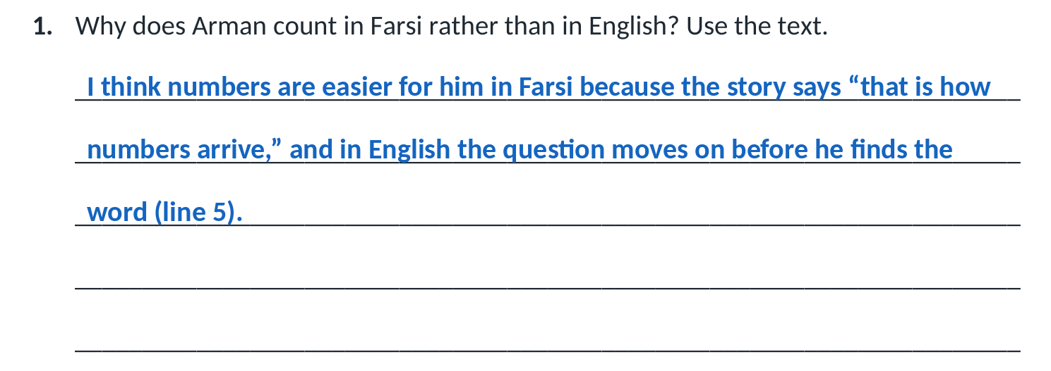
OBJECTIVE
Read a short unseen story without help, and answer questions about it in writing.
COM
TH
PS
Outcomes W1 academic language · W5 sentences with because · W14 complete sentences
ELL3 · Unit 1 · Lesson 2
ANSWERS · 1 OF 5
Part D answers — Underneath the page

Slide 59
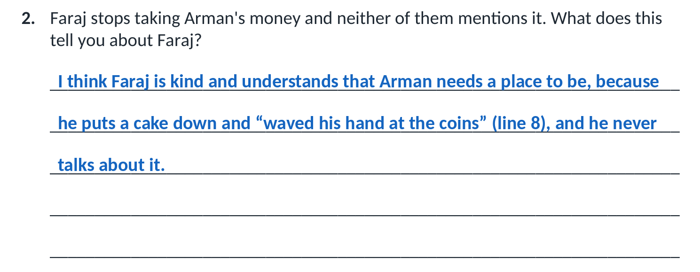
OBJECTIVE
Read a short unseen story without help, and answer questions about it in writing.
COM
TH
PS
Outcomes W1 academic language · W5 sentences with because · W14 complete sentences
ELL3 · Unit 1 · Lesson 2
ANSWERS · 2 OF 5
Part D answers — Underneath the page

Slide 60
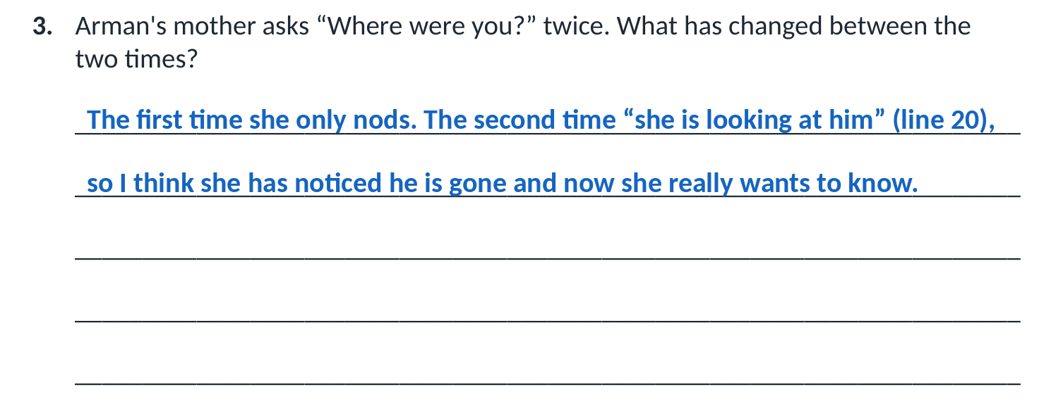
OBJECTIVE
Read a short unseen story without help, and answer questions about it in writing.
COM
TH
PS
Outcomes W1 academic language · W5 sentences with because · W14 complete sentences
ELL3 · Unit 1 · Lesson 2
ANSWERS · 3 OF 5
Part D answers — Underneath the page

Slide 61
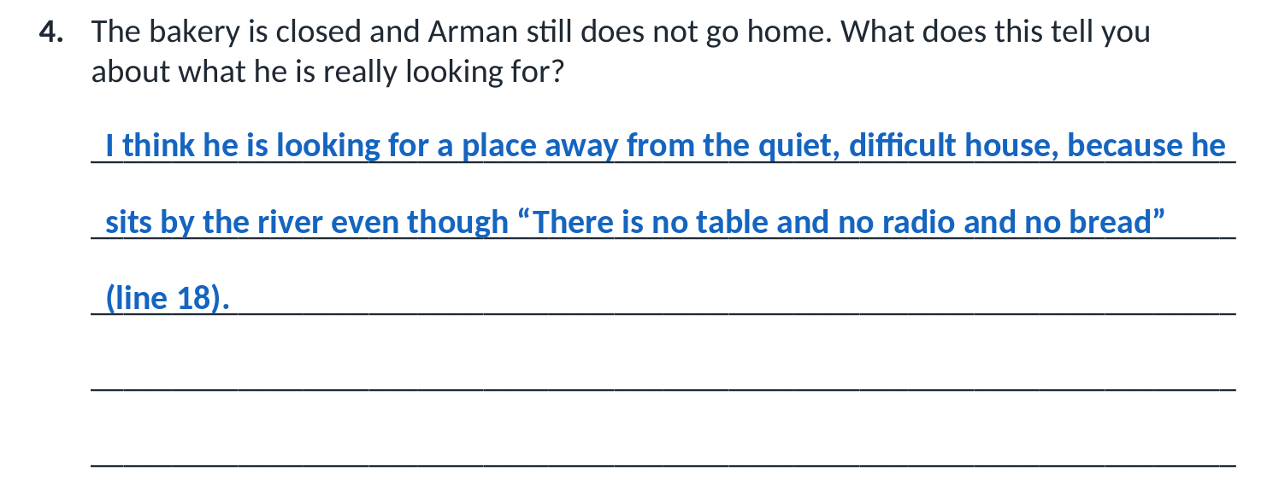
OBJECTIVE
Read a short unseen story without help, and answer questions about it in writing.
COM
TH
PS
Outcomes W1 academic language · W5 sentences with because · W14 complete sentences
ELL3 · Unit 1 · Lesson 2
ANSWERS · 4 OF 5
Part D answers — Underneath the page

Slide 62
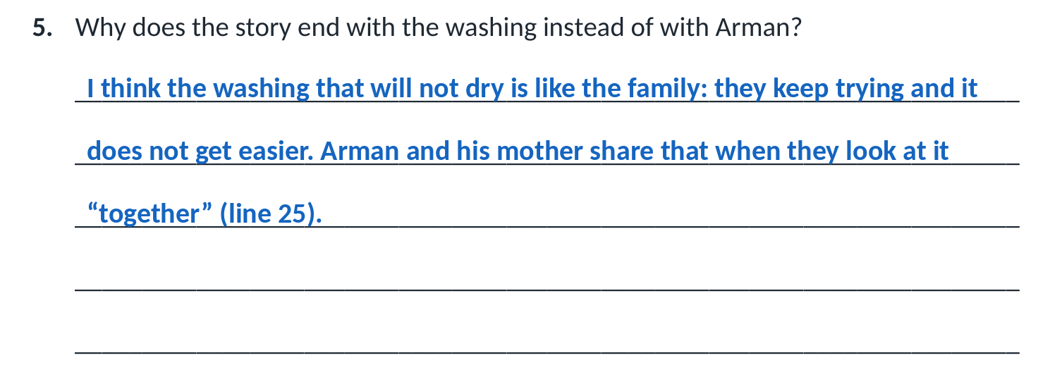
OBJECTIVE
Read a short unseen story without help, and answer questions about it in writing.
COM
TH
PS
Outcomes W1 academic language · W5 sentences with because · W14 complete sentences
ELL3 · Unit 1 · Lesson 2
ANSWERS · 5 OF 5
Part D answers — Underneath the page
Next → Talk it through

Slide 63

OBJECTIVE
Read a short unseen story without help, and answer questions about it in writing.
COM
TH
PS
Outcomes W1 academic language · W5 sentences with because · W14 complete sentences
ELL3 · Unit 1 · Lesson 2
SPEAKING
Talk it through
Compare your reading: which words did you underline? Where are your stars? What confused you?
SENTENCE FRAMES
I underlined _____ because _____.
I put a star beside _____ because I could picture _____.
The part I did not understand was _____.
I think _____ means _____, because the sentence says _____.
With a partner. You do not have to agree.
Next → Part E — Your reading strategies

Slide 64
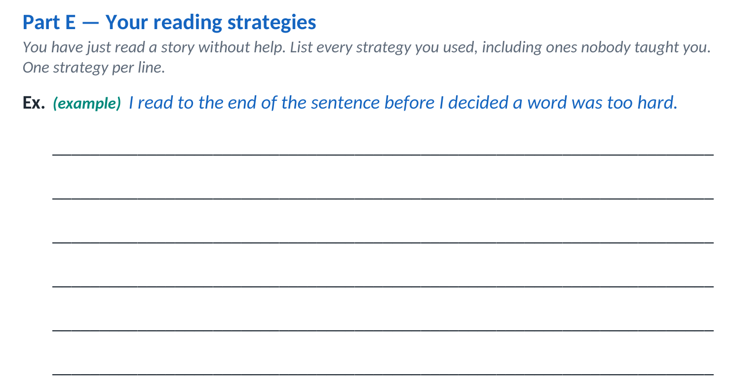
OBJECTIVE
Read a short unseen story without help, and answer questions about it in writing.
COM
TH
PS
Outcomes W1 academic language · W5 sentences with because · W14 complete sentences
ELL3 · Unit 1 · Lesson 2
WORKSHEET WALKTHROUGH
Part E — Your reading strategies
HOW TO COMPLETE IT
Write one strategy per line — anything you did to understand the story. There is no wrong answer: this is your own reading.
Next → Part F — Check your understanding

Slide 65
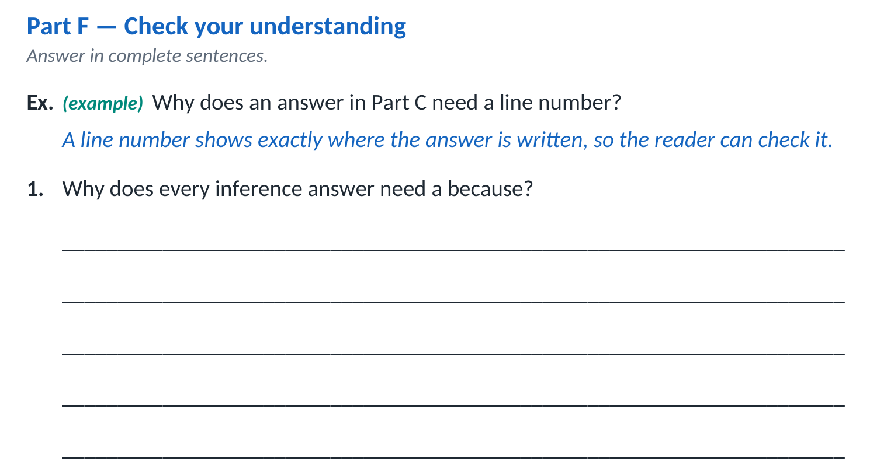
OBJECTIVE
Read a short unseen story without help, and answer questions about it in writing.
COM
TH
PS
Outcomes W1 academic language · W5 sentences with because · W14 complete sentences
ELL3 · Unit 1 · Lesson 2
WORKSHEET WALKTHROUGH
Part F — Check your understanding
HOW TO COMPLETE IT
Answer each question in complete sentences, like the example. Use today’s words: literal, inference, evidence.
Next → Part F answers

Slide 66
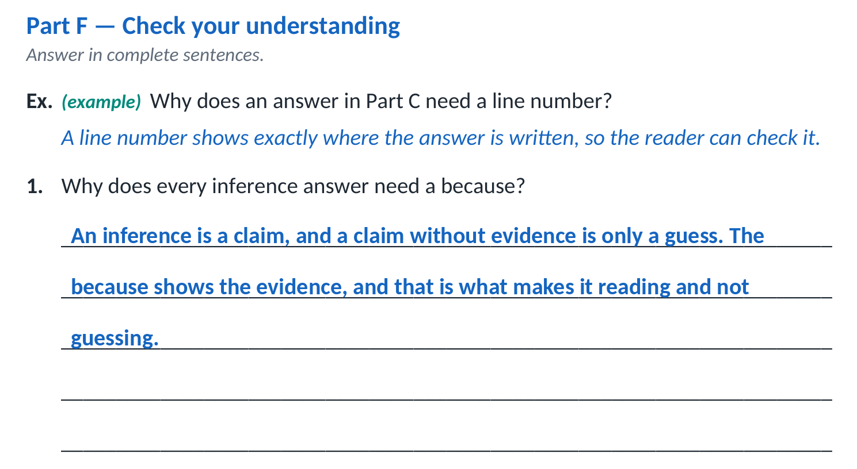
OBJECTIVE
Read a short unseen story without help, and answer questions about it in writing.
COM
TH
PS
Outcomes W1 academic language · W5 sentences with because · W14 complete sentences
ELL3 · Unit 1 · Lesson 2
ANSWERS · 1 OF 2
Part F answers — Check your understanding

Slide 67
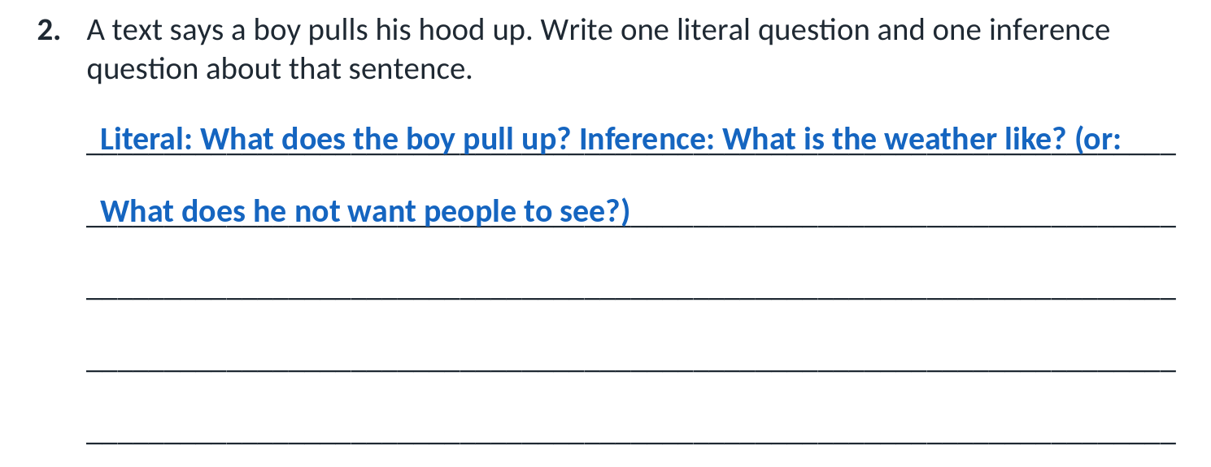
OBJECTIVE
Read a short unseen story without help, and answer questions about it in writing.
COM
TH
PS
Outcomes W1 academic language · W5 sentences with because · W14 complete sentences
ELL3 · Unit 1 · Lesson 2
ANSWERS · 2 OF 2
Part F answers — Check your understanding
Next → Part G — Check your work

Slide 68
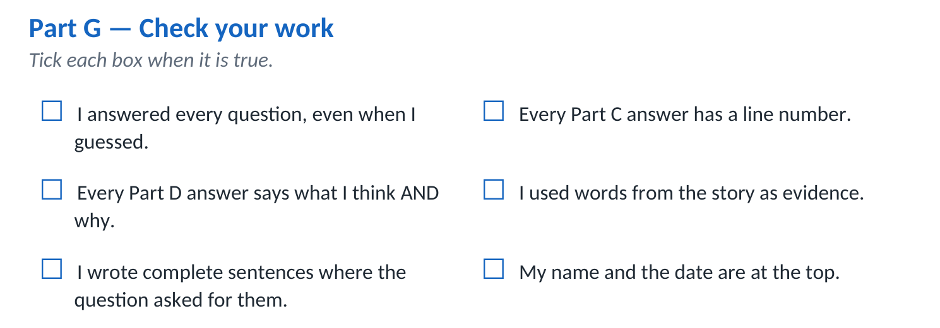
OBJECTIVE
Read a short unseen story without help, and answer questions about it in writing.
COM
TH
PS
Outcomes W1 academic language · W5 sentences with because · W14 complete sentences
ELL3 · Unit 1 · Lesson 2
WORKSHEET WALKTHROUGH
Part G — Check your work
HOW TO COMPLETE IT
Read each sentence. Tick the box only when it is true. If it is not true yet, fix your work first.
Next → Exit ticket

Slide 69
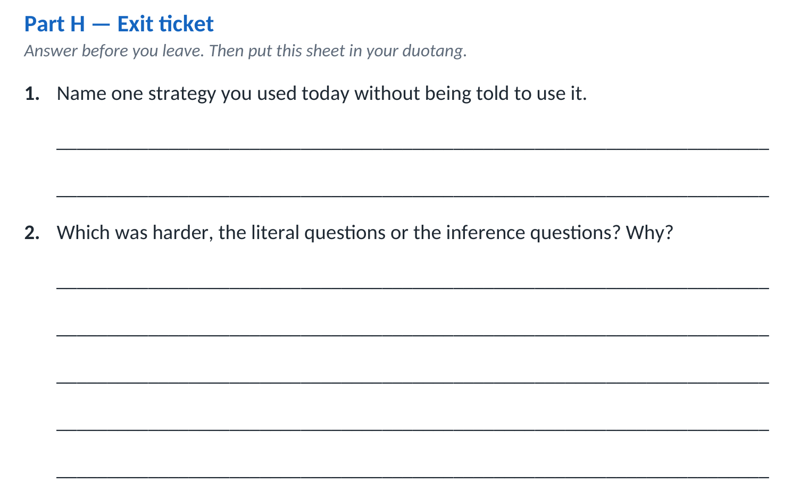
OBJECTIVE
Read a short unseen story without help, and answer questions about it in writing.
COM
TH
PS
Outcomes W1 academic language · W5 sentences with because · W14 complete sentences
ELL3 · Unit 1 · Lesson 2
EXIT TICKET
Exit ticket — Part H
Name one strategy you used today without being told to use it.
1
Which was harder, the literal questions or the inference questions? Why?
2
Finished? Put your whole worksheet in your duotang.
Next → Next class

Slide 70
OBJECTIVE
Read a short unseen story without help, and answer questions about it in writing.
COM
TH
PS
Outcomes W1 academic language · W5 sentences with because · W14 complete sentences
ELL3 · Unit 1 · Lesson 2
NEXT CLASS
Next class
Class write
Bring your exercise book and a pencil.
Next → Exercise books

Slide 71

OBJECTIVE
Read a short unseen story without help, and answer questions about it in writing.
COM
TH
PS
Outcomes W1 academic language · W5 sentences with because · W14 complete sentences
ELL3 · Unit 1 · Lesson 2
BEFORE YOU GO
Take out your exercise book
Next class:
Class write — bring your exercise book.
Homework:
None tonight.
Write it down before you leave.
Remember:
Your worksheet is in your duotang. Your exercise book comes home with you.

