Slide 1

The
Sentinel AI
Democratized and Incentivized Machine Learning on Blockchain in a Secure and Privacy-Preserving Manner.
Join the Network

Slide 2

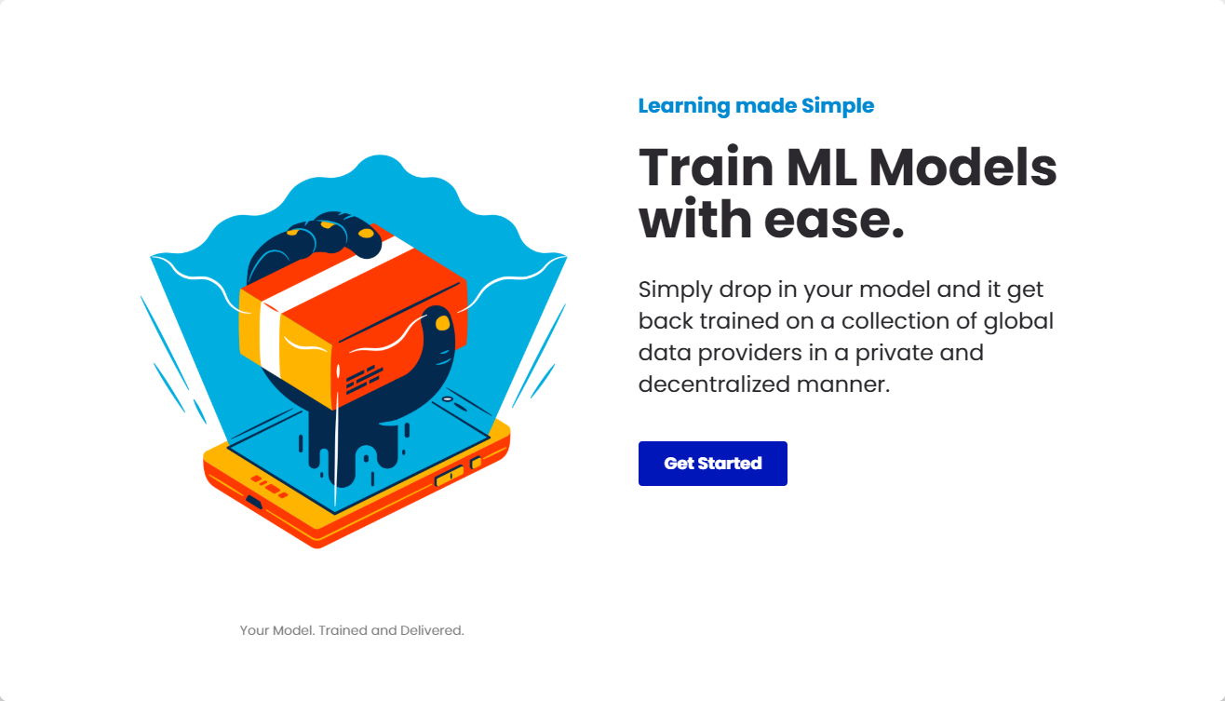

Slide 3
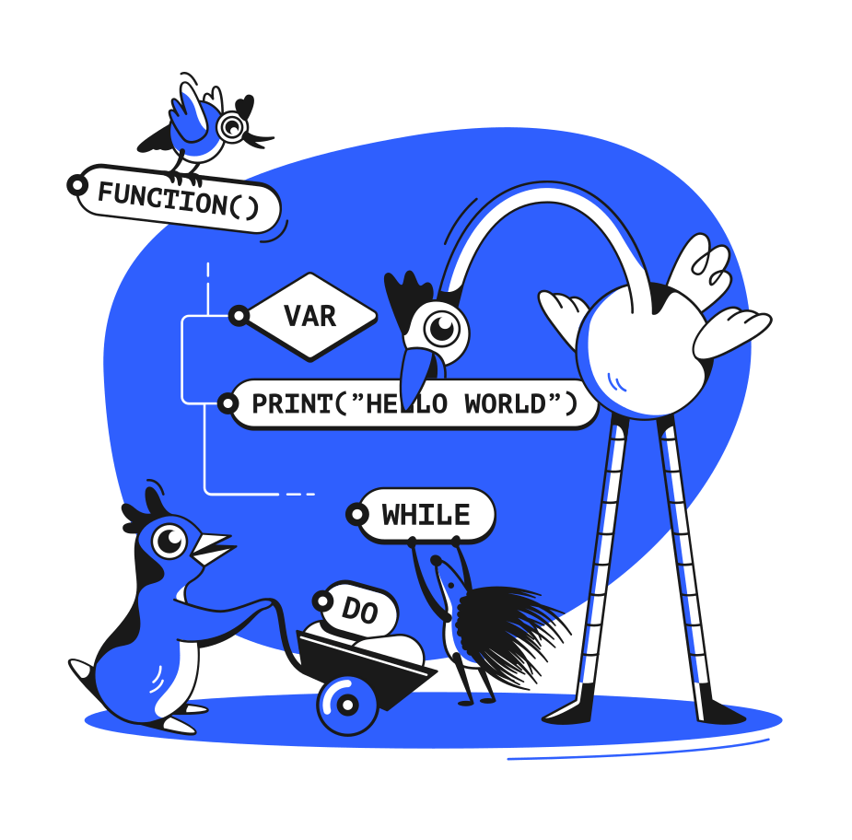
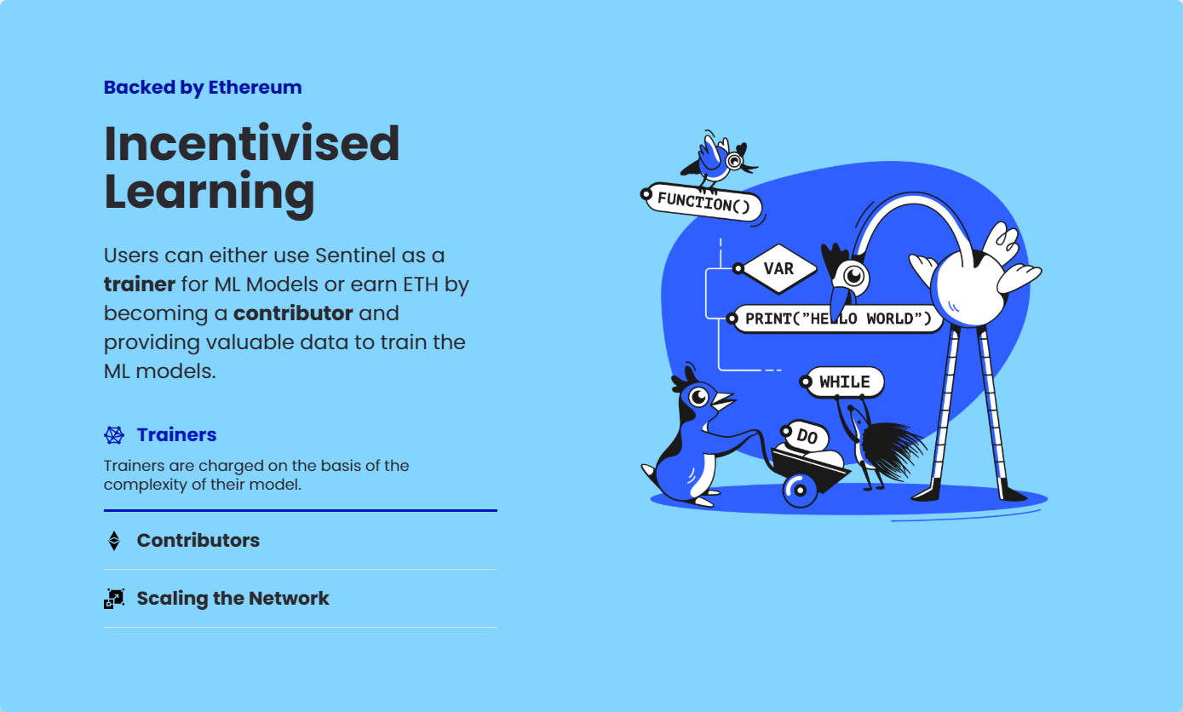

Slide 4
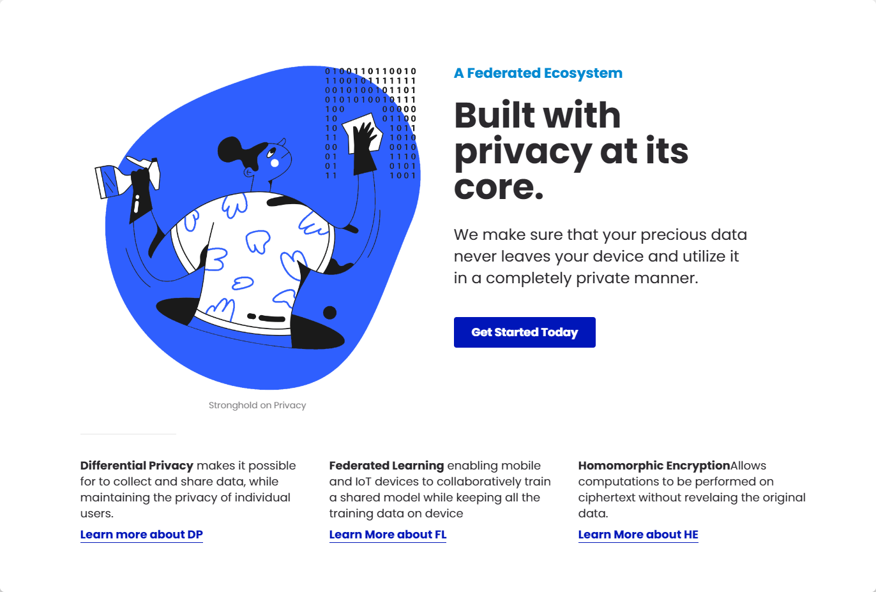
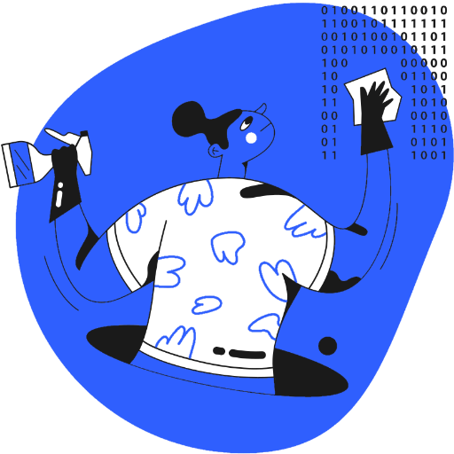

Slide 5
