Slide 1
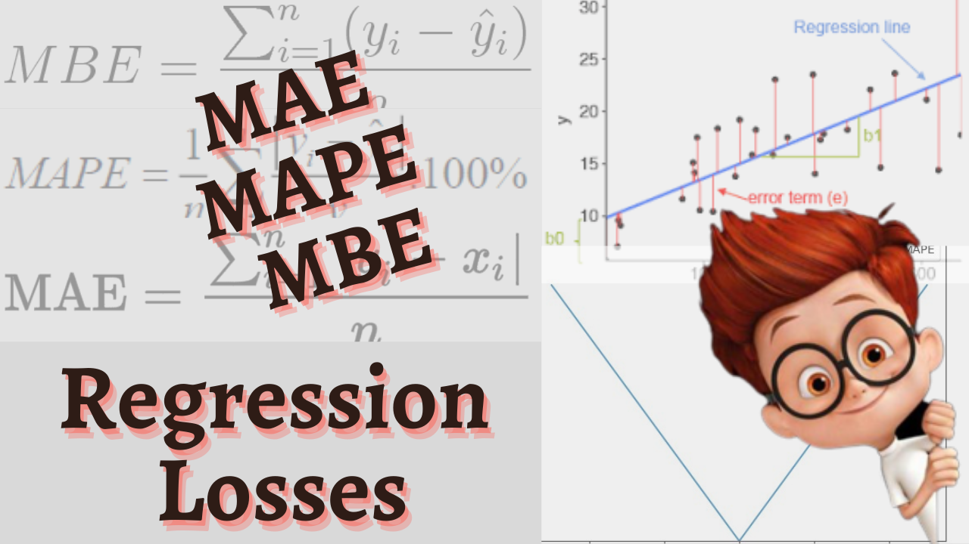

Slide 2
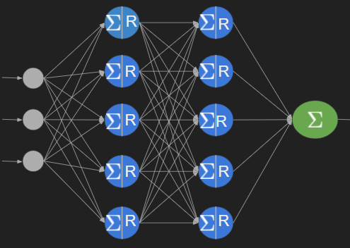
Context
Targets
Features (X)
Y
Entry-1 8 27000 Petrol 3.5
Entry-2 9 43000 Diesel 4.75
. .
. .
Entry-n 7 33400 Diesel 6.5
Y^
3
6.5
.
.
8
Loss
Gradient Descent
Updates
Weights & Biases

Slide 3

Loss
Actual Predicted
Y^-Y
—-------------
3 - 3.5
6.5 - 4.75
4.25 - 7.25
3.5 - 2.85
8.5 - 6.5
Y^-Y
—---------
-0.5
1.75
- 3.0
0.65
2.0
Y
—
3.5
4.75
7.25
2.85
6.5
Y^
—
3
6.5
4.25
3.5
8.5
Sum
Mean
0.9
0.18
Loss
Mean Bias Error

Slide 4
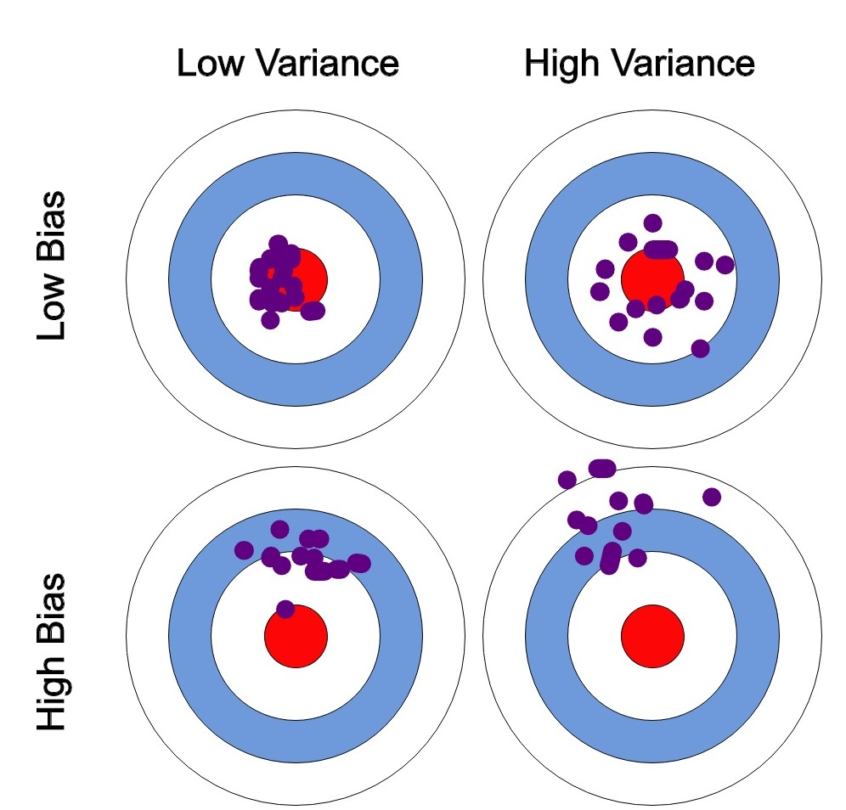
Bias and Variance
Bias - Overall direction of error
Bias - Historical average error
Variance - Spread of predictions

Slide 5
Bias
Actual Predicted
Actual Predicted
Y
—
3.5
4.75
7.25
2.85
6.5
Y^
—
50
56.5
48.255
46.5
Y
—
3.5
4.75
7.25
2.85
6.5
Y^
—
0.78
0.5
0.250.85
1.1.5
Loss
Loss

Slide 6
Drawback
Actual Predicted
MBE = ?
Y
—
3.5
4.5
7.5
2.5
6.5
5.0
Y^
—
4.0
4.0
7.0
3.0
7.0
4.5
(4.0 - 3.5) + (4.0 - 4.5) + (7.0 - 7.5) + (3.0 - 2.5) + (7.0 - 6.5) + (4.5 - 5.0)
=
= 0
—----------------------------------------------
6
Loss

Slide 7

Mean Absolute Error
L1 loss
MAE =
Actual Predicted
Y^-Y
—-------------
3 - 3.5
6.5 - 4.75
4.25 - 7.25
3.5 - 2.85
8.5 - 6.5
|Y^-Y|
—---------
0.5
1.75
3.0
0.65
2.0
Y
—
3.5
4.75
7.25
2.85
6.5
Y^
—
3
6.5
4.25
3.5
8.5
Sum
Mean
7.9
1.58
Loss

Slide 8

Mean Absolute Percentage Error
MAPE =
Actual Predicted
Y
—
3.5
4.75
725
2.85
6.5
Y^
—
3
6.5
425
3.5
8.5
MAE = 60.98
MAPE = 0.2918
Loss

