Slide 1
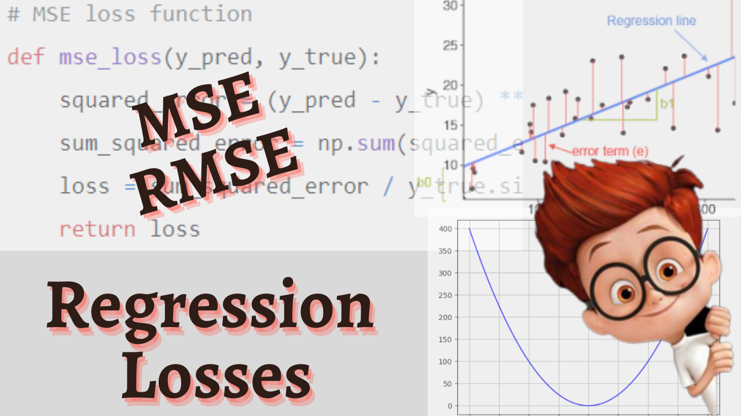

Slide 2

Mean Squared Error
L2 loss
MSE =
Actual Predicted
Y^-Y
—-------------
3 - 3.5
6.5 - 4.75
4.25 - 7.25
3.5 - 2.85
8.5 - 6.5
(Y^-Y)^2
—---------
0.25
3.06
9.0
0.422
4.0
Y
—
3.5
4.75
7.25
2.85
6.5
Y^
—
3
6.5
4.25
3.5
8.5
Sum
Mean
16.732
3.34
Loss

Slide 3
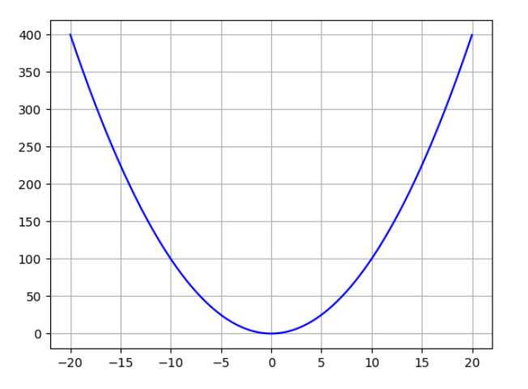
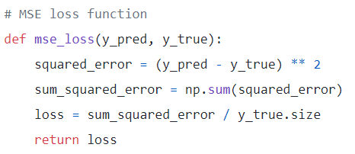
Python Implementation
Error Surface
y-y^

Slide 4
Features
No positive-negative value cancellation
Weighted errors
Smooth loss function
Prefered to MAE
High loss in case of outliers

Slide 5

Root Mean Squared Error (RMSE)
Square Root of MSE
Better interpretation of Error
Preferred to MSE
Commonly used loss function

