Slide 1
Neural Networks
An Intuition

Slide 2
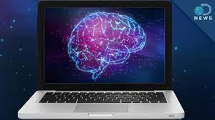
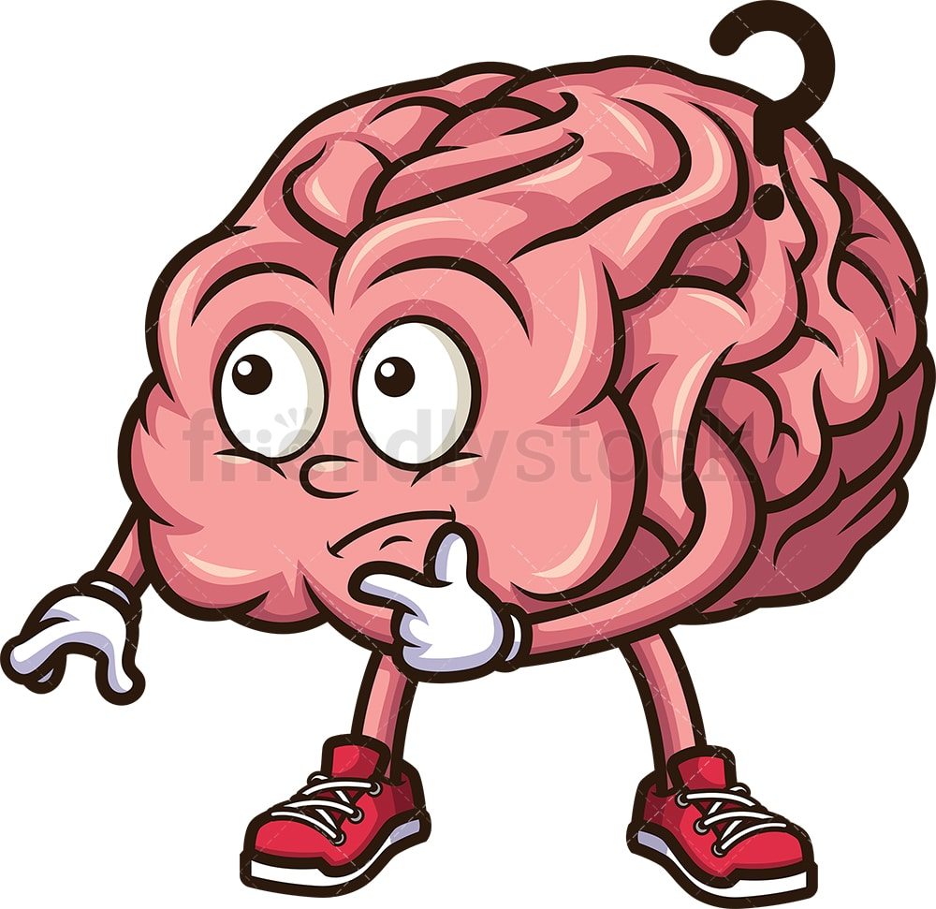

Slide 3

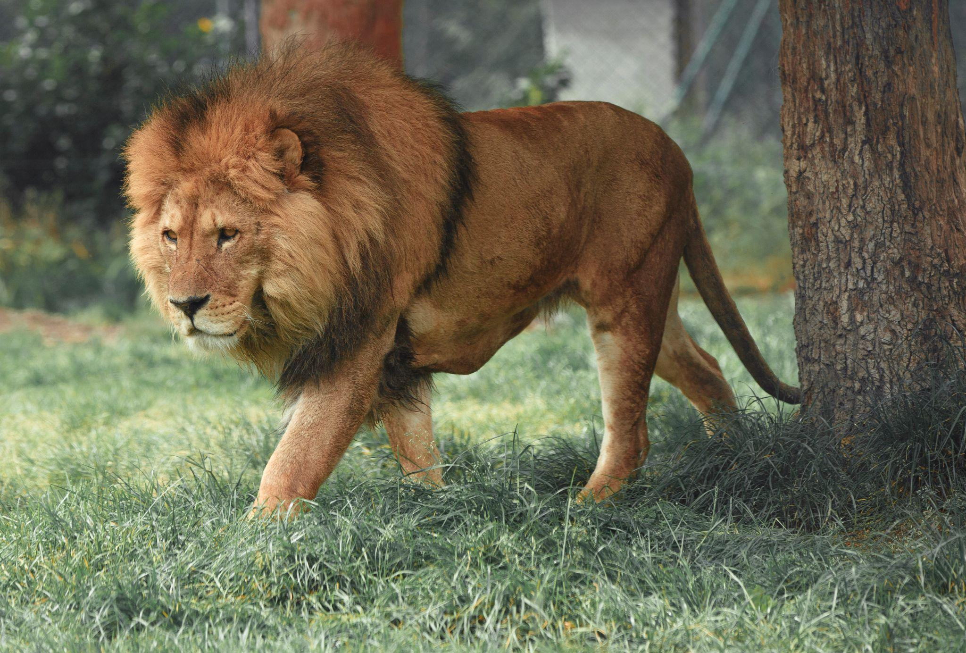





Slide 4
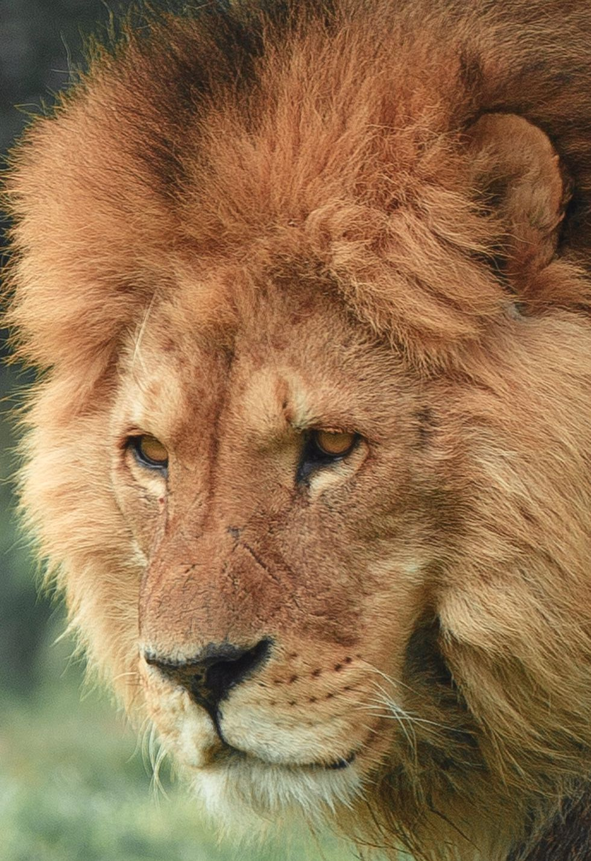
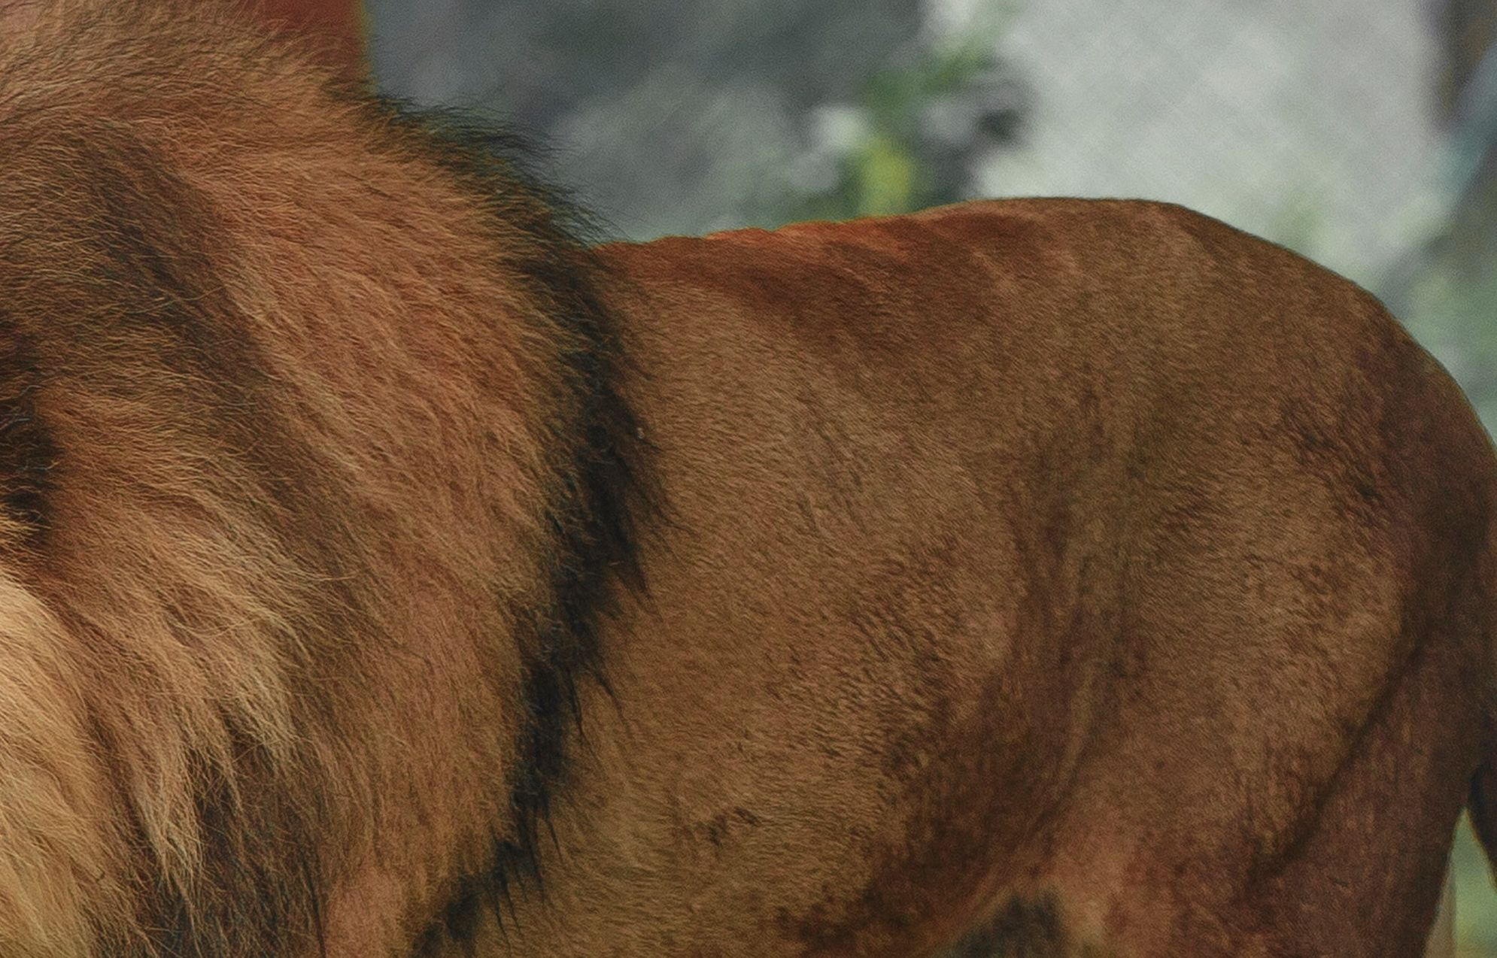
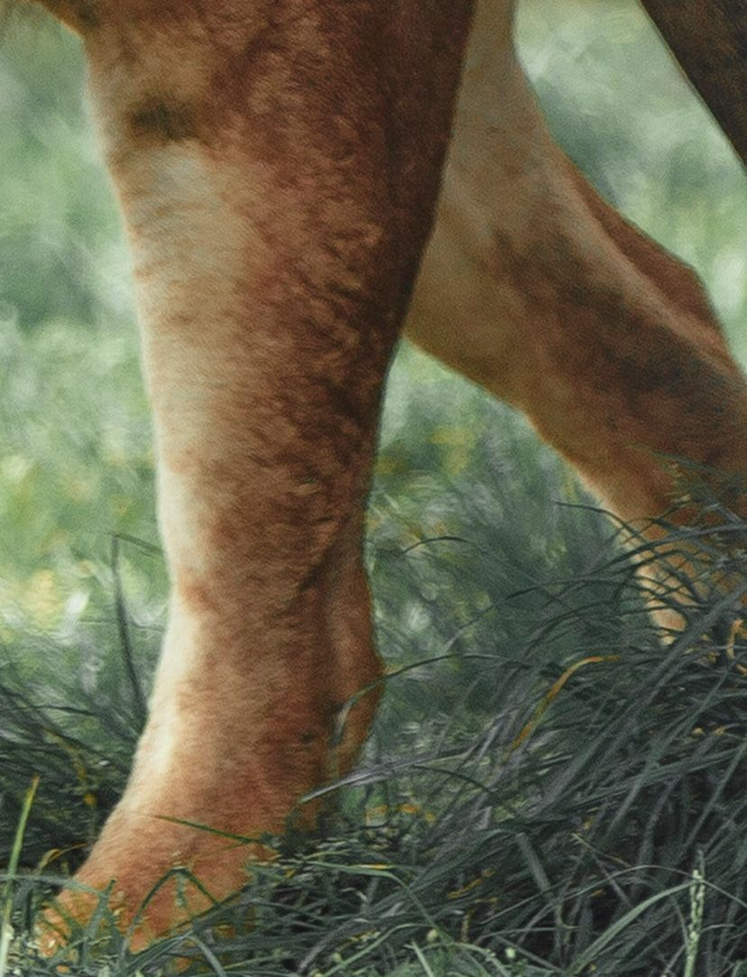
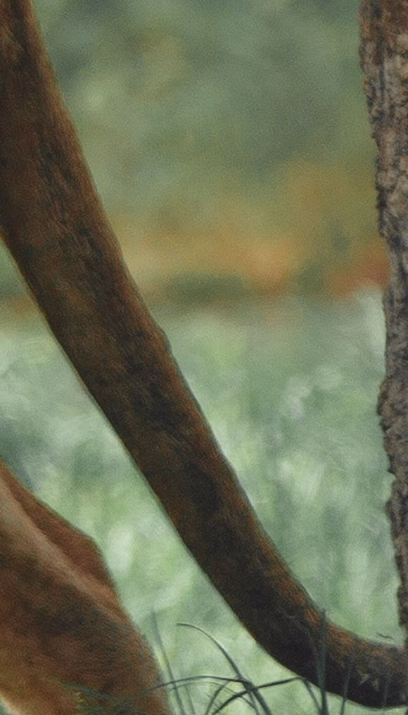

Slide 5
I can’t
I will give help

Slide 6


R u Happy?

Slide 7
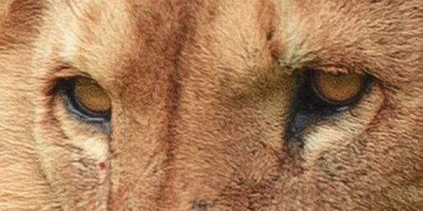
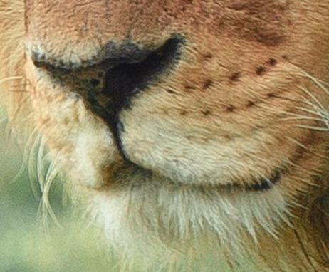
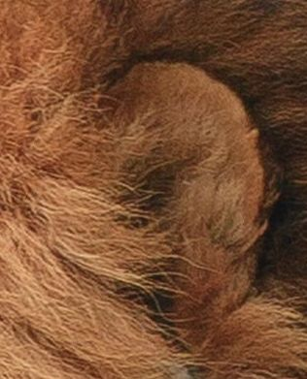
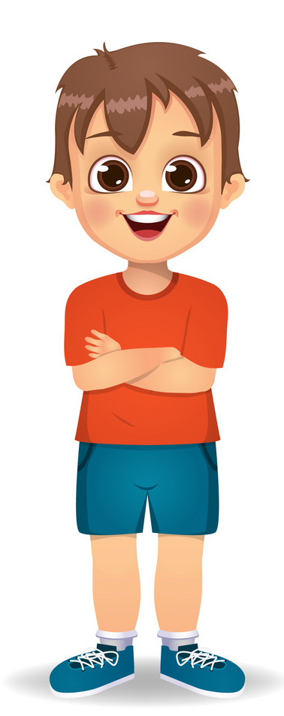
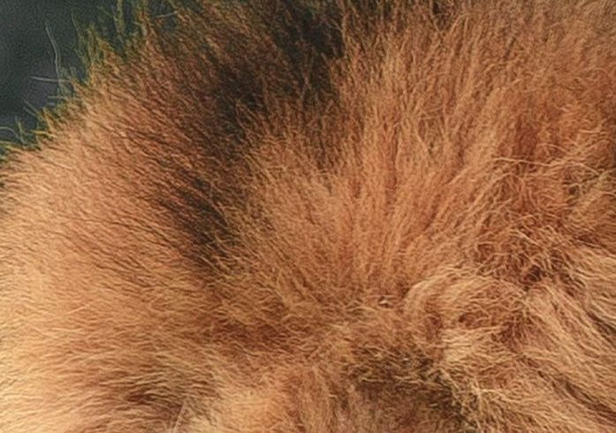

Slide 8
Man! That’s too much for
me

Slide 9


Slide 10

Lion or
not?

Slide 11
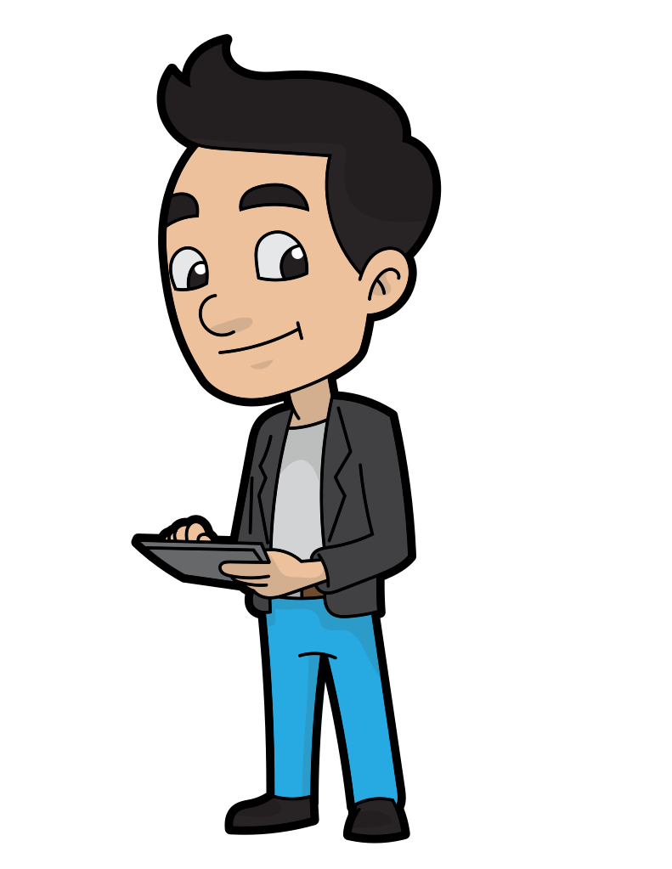
Group
Feedback

Slide 12
Feedback
Feedback

Slide 13
Feedback
Training

Slide 14
Group
Feedback

Slide 15
Network
Lion
Or
Not

Slide 16
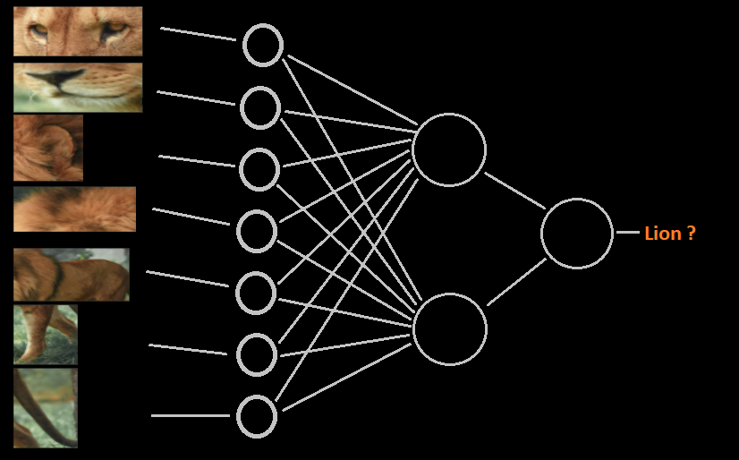

Slide 17
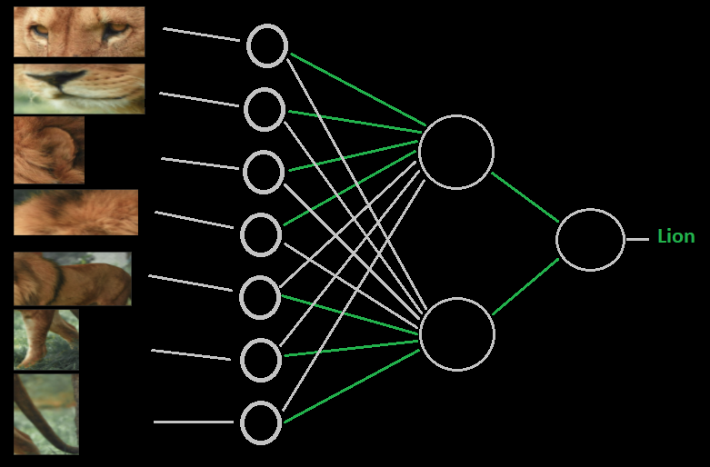

Slide 18
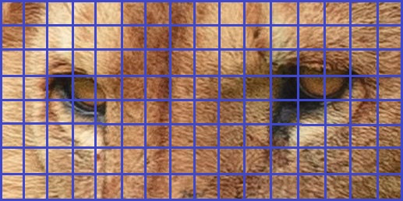
Input Layer
Hidden Layer
16x8 pixels
.
.
128
128x1 vector
64

Slide 19
Thank you!

