Slide 1
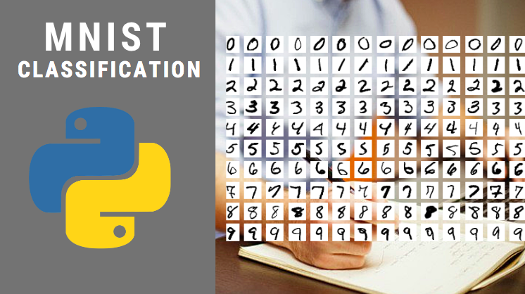

Slide 2
MNIST dataset
http://yann.lecun.com/exdb/mnist/
Details:
Task - Handwritten Digit recognition
Type - Images
Resolution - 28x28
Train - 60000
Test - 10000
Format - UBYTE

Slide 3
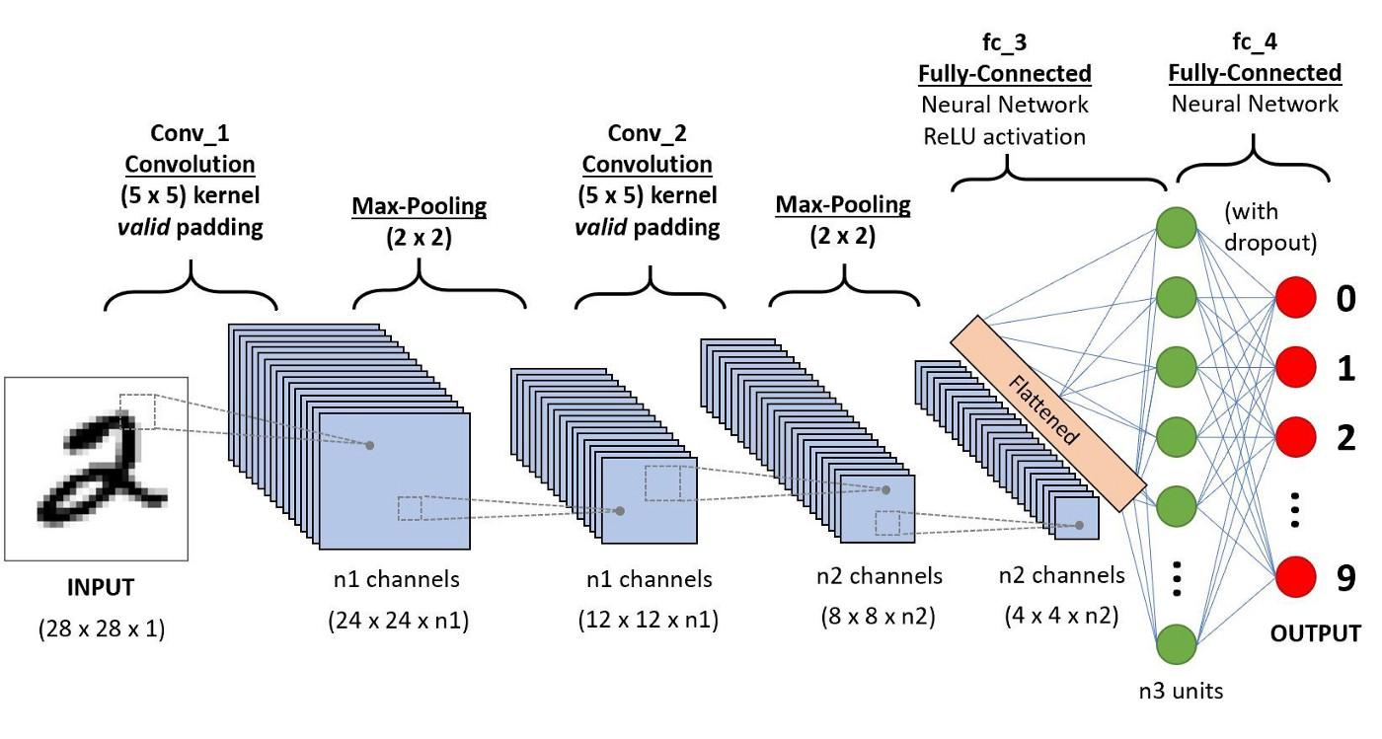
Using CNN

Slide 4
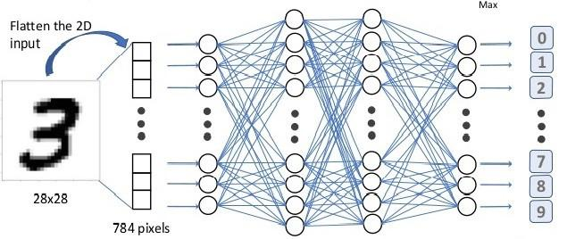
Using Dense Networks

Slide 5
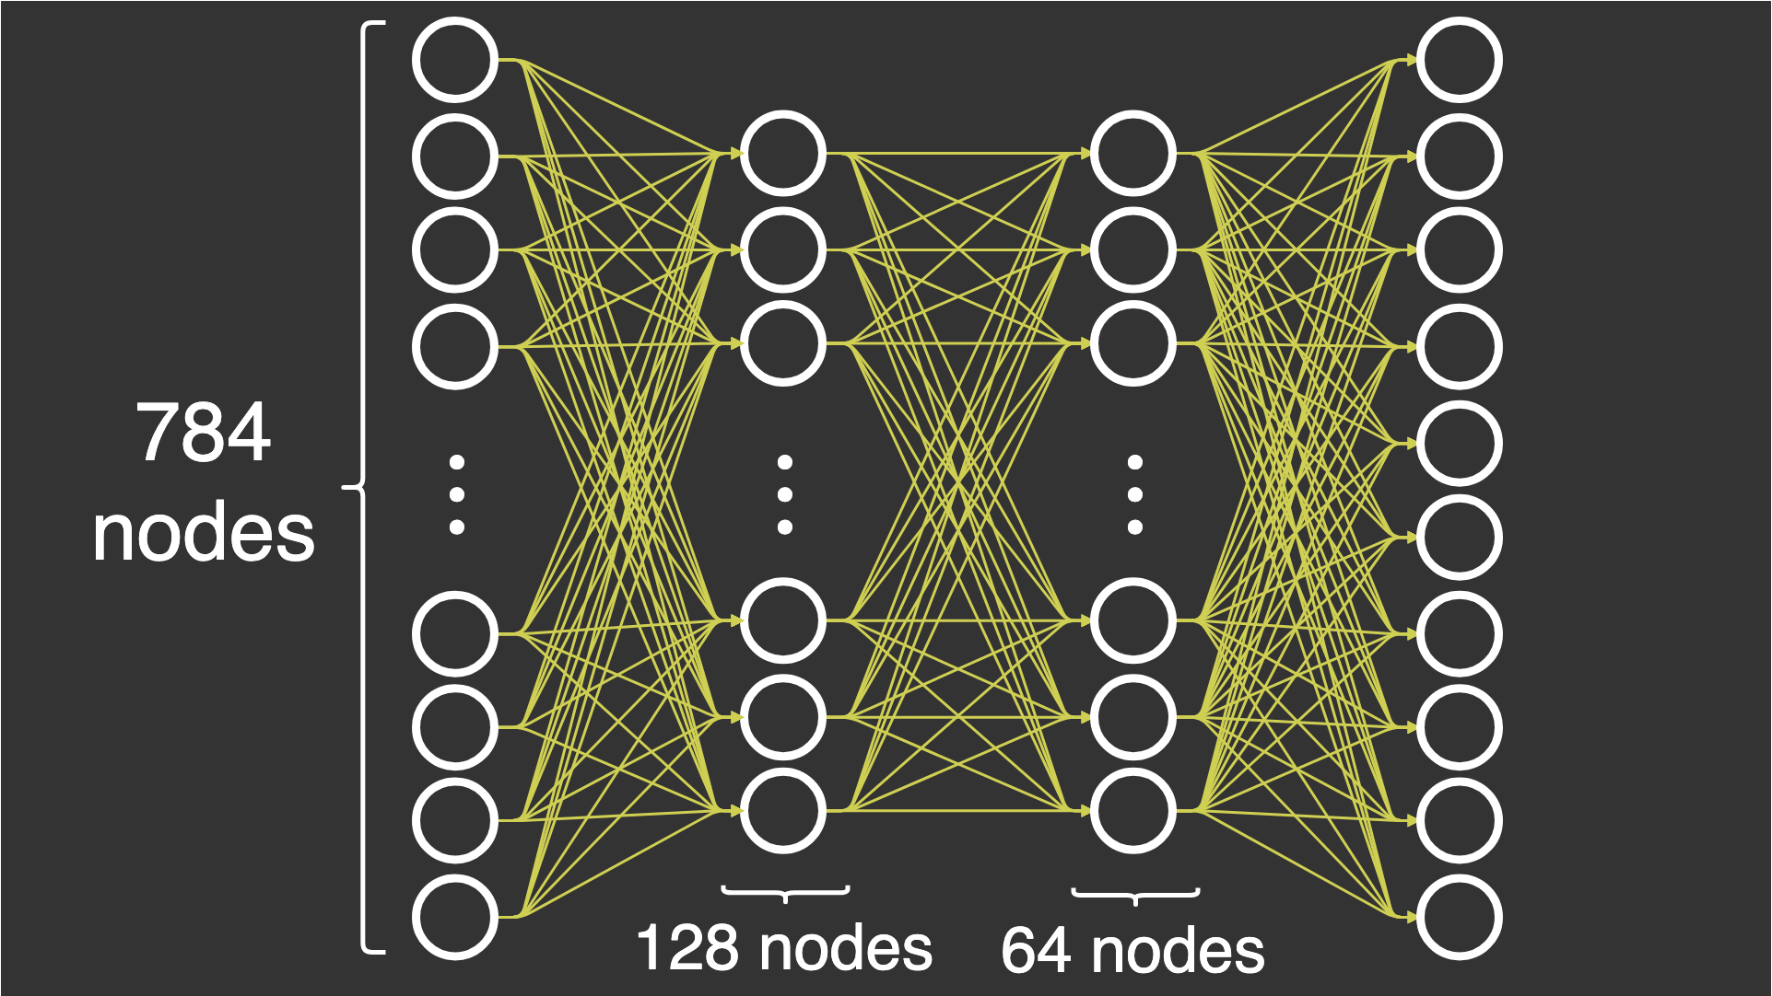
Our Network

Slide 6
Steps
Convert the mnist data to csv files
Load the dataset and visualize
Build the neural network
Training the Network
Evaluating the Network

