Slide 1
The standardiser tool
Francis Atkinson
Chemogenomics Group
EMBL-EBI

Slide 2
Chemical Structure Standardisation
Combining heterogeneous sources of chemical structures can cause problems due to differing representations
The ChEMBL database’s methods of dealing with these issues will be discussed first as background
The standardiser tool will then be introduced
Please note that, while this tool was inspired by the ChEMBL protocols, it is a separate project

Slide 3
What is ChEMBL?
A freely-available source of bioactivity data
Bulk of data is for small organic molecules
A small amount is for inorganics, biologicals etc.
Core is data from key MedChem journals
J. Med. Chem, Bioorg. Med. Chem. Lett.
Supplemented by…
Subset of data from PubChem
Only full-curve data taken at present
Other free databases
e.g. DrugMatrix, TPSearch
Deposited datasets
e.g. NTD consortia, GSK kinase set
Heterogeneous sources of chemical structures!

Slide 4
Example of issues
Hypervalent vs. charge-separated
Charged vs. neutral salts
Chemical databases cantreat these as different
Could cause SSS to fail if alternative depiction used as query
Standardization is required

Slide 5


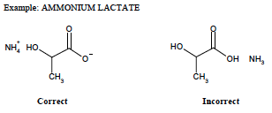
Standardisation
The FDA have published a compound depiction SOP for their Substance Registration System
Used as basis for ChEMBL standardisation rules
with some modifications, e.g. …
ChEMBL would treat these the same as other salts, i.e. they would be neutralized

Slide 6
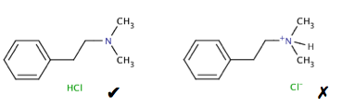
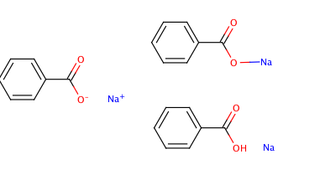

Examples of rules: charges
Consistent rules for drawing salts
Compounds to be charge-neutral if possible
quaternary N an exception if counterion unknown

Slide 7


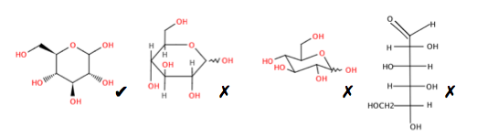
Example of rules: functional groups
Charge-separated preferred over hypervalent
Stylistic rules for sugars, peptides, steroids etc.

Slide 8
Salt stripping
Salt/solvate components should not affect the biological activity of a compound
There can be exceptions
e.g. salt form may affect solubility
However, any 3D or QSAR modelling should be done using only the bioactive ‘parent’
It is desirable to be able to view compounds with a common parent together
It can be appropriate to aggregate data for the parent compound

Slide 9
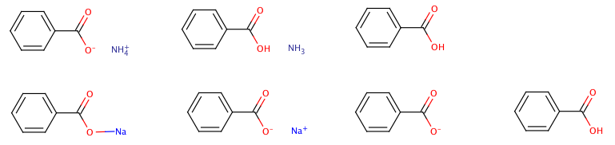
Salt stripping (2)
Counterions and solvent molecules are removed using a custom ‘salt dictionary’
Acids with inorganic cations may require a further round of charge-neutralization…
The parent is registered as a separate structure
The parent and original salt are linked via the ‘molecule hierarchy’ table
Strip salts
neutralise
Salt
Parent
As stored in ChEMBL
Break bond
Strip salts
neutralise

Slide 10

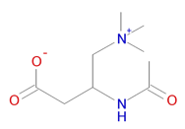
Curator intervention
Structures with permanent charges
i.e. counterion not recorded
Zero charge used as check on neutralization steps
Zwitterions
Naïve neutralization could introduce errors
These types automatically routed for inspection
Possible manual standardisation

Slide 11

Inorganics & organometallics
Handled poorly by current chemoinformatics tools…
multicenter bonding
coordination complexes
Non tetrahedral stereochemistry
Cannot distinguish cis- and trans-platins
Charge-balancing, salt-stripping etc. are difficult
Cannot be properly searched for by cartridge
Not put through main standardisation process
May be redrawn for clarity in some cases
e.g. approved drugs such as the platins
Structures now excluded (post-CHEMBL17)
~3200 structures affected
Bioactivities are retained
ferrocene ?!

Slide 12
Implementation in ChEMBL
Rules are applied via Pipeline Pilot protocols
Run by ChEMBL’s chemical curator
Allow manual intervention in difficult cases
The protocols are available on request
However, they are…
tightly coupled with data-loading pipeline
subject to change as new issues identified
Pipeline Pilot is commercial software

Slide 13

standardiser
Tool to pre-process structures for modelling
Funded by IMI eTOX project
Molecular representation can affect results…
Descriptor calculation
Docking
QM
Need to standardise representation
Same for both training and application

Slide 14
standardiser
‘Inspired by’ ChEMBL curation strategy
An entirely separate project , however
Several key differences to ChEMBL…
Only interested in parent (bioactive) component
Attempts to standardise tautomers
i.e. hydroxy-pyridine -> pyridone
N.B. Does not attempt tautomer canonicalization
No manual intervention
Implemented in Python & RDKit
Fully open-source

Slide 15
Procedure
Break bonds to Group I or II metals
Neutralize charges by adding/removing protons
Apply standardization rules
Neutralize any charges exposed by rules
Discard any salt/solvate components
Return standardized parent

Slide 16
Limitations
Rule set could be expanded
e.g. will review RCS / CVSP rules
No attempt to handle inorganics
Impractical with current tools
No attempt to produce ‘canonical’ tautomer
Could flag tautomeric molecules for inspection?
re-charging not handled

Slide 17
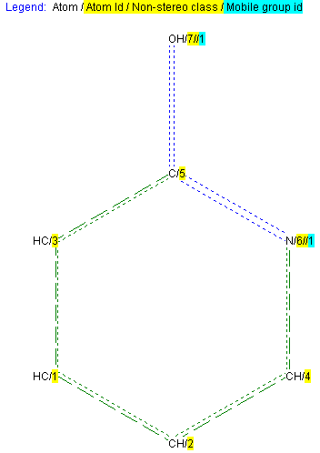
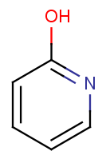
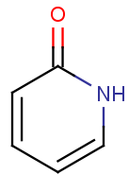
Key differences to ChEMBL
ChEMBL makes no attempt to standardise tautomers
InChI codes are used for registration (i.e. assignment of database identifiers/keys)
i.e. two molecules are the if they have the same InChI
For any molecule, the first-encountered tautomer will always be used
to generate images, for searching and in downloadable SDF files etc.
Thus, for example: if the first time a molecule encountered it is shown as the hydroxy-pyridine, this tautomer will be stored (as a molfile) and will be used for the depiction of this molecule even where an alternative tautomer is encountered in a later document
By contrast, standardiser does attempt to standardise tautomers
e.g. the pyridone is preferred, as it is likely to be the lower-energy tautomer
ChEMBL
standardiser
Encountered first: molfile stored in database against this InChI
Encountered second: hydroxy-pyridine molfile will be used for depiction etc.
hydroxy-pyridine
pyridone
input
output
﻿InChI=1S/C5H5NO/c7-5-3-1-2-4-6-5/h1-4H,(H,6,7)

Slide 18
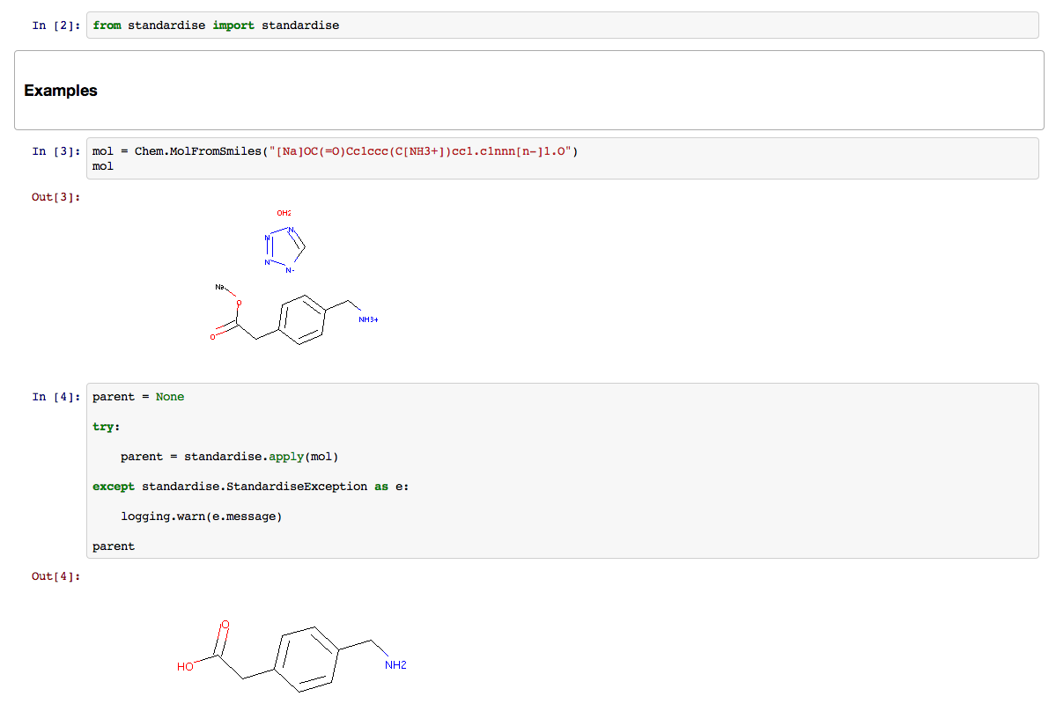
Example
Provided as a Python package
A simple driver program for batch processing is included
Accepts SDF or SMILES input

Slide 19
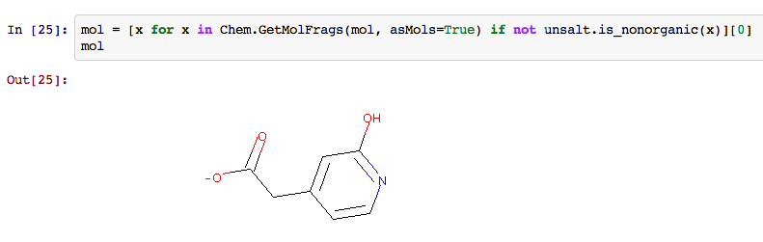
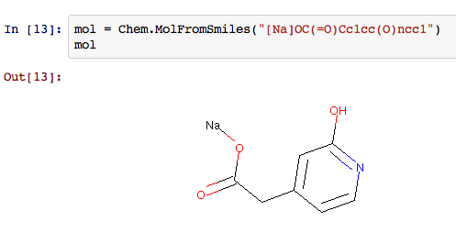
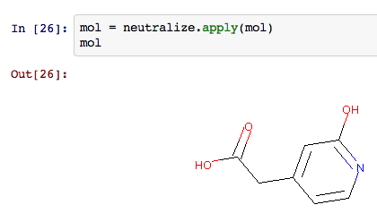
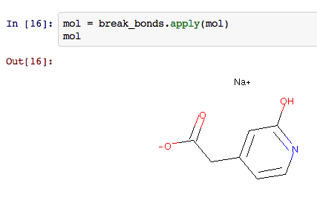
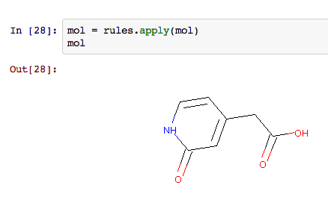
Modules within package
Modules implementing different steps may be called independently
could be incorporated into different workflows

Slide 20
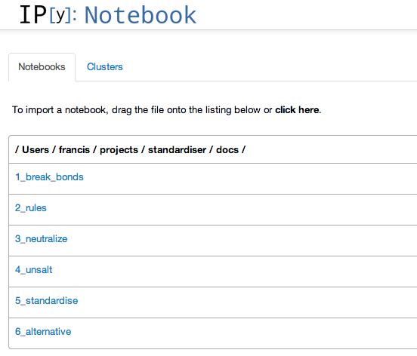
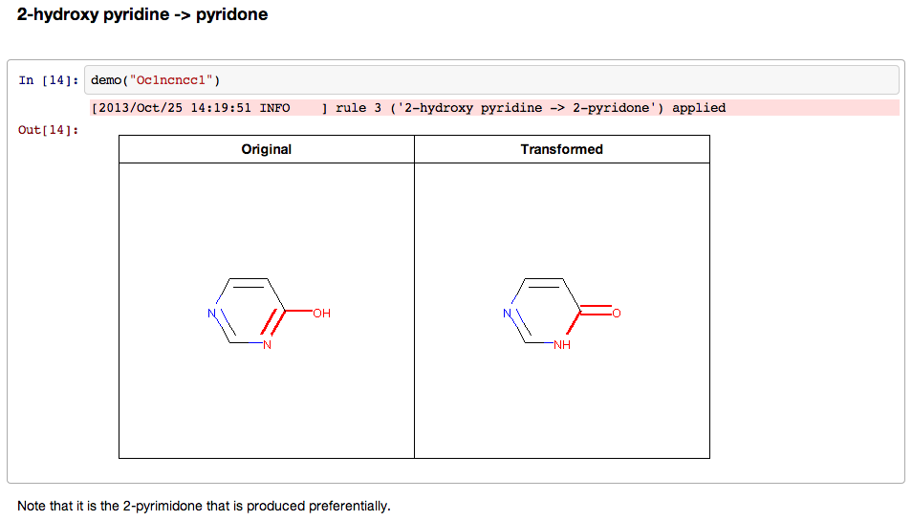
Documentation
Provided as IPython Notebooks
Also available as static web pages

Slide 21
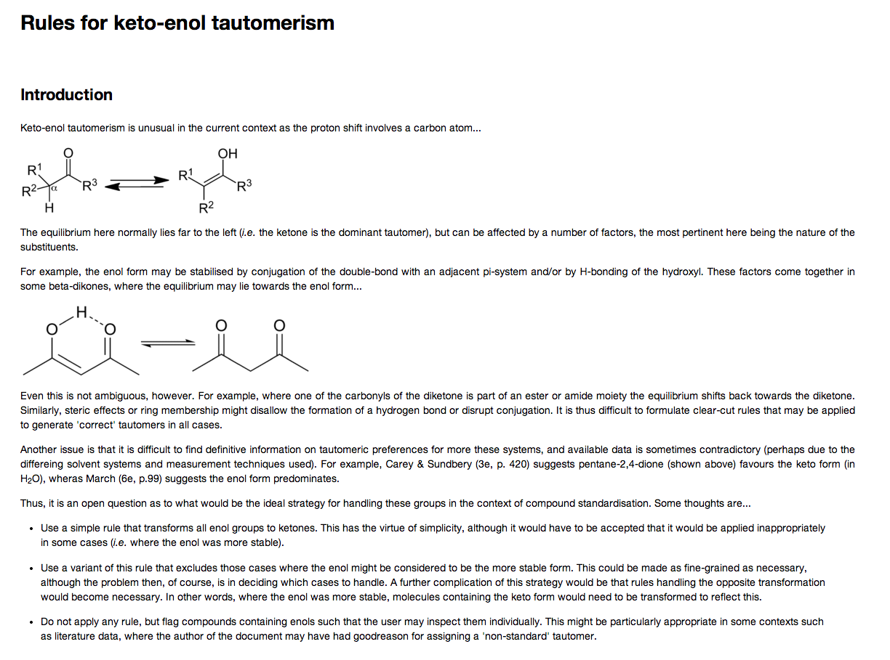
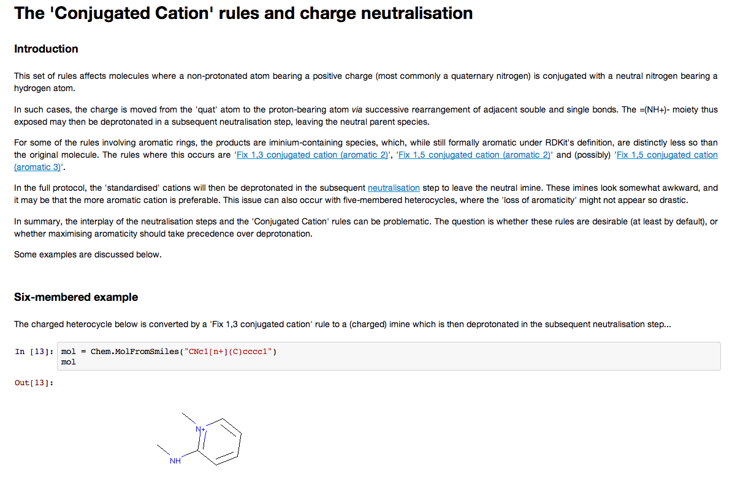
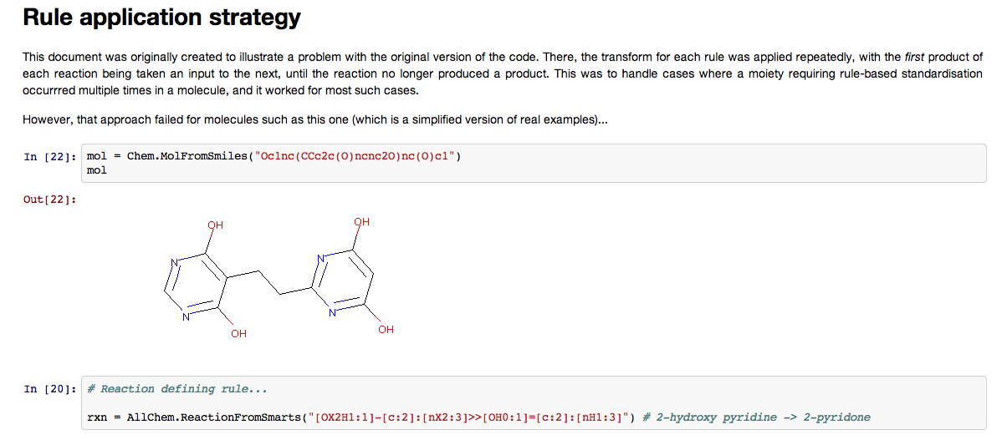
Futher Documentation
Also included are some pages describing various issues
Intended to stimulate debate on best practices

Slide 22
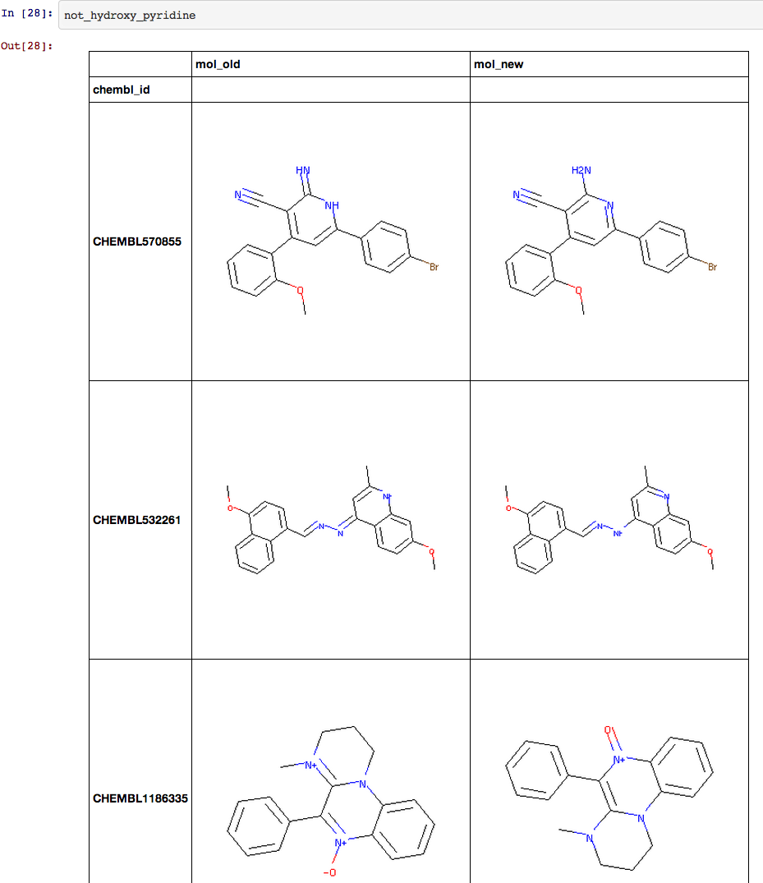
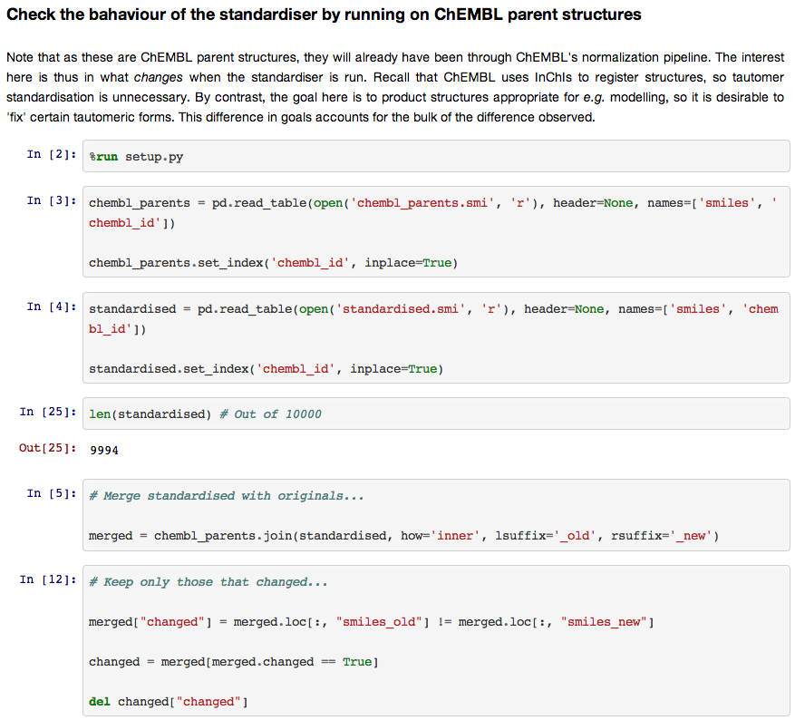
Futher Documentation
The tool will be run on diverse test sets and the results posted
Again, designed to detect flaws and promote discussion
Oops! This isn’t good…

