Slide 1

MINDFUL CHAT
Names: Shaany Gangle, Satyam Bhikonde, Seemant Savle
Under the guidance of: Prof. Ajeet Singh Rajput
Prof. Mohammed Mazhar Khan
University: Medi-Caps University

Slide 2
INTRODUCTION
Mindful Chat is a web-based platform that connects patients and psychologists through real-time messaging.
It improves access to mental health support by offering a simple, secure, and user-friendly consultation experience.
Built with modern web technologies, it reduces the need for physical consultations and enhances healthcare accessibility.

Slide 3
OBJECTIVE AND SIGNIFICANCE
Enable real-time secure doctor-patient communication
Design intuitive, easy-to-use interfaces
Ensure backend scalability and security
Save chat histories securely
Improves mental health service accessibility
Reduces need for physical consultations
Foundation for future AI, video consultation, and health record integrations

Slide 4
TECH STACK
Frontend: React.js + Tailwind CSS
Backend: Node.js + Express
Database: MongoDB
Real-time: Socket.IO

Slide 5
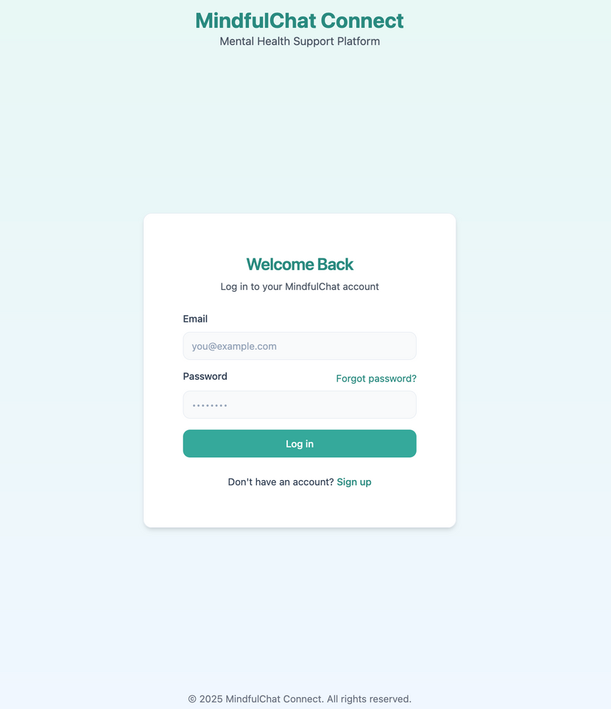
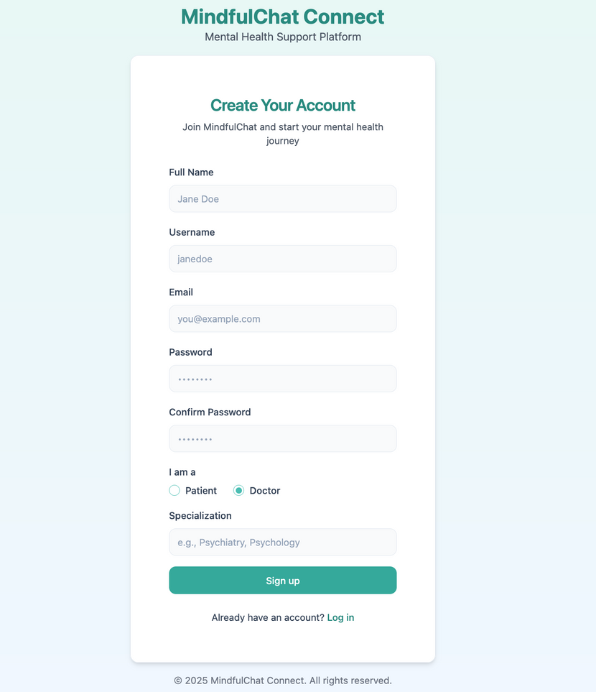
USER INTERFACE SNAPSHOTS

Slide 6
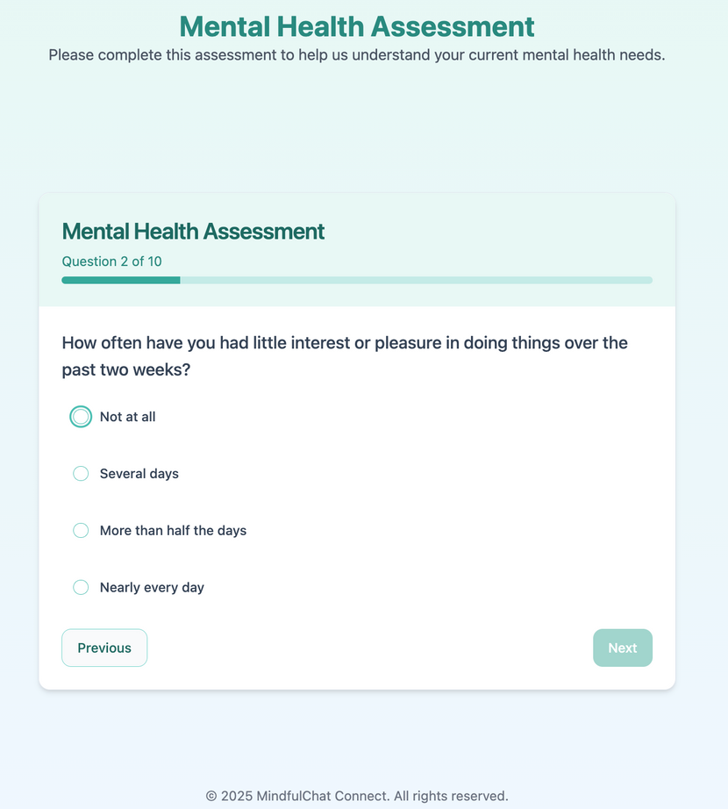
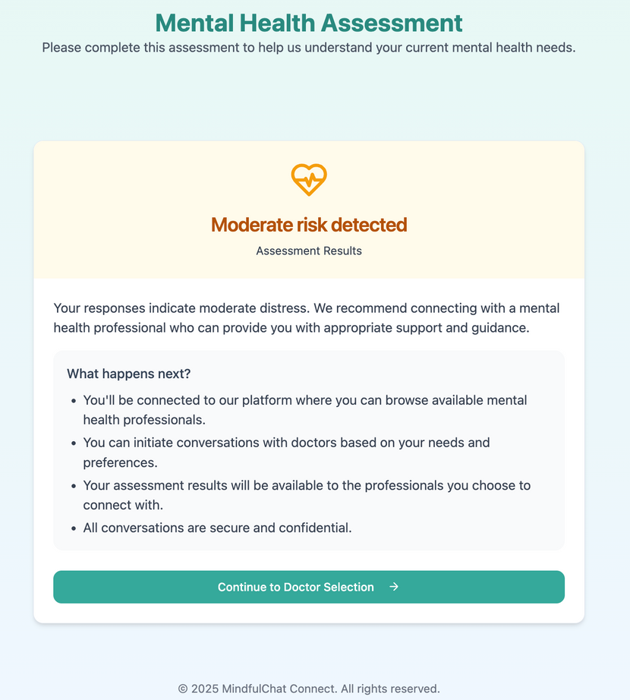
USER INTERFACE SNAPSHOTS

Slide 7
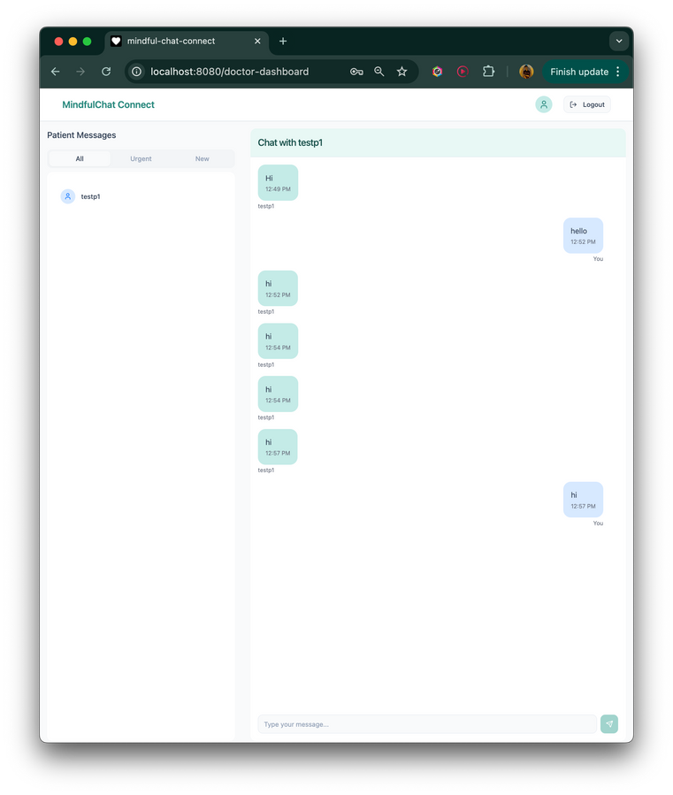
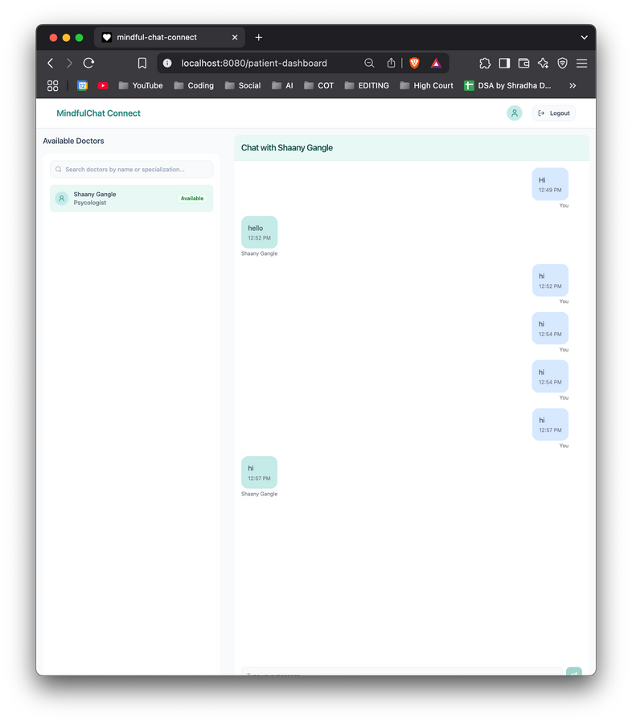
USER INTERFACE SNAPSHOTS

Slide 8
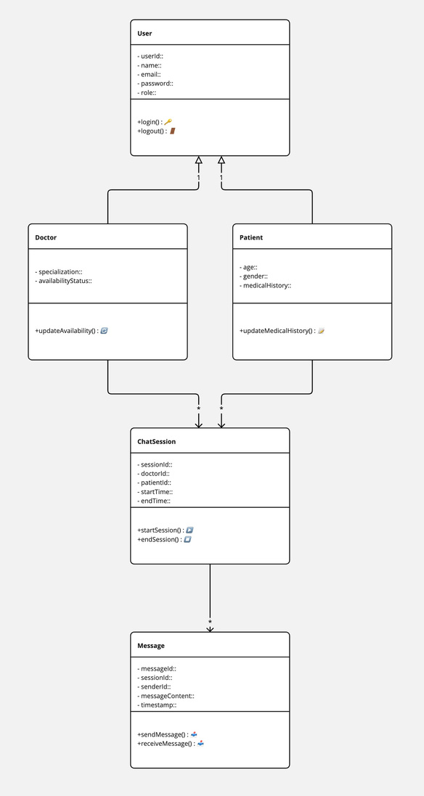
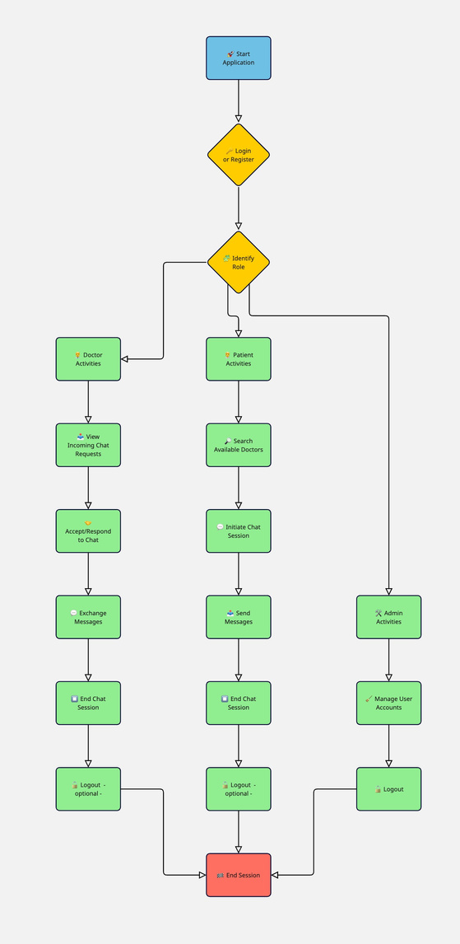
SYSTEM DESIGN DIAGRAMS
FUNCTIONAL REQUIREMENTS
USER REGISTRATION/LOGIN (PATIENTS, DOCTORS, ADMIN)
Real-time chat fUNCTIONALITY
SECURE DATA TRANSMISSION AND STORAGE
ADMIN DASHBOARD FOR USER MANAGEMENT

Slide 9
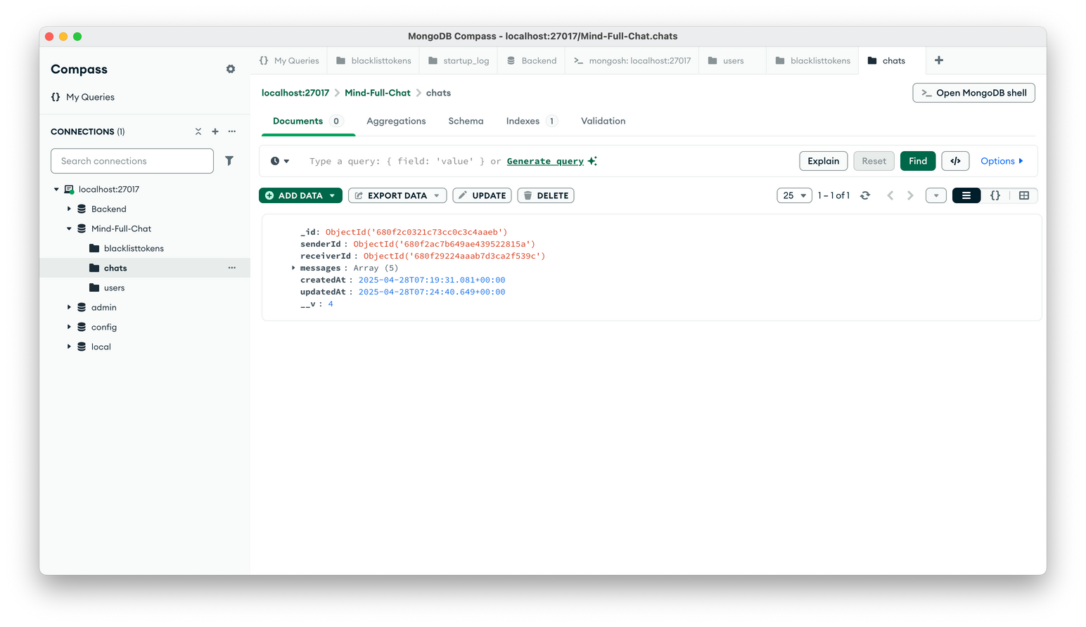
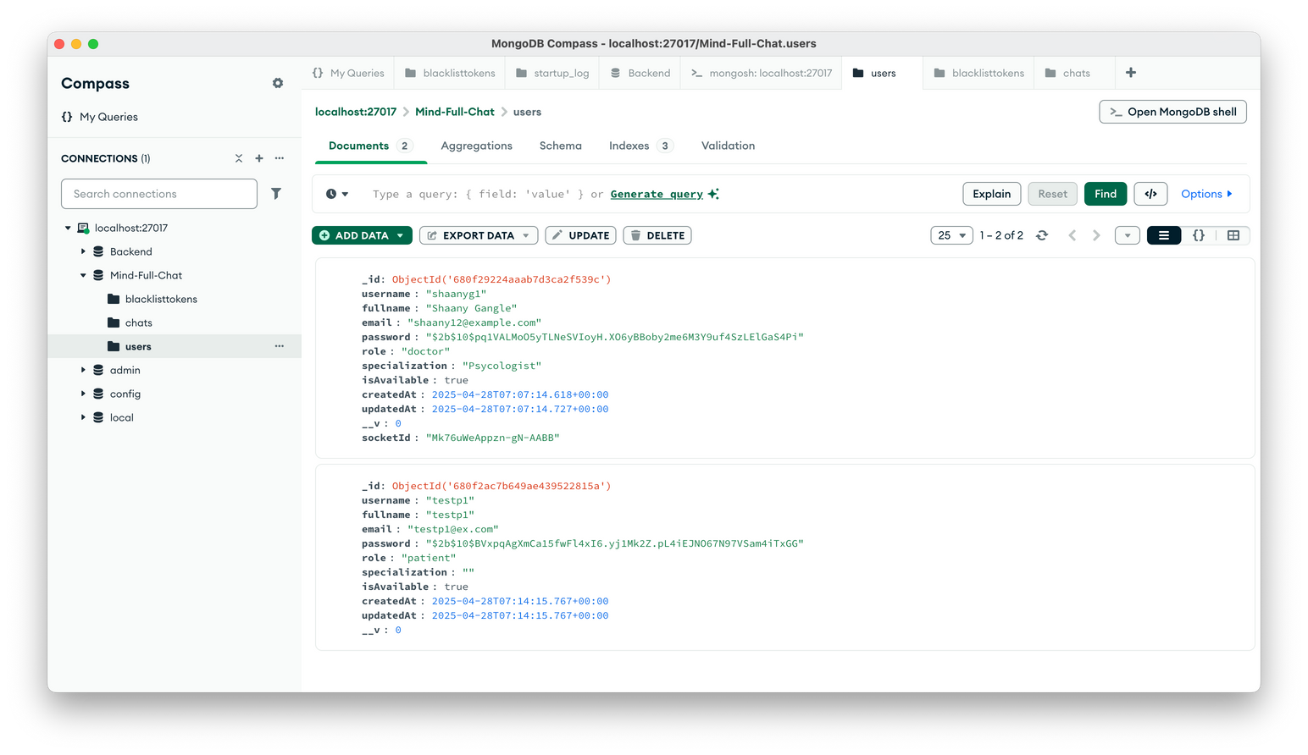
DATABASE SNAPSHOTS

Slide 10
SUMMARY AND CONCLUSION
SUCCESSFULLY DEVELOPED A SECURE, SCALABLE REAL-TIME CHAT APPLICATION
SEAMLESS EXPERIENCE FOR DOCTORS AND PATIENTS
SYSTEM LAYS GROUNDWORK FOR ADDING FUTURE FEATURES LIKE VIDEO CALLS AND APPOINTMENTS
FUTURE SCOPE
APPOINTMENT SCHEDULING
VIDEO CONSULTATIONS (WEBRTC)
FILE SHARING (MEDICAL REPORTS)
PAYMENT GATEWAY INTEGRATION
MOBILE APP DEVELOPMENT
AI-POWERED CHATBOT

Slide 11
THANK YOU

