Slide 1

Department of Information Technology VIGNAN’S INSTITUTE OF INFORMATION TECHNOLOGY Project Review on
Keylogger Application
Presented By
Batch No: 15
P.Shanmukha(18L31A1246)
Ch. Dilip kumar(18L31A1255)
A. Rajesh(18L31A1240)
Under The Esteemed Guidance of
Dr. Koduganti Venkata Rao,
Professor
IT Department
09/10/2021

Slide 2

CONTENTS
Title
Abstract
Introduction
Proposed System
Expected Results
Technologies and Modules Used
System Design
UML Diagrams
Application Requirements
Conclusion & Future work

Slide 3
TITLE
Keylogger
Application

Slide 4
ABSTRACT
In many companies now-a-days data security and data recovery is the most important factor. So there are many cases where data recovery is required. For these kinds of problems keylogger is one of the best solutions which is often referred to as keylogging or keyboard capturing.
Keyboard capturing is the action of recording the keys stroke on a keyboard, typically covertly, so that the person using the keyboard is unaware that their actions are being monitored.
This is a surveillance application used to track the users which logs keystrokes; uses log files to retrieve information. Using this application we can recall forgotten email or URL.
In this keylogger project, whenever the user types something through the keyboard, the keystrokes are captured and mailed to the mail id of admin without the knowledge of the user within the time set.

Slide 5
INTRODUCTION
In many IT infrastructure organizations now-a-days, data security and data recovery are the most important factors which is basically deployed in Computer Forensics.
Computer forensics consists of the art of examining digital media to preserve, recover and analyze the data in an effective manner.
So by using keylogger application we can monitor the user activities and users can retrieve data in the time of disaster and damaging of working file due to loss of power.
The collected information is saved on the system as a hidden file or emailed to the Admin or the forensic analyst.

Slide 6
PROPOSED SYSTEM
Keystroke loggers are available in software and hardware form, and are used to capture and compile a record of all typed keys.
The information gathered from a keystroke logger can be saved on the system as a hidden file, or emailed to the forensic analyst or the Administrator.
Our project keylogger has the following features :
- Logs keystrokes including special key along with Date & Time
- Sends mail to the Admin’s mail Id
Additional Features:
- Automated Screenshots at regular intervals
- Get List of all Background running Processes or User working Applications
Advantages :
For Business Services - It provides complete protection of confidential data that benefits business management and operations.
For Educational Institutes - It remotely monitor faculty and student computer activities
For Parenting Purposes - Parents can keep track of the kid’s online presence, time spent, and URLs engaged.

Slide 7
EXPECTED RESULT
It tracks on every key that is typed through the keyboard and store all type of keys as logs in text file.
Note Date & Time of every User Activity.
Additionally, Takes automated screenshots at regular intervals.
Get List of all Background running Processes or User working Applications & Platform.
All data is send to the admin through the mail server in the time set or given.
It provides confidentiality as well as data recovery to all the IT infrastructures in need.

Slide 8
TECHNOLOGIES AND MODULES USED
Python :
Python is a high-level, interpreted, interactive and object-oriented scripting language.
Modules Used:
Smtplib
OS
Subprocess
Threading
Keyboard
Pyautogui
Datetime
Time
Tkinter

Slide 9
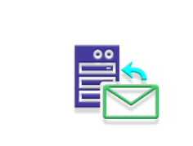
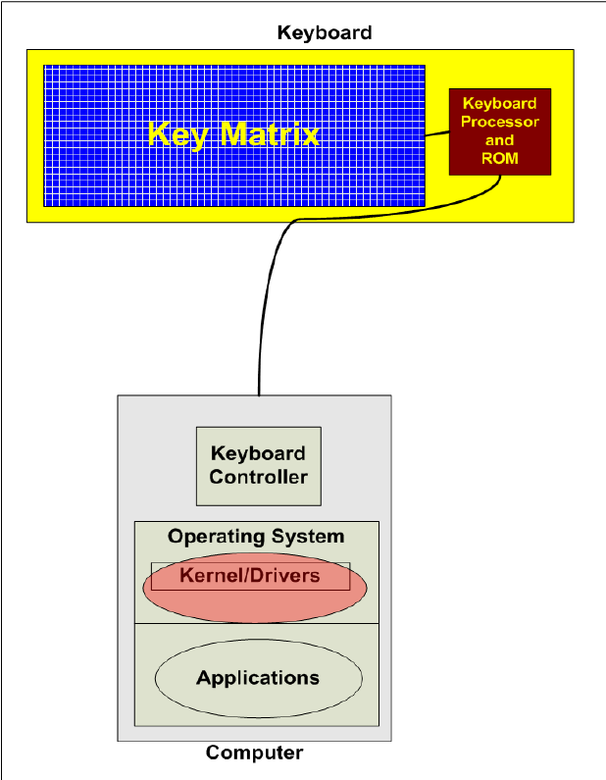


SYSTEM DESIGN

Slide 10
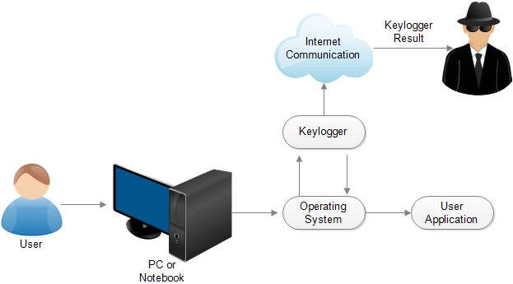
UML DIAGRAM
Mail Server
Remote PC

Slide 11
Application Requirements
Software:
Windows OS
Windows 2000, Windows XP (32-bit and x64), Windows Server 2003/2008, Windows Vista (32-bit and x64), Windows 7, Windows 8 (32-bit and x64); Windows 10 ,
Windows 2000 or later ,
Internet Explorer 5.0 or later ,monitor : 15” colour ,HDD 40GB
Basic input devices required: keyboard
Basic output devices required: mobile devices
S/W requirement: PyCharm, Python 3.8.0
Technologies used: Advanced programming using Python
Hardware:
monitor: 15” colour,
HDD: 40GB minimum
Basic input devices required: keyboard
Basic output devices required: SMTP Mail Server

Slide 12
CONCLUSION & FUTURE WORK
A Keylogger is a form of software which is used to track or log the all the keys that a user strikes on their keyboard, usually in secret so that the user of the system doesn’t know that their actions are being monitored. It is otherwise known as keyboard capturer. These are perfectly legal and useful.
They can be installed by employers to oversee the use of their computers, meaning that the employees have to complete their tasks instead of procrastinating on social media. Some of the possible amendments and improvements in this project are:
Full remote cloud monitoring
Gathering visited websites
Recording user screen
Gathering Malware softwares
Network monitoring

Slide 13
Thank You

