Slide 1

Note: The data and information in this document is reflective of a hypothetical situation and client. This document is to be used for KPMG Virtual Internship purposes only.
Sprocket Central Pty Ltd
Data analytics approach
Shashank S.

Slide 2
Note: The data and information in this document is reflective of a hypothetical situation and client. This document is to be used for KPMG Virtual Internship purposes only.
Agenda
Introduction
Data Exploration
Model Development
Interpretation

Slide 3
Note: The data and information in this document is reflective of a hypothetical situation and client. This document is to be used for KPMG Virtual Internship purposes only.
Introduction
Analysis of the Existing Customer Data to Classify New target Customers.
Sprocket Central Pty Ltd has recently acquired new customer data, including those without prior transactions with the company. This analysis aims to filter and evaluate various metrics from the existing customer base to determine which of the new customers should be prioritized.

Slide 4
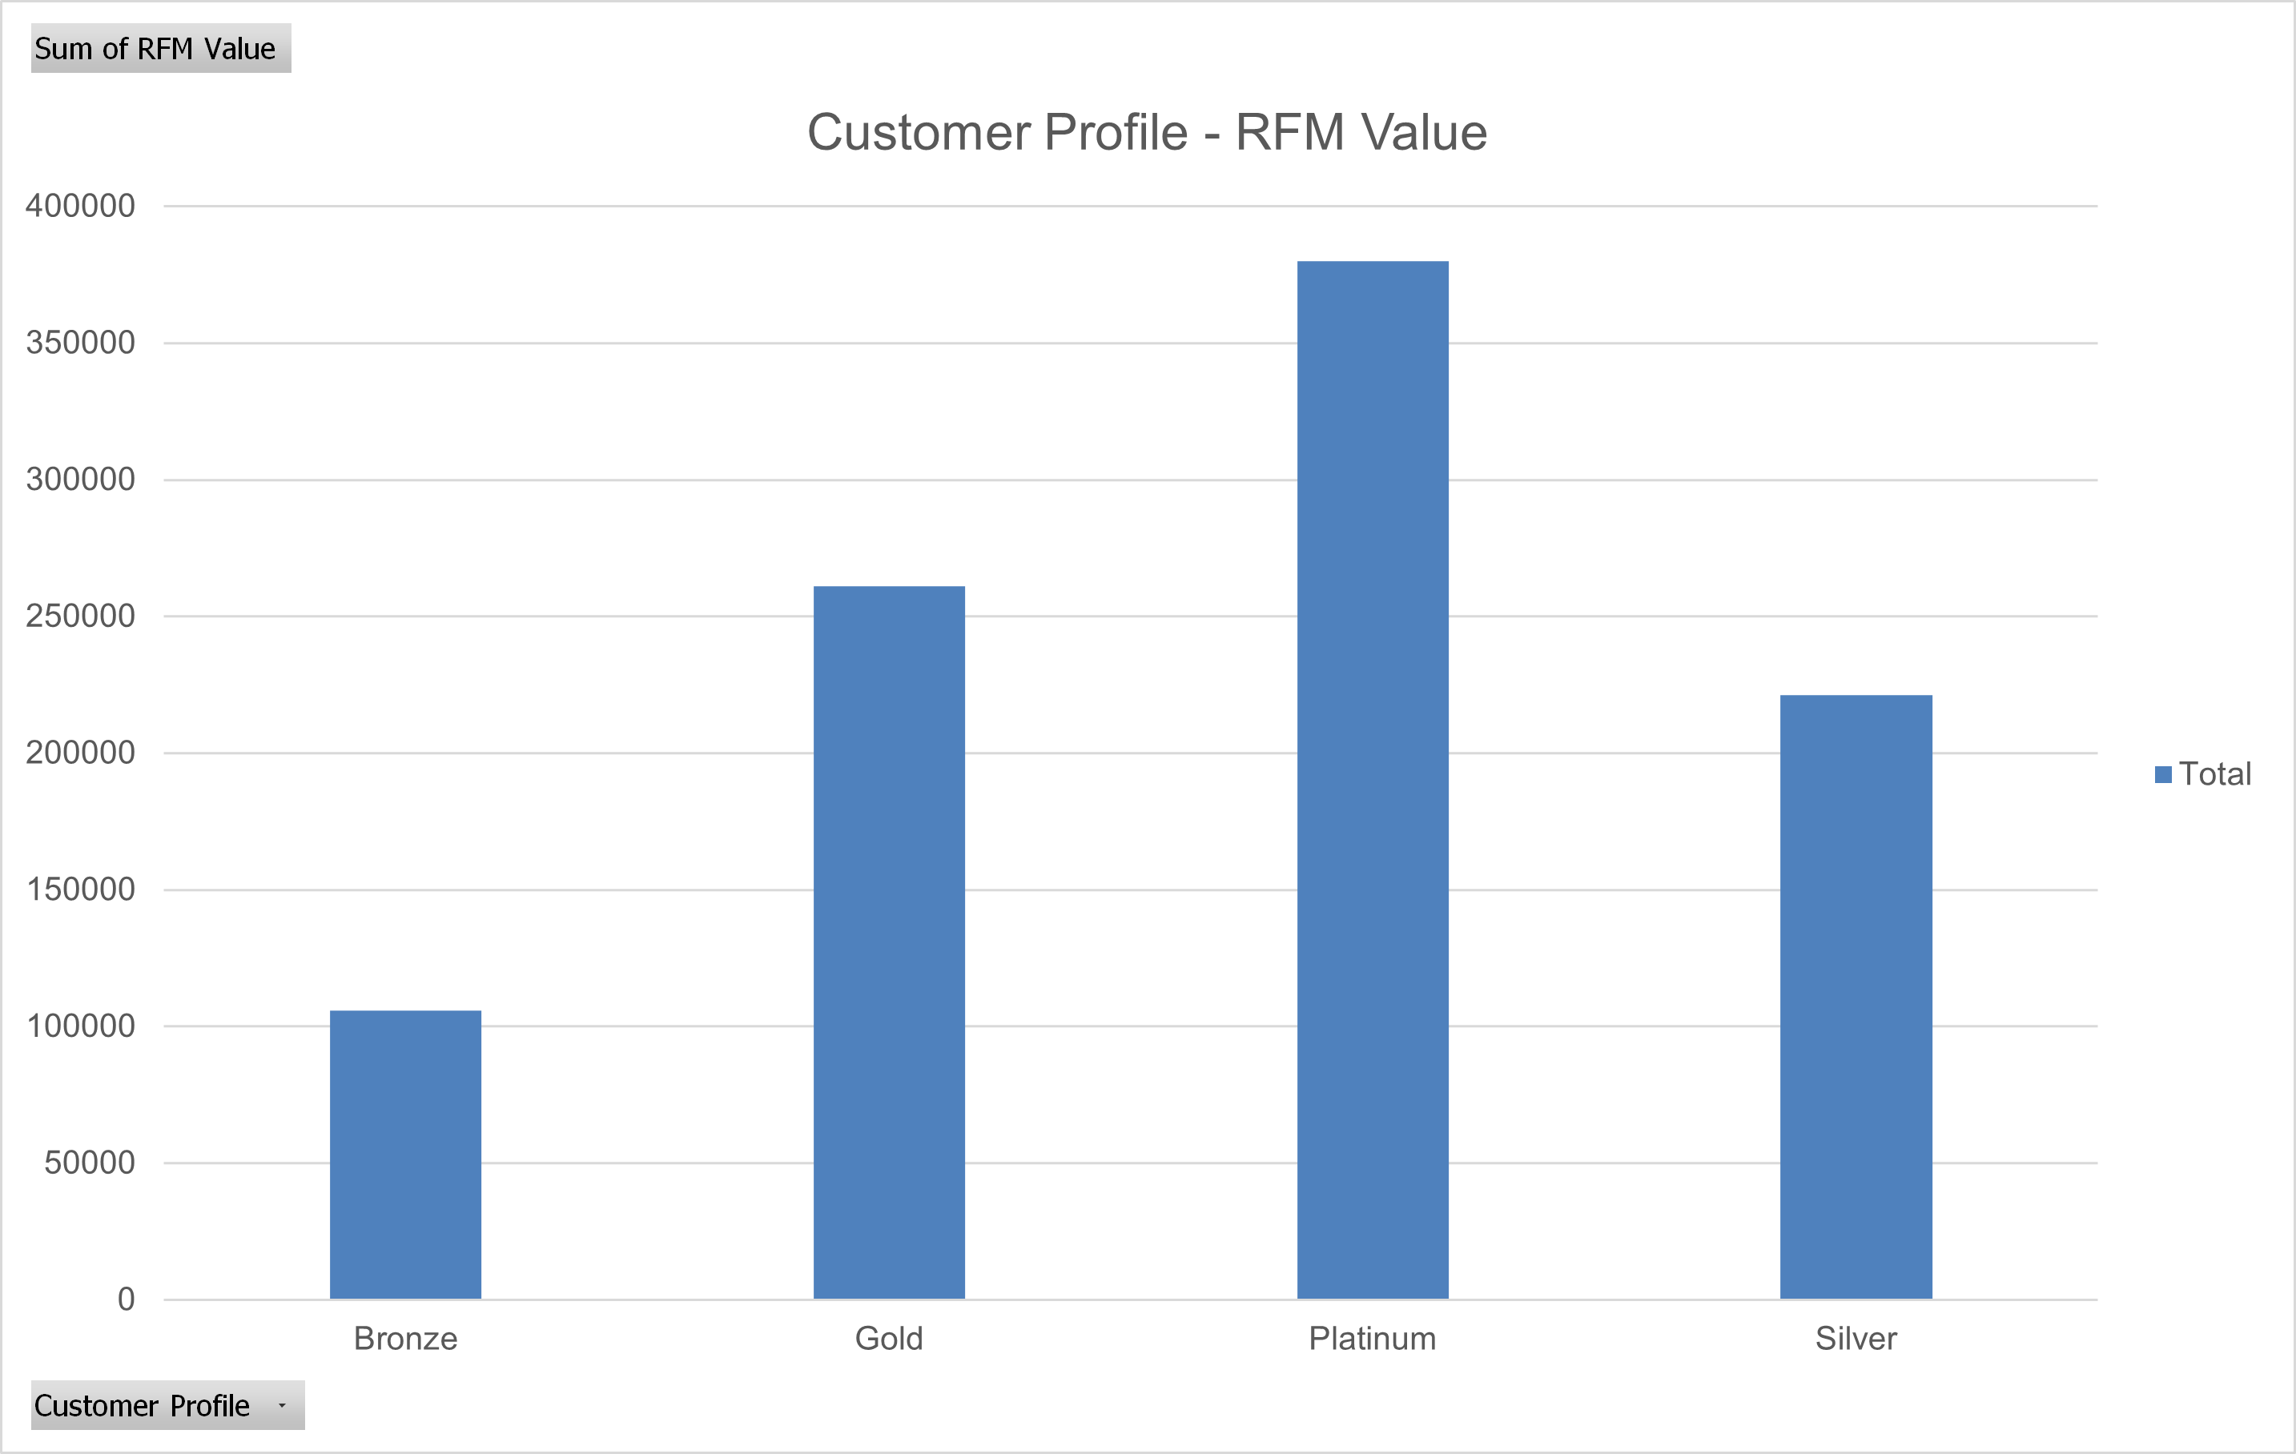
Note: The data and information in this document is reflective of a hypothetical situation and client. This document is to be used for KPMG Virtual Internship purposes only.
Data Exploration
RFM Analysis
Utilized the RFM framework to analyze the data and classify customers into Bronze, Silver, Gold, and Platinum tiers based on their RFM values. This approach facilitates the efficient categorization of new customers.

Slide 5
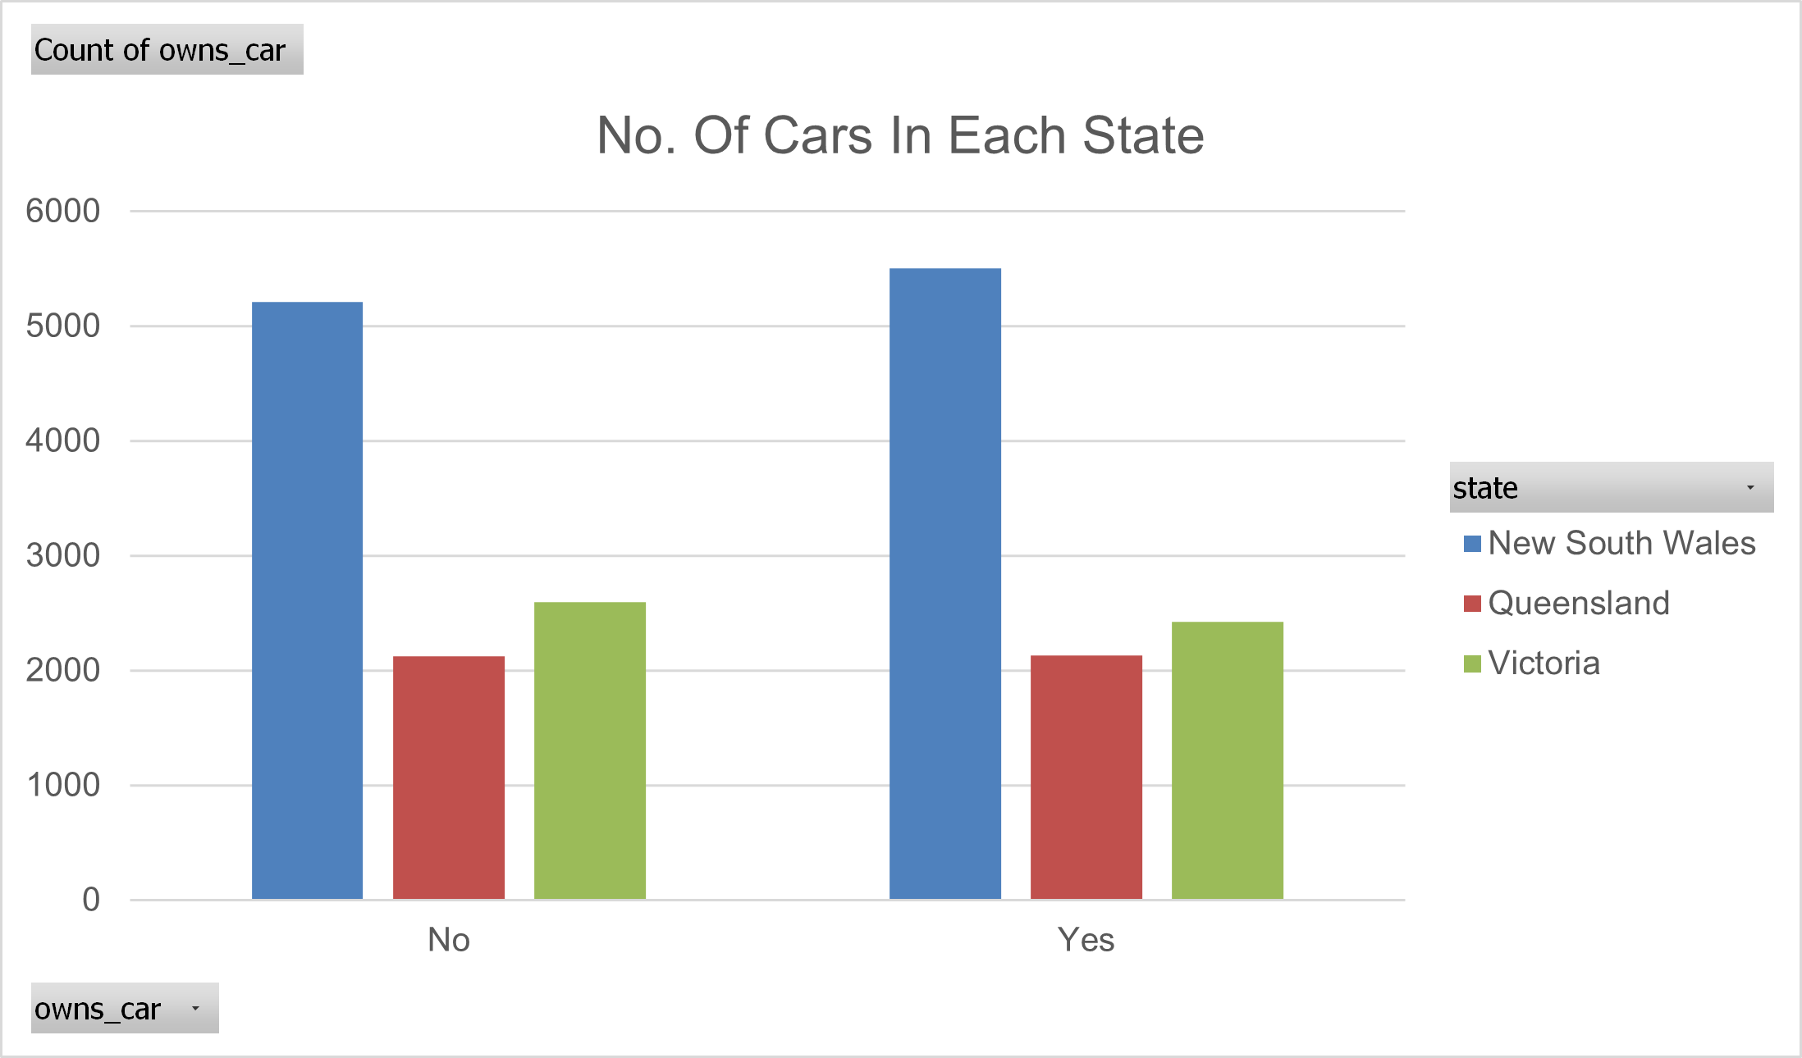
Note: The data and information in this document is reflective of a hypothetical situation and client. This document is to be used for KPMG Virtual Internship purposes only.
Model Development
Sorting Customers
The dataset contained information on deceased customers, which has been removed. The data was then sorted by the number of cars owned per state, allowing us to target customers above a certain wealth threshold.

Slide 6
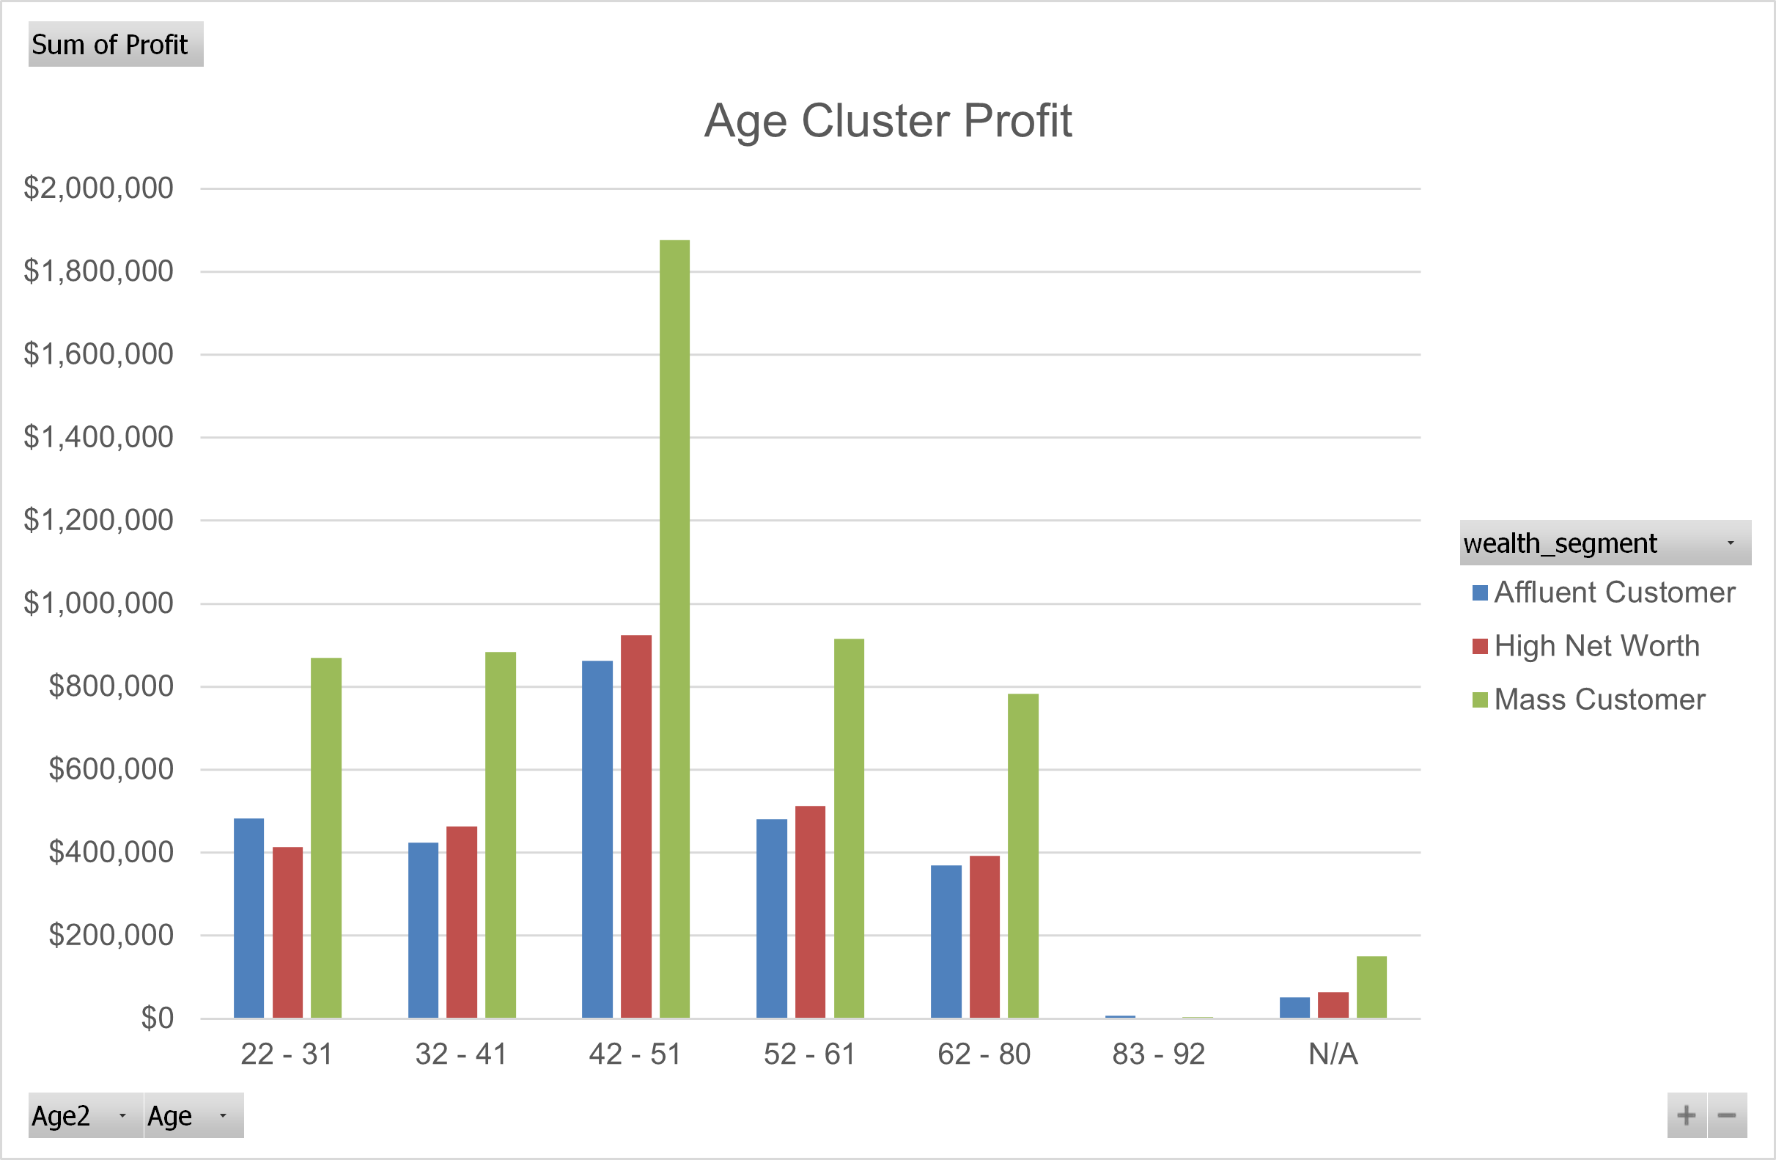
Note: The data and information in this document is reflective of a hypothetical situation and client. This document is to be used for KPMG Virtual Internship purposes only.
Interpretation
Desired Market
Based on our analysis, the ideal customer base is individuals aged 42 to 51, as they possess greater financial power compared to other age groups.

Slide 7
Note: The data and information in this document is reflective of a hypothetical situation and client. This document is to be used for KPMG Virtual Internship purposes only.
Thank You

