Slide 1
US Agency Market Analysis
2023 Market Overview by Region, Port & Vessel Class
Total Market: $167.7M | 49,726 Port Calls

Slide 2
Executive Summary
Market Overview
• Total US Agency Market: $167.7M in annual revenue
• 49,726 port calls across all US ports
• Average fee per call: $3,373
Regional Concentration
• Gulf Coast dominates: 47.8% of total market revenue
• Houston is the mega-market: $24.7M (17.6% of US total)
• Top 5 ports = 46.9% of market | Top 10 ports = 72.0% of market
Vessel Class Insights
• Bulk Carriers: 38.2% of revenue ($64.0M) with $9,000 avg fee
• Tankers (Oil/Crude): 25.4% of revenue ($42.5M) with $4,500 avg fee
• Container Ships: High volume (28% of calls) but low revenue (5.4%) at $650/call
Strategic Implications
• Market highly concentrated in Gulf Coast energy/bulk trade
• Texas triangle (Houston + South Texas) = 31.4% of entire US market
• Container shipping represents volume opportunity with lower margins

Slide 3
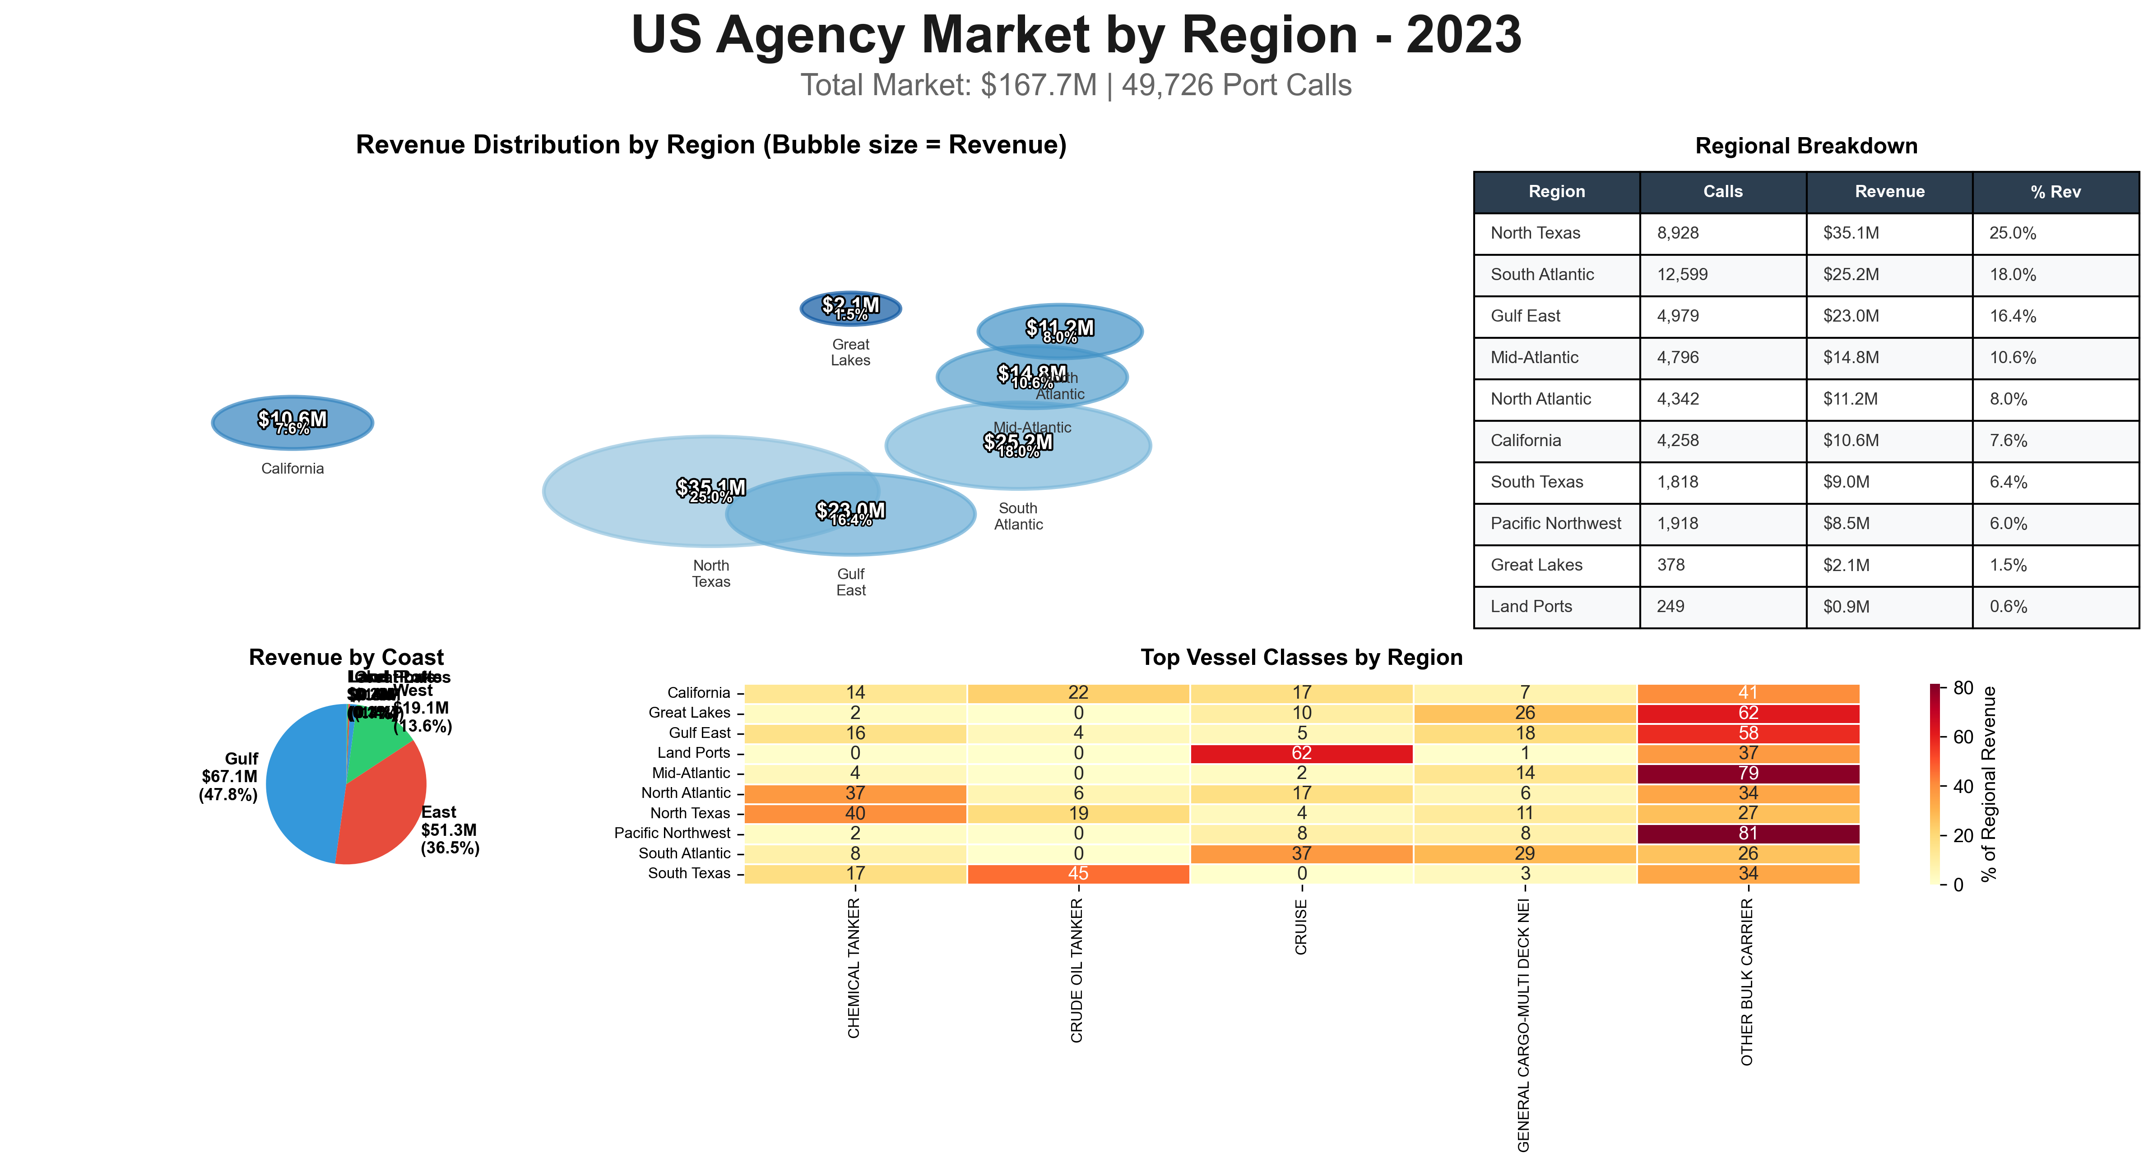

Slide 4
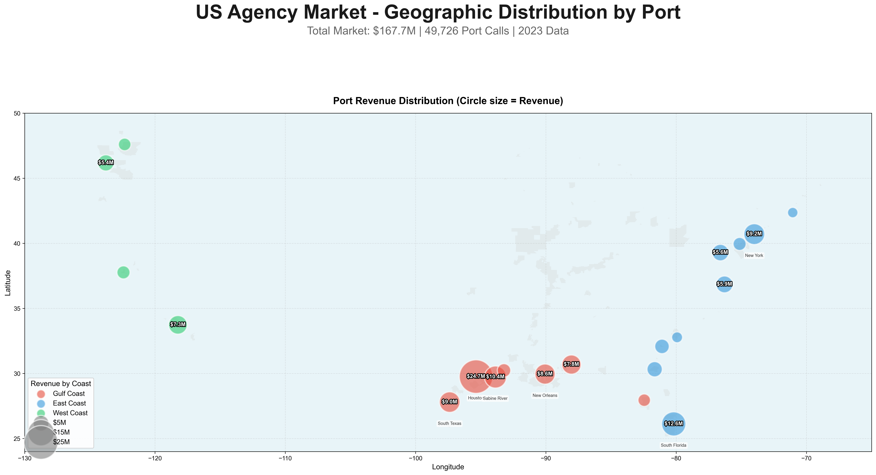

Slide 5
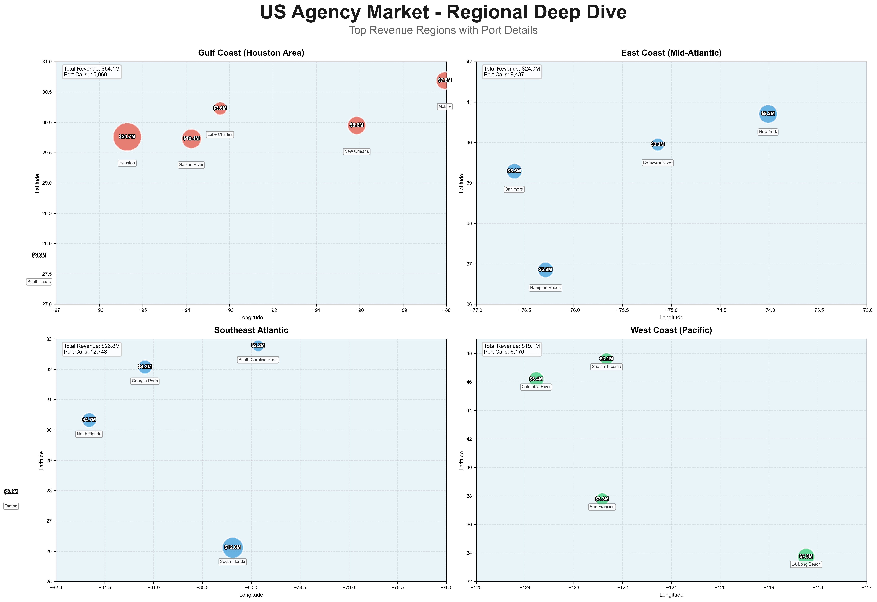

Slide 6
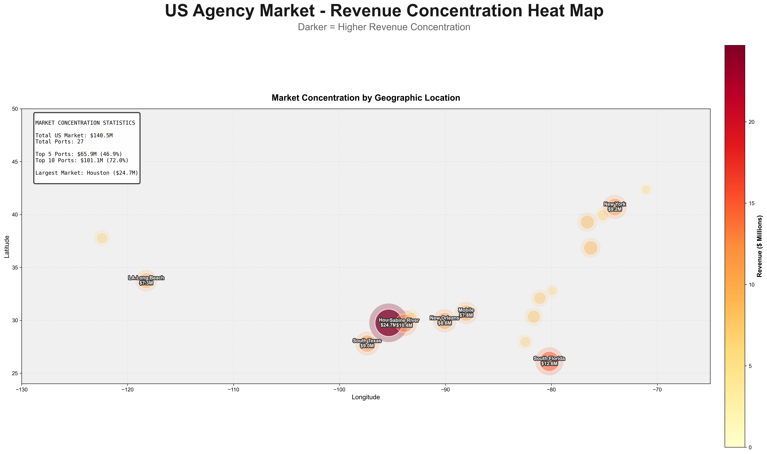

Slide 7
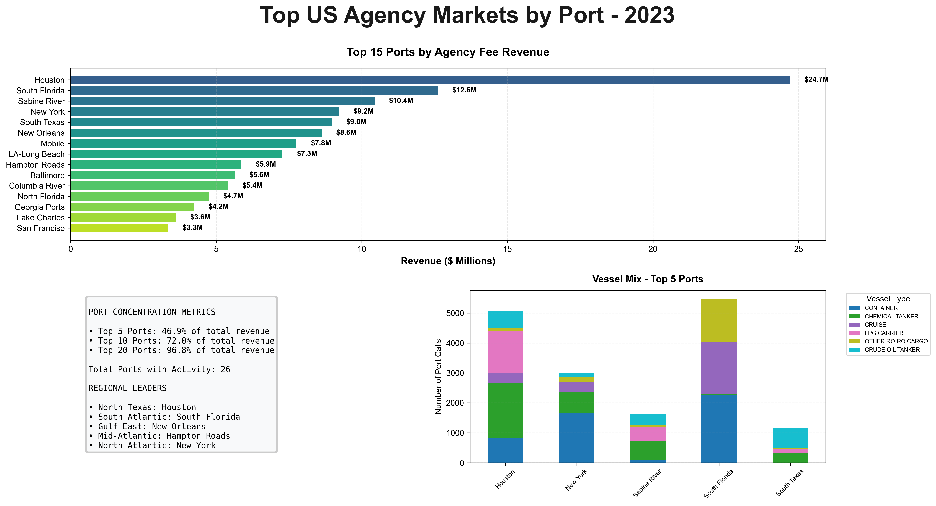

Slide 8
Key Takeaways & Strategic Insights
Geographic Concentration
• Gulf Coast = 48% of US market
• Houston mega-market dominates
• Texas corridor (Houston to Brownsville)
controls 31% of total revenue
Market Structure
• Highly concentrated: Top 10 ports = 72%
• Energy & bulk commodities drive revenue
• Container = high volume, low margin
• Tankers/bulk = lower volume, high margin
Regional Champions
• North Texas: Houston ($24.7M)
• South Atlantic: South Florida ($12.6M)
• Gulf East: New Orleans ($8.6M)
• Mid-Atlantic: New York ($9.2M)
• California: LA-Long Beach ($7.3M)
Vessel Class Opportunities
• Bulk Carriers: Highest revenue/call
($9,000 avg) - 38% of market
• Tankers: Strong margin ($4,500 avg)
Oil/Chemical = 39% combined
• Gas Carriers: Premium segment
LNG/LPG = 8.2% of market
• Container: Volume play ($650 avg)
but 28% of all port calls
Market Entry Strategy
• Focus on Gulf Coast for bulk/energy
• East Coast for container volume
• Regional approach vs. national
• Partner with established ports
• Specialize by vessel class
Growth Potential
• Container volume growing
• Energy export expansion (LNG)
• Chemical tanker demand increasing
• Regional consolidation trends

