Slide 1



OPTIMIZING CALL CENTER PERFORMANCE FOR UNITED AIRLINES
GitHub
Colab Link
By SHREYA & HARSHIT

Slide 2

PROBLEM STATEMENT
As United Airlines strives to provide world-class customer service, optimizing call center operations is essential. We face challenges in improving key metrics like Average Handle Time (AHT) and Average Speed to Answer (AST).
Your task is to analyze existing call center data to identify inefficiencies, determine the causes of prolonged AHT and AST, and suggest strategies to enhance customer satisfaction, reduce escalations, and improve overall operational efficiency.

Slide 3
INTRODUCTION
Effective performance optimization is crucial for call centers to enhance customer satisfaction and streamline operations. This analysis focuses on examining key performance metrics of call center data, enabling better decision-making and strategic planning. By leveraging advanced data techniques, the goal is to uncover actionable insights and trends.
Objective
Key Metrics
Method
To analyze call center data for performance optimization.
Average Handle Time (AHT), Average Sentiment, Call Reasons, Elite Level Code, Avergae Sentiment Score, Agent Tone, Customer Tone, Call Transcripts, Allocation time.
Data merging, preprocessing, and visualization, modelling, and evaluation.

Slide 4
METHODOLOGY
Exploratory Data Analysis (EDA):
Tool Used: Python
Libraries Utilized:
Pandas for data manipulation and cleaning, NumPy for numerical operations, Matplotlib and Seaborn for data visualization, NLTK for natural language processing tasks
Process:
Data Cleaning: Handled missing values and corrected data types.
Descriptive Statistics: Summarized key metrics (mean, median, variance) to understand data distribution.
Visualization: Created histograms, bar charts, box plots, and heatmaps to identify trends and correlations.
Feature Engineering:
Purpose: Enhance model performance by creating new features from existing data.
Techniques Used:
Categorical Encoding: One-hot encoding for categorical variables (e.g., agent tone, customer tone).
Time Features: Extracted time-based features from datetime columns (e.g., call duration, call time of day).
Analysis Techniques:
Correlation analysis to identify relationships between call characteristics and AHT/AST.
Regression analysis to model and predict AHT based on various features.
Machine Learning Algorithms: Implemented Random Forest for predictive modeling to assess factors influencing AHT, effectively handling complex feature interactions.

Slide 5
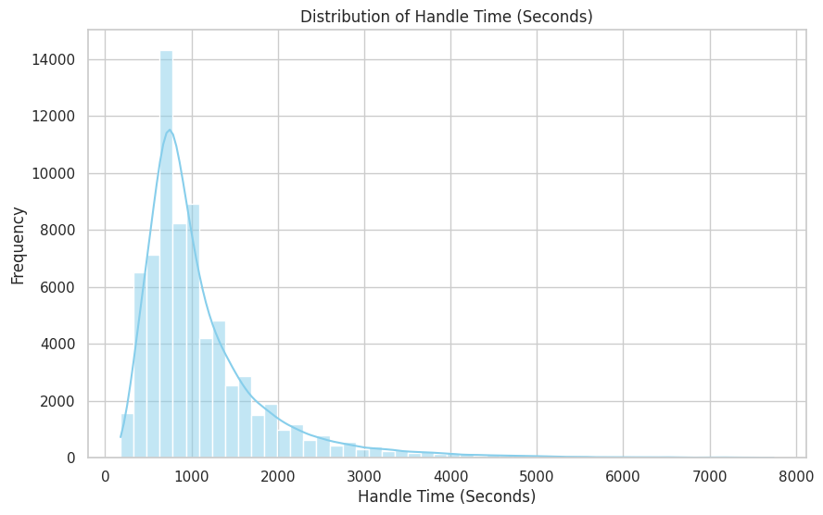
OVERVIEW OF CALL CENTER METRICS
Total Calls Analyzed: 71,810
Average Handle Time (AHT): 1,134.12 seconds
Average Speed to Answer (AST): 437.07 seconds

Slide 6
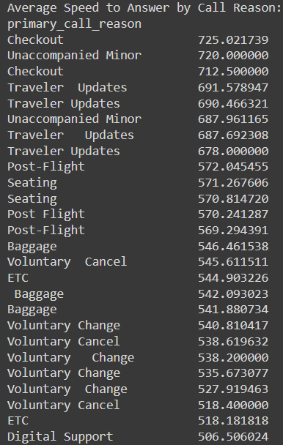
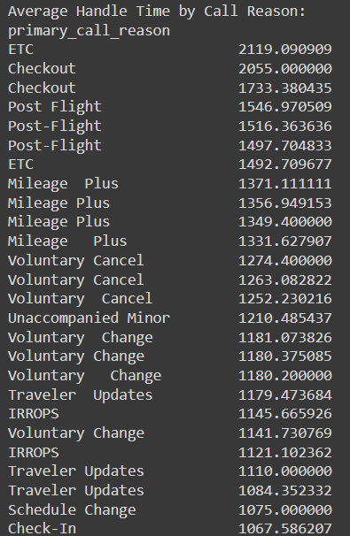
KEY DRIVERS OF HIGH AHT AND AST
Average Speed to Answer (AST)
Average Handle Time (AHT)

Slide 7
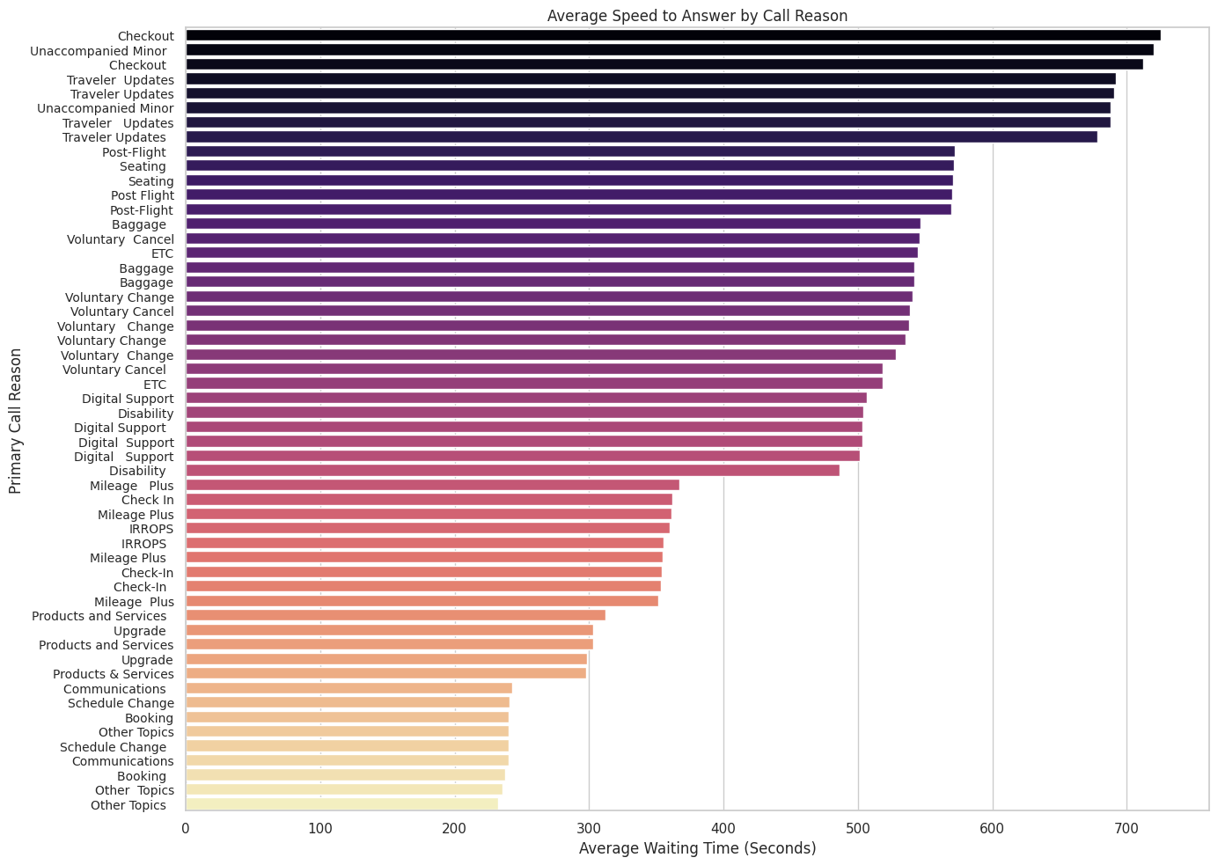

Slide 8
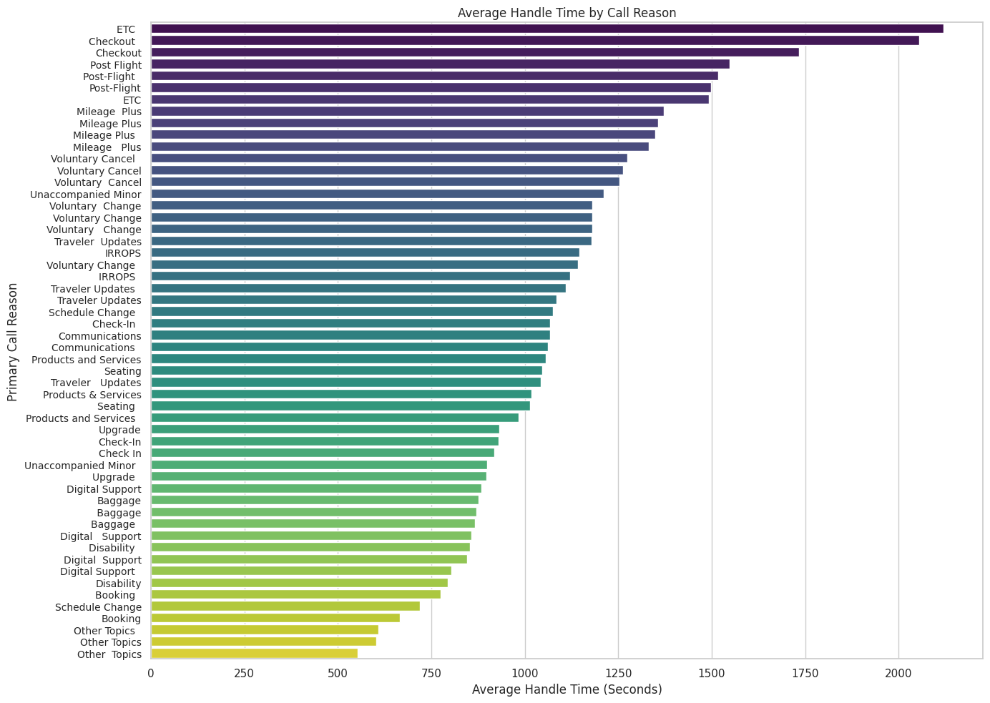

Slide 9

ANALYSIS AVERAGE HANDLE TIME VS AGENT TONE, CALL REASON, AND CUSTOMER TONE
Average Handle Time vs Agent Tone
Average Handle Time was closely related to agent tone.
Agents with different tones showed variations in how long it took to handle calls.
Average Handle Time vs Call Reason
Average Handle Time showed correlation with call reasons.
Certain call reasons resulted in longer handling times, suggesting more complex issues.
Average Handle Time vs Customer Tone
Average Handle Time didn’t show a strong relation with customer tone.
Customer tone appeared to have minimal impact on how quickly calls were resolved.

Slide 10
ANALYSIS OF AHT AND AST FOR PEAK CALL VOLUME PERIODS
Call Volume Peaks:
There is a significant spike in call volume between 9 AM and 6 PM, with peak values reaching around 5000 calls per hour.
This suggests that this time frame may be particularly busy for the call center.
Average Allocation Time:
The average allocation time (depicted by the blue line) generally hovers around 440 to 450 seconds.
There are slight fluctuations throughout the day, but the average allocation time seems to remain relatively stable despite changes in call volume.
Low Volume Periods:
There are periods, particularly in the early morning (around 1 AM to 5 AM), where call volume is significantly lower, and the average allocation time shows minor fluctuations.
This could be indicative of less activity during these hours, allowing for potentially more thorough customer service.

Slide 11
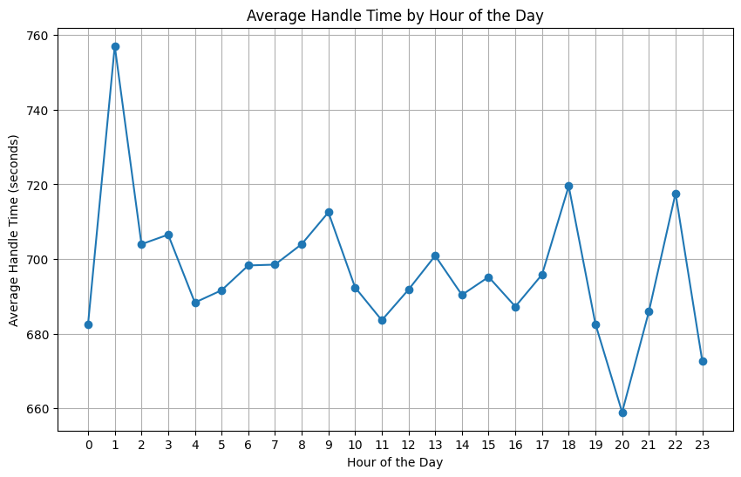

Slide 12
CALL VOLUME TRENDS
High Call Volume: The highest call volume occurs between 9 AM and 10 AM, coinciding with the busiest period observed.
Volume Decrease: Following the peak, there’s a noticeable decline in call volume, particularly after 10 AM, suggesting a gradual tapering off of inquiries.
Low Volume Periods: Significant low call volumes are observed from 1 AM to 5 AM, reinforcing that the call center experiences much less activity during these hours.

Slide 13
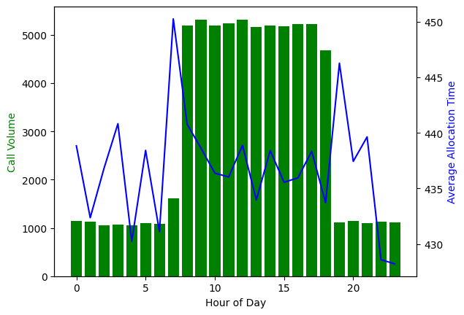
KEY DRIVERS OF LONG AHT & AST DURING HIGH VOLUME PERIODS
Frequent & Complex Call Reasons:
IRROPS (Irregular Operations): The most frequent call reason with the highest average handling time (~13.05 minutes). These calls often involve rescheduling, rebooking, or complex customer needs.
Special Cases (e.g., Unaccompanied Minors): While less frequent, these calls require more attention and adherence to policies, leading to longer handling times.
2. Sentiment & Call Experience:
Average Sentiment: -0.03369: Slightly negative, indicating frustration, especially during disruptions (e.g., flight delays/cancellations).
High Silence Percentage (28.5%): Suggests long pauses, likely due to agents searching for information, leading to prolonged Average Speed of Answer (AST) and AHT.
Percentage Difference: 53.39% difference in AHT, indicating IRROPS calls take significantly longer to handle than unaccompanied minor calls.
3. Call Volume Impact:
During peak times (9 AM - 5 PM), higher call volumes increase hold times, resulting in longer AST. The average AHT rises to 694.70 seconds (~11.57 minutes), as agents juggle multiple high-priority cases.
Average AHT during Peak Hours: 694.70 seconds (~11.57 minutes): This is the average handling time during the peak hours of 9 AM to 5 PM.

Slide 14

AVERAGE SENTIMENT ANALYSIS PER HOUR OF THE DAY
01
The provided table shows the average sentiment score throughout the day, indicating customer sentiment during each hour.
Negative Sentiment: Average sentiment scores are predominantly negative, hovering around -0.03 to -0.04, suggesting customer dissatisfaction or challenges faced during interactions.
02
03
Stable Sentiment: Sentiment appears relatively stable, with minor fluctuations that do not correlate strongly with changes in call volume or AHT.

Slide 15
ANALYSIS AVERAGE HANDLE TIME VS AGENT TONE, CALL REASON, AND CUSTOMER TONE
Average Handle Time vs Agent Tone
Average Handle Time was closely related to agent tone.
Agents with different tones showed variations in how long it took to handle calls.
Average Handle Time vs Call Reason
Average Handle Time showed correlation with call reasons.
Certain call reasons resulted in longer handling times, suggesting more complex issues.
Average Handle Time vs Customer Tone
Average Handle Time didn’t show a strong relation with customer tone.
Customer tone appeared to have minimal impact on how quickly calls were resolved.

Slide 16
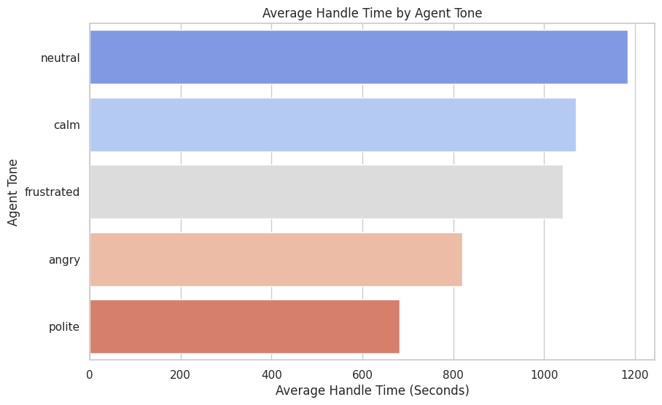
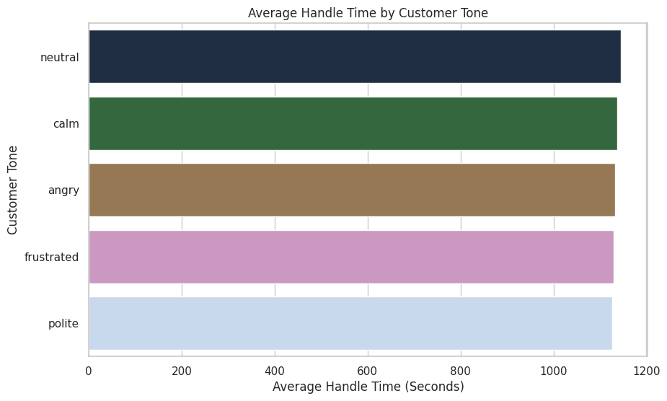
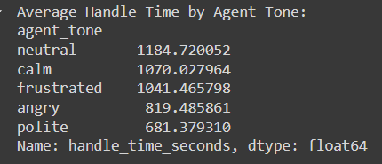
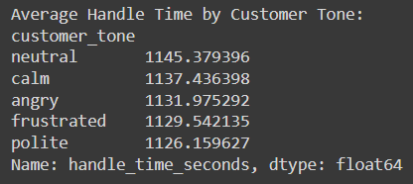
HANDLE TIME BY AGENT AND CUSTOMER TONE

Slide 17
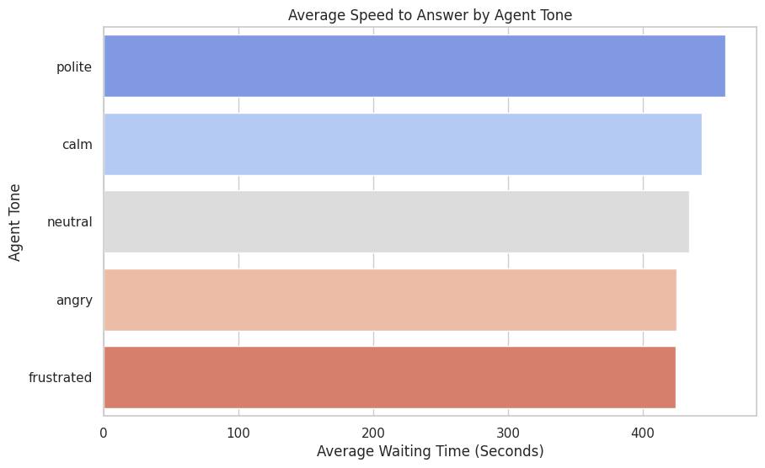
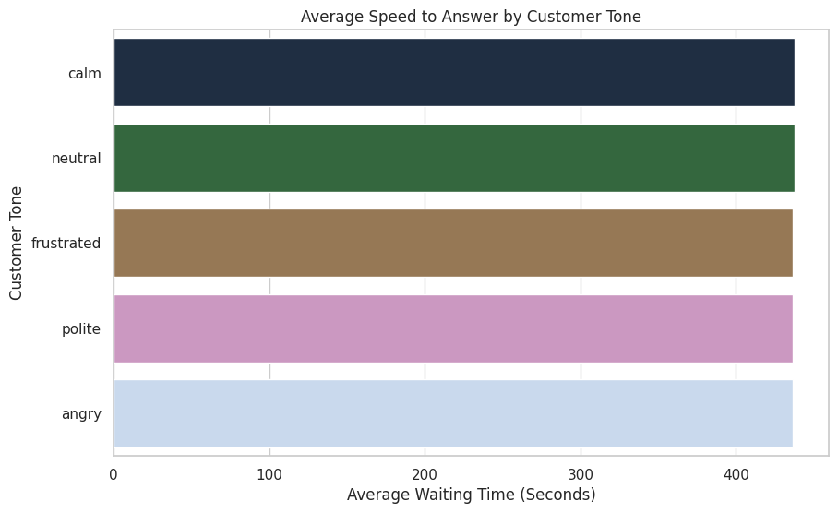
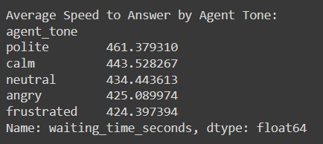
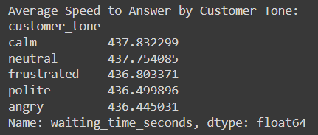
SPEED TO ANSWER BY AGENT AND CUSTOMER TONE

Slide 18
ANALYSIS OF AVERAGE SILENCE PERCENTAGE VS HANDLE TIME AND AGENT TONE
01
Average Handle Time vs Average Silence Percentage
Average Handle Time was below 3000 for most of the calls.
Variations in silence percentage among agents impacted their call handling times.
Average Silence Percentage vs. Agent Tone
Angry Agents (19.01%): Lower silence percentage indicates quick responses, which may compromise service quality.
Calm Agents (29.14%): Higher silence percentage suggests thoughtful responses, allowing pauses for reflection.
Frustrated Agents (25.13%): Longer pauses may indicate difficulty managing the call, affecting efficiency.
Neutral Agents (28.60%): Moderate silence reflects a balanced interaction approach.
Polite Agents (25.66%): Measured pauses contribute to respectful dialogue while addressing customer needs.
02
Conclusions
Impact of Agent Tone: Agent tone affects silence percentages; angry agents exhibit lower silence, resulting in rapid responses that may compromise quality.
Training Opportunities: Targeted training can encourage agents to adopt calm and polite tones, improving communication and customer satisfaction.
Enhanced Engagement Strategies: Understanding the link between agent tone and silence can help optimize interactions and call handling.
Performance Monitoring: Regular monitoring of average handle time (AHT) and silence percentages provides insights into agent performance and identifies those needing additional support.

Slide 19
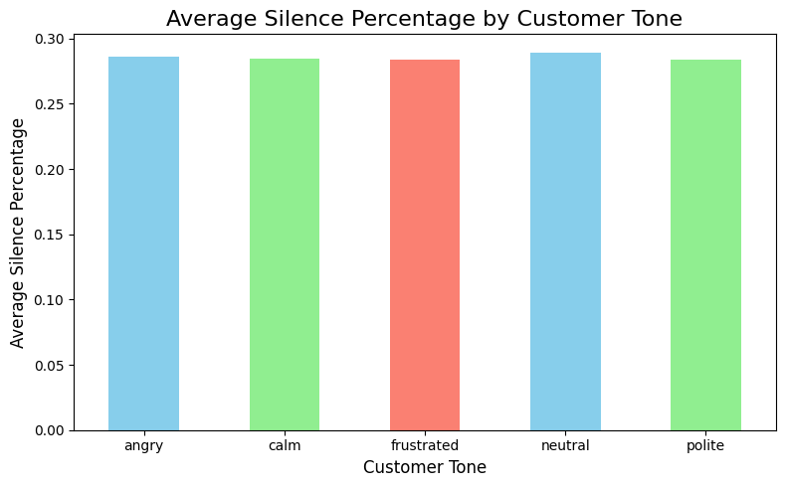
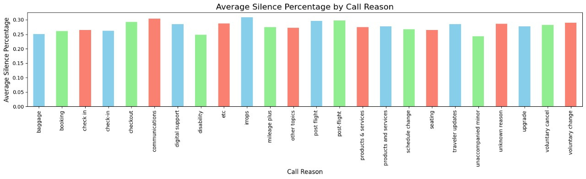

Slide 20
ANALYSIS OF AVERAGE SILENCE PERCENTAGE VS CALL REASON AND CUSTOMER TONE
01
Analysis of Average Silence Percentage vs. Primary Call Reason
Complex Issues Lead to Higher Silence Percentages: Calls regarding communications (30.36%) and irregular operations (30.94%) showed the highest silence percentages, indicating more complex discussions.
Lower Silence with Simpler Issues: Calls related to disability (24.86%) and unaccompanied minor (24.25%) had lower silence percentages, suggesting they are more straightforward.
Mid-Range Silence Percentages: Call reasons like booking (26.09%) and checkout (29.23%) exhibited mid-range silence percentages, reflecting varying degrees of complexity and idle time potential.
02
Average Silence Percentage vs. Customer Tone
Customer tone does not significantly impact the average silence percentage during calls, as silence percentages are consistent across different tones.
Conclusions
Call Complexity Influence: Primary call reasons affect silence percentages; complex issues lead to longer silences, while simpler inquiries require less idle time.
Training Insights: Understanding which call reasons result in higher silence can help train agents to handle complex situations more efficiently, reducing wait times.
Recommendations for Future Analysis: Break down call handling processes by reason to identify best practices and optimize responses.
Customer Tone Impact: Customer tone does not significantly affect silence percentages; silence remains consistent across tones.
Exploration of Other Factors: Investigate factors like call complexity and customer issues to better explain silence and handling time variations.

Slide 21
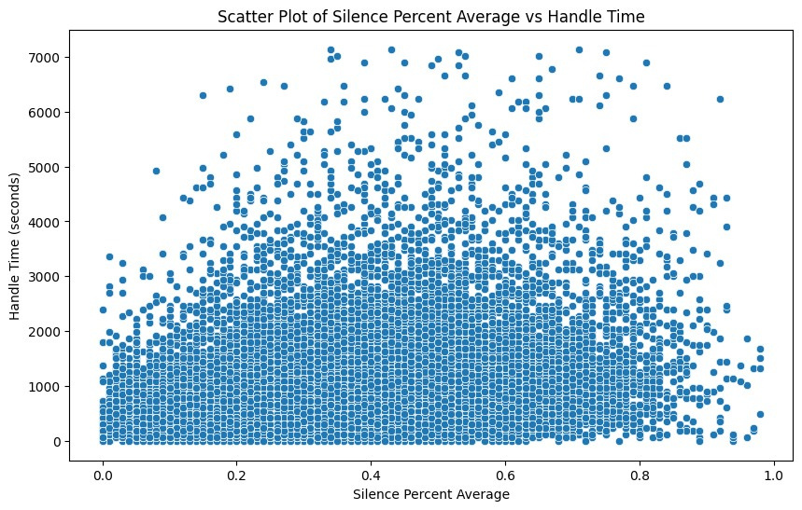
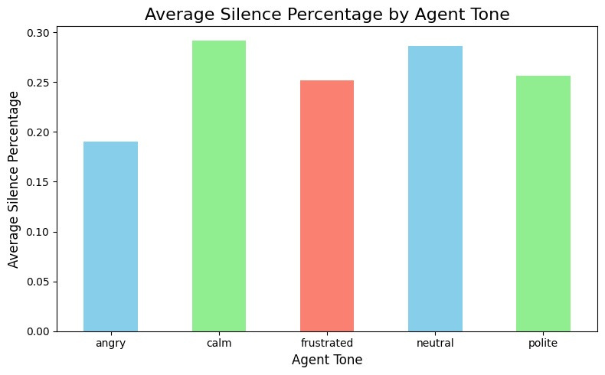

Slide 22
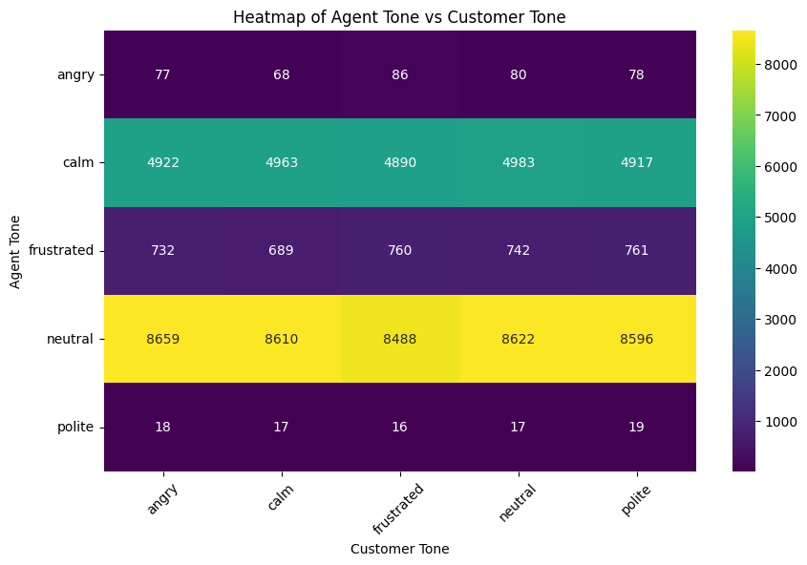
ANALYSIS OF AGENT TONE VS CUSTOMER TONE
Dominance of Neutral and Calm Tones:
The highest frequency of interactions is in the neutral tone, followed by calm tones for both agents and customers.
When agents use a neutral tone, it often corresponds to customers also using a neutral tone (frequency: 8659).
Similarly, when agents are calm, the customer tends to be calm too (highest in this row with a frequency of 4963).
Low Occurrences of Extreme Emotions:
Angry and polite tones are used far less frequently compared to other tones.
The lowest interaction frequencies are between polite agents and various customer tones, suggesting polite tones are rarely observed.
Customer Neutral Tone Matches Multiple Agent Tones:
While customers often show a neutral tone, agents might respond with various tones, not strictly mirroring the customer’s tone.
This indicates that in customer service settings, keeping interactions neutral or calm is the prevalent strategy.

Slide 23
ANALYSIS OF CALL TRANSCRIPTS AND OPTIMIZING SELF-SERVICE OPTIONS TO REDUCE AGENT WORKLOAD
Current Situation:
High volume of agent calls are related to issues that could potentially be resolved via automated self-service options.
Top call categories include "IRROPS" (Irregular Operations), "Seating," "Upgrade," and "Mileage Plus", accounting for a large percentage of the total call volume.
Key Findings from Transcript Analysis:
Frequent use of terms like “flight,” “change,” “help,” and “agent” indicates customers are often seeking help for flight adjustments and loyalty program queries.
A significant number of calls are for routine inquiries or updates (e.g., seating preferences, flight changes, cancellations).
Supporting Data:
"IRROPS" and "Voluntary Change" are the most frequent call reasons, accounting for a combined 25%+ of total call volume.
Text analysis shows that terms related to "change" and "agent" are prominent, reinforcing the need for streamlined automated change handling.

Slide 24
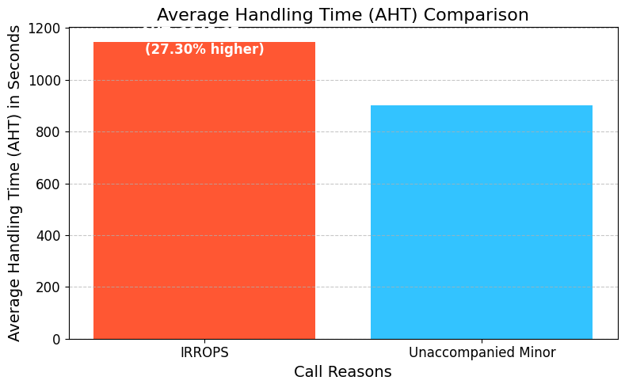

PERCENTAGE DIFFERENCE BETWEEN THE AVERAGE HANDLING TIME FOR THE MOST FREQUENT AND LEAST FREQUENT CALL REASONS
Most Frequent Call Reason:
- IRROPS
- Average Handling Time (AHT): 1,145.67 seconds
Least Frequent Call Reason:
- Unaccompanied Minor
- Average Handling Time (AHT): 900.00 seconds

Slide 25
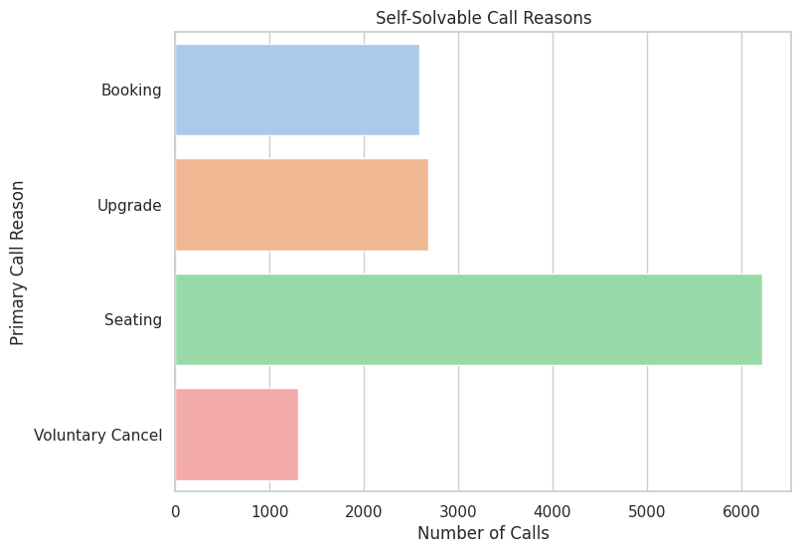
SELF-SOLVABLE CALL REASONS
17.82% of all calls are potentially self-solvable.

Slide 26
PROPOSED IVR IMPROVEMENTS
1. Expand IVR Capabilities
Booking: Enable customers to manage their bookings through IVR.
Key Features:
Make, Modify, or Cancel: Customers can complete booking actions without needing an agent.
Confirmation: Automatic confirmation messages sent post-transaction.
Example Prompt: "Press 1 to make a new booking, 2 to modify an existing booking, or 3 to cancel."
Upgrade: Facilitate ticket upgrades and service enhancements via IVR.
Key Features:
Options and Prompts: Clearly present upgrade choices (e.g., first class, extra baggage).
Instant Confirmation: Customers receive immediate confirmation of their upgrades.
Example Prompt: "Press 1 to upgrade your ticket, or 2 for more service options."
Seating: Allow customers to select or change their seats easily.
Key Features:
Seat Selection: Present seat availability and allow customers to choose.
Visuals: Offer a digital seat map via SMS or email post-selection.
Example Prompt: "Press 1 to select a seat from available options, or 2 to change your existing seat."

Slide 27
PROPOSED IVR IMPROVEMENTS
2. Implement Self-Service Menus
Design User-Friendly Menus:
Intuitive Structure: Ensure menus are logically organized and easy to navigate.
Comprehensive Coverage: Include all self-solvable issues (e.g., check flight status, baggage info).
Example Prompt: "For baggage inquiries, press 1; for flight status, press 2."
Personalization:
Data Utilization: Leverage customer data (e.g., loyalty status) to customize IVR options.
Tailored Navigation: Provide shortcuts for frequent flyers or members of loyalty programs.
Example Prompt: "Welcome back, [Customer Name]. Press 1 for your frequent flyer options.
Feedback Loop:
Continuous Improvement: Implement a feedback mechanism to gather user experiences.
Data Collection: Use customer feedback to enhance self-service offerings.
Example Prompt: "After your interaction, please rate your experience from 1 to 5."

Slide 28
PROPOSED IVR IMPROVEMENTS
3. Reduce Escalation Rates
Identify Common Escalations:
Call Transcript Analysis: Regularly analyze transcripts to pinpoint frequent escalation issues.
Root Cause Analysis: Investigate underlying problems causing unnecessary escalations.
Key Metrics: Track the percentage of calls that escalate to an agent.
Automate Solutions:
Integrate Solutions into IVR: Provide automated responses for common issues identified.
Proactive Assistance: Anticipate customer needs and offer solutions in advance.
Example Prompt: "If you are calling about a lost bag, press 1 for self-service options."

Slide 29

Additional Recommendations for IVR Implementation
Personalized Call Routing
Voice Recognition Capabilities
Proactive Notifications
Self-Service Promotion
Use caller data (e.g., Mileage Plus tier, recent booking history) to tailor the IVR menu options dynamically.
Example: Frequent flyers may hear a personalized greeting and menu options relevant to loyalty program details or upgrades.
Implement natural language processing (NLP) to allow customers to state their requests in their own words.
Example: If a caller says, “I need to change my seat,” the system can directly route to the seat selection option.
Send proactive text or email notifications for common scenarios like flight changes, cancellations, and seat upgrades, along with self-service links.
Example: “Your flight has been rescheduled. Click here to choose a new option or call us and select option 2 for flight rescheduling.”
Use the IVR’s hold messages to inform customers about the self-service options.
Example: “Did you know you can check your flight status and make changes without speaking to an agent? Use our self-service options to save time.”
Benefits of Implementing Enhanced Self-Service Options:
Reduced Call Volume for agents, allowing them to focus on more complex cases.
Improved customer satisfaction by enabling quicker resolution for common queries.
Decreased hold times and operational costs for the contact center.

Slide 30
IMPACT OF IVR SYSTEM AUTOMATION
Estimated AHT Reduction: Automating self-solvable calls could reduce handle time by 12,382,320 seconds.
Impact on Operational Efficiency: Significant reduction in agent workload, allowing for reallocation of resources.
Estimated AST Improvement: Self-solvable calls currently have an Average Speed to Answer (AST) of 443 seconds.
This AST is already close to the average, indicating potential for smoother customer experiences with automation.
Enhanced Customer Experience: Automating self-service options allows customers to resolve issues quickly, resulting in a better overall experience and increased loyalty.
Operational Efficiency: Reduced call volume for agents enables them to handle more complex inquiries, leading to higher productivity and decreased wait times for customers.
Cost Savings: Lower operational costs associated with reduced handling times can lead to significant savings for the organization.

Slide 31
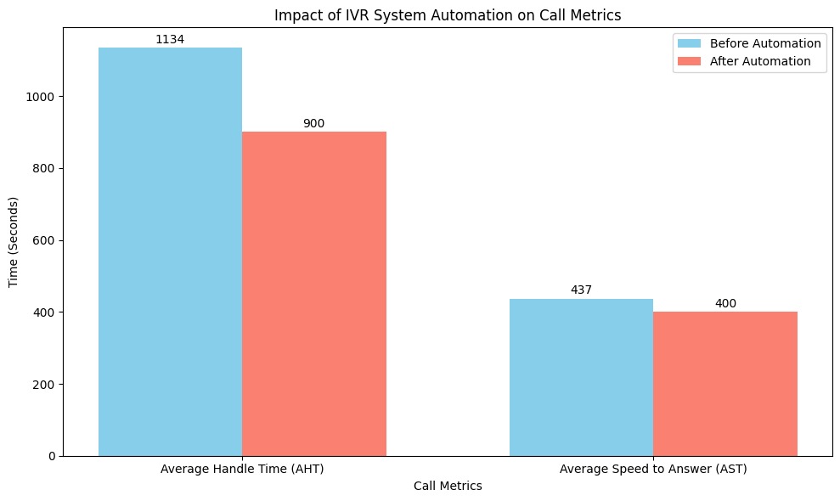

Slide 32
APPROACH TO ANALYZE PRIMARY CALL REASONS
Understanding the primary reasons for incoming calls is crucial for improving operational efficiency and enhancing customer service. Accurately categorizing these call reasons allows the call center to streamline processes, reduce manual tagging efforts, and direct customers to the appropriate resources.
Data Analysis Techniques
Data Cleaning:
Remove duplicates and handle missing values in key columns such as primary_call_reason.
Standardize call reason text for consistency (e.g., converting to lowercase).
Exploratory Data Analysis (EDA):
Visualize the distribution of call reasons using bar charts to understand frequency and identify trends.
Analyze call durations, sentiment scores, and agent performance to uncover potential correlations with call reasons.

Slide 33
APPROACH TO ANALYZE PRIMARY CALL REASONS
3. Feature Identification:
Extract features from the call_transcript using natural language processing (NLP) techniques, such as:
Tokenization to break down the text into words or phrases.
Sentiment analysis to derive emotional tone.
Use the average_sentiment and silence_percent_average to gauge call quality and customer experience.
4. Pattern Recognition:
Cluster call reasons based on frequency and sentiment scores to identify common themes.
Apply K-Means clustering to categorize calls and visualize results using the Elbow method to determine optimal clusters.
5. Categorization Strategy:
Develop rules to categorize call reasons further based on patterns observed (e.g., grouping by booking issues, upgrade requests, etc.).
Create a decision tree structure or rule-based system to classify calls for more precise routing and reporting.

Slide 34
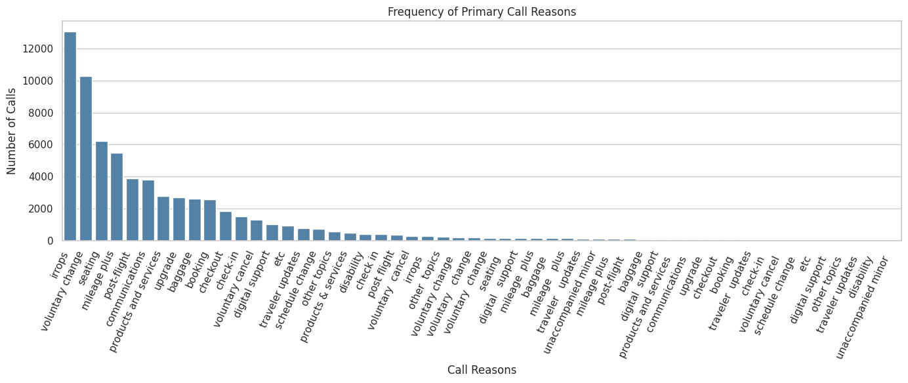

Slide 35
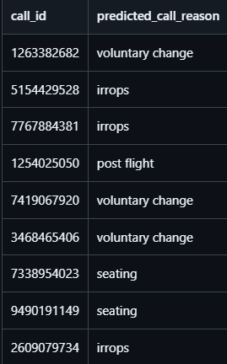
PREDICTING CALL REASONS FROM TEST.CSV
1. Data Preprocessing:
Removed rows with missing target values.
Filled missing call transcripts with empty strings and replaced NaN or infinite values in numeric fields with their respective means.
2. Text Feature Extraction:
Applied TF-IDF Vectorization to convert call transcripts into numerical features (limited to 500 features).
Modeling:
Split the dataset into training (80%) and validation (20%) sets.
Trained a Random Forest Classifier on the combined features (TF-IDF and numerical data).
3. Model Evaluation:
Achieved Accuracy: X% (from the validation set).
Generated a detailed classification report to analyze model performance.
4. Test Data Prediction:
Processed the test data similarly to predict call reasons.
Exported predictions to a CSV file for further analysis.

Slide 36
CONCLUSION
The analysis clearly demonstrates the significant potential of IVR system automation in reducing call center load and improving overall efficiency. By automating 17.82% of calls related to self-solvable issues like seating and booking, United Airlines can drastically reduce agent workload, leading to shorter Average Handling Times (AHT) and improved customer satisfaction.
Key Insights:
Automating frequently recurring issues can reduce the Average Handling Time (AHT) by a considerable margin, driving agent productivity and reducing operational costs.
Calls related to IRROPS (Irregular Operations) and Seating Issues represent the most frequent and time-consuming call categories, highlighting opportunities for streamlining through automation.
Further refinement of the “Other” call category will provide better insights into hidden trends, enabling targeted improvements in customer service.
Recommendations:
Enhance IVR Capabilities to handle frequently occurring issues like seating and booking without agent involvement, offering faster resolutions.
Refine Call Categorization to ensure more accurate tracking and analysis of call reasons, particularly for issues currently classified under "Other."
Improve Customer Experience through quicker resolutions and self-service options, which will boost customer satisfaction and loyalty.

Slide 37
THANK YOU

