Slide 1

HackerFrogs Afterschool
Python Programming Basics: Extra
Class:
Programming (Python)
Workshop Number:
AS-PRO-PY-??
Document Version:
1.2
Special Requirements:
Completion of AS-PRO-PY-08

Slide 2
What We Learned Before
This workshop is an
extra class for intro
Python programming.
During our last workshop,
we learned about a few
programming concepts
through Python, including
the following:

Slide 3
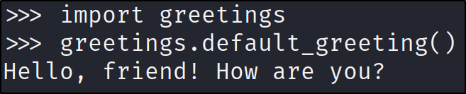
Modules and Packages
Modules and packages are pre-written code that can be imported into Python files to add functionality.

Slide 4

The Python Socket Module
The Python socket module can be used to connect to, and interact with, networking ports on remote servers.

Slide 5

The Python Requests Module
And the Python requests module can be used to perform web requests and obtain data from websites.

Slide 6
The Python Socket Library
Let's learn how to use the socket module to solve some CTF challenges.

Slide 7

Internet Connected Web VM?
But where can we practice Python with a VM that is (kind of) internet connected? That's where PicoCTF saves the day!

Slide 8
Internet Connected Web VM?
We'll be using picoCTF to practice solving their CTF challenges with Python!
https://play.picoctf.org/practice/challenge/242?category=5&page=2

Slide 9

Summary
Let's review the programming concepts we learned in this workshop:

Slide 10
Modules and Packages
Modules and packages are pre-written code that can be imported into Python files to add functionality.

Slide 11
What's Next?
This is the end of the
HackerFrogs AfterSchool
intro to Python
programming classes, but
now that we know the
basics we can start
learning a lot more about
coding in this extremely
popular programming
language!

Slide 12

Extra Credit
Looking for more study
material on this
workshop's topics?
See this video's
description for links to
supplemental documents
and exercises!

Slide 13

Until Next Time, HackerFrogs!

