Slide 1

HackerFrogs Afterschool
Cryptography Basics 4
Class:
Cryptography
Workshop Number:
AS-CRY-04
Document Version:
1.75
Special Requirements:
Registered account at
picoctf.org

Slide 2
Welcome to HackerFrogs Afterschool!
Hey there HackerFrogs!
This workshop is the
fourth session for
cryptography basics
In the last session we
learned about the following
cryptography concepts

Slide 3
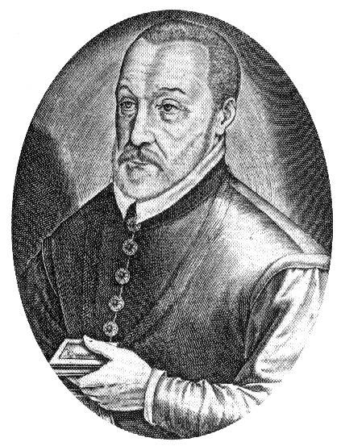
The Vigenere Cipher
The Vigenere Cipher is
a type of symmetrical
substitution cipher
where each character
is substituted according
to its relation to a key,
which is a word or
phrase

Slide 4
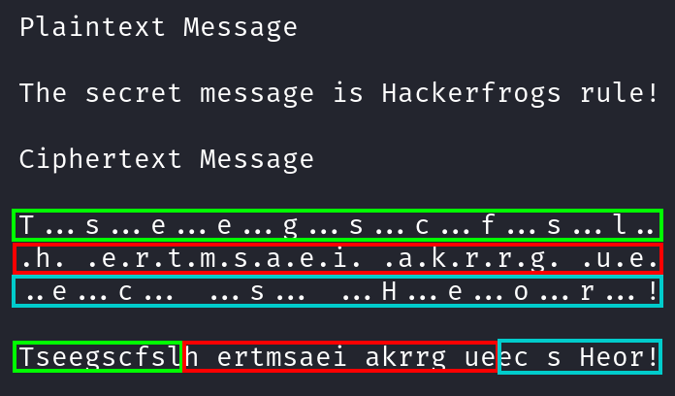
The Rail-Fence Cipher
The Rail-Fence cipher is a transposition cipher where the plaintext content remains the same, but it is rearranged according to a specific system

Slide 5
This Session's Topics
- Intro to the XOR operation
- XOR properties
- Brute forcing XOR

Slide 6

The XOR Operation
XOR is a bitwise
operator which can be
performed between 2
or more numbers, and
returns the number
0 if the bits are the
same, and 1 if they
are different

Slide 7
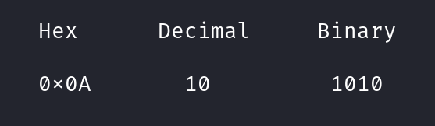
The XOR Operation
Because XOR is a bitwise operation, non-binary numbers must be converted before XOR can take place

Slide 8
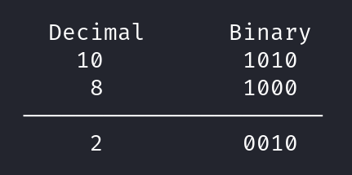
The XOR Operation
Here we see that the result of XOR between the decimal numbers 10 and 8 is 2

Slide 9
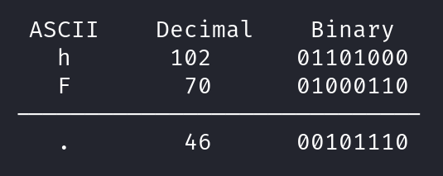
The XOR Operation
It's possible to perform XOR operations between ASCII characters, since each character can be represented by a binary number

Slide 10
CryptoHack – XOR Starter
Let's learn more about the XOR operation by working through a challenge on CryptoHack. Navigate to the following URL
https://cryptohack.org/courses/intro/xor0/

Slide 11
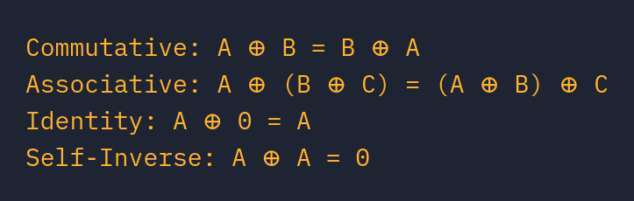
XOR Properties
There are several rules that apply to XOR operations, as illustrated above

Slide 12
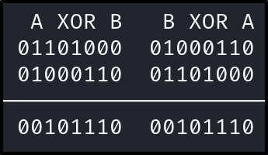
XOR is Commutative
The order in which you XOR numbers does not affect the result. A ^ B is the same as B ^ A

Slide 13
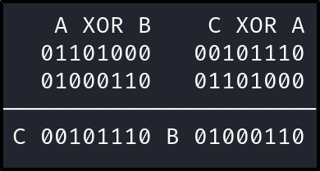
XOR is Associative
The associative nature of XOR operations means that if we have the XOR result of two numbers, and we know one of the two numbers, we can discover the other number through another XOR

Slide 14
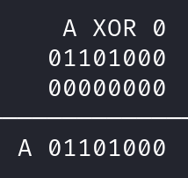
XOR is Identitive (?)
The identitive nature of XOR means that the result of any number XOR zero will be the same number

Slide 15
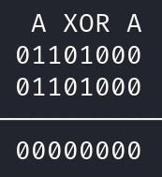
XOR is Self-Inversive
And finally, the self-inversive nature of XOR means that the result of any number XOR with itself will be zero

Slide 16
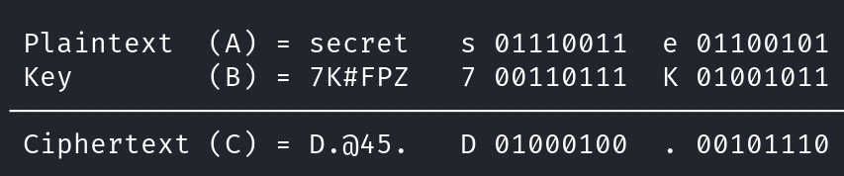
A XOR B = C = Cryptography!
If we suppose that A is a plaintext string, and B is a key, then the result of A ^ B would be C, which is ciphertext.

Slide 17
A XOR B = C = Cryptography!
That means that if we know the ciphertext (c) and the key (B), then we can XOR them together to obtain the plaintext (A)

Slide 18
CryptoHack – XOR Properties
Let's learn more about the XOR operation by working through a challenge on CryptoHack. Navigate to the following URL
https://cryptohack.org/courses/intro/xorkey0/

Slide 19
CryptoHack – Favourite Byte
Let's learn more about the XOR operation by working through a challenge on CryptoHack. Navigate to the following URL
https://cryptohack.org/courses/intro/xor1/

Slide 20

Summary
Let's review the cryptography concepts we learned in this workshop:

Slide 21
The XOR Operation
XOR is a bitwise
operator which can be
performed between 2
or more numbers, and
returns the number
0 if the bits are the
same, and 1 if they
are different

Slide 22
XOR Properties
There are several rules that apply to XOR operations, as illustrated above

Slide 23
What's Next?
In the next HackerFrogs
Afterschool Cryptography
workshop, we'll take a
look at the cryptographic
cipher which uses XOR
principles, the OTP
cipher!

Slide 24

Until Next Time, HackerFrogs!

