Slide 1

Linux Operations Basics: Part 5
Filesystems and Permissions
Class:
Linux OS Operations
Workshop Number:
AS-LIN-05
Document Version:
1.2
Special Requirements:
None

Slide 2
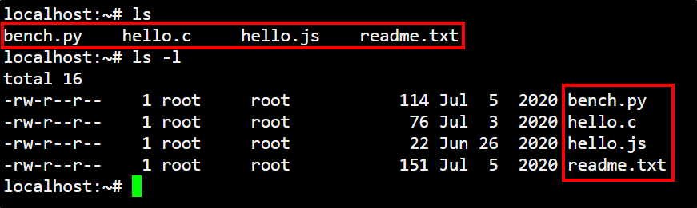
LS command: list directory contents
The LS command lists out the current directory's contents. It's often used with the -l switch to output in list form, or with the -a switch to output hidden files as well

Slide 3
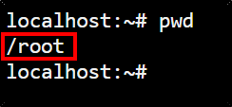
PWD command: print working directory
The PWD command outputs our current (working) directory. When we see a slash in front of a name in Linux, we know that's a directory name

Slide 4
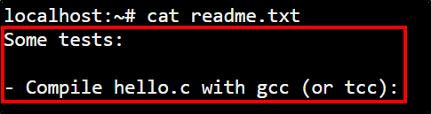
CAT command: read file contents
The CAT command is used to read file contents

Slide 5
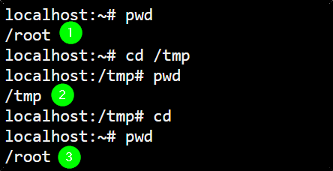
CD command: change working directory
The CD command is used to change our current (working) directory. If we use CD by itself, it will send us to our home directory

Slide 6
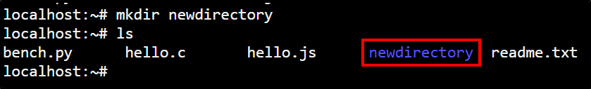
MKDIR command: create a new directory
The MKDIR command is used to create new directories. We usually can't create directories outside of our home directory or the /tmp directory

Slide 7
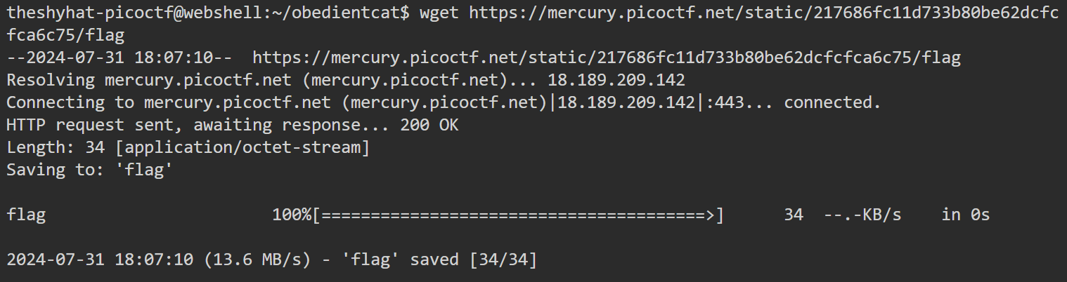
WGET command: download a file
The WGET command is used to download files. We usually can't download files outside of our home directories or the /tmp directory

Slide 8
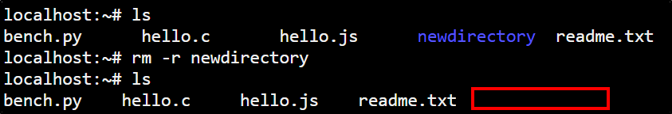
RM command: delete files or directories
The RM command is used to delete files or directories. Directories that aren't empty can't be deleted unless we use the -r switch.

Slide 9

NC command: connect to remote server
The NC (Netcat) command is used to connect to remote servers (other internet connected computers).

Slide 10
NC command: connect to remote server
To connect using netcat, we need to know the address of the server to connect to, and the port number.

Slide 11
NC command: connect to remote server
The NC command is similar to the SSH command, but NC is an older command.

Slide 12
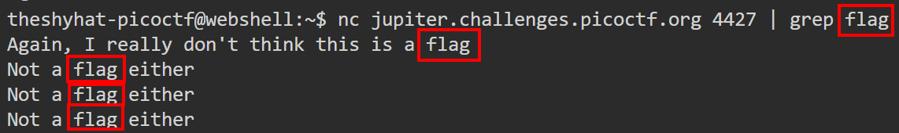
GREP command: delete files or directories
The GREP command is used to search for text inside of output or inside of files.

Slide 13
FIND command: searching for files
The FIND command is used to search for files in the filesystem. One way to search is by the name of the file.

Slide 14
Command Piping: passing output to another command
In Linux, command piping is the process of passing the output of one command into the input of a second command.

Slide 15
Command Piping: passing output to another command
This is a very useful feature, because it allows commands to be chained together to achieve a lot of flexible output.

Slide 16
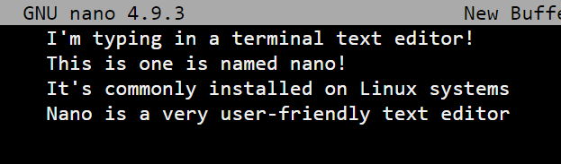
Terminal Text Editors
From time to time, we'll need to write new files or modify existing ones. To do so, we'll need to use Linux text editors.

Slide 17


Terminal Text Editors
Two commonly installed text editors on Linux systems are Nano and Vim.

Slide 18
Nano Text Editor
Nano is the more straightforward and user-friendly of the two text editors.

Slide 19
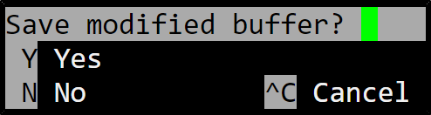
Nano Text Editor
The most important command to know in the Nano text editor is the ` Ctrl + C `command, which lets us save the file and exit.

Slide 20
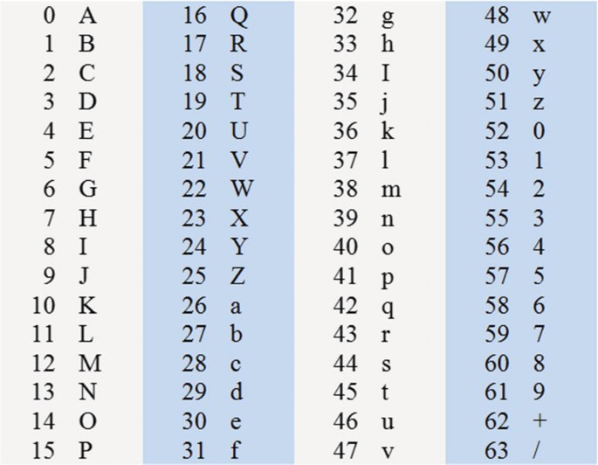
Base64 Command
The Base64 command
encodes / decodes data
according to the Base64
codec. It is often
used to convert data
for transmission across
computer networks.

Slide 21
Base64 Command
The characters used in
Base 64 encoding are
shown here. Note that
all Base 64 encoded
strings must consist of
a number of characters
that is divisible by 4.

Slide 22

Base64 Command
In cases where an encoded string is not divisible by 4, the encoding process will “pad out” the string with equal symbols until the string is divisible by 4.

Slide 23

Base64 Command (decode)
1 – The command itself
2 – The decode switch
3 – The file to be operated upon

Slide 24
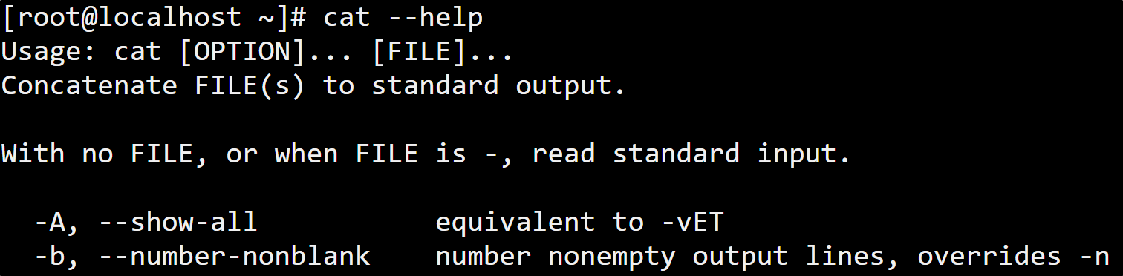
The Help Flag
The --help flag can be used as part of any command to return a relatively brief explanation as to how to use the command.

Slide 25
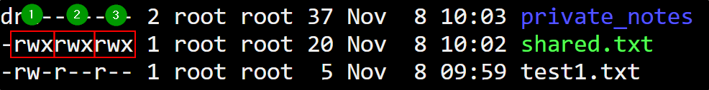
Linux File Permissions
Each file in the Linux filesystem has different (r)ead, (w)rite, and e(x)ecute permissions, depending on whether a user is (1), the file owner, (2), part of a certain group, or (3), any other user.

Slide 26
Noteworthy Linux File Directories
/etc where system files (user passwords) are stored
/var where log files and database files are stored
/root typically the folder with the most secure access
/tmp all files here are deleted on a regular basis
/home where individual user account files are stored

Slide 27

Sudo – The Super Command
The sudo command can be added to any other command, and it allows the command to be executed in the context of the root user.

Slide 28

Sudo – The Super Command
Sudo needs to be used whenever we try to access or modify systems files or directories.

Slide 29
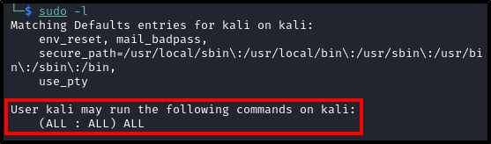
Sudo – The Super Command
Generally, only system administrator accounts should be allowed to use sudo with all commands.

Slide 30
Sudo – The Super Command
But some systems have users who are able to use sudo with a specific command for some reason or another.

Slide 31
Sudo – The Super Command
If you ever try to run a command as a regular user, and you see the permission denied message...

Slide 32

Sudo – The Super Command
You can usually retry that command with sudo to execute it successfully.

Slide 33

Sudo – The Super Command
If we need to use sudo, we should always try to understand why we need to use it...

Slide 34
Sudo – The Super Command
Since it means we're interacting with sensitive files or directories.

Slide 35
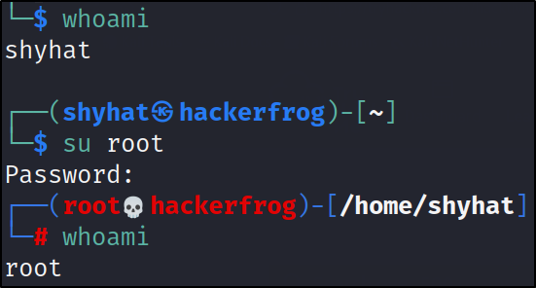
Su Command
The su (switch user) command is used to switch between active user accounts during a CLI session. When using the su command, the password of the user account being accessed must be supplied.

