Slide 1
CUPS Service
CUPS (Common UNIX Printing System) is a open-source printing service that is based on IPP (Internet Printing Protocol)
It offers a web-based interface that allows the administration and management of printers on a network

Slide 2
CUPS Service
CUPS (Common UNIX Printing System) is a open-source printing service that is based on IPP (Internet Printing Protocol)
It offers a web-based interface that allows the administration and management of printers on a network

Slide 3
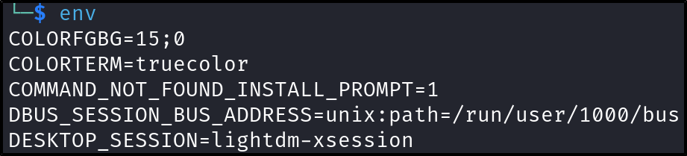
Privilege Escalation
SUID Env
The Env program in Linux is used to run a command or script in a modified environment

Slide 4

Privilege Escalation
SUID Env
If the Env program is running as a SUID binary, we can run the command like the above example to gain root shell access

