Slide 1

Linux Operations Basics: Part 4
Text Editors and Base64 Encoding
Class:
Linux OS Operations
Workshop Number:
AS-LIN-04
Document Version:
1.2
Special Requirements:
None

Slide 2
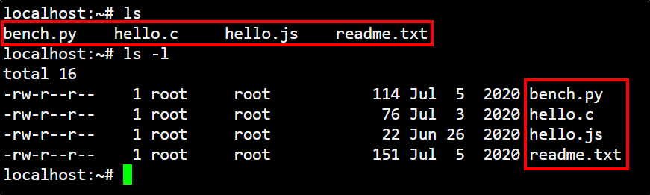
LS command: list directory contents
The LS command lists out the current directory's contents. It's often used with the -l switch to output in list form, or with the -a switch to output hidden files as well

Slide 3
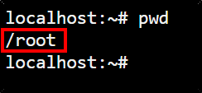
PWD command: print working directory
The PWD command outputs our current (working) directory. When we see a slash in front of a name in Linux, we know that's a directory name

Slide 4
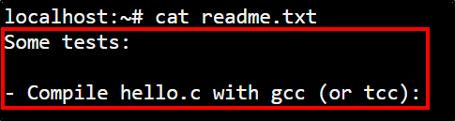
CAT command: read file contents
The CAT command is used to read file contents

Slide 5
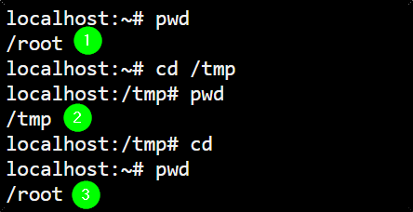
CD command: change working directory
The CD command is used to change our current (working) directory. If we use CD by itself, it will send us to our home directory

Slide 6
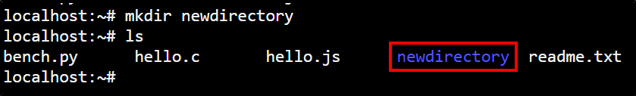
MKDIR command: create a new directory
The MKDIR command is used to create new directories. We usually can't create directories outside of our home directory or the /tmp directory

Slide 7
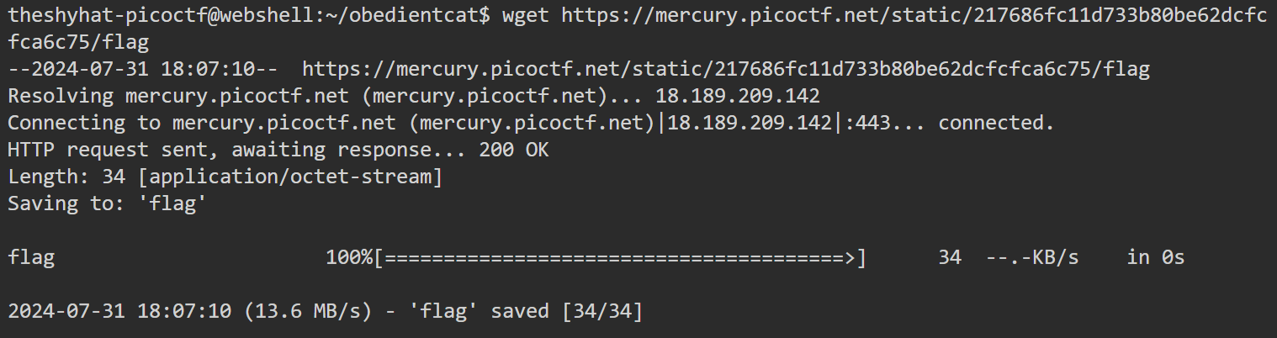
WGET command: download a file
The WGET command is used to download files. We usually can't download files outside of our home directories or the /tmp directory

Slide 8
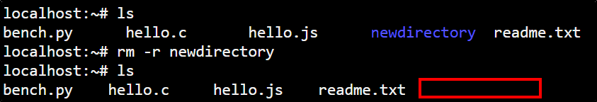
RM command: delete files or directories
The RM command is used to delete files or directories. Directories that aren't empty can't be deleted unless we use the -r switch.

Slide 9

NC command: connect to remote server
The NC (Netcat) command is used to connect to remote servers (other internet connected computers).

Slide 10
NC command: connect to remote server
To connect using netcat, we need to know the address of the server to connect to, and the port number.

Slide 11
NC command: connect to remote server
The NC command is similar to the SSH command, but NC is an older command.

Slide 12
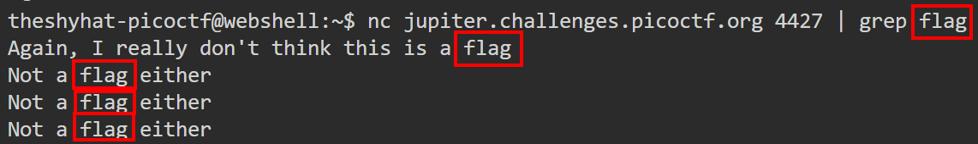
GREP command: delete files or directories
The GREP command is used to search for text inside of output or inside of files.

Slide 13
FIND command: searching for files
The FIND command is used to search for files in the filesystem. One way to search is by the name of the file.

Slide 14
Command Piping: passing output to another command
In Linux, command piping is the process of passing the output of one command into the input of a second command.

Slide 15
Command Piping: passing output to another command
This is a very useful feature, because it allows commands to be chained together to achieve a lot of flexible output.

Slide 16
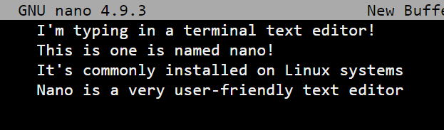
Terminal Text Editors
From time to time, we'll need to write new files or modify existing ones. To do so, we'll need to use Linux text editors.

Slide 17


Terminal Text Editors
Two commonly installed text editors on Linux systems are Nano and Vim.

Slide 18
Nano Text Editor
Nano is the more straightforward and user-friendly of the two text editors.

Slide 19
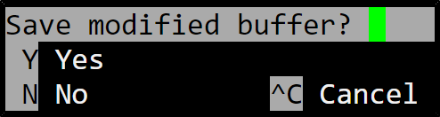
Nano Text Editor
The most important command to know in the Nano text editor is the ` Ctrl + C `command, which lets us save the file and exit.

Slide 20
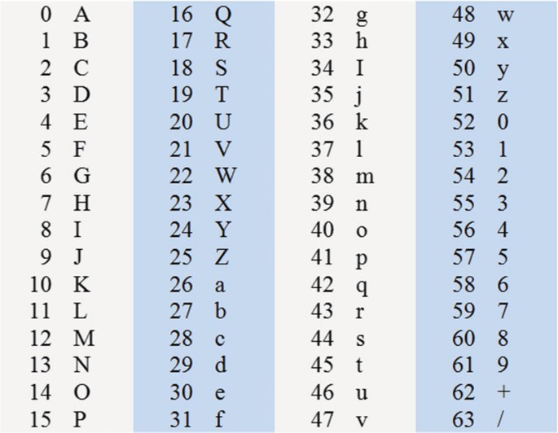
Base64 Command
The Base64 command
encodes / decodes data
according to the Base64
codec. It is often
used to convert data
for transmission across
computer networks.

Slide 21
Base64 Command
The characters used in
Base 64 encoding are
shown here. Note that
all Base 64 encoded
strings must consist of
a number of characters
that is divisible by 4.

Slide 22

Base64 Command
In cases where an encoded string is not divisible by 4, the encoding process will “pad out” the string with equal symbols until the string is divisible by 4.

Slide 23

Base64 Command (decode)
1 – The command itself
2 – The decode switch
3 – The file to be operated upon

