Slide 1

HackerFrogs Afterschool
Python Programming Basics: Intro
Class:
Programming (Python)
Workshop Number:
AS-PRO-PY-00
Document Version:
1.0
Special Requirements:
None

Slide 2
Welcome to HackerFrogs Afterschool!
HackerFrogs Afterschool is a
cybersecurity program for
learning beginner
cybersecurity skills across
a wide variety of subjects.
This is the intro video to
Python programming.

Slide 3
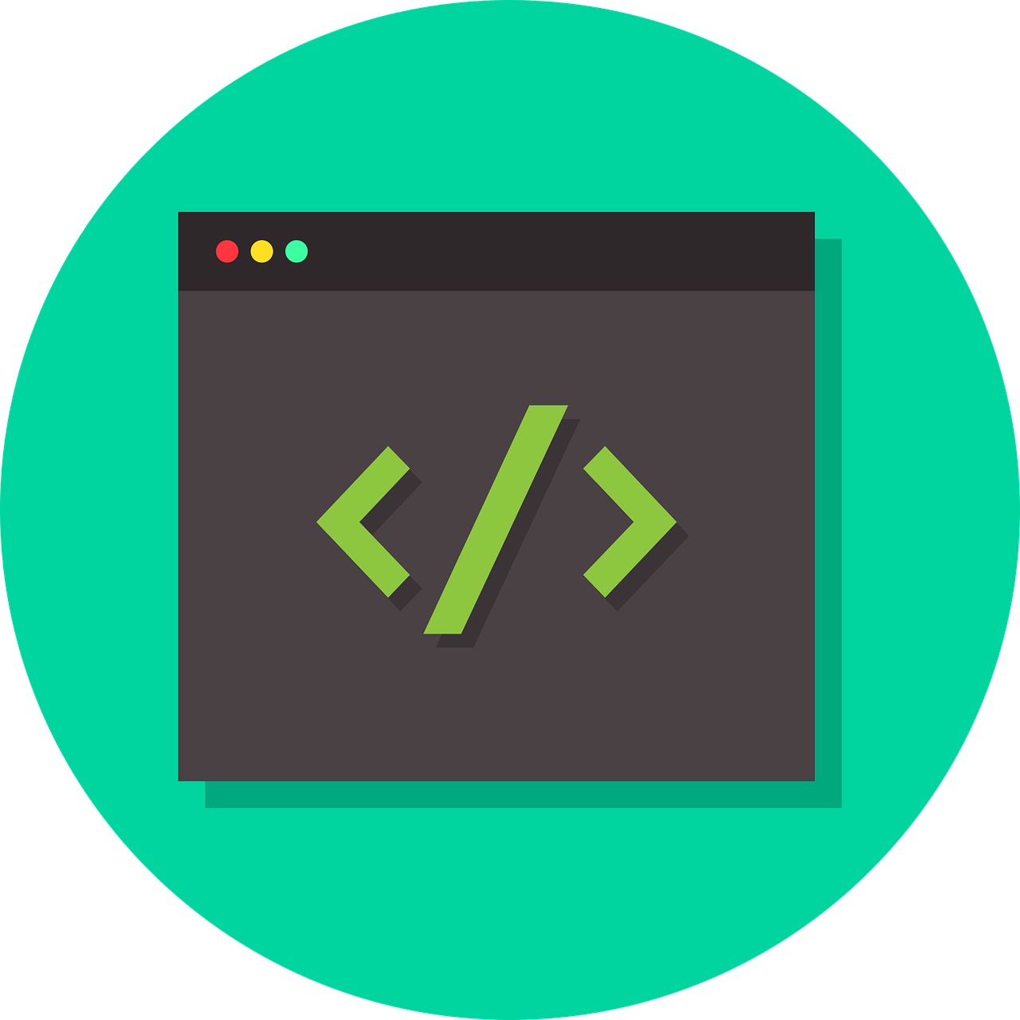
What is Programming?
According to Wikipedia,
computer programming
is the process of
performing a particular
computation (or more
generally, accomplishing
a specific computing
result), usually by
designing and building
an executable
computer program.

Slide 4
What is Programming?
Put in broader terms,
programming is the
process of writing
instructions for a
computer to execute.

Slide 5
What is Programming?
The instructions can
result in output as simple
as printing the answer to
a simple math equation
or a word to the screen,
or as complex as the
latest video editing
software, games,
websites, or countless
other pieces of software
used in our daily lives.

Slide 6
What is Programming?
Many different
programming languages
are used for writing
software, and each
programming language
has its own advantages
and disadvantages for
developing different
types of software.

Slide 7
What is Programming?
The programming
language we will learn
to use in these
workshops is called
Python.

Slide 8
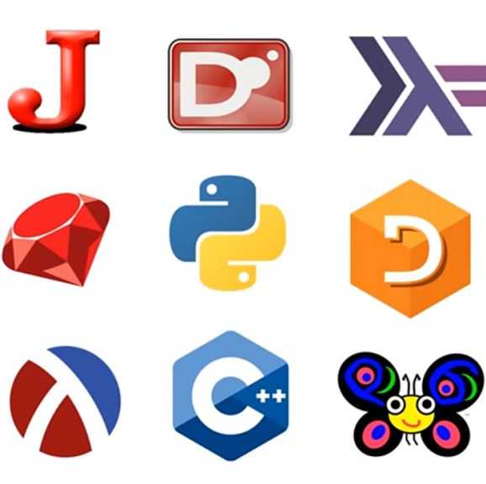
Why Learn Python?
There are a lot of
programming
languages out there,
so why are we learning
Python?
We'll go over three
reasons:

Slide 9

Why Learn Python?
1) Python is a very
popular language with an
active online community,
so there's a lot of
support for students.

Slide 10
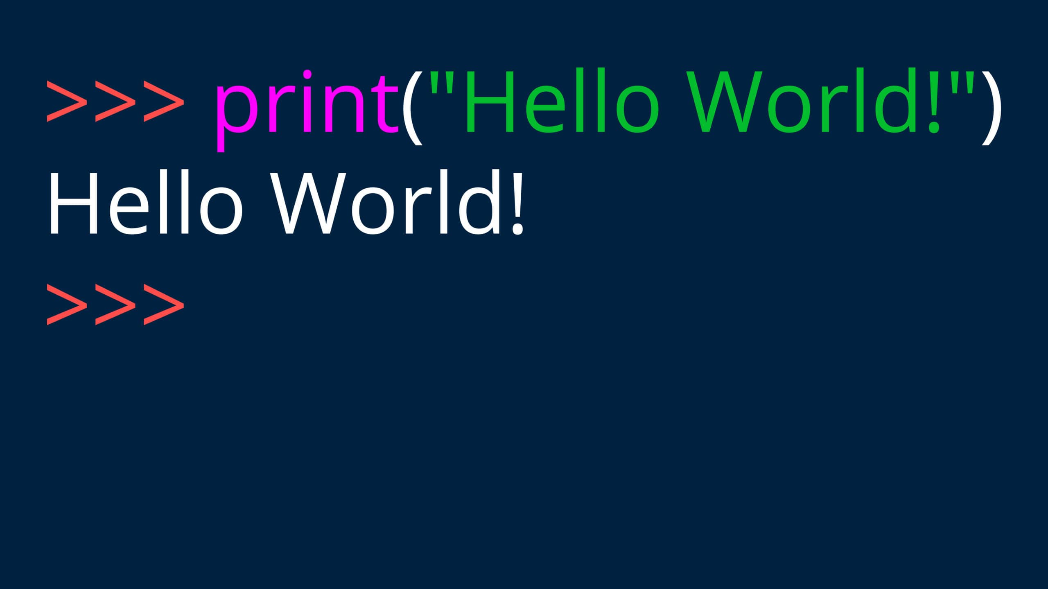
Why Learn Python?
2) Python uses a syntax
that is much closer to
written English than
other programming
languages, so it's easier
to read and understand

Slide 11

Why Learn Python?
3) Python automates
some tedious operations
common to other
programming languages,
such as memory
management.

Slide 12
What is Python? An Overview
Python is a high-level,
interpreted,
general-purpose
programming language.
What does this mean?

Slide 13
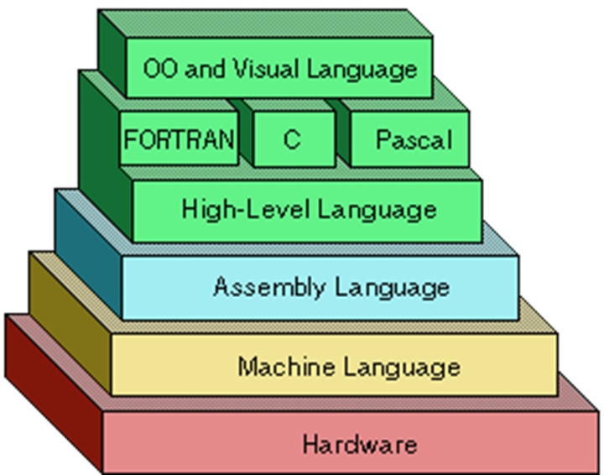
High-Level Language
Programming languages
are classified as either
low-level or high-level,
depending on how
abstract the language is
from the pure machine
code that computer
processors use.

Slide 14
High-Level Language
Programming in a
high-level language has
two major effects:

Slide 15
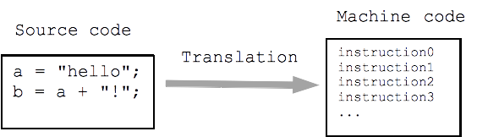
High-Level Language
First, abstract syntax allows easier understanding for people who need to read code written in high-level languages and write code using the same.

Slide 16

High-Level Language
Second, due to its high level of abstraction from
machine language, processes using high-level
languages are relatively slower than the same
processes performed by low-level languages.

Slide 17


High-Level Language
In other words, high-level
programming language
code is easier to write and
read, but programs
created with that code are
slower than programs
created with
low-level languages.

Slide 18
Interpreted Language
Interpreted languages
are programming
languages that do not
require compilation
before instructions
are run.

Slide 19
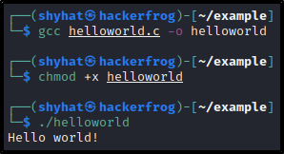
Interpreted Language
As opposed to
compiled languages,
where programming
code must be
converted into
machine code by a
compilation program
before it can be run.

Slide 20

General-Purpose Language
General-purpose
programming languages
are programming
languages designed to
be able to create a wide
range of application
types.

Slide 21
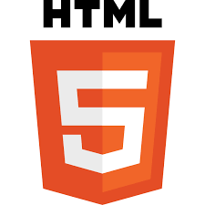
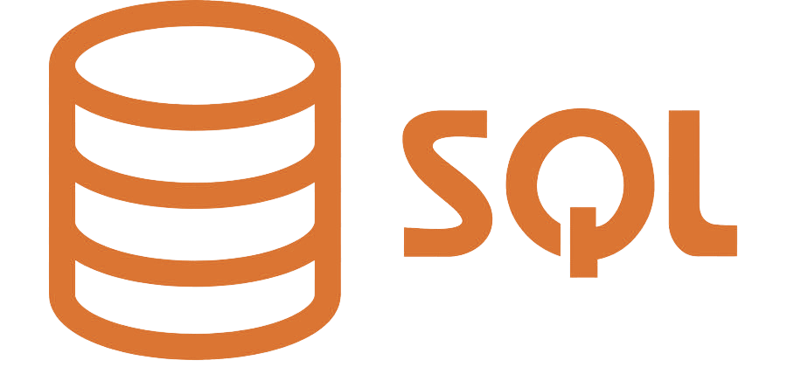
General-Purpose Language
As opposed to
domain-specific
programming languages,
which typically are used
to operate in specialized
environments.

Slide 22
What's Next?
In the next HackerFrogs
Afterschool programming
workshop, we'll start
learning Python with the
learnpython.org website.

Slide 23

Until Next Time, HackerFrogs!

