Slide 1

HackerFrogs Afterschool
Python Programming Basics: Part 1
Class:
Programming (Python)
Workshop Number:
AS-PRO-PY-01
Document Version:
1.0
Special Requirements:
None

Slide 2
Python Programming Intro
This is the first
workshop to intro
Python programming.
Let us begin!

Slide 3
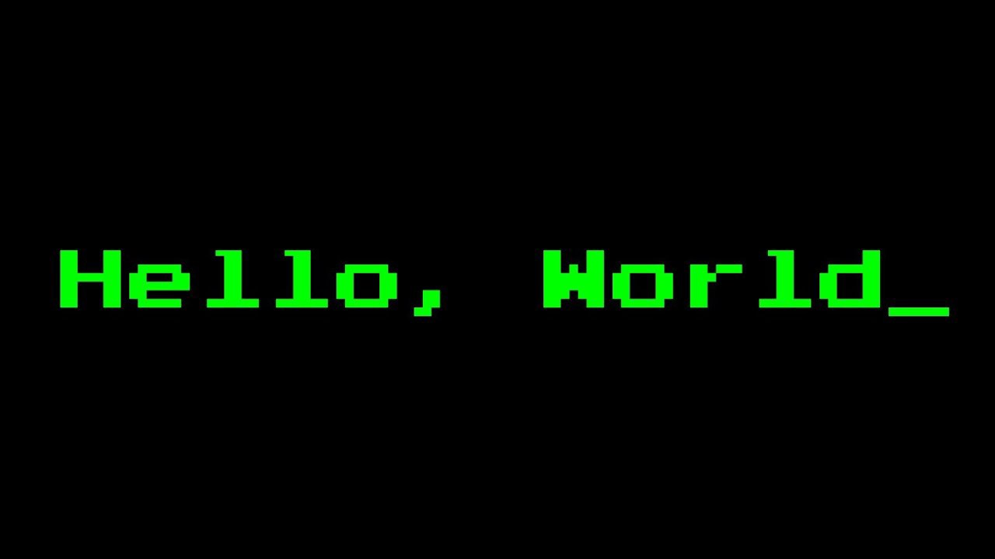
Part 1: Hello, World!
Programmers learning a language usually write a “Hello, World!” program as their first exercise.

Slide 4
Hello, World!
To complete our Hello, World! exercise, we'll go over the Python print function first.

Slide 5

The Print Function
Virtually all programming languages have some method of printing text to the screen (often referred to as the console). In Python, the print function is the primary method of doing so.

Slide 6
The Print Function
To use the print function, we use the function name, print, then a pair of parentheses, then encase what we want printed, in either single or double quotes, between the parentheses.

Slide 7
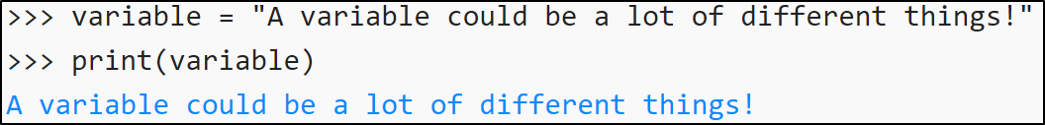
The Print Function
Another common use of the print function is to print the values of variables to the console. In this case, we simply input the name of the variable we want printed between the parentheses.

Slide 8
Let's Learn with Learnpython.org
For a more hand-on and interactive session, we'll be using the Learnpython.org website. Please navigate to the following URL:
https://learnpython.org/en/Hello,_World!

Slide 9
Part 1 – Hello World Quiz
If we write a print function without parentheses, what will happen?
A) You should only use double quotes ( '' )
B) You should only use single quotes ( “” )
C) You can use either single or double quotes ( '',”” )
D) Neither, you should use backticks ( `` )

Slide 10
Part 1 – Hello World Quiz
If we write a print function without parentheses, what will happen?
A) You should only use double quotes ( '' )
B) You should only use single quotes ( “” )
C) You can use either single or double quotes ( '',”” )
D) Neither, you should use backticks ( `` )

Slide 11
Part 2: Variables
Virtually all programming languages use variables, which are storage locations associated with a specific name, as well as a value. Take the following as an example:
my_name = 'shyhat'

Slide 12
Variables
Wherever we refer to my_name in the code, shyhat will be inserted there. So, if we have the following code:
my_name = 'shyhat'
print(my_name)
The output should be shyhat.

Slide 13
Variables
The real benefit of using variables in programming is that a variables can be referenced multiple times in the same code, saving a lot of time and accounting while writing code.
In addition, variables can change value after they've been defined.

Slide 14

Variables
For example, say we have
an online store program
where we sell televisions.

Slide 15
Variables
The program has two
variables, tv_price,
which is the price of a
television, and
current_total, which
keeps track of the total
price of the user's
shopping cart.

Slide 16
Variables
The two variables are set
to 199.99 and 0,
respectively. However, if
a TV is purchased, then
the total_price
variable increases by a
value equal to the
tv_price variable.
See the following:

Slide 17
Variables
tv_price = 199.99
current_total = 0
current_total = current_total + tv_price
print(current_total)
The output should be 199.99

Slide 18

Data Types
Data types are attributes
of data which tell the
compiler or interpreter
how to use the data.
The data types covered
in this workshop are
as follows:

Slide 19
Data Types
Strings (str)
Non-numerical characters, or a combination of numerical and non-numerical characters. E.g, “Mark Twain”, “P@ss\/\/ord123”, “carrot”
Integers (int)
Whole numbers. E.g., 1, 255, 1337
Floating-Point Numbers (float)
Numbers that are accurate to several decimal places. E.g., 0.5 or 12.758

Slide 20

Data Types
The reason why data types are important is because computers do not inherently
know how to interpret data.

Slide 21
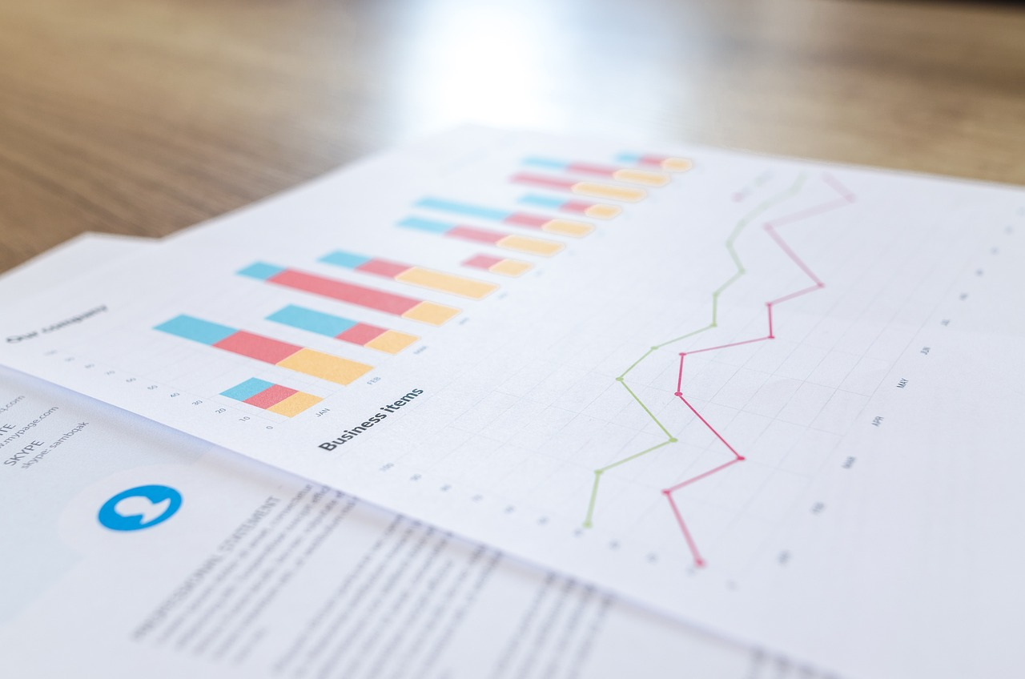
Data Types
For example, if we have a program which calculates the average of school grades (adds all grades together, then divides the sum by the number of assignments) --

Slide 22
Data Types
the program wouldn't work if it was given words instead of numbers for the grades.

Slide 23
Data Types
Because there are data types, we can have the program check that all of the grades are numbers, and if there is a non-number in the input, we can inform the user that the program only accepts numbers for input, and prompt the user to input another value.

Slide 24
Variables and Types Exercise
Let's cover the next few exercises on the Learnpython.org website:
https://www.learnpython.org/en/Variables_and_Types

Slide 25
Part 2 – Variables and Types Quiz
Which of the following about naming variables is true?
A) Python keywords (e.g., class, def, True, False, None) should never be used as variable names
B) Use single-leter variable names (x, y, a, b) as much as possible
C) Variables that contain number should be named in UPPERCASE letters, and variables with text should be named in lowercase letters.
D) None of the above

Slide 26
Part 2 – Variables and Types Quiz
Which of the following about naming variables is true?
A) Python keywords (e.g., class, def, True, False, None) should never be used as variable names
B) Use single-leter variable names (x, y, a, b) as much as possible
C) Variables that contain number should be named in UPPERCASE letters, and variables with text should be named in lowercase letters.
D) None of the above

Slide 27
Part 2 – Variables and Types Quiz
Which of the following is not a Python data type?
A) Strings – letters or combinations of letters and number that are encased in single or double quotes
B) Integers – whole numbers, such as 1, 1337, and 256. If put between quotes, they become strings.
C) Floats (floating point numbers) – numbers with decimal points, such as 0.0, 5.285, and 3.16.
D) HackerFrogs – folks who like hacking and live streams

Slide 28
Part 2 – Variables and Types Quiz
Which of the following is not a Python data type?
A) Strings – letters or combinations of letters and number that are encased in single or double quotes
B) Integers – whole numbers, such as 1, 1337, and 256. If put between quotes, they become strings.
C) Floats (floating point numbers) – numbers with decimal points, such as 0.0, 5.285, and 3.16.
D) HackerFrogs – folks who like hacking and live streams

Slide 29
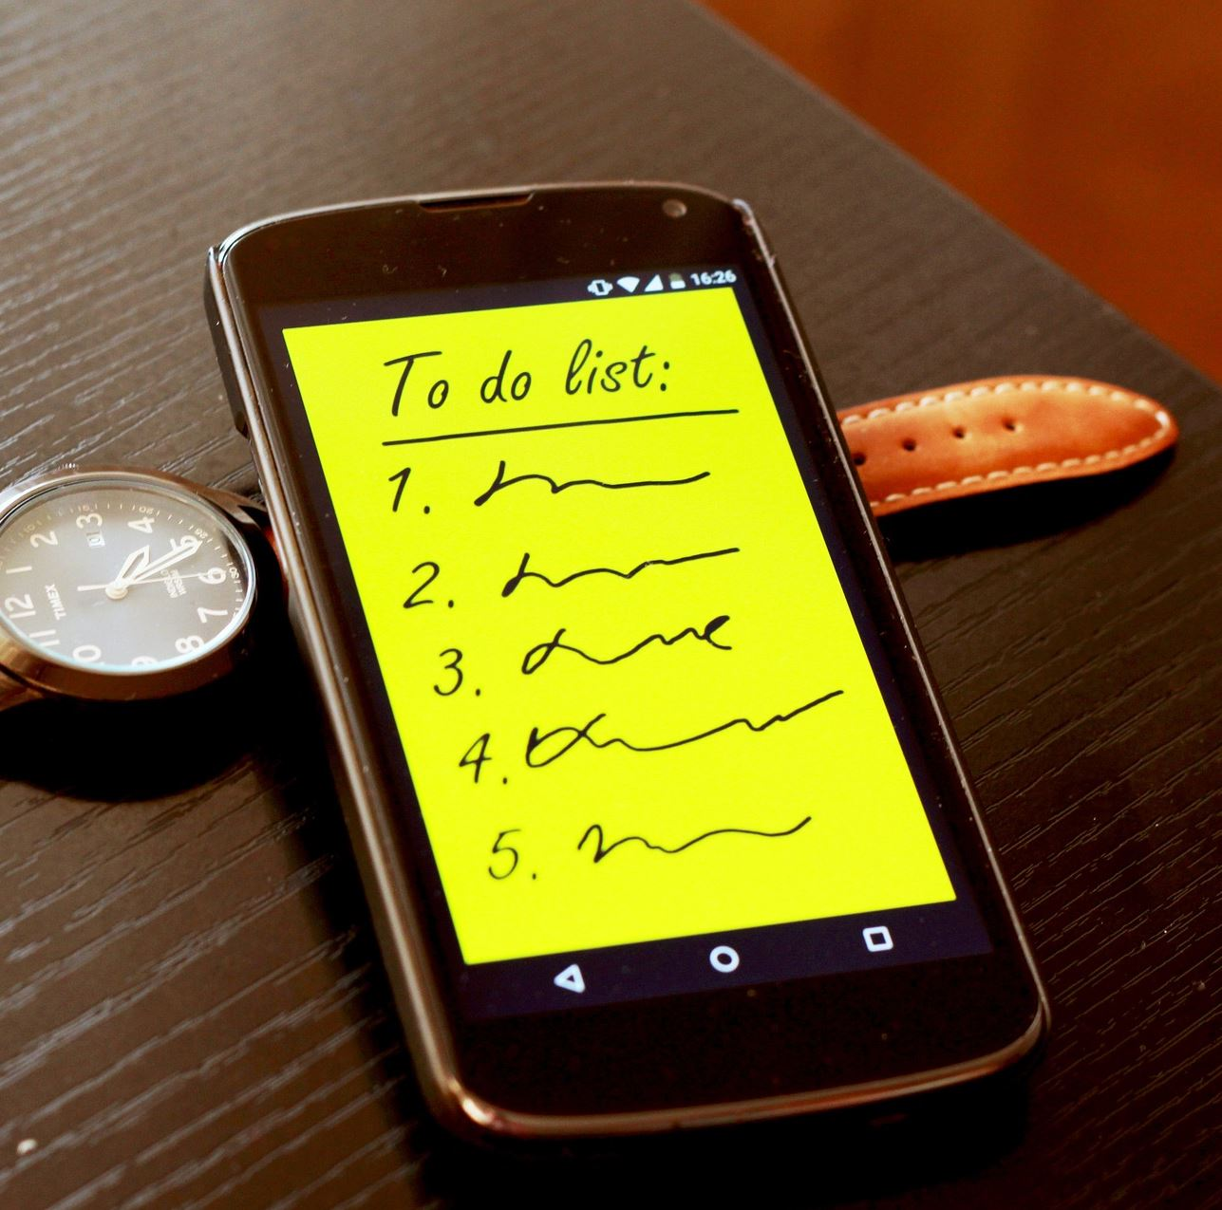
Part 3: Lists
Lists are part of what
Python categorizes as
collections, variables that
hold one or more values,
which can be strings,
numbers, or a mixture of
different data types.

Slide 30
Lists
An example list
in Python could look
like the following:

Slide 31
Lists
vegetables = ["carrots", "lettuce", "beets"]
or
related_to_pie = ["round", 3.14, "delicious"]
As we can see by the example, a list is defined as a number of objects (separated by commas ' , ') between a pair of square brackets ' [ ] '.

Slide 32
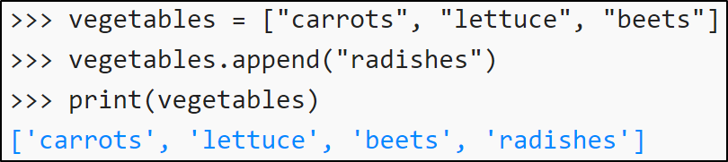
List Methods
Methods are actions that can be
performed with objects.

Slide 33
List Methods
Methods are performed by indicating the name of the object (the list), then a dot ( . ), then the name of the method, followed by a pair of parentheses, which contain any arguments required for that method.

Slide 34
List Methods
The list method we will learn in this workshop is the append method. The append method will add an item to the end of the specified list.
Take the following code as an example:

Slide 35
List Methods
friends = ['Alex', 'Barb']
friends.append('Carl')
print(friends)
The output should be:
['Alex', 'Barb', 'Carl']

Slide 36
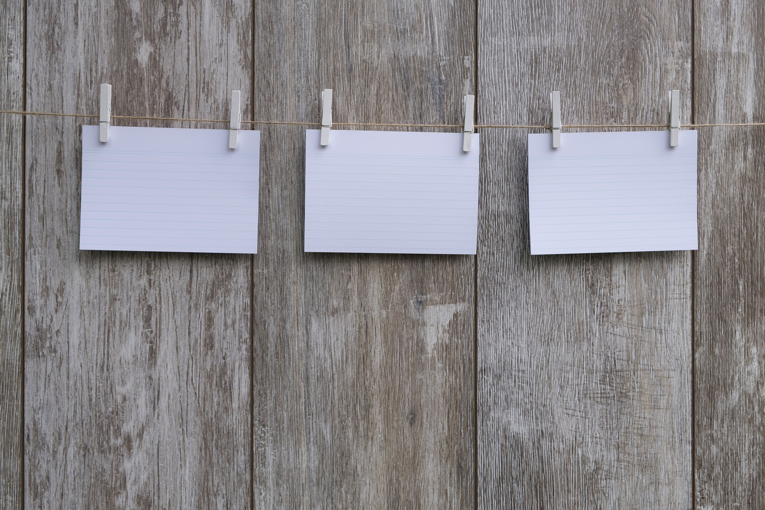
List Indexing
List indexing allows for
the selection of specific
items in a list by referring
to them by the position
in which they appear
in the list.

Slide 37
List Indexing
To use list indexing, use
the name of the list,
directly followed by a
pair of square brackets
' [ ] ', with the position of
the desired list item
inside the brackets.
For example:

Slide 38
List Indexing
trees = ['pine', 'elm' , 'cedar']
print(trees[0])
The output should be pine, since pine is the first item on the list. Note that counting positions in indexing start from zero, not one. In this example, trees[2] refers to cedar, since cedar is the number 2 item on the list if we count from zero.

Slide 39
Lists Exercise
Let's cover the next few exercises on the Learnpython.org website:
https://learnpython.org/en/Lists

Slide 40
Part 3 – Lists Quiz
Which of the following statements about Python lists is false?
A) When printing a list, all items in the list must be printed
B) It's not possible to add items to a list after list creation
C) Counting items in a list starts from zero, not one
D) Items in a list cannot be changed after they've been added

Slide 41
Part 3 – Lists Quiz
Which of the following statements about Python lists is false?
A) When printing a list, all items in the list must be printed
B) It's not possible to add items to a list after list creation
C) Counting items in a list starts from zero, not one
D) Items in a list cannot be changed after they've been added

Slide 42
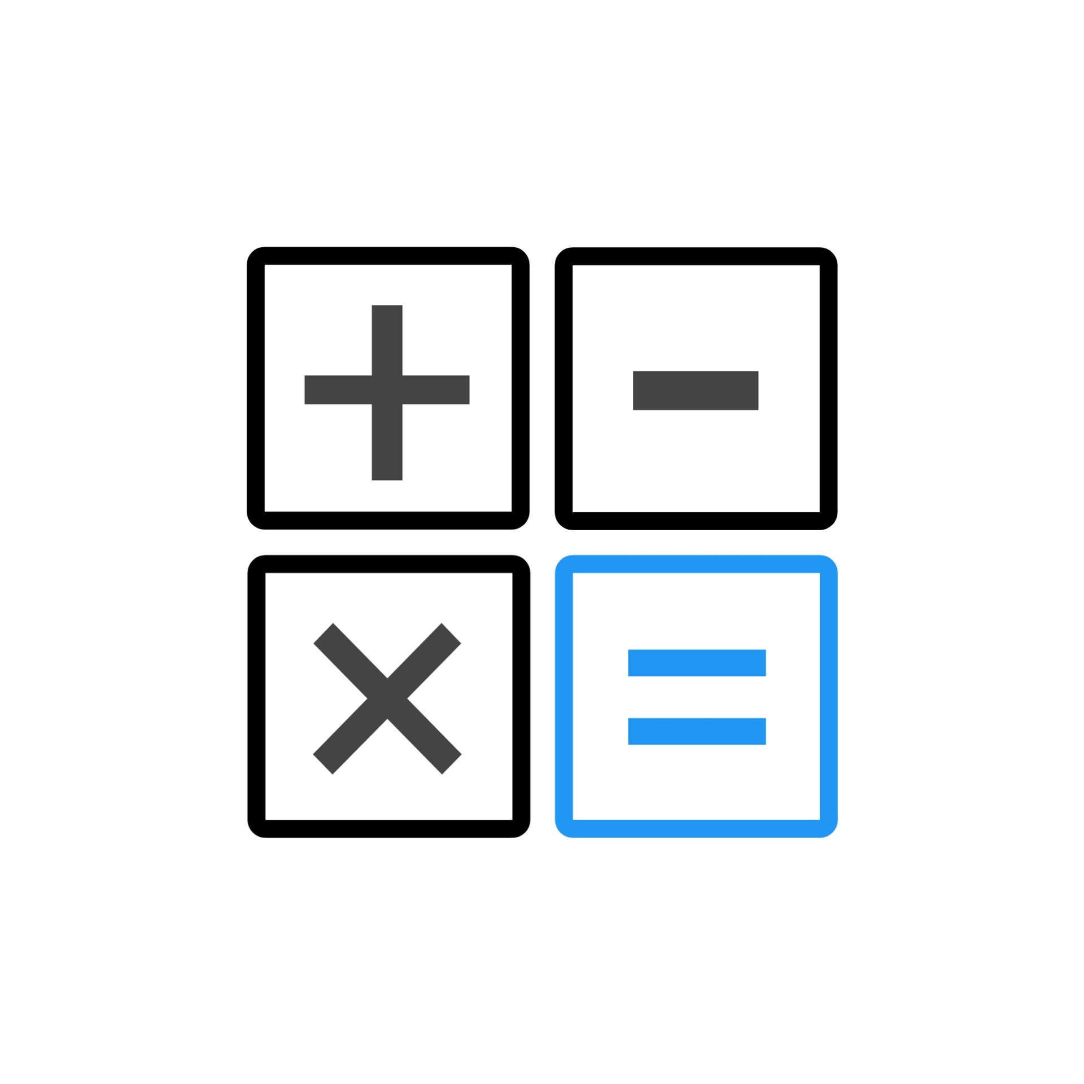
Part 4: Basic Operators
In programming terms,
operators are used to
perform an operation
on a piece of data.

Slide 43
Basic Operators
In this lesson, we will
learn about basic
arithmetic operators
that are used for
mathematical addition,
subtraction, division,
multiplication, and
a couple of others.

Slide 44
Basic Operators
Python uses the following operators (symbols) for basic arithmetic:
Operator Name Symbol Example
Addition + x + y
Subtraction - x - y
Multiplication * x * y
Division / x / y
Exponentiation ** x ** y

Slide 45
Basic Operators
The arithmetic
operations that occur
in Python follow the
PEMDAS order of
operations.

Slide 46
Basic Operators
(P)arentheses
(E)xponents
(M)ultiplication
(D)ivision
(A)ddition
(S)ubtraction

Slide 47
Basic Operators
(P)arentheses
(E)xponents
(M)ultiplication
(D)ivision
(A)ddition
(S)ubtraction

Slide 48
Basic Operators
(P)arentheses
(E)xponents
(M)ultiplication
(D)ivision
(A)ddition
(S)ubtraction

Slide 49
Basic Operators
(P)arentheses
(E)xponents
(M)ultiplication
(D)ivision
(A)ddition
(S)ubtraction

Slide 50
Basic Operators
(P)arentheses
(E)xponents
(M)ultiplication
(D)ivision
(A)ddition
(S)ubtraction

Slide 51
Basic Operators
(P)arentheses
(E)xponents
(M)ultiplication
(D)ivision
(A)ddition
(S)ubtraction

Slide 52
Basic Operators
(P)arentheses
(E)xponents
(M)ultiplication
(D)ivision
(A)ddition
(S)ubtraction

Slide 53
Basic Operators
In summary, all operations enclosed in (p)arentheses are performed first, then all (e)xponent operations are resolved, followed by (m)ultiplication, (d)ivision, (a)ddition, then (s)ubtraction operations at the end.

Slide 54
Basic Operators
Given the following equation in Python syntax:
(4 / 2) * 2 ** 2 / 4 + 2 - 4
First the division operation inside of the parentheses (4 divided by 2) is performed. Second, the exponent operation (2 ** 2, which is Python's syntax for “two to the second power”, is resolved. Third, the multiplication (2 times 4) is resolved.

Slide 55
Basic Operators
Given the following equation in Python syntax:
8 / 4 + 2 - 4
Forth, the division (8 divided by 4) is resolved. Fifth, the addition (2 + 2) is resolved. Finally, the subtraction (4 - 4) is resolved, which sets our final result to 0 (zero).

Slide 56
Basic Operators
A common operator used in programming is the modulo operator ( % )
5 % 2 = 1
8 % 5 = 3
A modulo operation returns the remainder after one number is divided by another. The resulting number after a modulo operation is called the modulus

Slide 57
Basic Operators
n % 2
A typical use for the modulo operation is to determine whether a number is even or odd by performing a modulo operation on it with the number 2. If the result is 1, the number is odd, and if the result is 0, the number is even

Slide 58
Basic Operators Exercise
Let's cover the next few exercises on the Learnpython.org website:
https://learnpython.org/en/Basic_Operators

Slide 59
Part 4 – Basic Operators Quiz
Which of the following methods will allow us to print a string and an integer with the same print function?
A) No special method need be taken to mix a string and an integer with the print function
B) The integer must be converted to a string to mix integers and strings in a print function
C) The string must be converted to an integer to mix integers and strings in a print function
D) You cannot print a string and integer with print

Slide 60
Part 4 – Basic Operators Quiz
Which of the following methods will allow us to print a string and an integer with the same print function?
A) No special method need be taken to mix a string and an integer with the print function
B) The integer must be converted to a string to mix integers and strings in a print function
C) The string must be converted to an integer to mix integers and strings in a print function
D) You cannot print a string and integer with print

Slide 61
Workshop Review Exercise
Before finishing today's workshop, let's write a program that uses some of the concepts we learned:
We'll use one of the Python windows on the learnpython.org website to write the following program

Slide 62
Workshop Review Exercise
A sandwich restaurant owner wants a program that calculates and prints out the total price of customer orders.
The menu only consists of two items: sandwiches that cost 3.50 and soft drink cans, which cost 0.99.

Slide 63
Workshop Review Exercise
The program should print out two totals, corresponding with the following customer orders:
Order One: 3 sandwiches and 3 soft drinks
Order Two: 7 sandwiches and 6 soft drinks
The program should contain at least two variables, with values equal to the prices of the two menu items.

Slide 64
Workshop Review Exercise
We'll go over a possible version of the program after this, but please write your own attempt at the program now.
Order One: 3 sandwiches and 3 soft drinks
Order Two: 7 sandwiches and 6 soft drinks
sandwiches: 3.50
soft drinks: 0.99.

Slide 65
Workshop Review Exercise
The following program fulfills all of the requirements stated previously:
sandwich_price = 3.50
soft_drink_price = 0.99
order_one = (sandwich_price * 3) + (soft_drink_price * 3)
order_two = (sandwich_price * 7) + (soft_drink_price * 6)
print(order_one)
print(order_two)

Slide 66

Summary
Let's review the programming concepts we learned in this workshop:

Slide 67
Hello, World!
We wrote the Hello, World! program in Python, which is the first program students write for any computer language.

Slide 68
The Print Function
We learned how to use the Python print function, which prints information to the console and is common to almost all programs written in Python.

Slide 69
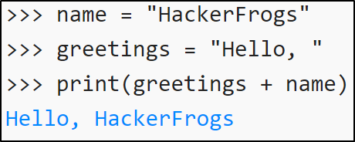
Variables
We learned about programming variables, named storage locations which hold specific values, which can be referenced multiple times in a program.

Slide 70
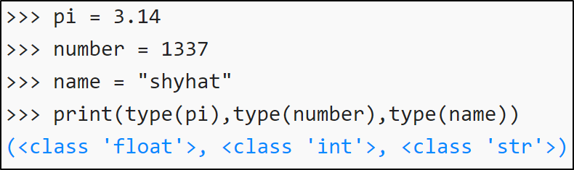
Data Types
We learned about Data Types, including strings (non-numeric text), integers (whole numbers), and floats (numbers which include decimal places).

Slide 71
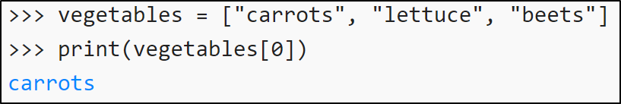
Lists
We learned about lists, which are variables with one or more items associated with them. Items in the list can be referenced by a process called list indexing.

Slide 72
Basic Operators
The last thing we
learned in this
workshop is Python
basic operators, which
are used to perform
arithmetic operations.

Slide 73
What's Next?
In the next HackerFrogs
Afterschool programming
workshop, we'll continue
learning Python with the
learnpython.org website.

Slide 74
Next Workshop's Topics
- String Formatting
- Basic String Operations
- Conditions

Slide 75
Next Workshop's Topics
- String Formatting
- Basic String Operations
- Conditions

Slide 76
Next Workshop's Topics
- String Formatting
- Basic String Operations
- Conditions

Slide 77
Next Workshop's Topics
- String Formatting
- Basic String Operations
- Conditions

Slide 78
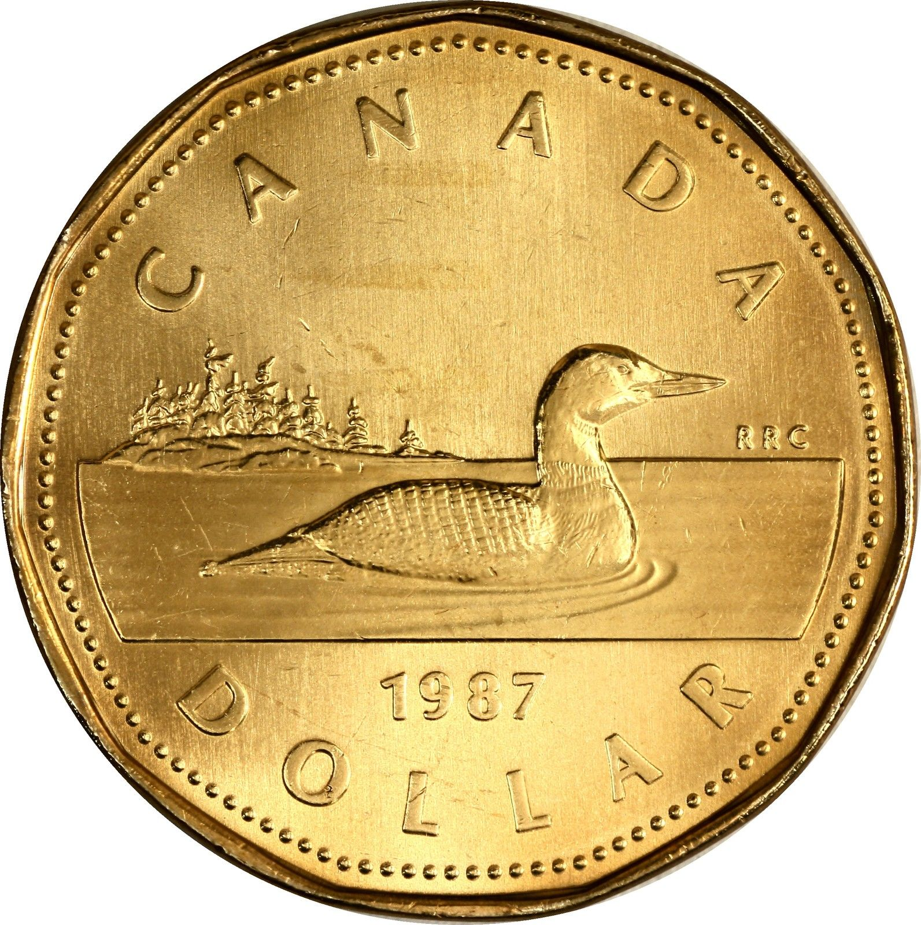
Extra Credit
Looking for more study
material on this
workshop's topics?
See this video's
description for links to
supplemental documents
and exercises!

Slide 79

Until Next Time, HackerFrogs!

Slide 80

Intermission

Slide 81
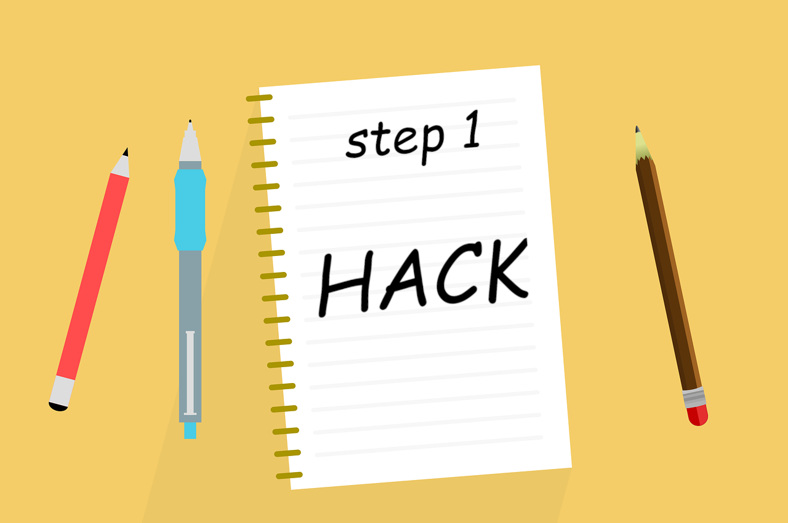
Intermission

Slide 82

Intermission

Slide 83
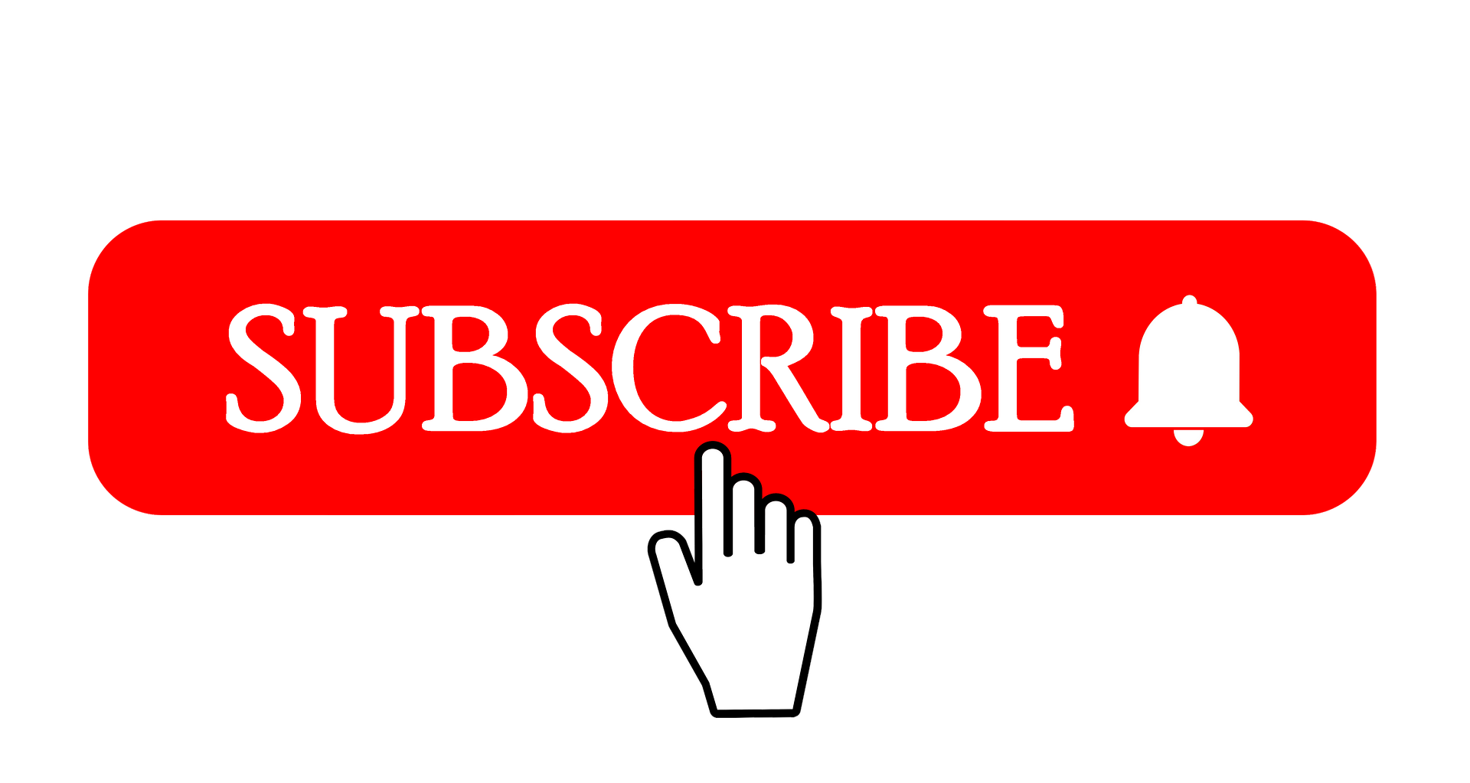
Intermission

Slide 84

Intermission

Slide 86
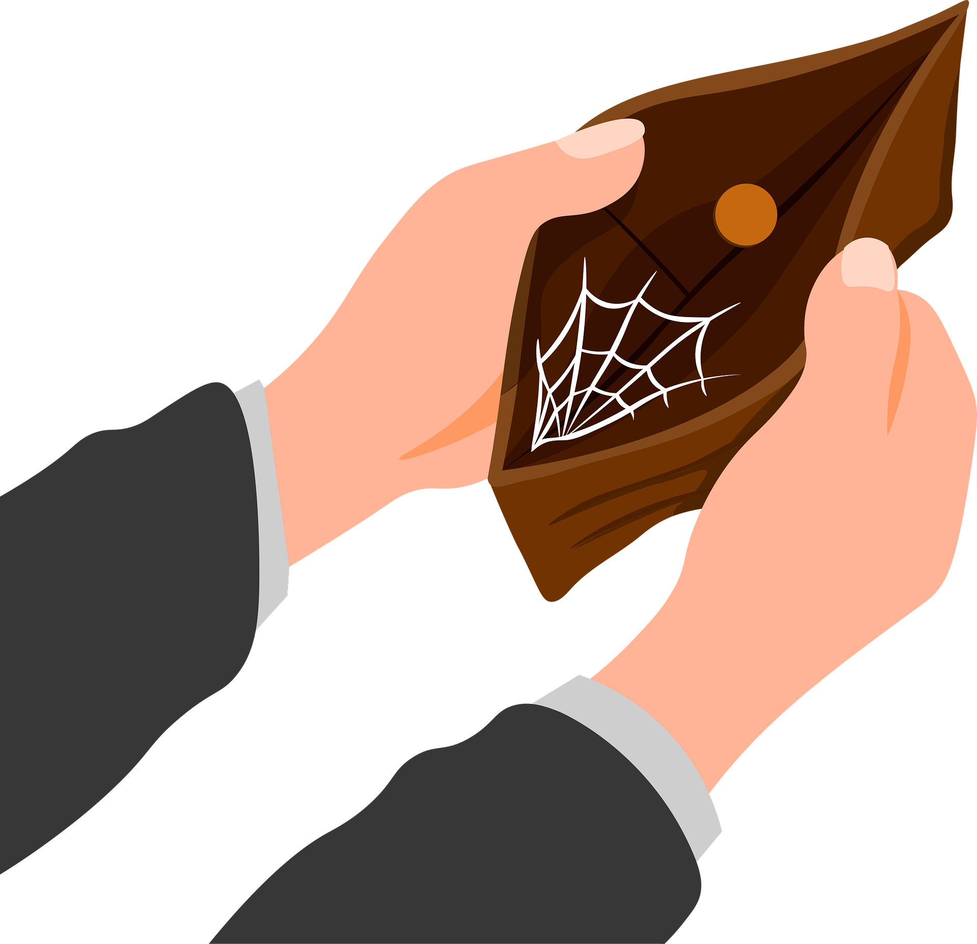

Slide 87


Slide 88


Slide 89
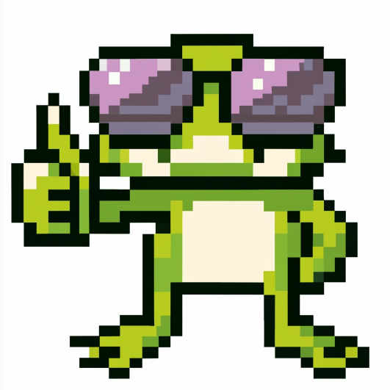

Slide 90
