Slide 1
AAAI ICWSM 2024 | Buffalo, NY, USA | June 3rd
Collectivist and Perspectivist Approaches to Studying Online Toxicity
Yotam Shmargad
Associate Professor
School of Government & Public Policy
University of Arizona

Slide 2
In 1903, sociologists Gabriel Tarde and Emile Durkheim debated the nature of collectives
A collective is a set of things – people, objects, ideas, etc.
For Durkheim, collectives are real and thus measurable. They exist independently of our perceptions of them, are stable, and can exert forces beyond their individual units.
For Tarde, this is nonsense. Collectives exists in the mind alone and are thus contingent on the state of the specific mind imagining the collective – that is, the perspective.
Durkheim is said to have won the debate and went on to found modern sociology. Thinking in terms of collectives (or groups) comes very naturally to us, but at what cost?
2

Slide 3
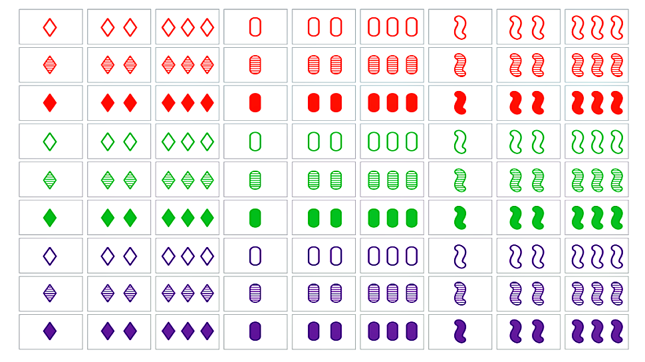
Defining a collective foregrounds similarity within group and dissimilarity across groups
But one can just as easily do the opposite – foreground differences within a group and similarities across groups
3

Slide 4
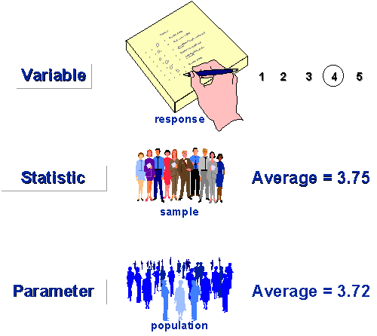
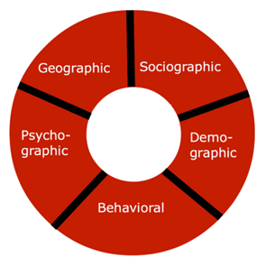

The 20th century saw the “collective” codified in statistics and monetized through marketing
“Focus group”
“Target market”
“Representative sample”
“All models are wrong, but some are useful”
- Statistician George E. P. Box
4

Slide 5
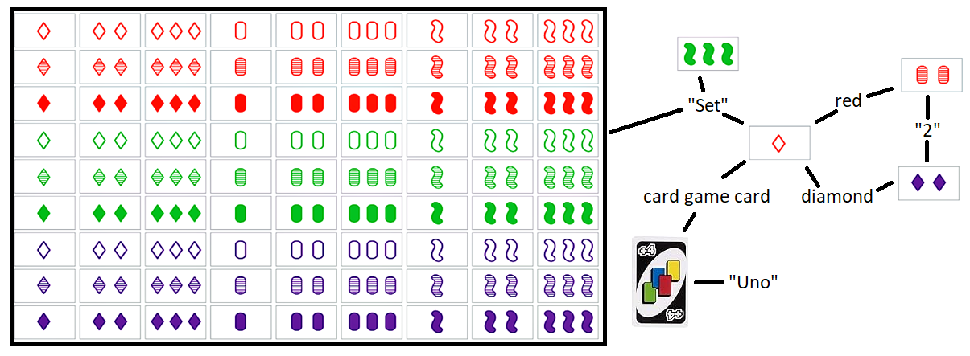
Latour (2002) argues that Tarde’s work is a precursor for his actor-network theory (ANT)
“By circulating.. from the actor to the network and back, we are not changing levels but simply stopping momentarily at a point, the actor, before moving on to the attributes that define them. It is because there is no jump to another level that ANT defines as ‘flat’ the connections thus designed by its method of circulation through data sets”
- Latour et al. (2012), ‘The whole is always smaller than its parts’
5

Slide 6
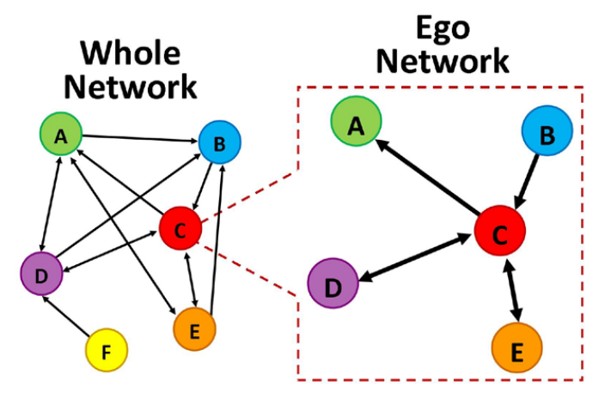
Network analysis is not inherently perspectivist and can be approached using both lenses
Collectivist
Perspectivist
In studies of social media, querying a set of keywords typically (though not always) lends itself to a collectivist approach, while a perspectivist approach uses ‘seeds’
6

Slide 7
Some ideas long predate the methodological advancements necessary to put them to use
It could be argued that a thinker of networks before their time could not transform his intuitions into data, because the material world he was interested in was not there yet to provide him with any empirical grasp. Things are different now that the technological networks are in place and that many of the arguments of Tarde can be turned into sound empirical use.
- Latour (2002), Gabriel Tarde and the End of the Social
The hyperlinked web and relational databases do facilitate perspectivism, but a key method developed in the 1940s
7

Slide 8
Handcock and Gile (2011) discuss the origins of snowball sampling and its ties to two-step flow
Lazarsfeld et al. (1944) argue that people often learn about politics from so-called opinion leaders (or “influentials”), not mass media
To study influentials, Merton (1949) asked respondents to name people who influenced them and conducted follow-up interviews
The approach was used by Katz and Lazarsfeld (1955) in a study that broadened the use of the two-step flow model beyond politics
Trow (1957) and Coleman (1958) both focused on studying hidden populations, and the connection to two-step flow was largely lost
→ Snowball sampling was initially developed to study social context
https://journals.sagepub.com/doi/10.1111/j.1467-9531.2011.01243.x
8

Slide 9
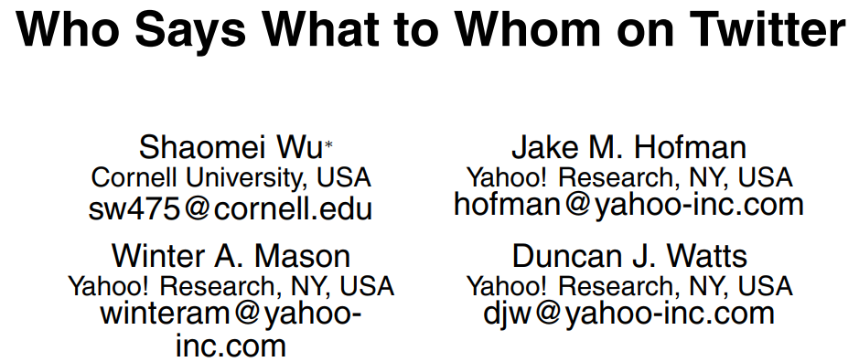
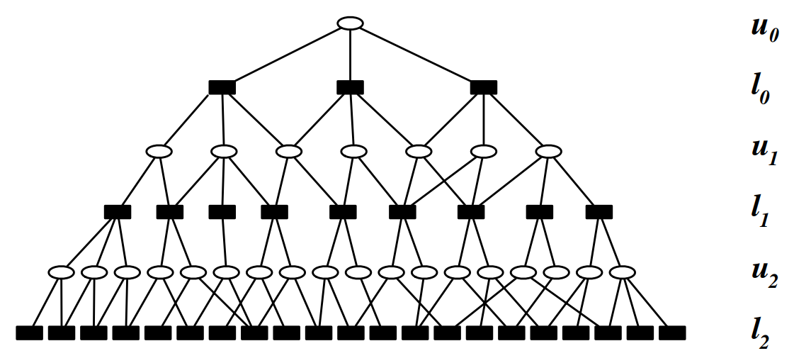
Wu et al. (2011) use snowball sampling to study two-step flow, reviving the historical connection
“Given the length of time that has elapsed since the theory of the two-step flow was articulated, and the transformational changes that have taken place in communications technology in the interim – given, in fact, that a service like Twitter was likely unimaginable at the time – it is remarkable how well the theory agrees with our observations” – Wu et al. (2011)
Here, snowball sampling is used to increase sample size
9

Slide 10

Snowball sampling opens up the possibilities for measuring social context and dynamics
Two designs
query
Post1
…
Postt
Post1
…
Postt
Shar11
…
Shar1t
Shart1
…
Shartt
Repl11
…
Repl1t
Replt1
…
Repltt
Post111
Post1t1
Postt11
Posttt1
Post111
Post1t1
Postt11
Posttt1
…
…
…
…
…
…
…
…
Post11t
Post1tt
Postt1t
Postttt
Post11t
Post1tt
Postt1t
Postttt
10

Slide 11
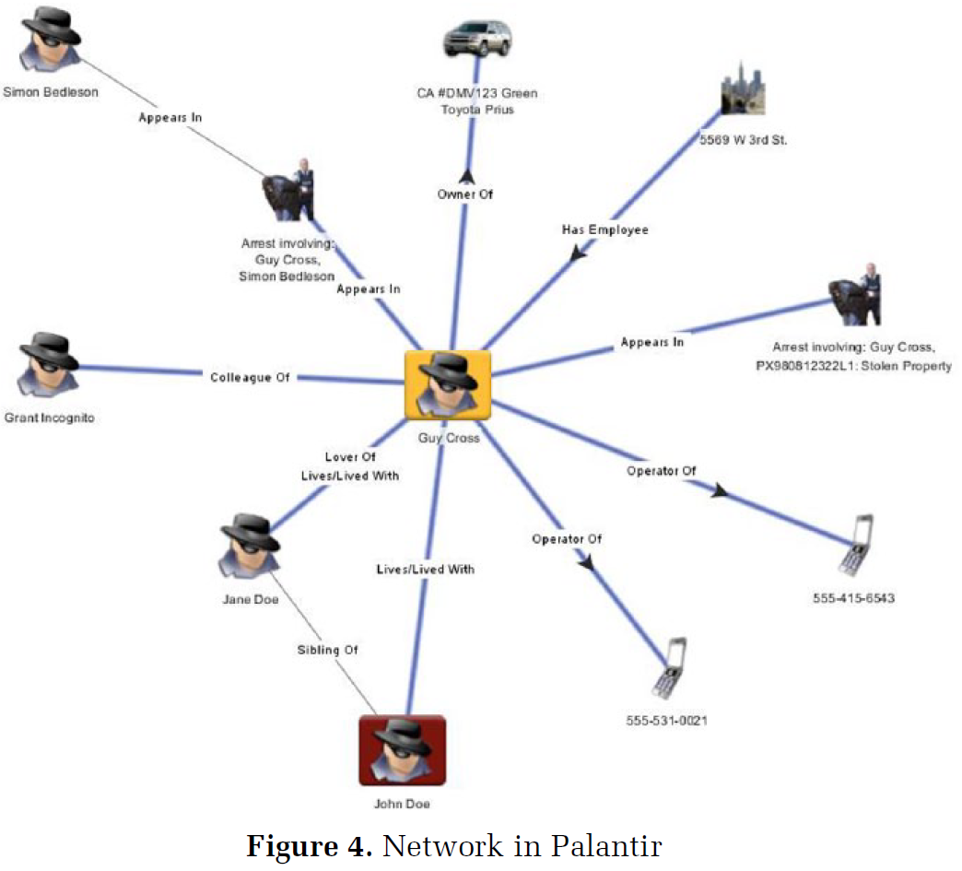
Big data are well-suited for snowball sampling, which is regularly used by security agencies
A paper by Mayer et al. (2016) shows that, under the National Security Agency’s ‘two-hop’ rule, telephone metadata can be used to obtain data about 25K people from a single seed
Sociologist Sarah Brayne (2017) documents how the Los Angeles Police Department uses a database provided by Palantir to generate ego networks of suspected criminals’ contacts
11

Slide 12
Perspectivism has Nietzschean roots, lives on in Viveiros de Castro and the “ontological turn”
Tarde echoes Nietzsche that knowledge of something is always bound to the perspective of those observing it
Anthropologist Viveiros de Castro coins ‘perspectivism’ in studies of Amerindian conceptions of nature and culture
The ontological turn in Anthropology questions Western understanding of culture as variable but nature as fixed
Anthropologist Matei Candea builds on these ideas
Edited a compilation on The Social after Gabriel Tarde
Likens Latour to Viveiros de Castro and the ontological turn
Contrasts frontal and lateral comparisons (us/them vs. this/that)
12

Slide 13
What follows is my attempt to apply these ideas to the large-scale study of online toxicity
Collectivist
Perspectivist
(us)
(them)
our comparison
I view the contrast between collectivist and perspectivist approaches as a frontal comparison – taking an outsider perspective and applying it to my data and research topic
Through both collectivist and perspectivist approaches, we will also be making lateral comparisons
Next: contrast norms surrounding toxicity on Reddit and Twitter
Later: contrast YouTube comments about Biden and Trump
13

Slide 14
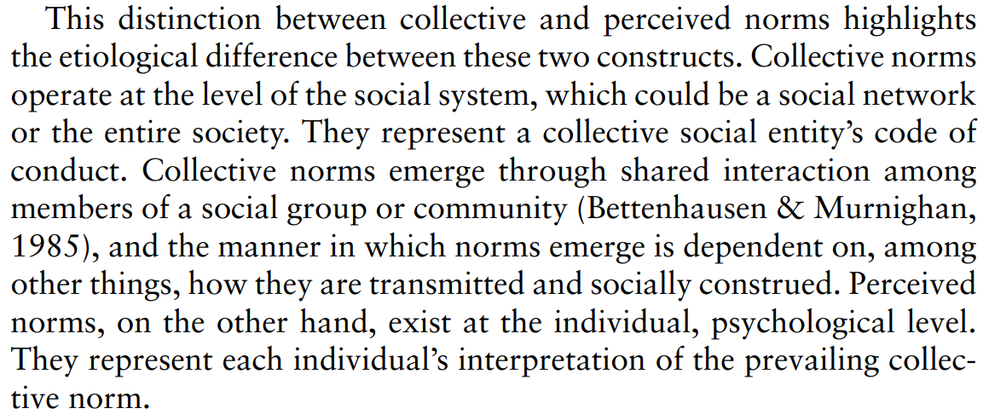
In the literature on social norms, a distinction is made between collective and perceived norms
- Lapinski and Rimal (2005), An Explication of Social Norms
Echoes the contrast between collectivism and perspectivism
14

Slide 15
A useful distinction for studying online toxicity is between descriptive and injunctive norms
Theoretical framework
Injunctive norms refer to rewards and penalties while descriptive norms capture how people actually behave (Cialdini et al. 1990)
Theory of normative social behavior: descriptive and injunctive norms interact in shaping behavior (Rimal and Real 2003, 2005)
“When people perceive that social sanctions exist for noncompliance, they are more likely to conform if they also perceive that the behavior is widespread among their peers” (Lapinski and Rimal 2005; italics added)
Such an interaction predicts alcohol use (Lee et al. 2007), political petition signing (Smith & Louis 2008), and handwashing among childcare workers (Lapinski et al. 2014), among other behaviors
15

Slide 16
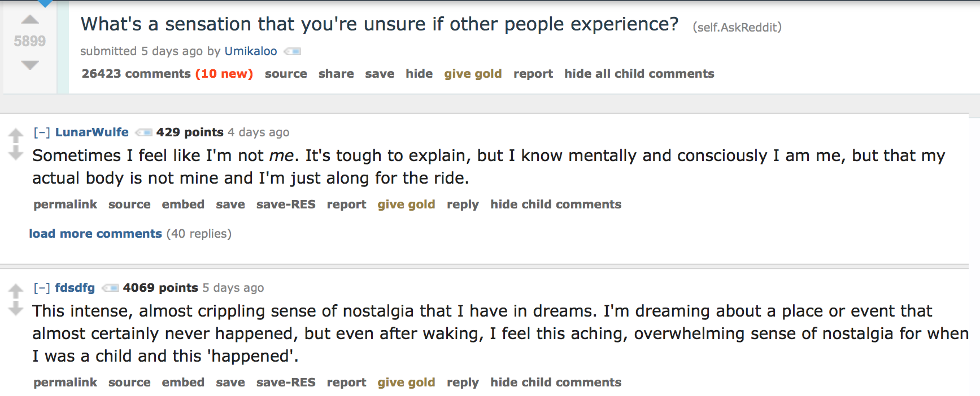
We can measure injunctive norms with votes and descriptive norms with nearby comments
Operationalizing norms (Shmargad et al. 2022)
We create a mapping of important social science constructs onto behavioral trace data (Lazer 2015)
16

Slide 17
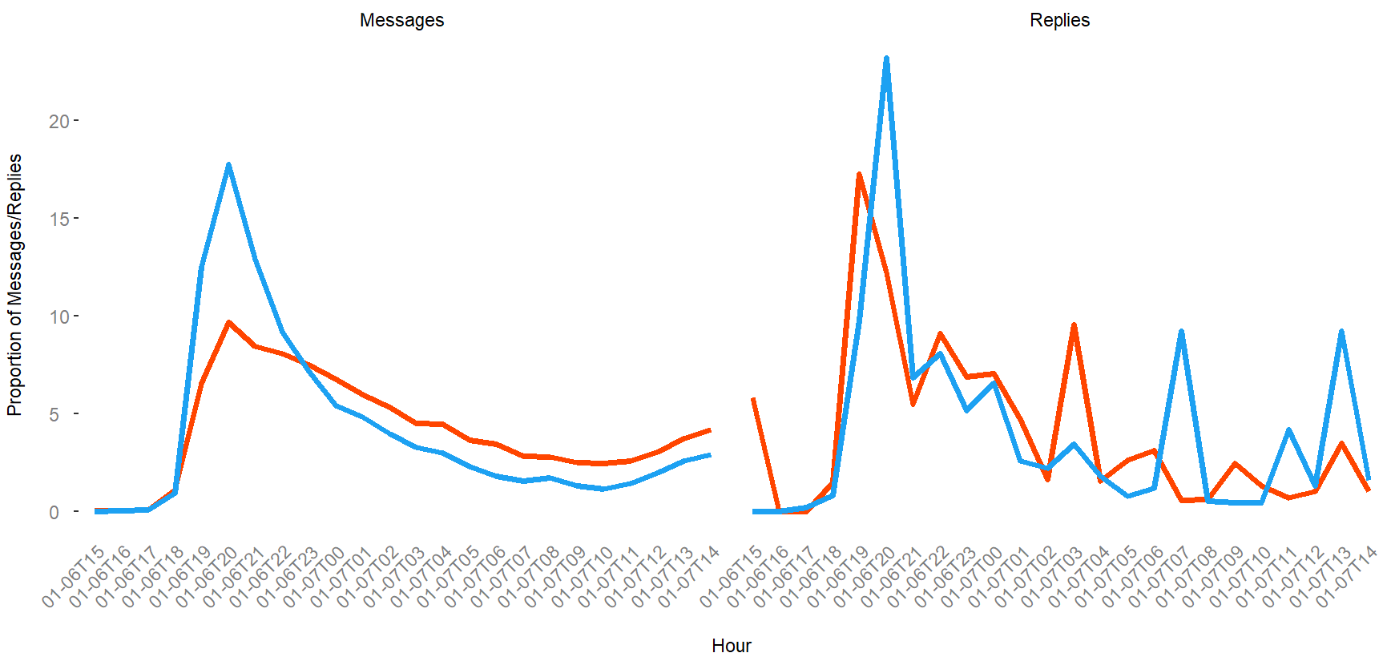
I collected discussion threads from both Reddit and Twitter as the 1/6 Capitol Riots unfolded
pushshiftR 16,054 Submissions
Search for ‘Capitol’ from 1/6 @11am – 1/7 @11am
academictwitteR
- Sample 1 ten second interval per minute
- After dropping replies: 144,665 Tweets
17

Slide 18
I collected discussion threads from both Reddit and Twitter as the 1/6 Capitol Riots unfolded
pushshiftR 16,054 Submissions
Search for ‘Capitol’ from 1/6 @11am – 1/7 @11am
academictwitteR
- Sample 1 ten second interval per minute
- After dropping replies: 144,665 Tweets
509 Submissions
Filter messages to those with between 100-500 replies
(Reddit API limits reply retrieval to 500 per submission)
423 Tweets
RedditExtractoR
76,852 Comments
(augmented code)
Collect reply data for threads with between 100-500 replies
httr (sample code)
105,373 Tweets
24,294 triplets
Filter thread data down to ‘user X –> user Y –> user X’ triplets
(using ‘structure’ for Reddit and ‘reply_to_status_id’ for Twitter)
11,795 triplets
12,594 triplets
Use the peRspective R package to label comments for toxicity
(then convert toxicity scores to binary metrics with .5 threshold)
6,303 triplets
18

Slide 19
We can measure the collective and perceived norms at both descriptive and injunctive levels
Measurement of Norms
 | Descriptive Norms | Injunctive Norms
Collective Norms | Aggregate statistics of toxicity prevalence | Aggregate statistics of votes given to toxic comments
Perceived Norms | Prevalence of toxicity in nearby comments | Votes given to toxicity in nearby comments
19

Slide 20
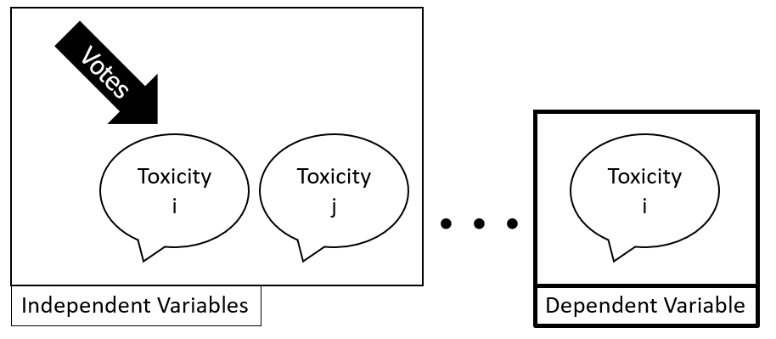
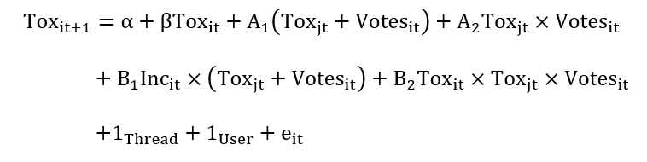
I organize comments into triplets to test the Theory of Normative Social Behavior
Longer gap?
Different thread?
20

Slide 21
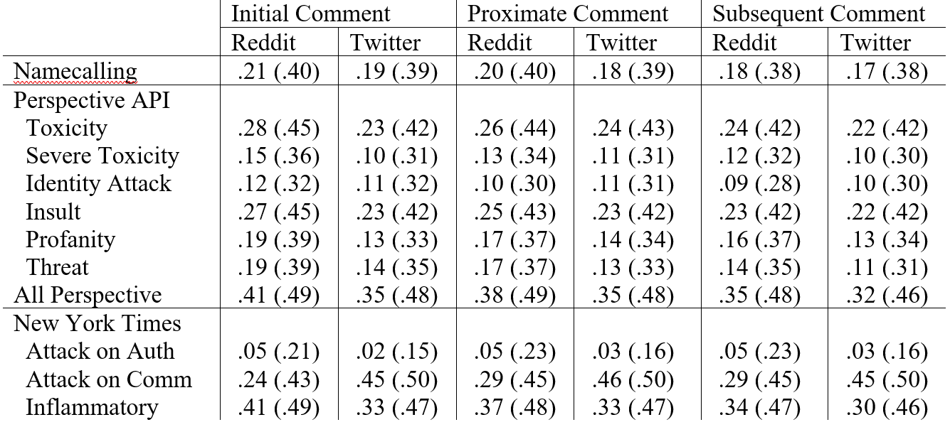
Anti-social commenting was more common on Reddit except, notably, Attacks on Commenters
Collective descriptive norms by platform
21

Slide 22
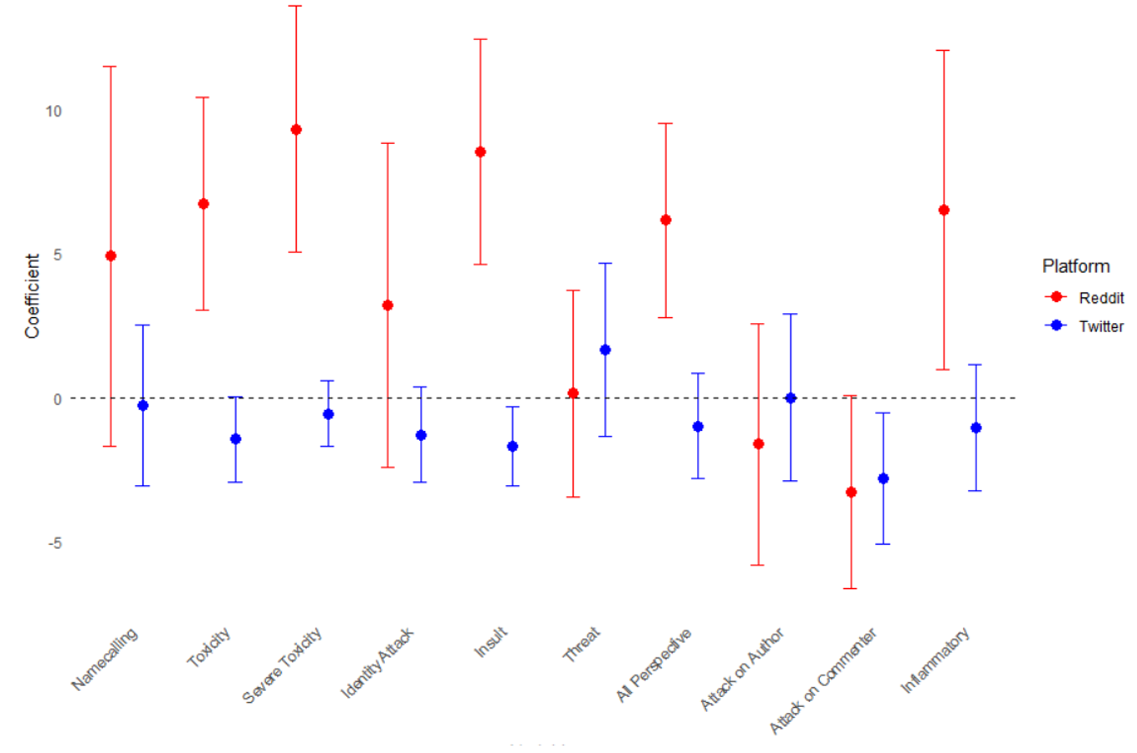
Anti-social commenting was typically rewarded on Reddit but not on Twitter
Collective injunctive norms by platform
22

Slide 23
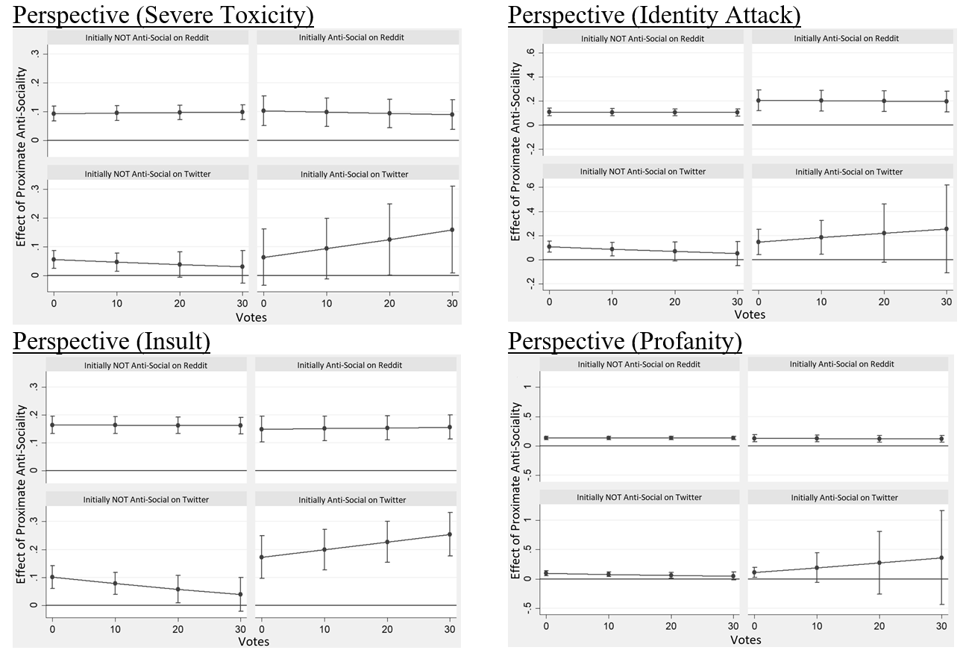
The Theory of Normative Social Behavior was more common on Twitter than on Reddit
Perceived descriptive and injunctive norms
23

Slide 24
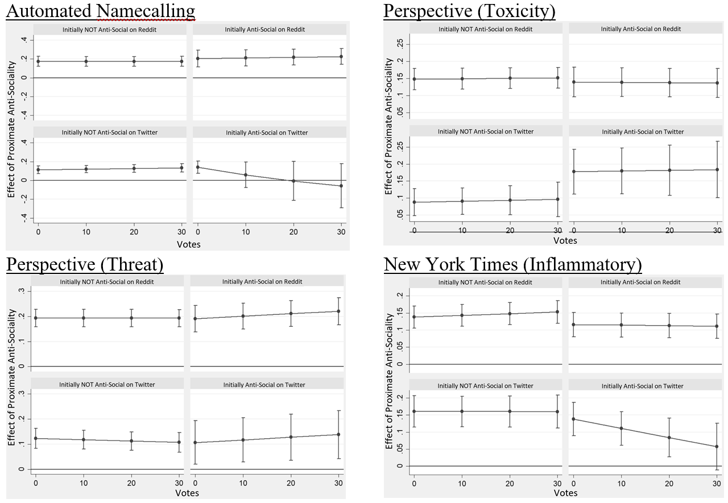
But there was variation in normative reactions across measures of anti-sociality on Twitter
Perceived descriptive and injunctive norms
24

Slide 25
We reach somewhat different conclusions from collectivist and perspectivist approaches
What do we choose to foreground?
 | Descriptive Norms | Injunctive Norms
Collective Norms | Reddit has higher levels of toxicity than Twitter | Toxicity receives more votes on Reddit but not Twitter
Perceived Norms | Toxicity is contagious on both Reddit and Twitter | Toxicity is more sensitive to votes on Twitter than Reddit
25

Slide 26
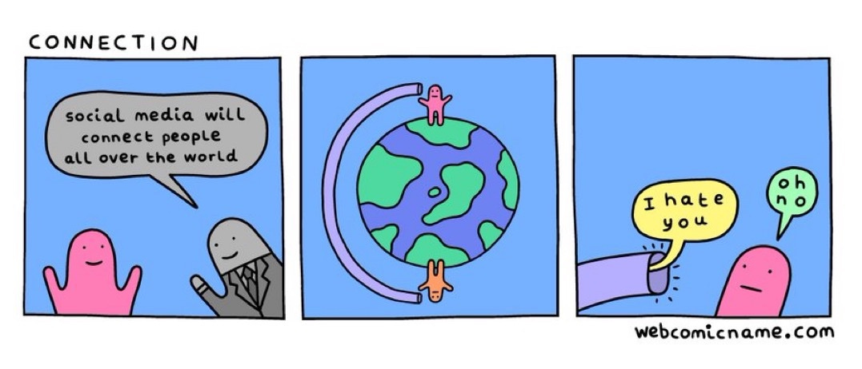
Next, we will apply collectivist and perspectivist approaches to study hate in YouTube comments
https://github.com/thesickish/ICWSM24

Slide 27
AAAI ICWSM 2024 | Buffalo, NY, USA | June 3rd
Collectivist and Perspectivist Approaches to Studying Online Toxicity
Yotam Shmargad
yotam@arizona.edu

