Slide 1
Bitwise-Reproducible Reduction Across Cluster Reshape
A Compiler/Fabric ABI

Slide 2
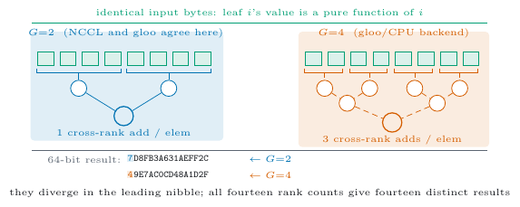
The same sum, twice, different answers
Reduce the identical bytes on a cluster. Reshape it. Reduce again.
Floating-point addition is not associative.
Changing the worker count changes which operands pair.
So the bit pattern changes.
Measured, not asserted: across fourteen world sizes, fourteen distinct roots on identical input.

Slide 3
Why this matters
Debugging — a run that cannot be reproduced cannot be bisected.
Regulation and audit — “same input, same output” is often a requirement.
Elasticity — cloud clusters reshape by design.
The usual answers: fix the worker count (gives up elasticity), or sort and compensate at every step (costly, and still order-dependent under reshape).

Slide 4
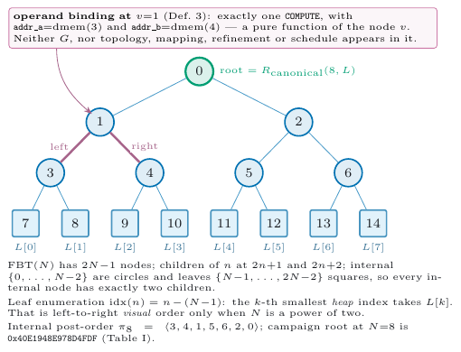
The idea: name one order, and make it a contract
Fix a canonical reduction tree FBT(N) — heap-indexed, leaves in ascending index order.
The result is defined by the tree, not by the machine that walks it.
The compiler must prove it emits that tree; the fabric must refuse to execute anything else.

Slide 5
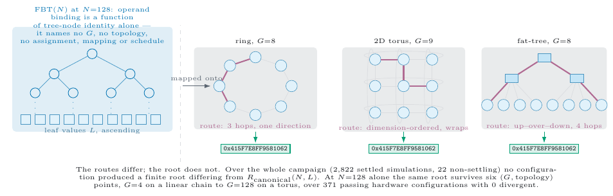
Claim 1 — the root does not depend on the topology

Slide 6
Routes differ. The reduction DAG does not. The 64-bit root does not.

Slide 7
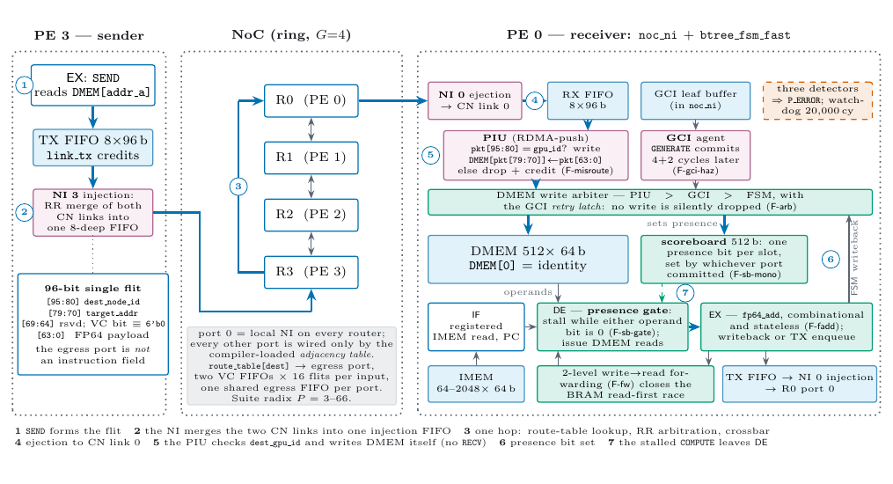
The fabric enforces it below the software

Slide 8
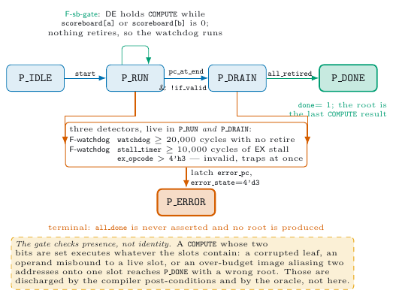
Property 2 — fail-stop, not wrong-answer
A missing or misrouted operand must halt the run.
It must never silently produce a different root — a wrong answer that looks like a right one is the failure mode that matters.

Slide 9
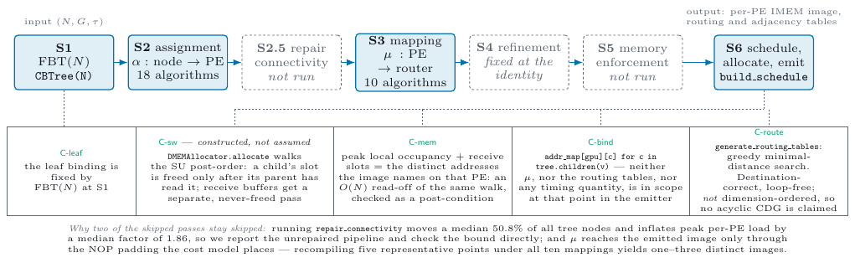
The compiler discharges the obligations

Slide 10
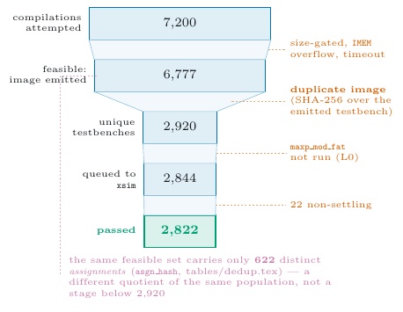
The campaign
2,844 compilations attempted
2,822 passing hardware runs
39 of 40 instances hardware-validated
6 topologies, N from 8 to 8192
The 40th instance elaborates completely; the simulator emits no kernel for it. We report that, and assert no cause.

Slide 11
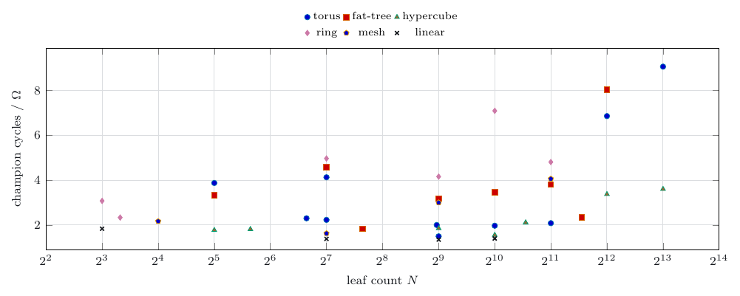
Cross-topology invariance holds
Every passing configuration yields a single root per instance.
Mutation testing shows the oracle is not vacuous — reordering does change the root, at twelve of the sixteen leaf counts.

Slide 12
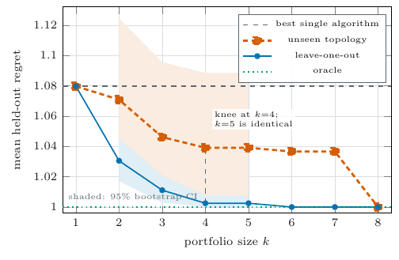
Which algorithm should you actually run?
A portfolio of four configurations, run and minimised over:
1.0391 mean regret on a topology it never saw (95% CI [1.0025, 1.0885])
versus 1.0488 for a rule that conditions on topology
Ignoring topology beats conditioning on it.

Slide 13
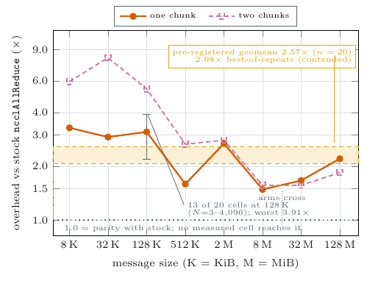
What it costs, in software
Pre-registered, and unfavourable:
2.57x stock ncclAllReduce at G=2
provisional — measured under GPU contention
about half of it is algorithmic at G=2, not an implementation defect
We pre-registered this comparison before running it, and report the branch we hit.

Slide 14
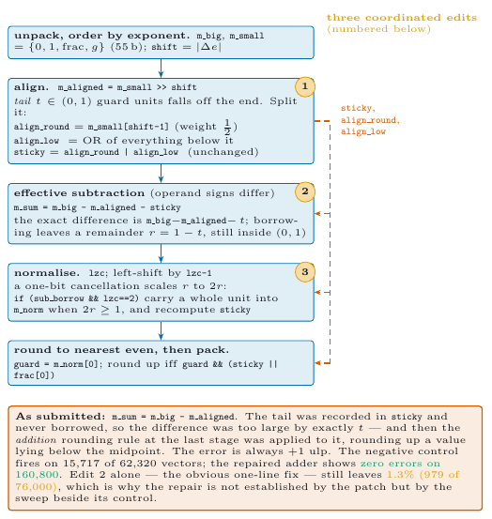
What we got wrong
Our own FP64 adder had a defect on effective subtraction — and our Python oracle was a transcription of that RTL, so it agreed.
Found by scoring against references external to the design: exact rationals and the host FPU.
Zero errors on 160,800 vectors after repair, beside a control that fires on 15,717 of 62,320.

Slide 15
Limitations we are not hiding
No silicon: RTL simulation of a single-chip fabric.
No measured same-fabric eta at non-power-of-two scale. At power-of-two, eta = 1 is a theorem, not a measurement.
The suite confounds N and G; no cell-level recommendation is derivable.
The software export is slower than stock NCCL, and we say by how much.

Slide 16
Takeaway
Reproducibility across reshape is achievable as an interface contract: the compiler proves the order, the fabric refuses anything else, and the result stops depending on the shape of the machine.
Bitwise-identical roots across six topologies.
Fail-stop rather than silently wrong.
A four-configuration portfolio that transfers to unseen topologies.

